Slide 1
TITLE
Subtitle

Slide 2
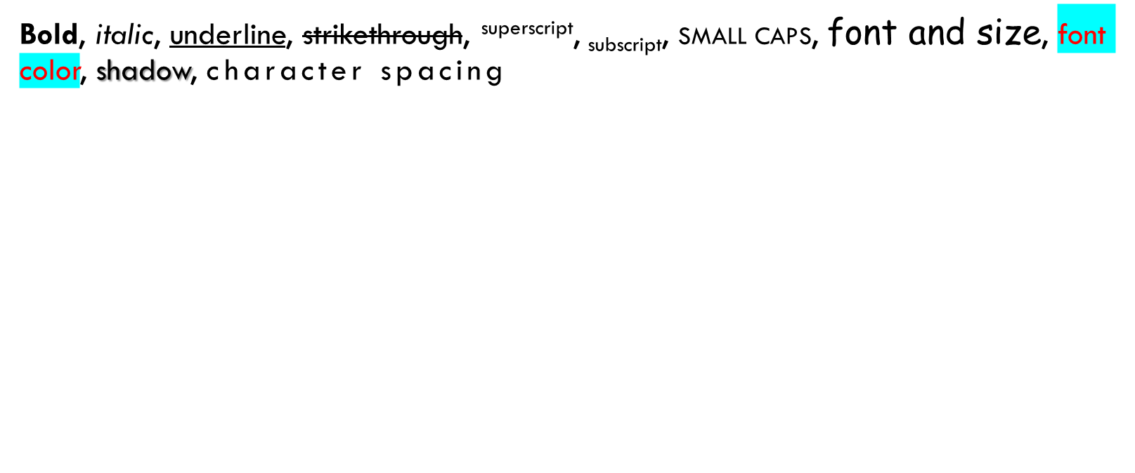
PARAGRAPH WITH FORMATTING

Slide 3

PICTURE

Slide 4
TABLE
1 | 2 | 3 | 4 | 5
1 | 2 | 3 | 4 | 5

Slide 5

LIST

Slide 6
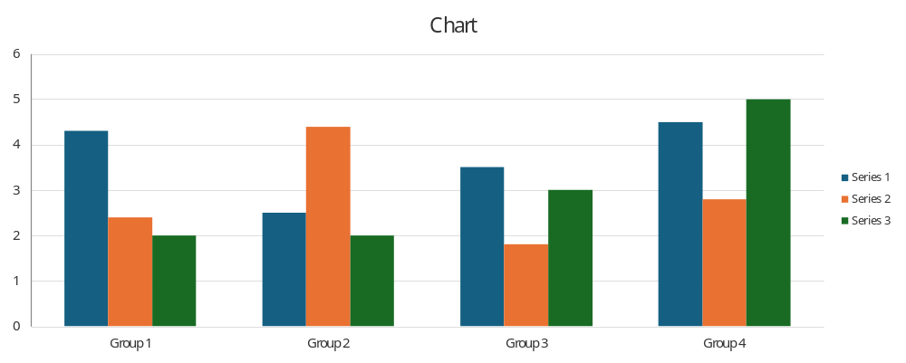
CHART

Slide 7
SHAPES

