Slide 1
Properties of Cryptographic Algorithms
What do protocol and application designers need to know about the internals of cryptographic algorithms?

Slide 2
Overview
Goal: Learn enough about crypto to know what to use, when and how...
Non-goals: Cryptanalysis, New algorithms, ...
Logic: Protocol and application developers need to know what crypto can do for them, and how to screw up less

Slide 3
Contents
Basic concepts
Modes of operation
Algorithm specifics
Implementation issues

Slide 4
Basics...
Secret-key, public-key and message digest (hash) algorithms
Encryption, decryption and integrity protection
Key managment primitives
(Pseudo) Random number generators

Slide 5
Important Terms
Secret Key Cryptography (e.g. AES)
Public Key Cryptography (e.g. RSA, Elliptic Curve Cryptography)
Message Digests (e.g. SHA256)
Diffie-Hellman (D-H) is an imporant key agreement primitive
  Integer and Elliptic Curve D-H (ECDH) variants
Key Derivation Functions (KDF) allow one to derive a new key from existing keys (securely)
(P)RNGs generate (pesudo) “random” bits

Slide 6
Fashion Items
Identity-Based Encryption (IBE/IBC) is a new(ish) variety of public key encryption
Partly or FullyHomomorphic Encryption (FHE) algorithms are elegant but still impractical
Quantum Computer Resistant schemes are another topic of current interest
Blockchain used to do <stuff that doesn’t need proof-of-work>

Slide 7
Secret Key Cryptography
Originally a way to keep secret data private
  Encode a message using a secret “key”
  A long and colorful history
Today, it has many uses
  Confidentiality, Authentication, Data Integrity

Slide 8
What is Encryption?
We agree on a secret way to transform data, then later...
Use that transform on data we want to pass over an unsafe communications channel
Instead of coming up with new transforms, design a common algorithm customized with a “key”

Slide 9
Secret Key Encryption for Privacy
Key
Key
Plaintext
Encrypt
Ciphertext
Decrypt
Plaintext

Slide 10
“Random” Looking
Each output value from pretty much any cryptographic function should have about 50% “1” bits
Changing one bit of input should change about 50% of the output bits (and it ought be unpredictable which)
Outputs should be uncorrelated, regardless of how closely related the inputs
Any subset of the output bits should be equally random
... but verifying randomness is hard.

Slide 11
How Secure is Encryption?
An attacker who knows the algorithm we’re using could try all possible keys (brute-force attack)
Security of cryptography depends on the limited computational power of the attacker
Even a fairly small key should represent a formidable challenge to the attacker (brute-force isn’t possible with 128 bits)
Algorithms have weaknesses that are independent of key size (strength != length)

Slide 12
How do we know how good an algorithm is?
A problem of mathematics: it is very hard to prove a problem is hard
It’s never impossible to break a cryptographic algorithm - we want it to be as hard as trying all keys
Fundamental Tenet of Cryptography: If lots of smart people have failed to solve a problem then it probably won’t be solved (soon, we hope)

Slide 13
To Publish or Not to Publish
If the good guys break your algorithm, you’ll hear about it
If you publish your algorithm, the good guys provide free consulting by trying to crack it
The bad guys will learn your algorithm anyway
Today, most commercial algorithms are published; most military algorithms are not

Slide 14
Uses of Cryptography
Confidentiality for data in transit: Transmitting secret data over an insecure channel
Confidentiality for data at-rest: Storing secret data on an insecure medium
Data Integrity: Message integrity checksum/authentication code (MIC/MAC)
Authentication: “challenge” the other party to encrypt or decrypt a random number

Slide 15
Secret Key Integrity Protection
Plaintext
Generate
MAC
MAC
Verify
MAC
Yes/No
Key
Key

Slide 16
Challenge / Response Authentication
Alice (knows K)
Bob (knows K)
I’m Alice
Pick Random R
Encrypt R using K
(getting C)
If you’re Alice, decrypt C
R

Slide 17
Ancient (pre-1990’s) Secret Key Algorithms
DES (Data Encryption Standard)
  56 bit key (+ 8 parity bits) controversial!
  Input and output are 64 bit blocks
  slow in software, based on (sometimes gratuitous) bit diddling
IDEA (International Data Encryption Algorithm)
  128 bit key
  Input and output are 64 bit blocks
  designed to be efficient in software
  IPR

Slide 18
Secret Key Algorithms
Triple DES (NOT RECOMMENDED)
  Apply DES three times (EDE) using K1, K2, K3 where K1 may equal K3
  Input and output 64 bit blocks
  Key is 112 or 168 bits
Advanced Encryption Standard (AES)
  2001 US standard to replace DES.
  Public Design and Selection Process Winner=Rijndael
  Key Sizes 128,192,256. Block size 128.
  AES IS RECOMMENDED

Slide 19
Secret Key Algorithms
RC4(VERY NOT RECOMMENDED)
  128-bit key stream cipher
  once widely used in TLS
  “Ron’s cipher #4”
  Broken
ChaCha20
  DJB productions
  256-bit key stream cipher
  Considered an ok replacement for RC4 – faster than AES on processors without the AES-NI instruction
  Recommended if not using AES
    today, could change

Slide 20
XOR (Exclusive-OR)
Bitwise operation with two inputs where the output bit is 1 if exactly one of the two input bits is one
(B XOR A) XOR A) = B
If A is a “one time pad”, this is very efficient and very secure, but NEVER re-use anything
Common stream-cipher encryption schemes (e.g. ChaCha20 described in RFC7539) calculate a pseudo-random stream from a short key
Actually, RFC7539 is a very good read as it describes a modern cipher in the manner needed for modern implementation

Slide 21
More Secret Key Algorithms (some busted)
  Magma, Russian cipher
    Part of GOST family
  SM4 Chinese symmetric cipher
    SM2, SM3 other cipher stuff
  A2/A5 – GSM algorithms
  Camellia, Aria, SEED, ...
  Simon/Speck
  ... there’ll always be more

Slide 22
Other Secret Key Algorithms
Many other secret key algorithms exist
It may appear easy to invent a new variant on one
It is very hard to invent secure algorithms
There are few good reasons to invent new ones
  And there is no reason for any of us here to want to invent new algorithms!!

Slide 23
Reasons for new algs...
We would like a “spare” for each cryptographic function that is already deployed so we can turn it on if/when today’s preferred option goes bad
  Remember: attacks only ever get worse
Some countries impose national requirements that national ciphers MUST be supported/used
  Bad plan, but not always avoidable

Slide 24
Public Key Cryptography
Two keys per user: a private key and a public key. The keys reverse each other’s effects.
Encrypt a message for Alice using her public key
Decryption requires her private key
Generating Digital Signatures requires the private key
Verifying them requires the public key
Note: Getting the role of public/private keys backwards is counterproductive, exam-wise:-)

Slide 25
Public Key Encryption for Confidentiality
Public Key
Private Key
Plaintext
Encrypt
Ciphertext
Decrypt
Plaintext
RNG

Slide 26
Public Key Integrity Protection
Plaintext
Generate
Signature
Signature
Verify
Signature
Yes/No
RNG?
Private Key
Public Key

Slide 27
Public Key Authentication
Alice (knows A’s
private key)
Bob (knows A’s
public key)
I’m Alice
Pick Random R
Encrypt R using
A’s public key
(getting C)
If you’re Alice, decrypt C
Decrypt C
R

Slide 28
Message Digest Functions
Also known as cryptographic hashes
Non-reversible function
Takes an arbitrary size message and mangles it into a fixed size digest
It should be impossible to find two messages with the same MD, or come up with a message with a given MD
Useful as a shorthand for a longer thing

Slide 29
Message Digest Functions
Message
Digest
Digest Value

Slide 30
Message Digest Functions
MD2, MD4, and MD5 used to be most popular.
  All produce 128 bit digests
  MD2, MD4 and MD5 are broken
  SHA-1 has significant, demonstrated weaknesses
SHA-256 currently the best choice
NIST competition for new digests:
  SHA-3 is Keccak
  But not very interesting!
Message digests are not difficult to design, but most are not secure
  Sound familiar?

Slide 31
Random number generators
True random number generator (TRNG) based on some physical source (e.g. noise diodes)
Pseudo random number generator (PRNG) based on some algorithm, usually with a seed
  All PRNGs will eventually repeat
  Not all PRNGs are good
  The seed needs to be good, $PID/time_t is not enough!
At least one PRNG was deliberately engineered to be secretly bad http://dualec.org

Slide 32
Using PRNGs
Do use the system PRNG unless you know that’s bad - On linuxes that’d be either /dev/random or /dev/urandom – be careful if you care about blocking/non-blocking calls, maybe install haveged
It’s always ok to add more randomness if you have an interface that allows that, e.g. packet checksums rx’d from n/w, but it’s not ok to fully re-start your PRNG with such – be similarly careful with forking and virutalisation
It’s a good idea to have different streams for public random stuff (e.g. nonces, message-IDs) and secret random stuff (keys etc.) in case you’re PRNG is borked like DUAL-EC
Be careful using APIs (e.g. C’s rand() is not good) – check out the API you’re looking at before using, and don’t believe just one posting that says it’s ok
General advice: think about what you want to do, and then, before doing it, check out to see if anyone else has done that and what folks thought about it (e.g. via stackexchange etc, but again don’t belive just one source)

Slide 33
Combining Cryptographic Functions for Performance
Public key cryptography is slow compared to secret key cryptography and hashes
Public key cryptography is often more convenient & secure in setting up keys
Algorithms can be combined to get the advantages of both

Slide 34
Hybrid Encryption
Instead of:
Message
Message
Encrypted with Alice’s Public Key
Use:
Randomly
Chosen K
Message
+
Encrypted with
Alice’s Public Key
Encrypted with
Secret Key K

Slide 35
Hybrid Signatures
Instead of:
Message
Message
Signed with Bob’s Private Key
Use:
Message
Digest (Message)
Message
+
Signed with Bob’s Private Key

Slide 36
Signed and Encrypted Message
Message
Randomly
Chosen K
Digest (Message)
+
Signed with
Bob’s Private Key
+
Encrypted with
Alice’s Public Key
Encrypted with
Secret Key K

Slide 37
Passwords as Secret Keys
A password can be converted to a secret key and used in a cryptographic exchange
An eavesdropper can often learn sufficient information to do an off-line attack
Most people will not pick passwords good enough to withstand such an attack
More later...

Slide 38
Sample Protocol
Alice
(knows pwd)
Workstation
Server
(knows h(pwd))
“Alice”, pwd
Compute h(pwd)
I’m Alice
R (a challenge)
{R}_{h(pwd)}

Slide 39
Key Distribution - Secret Keys
What if there are millions of users and thousands of servers?
Could configure n² keys
Better is to use a Key Distribution Center (KDC)
  Everyone has one key
  The KDC knows them all
  The KDC assigns a key to any pair who need to talk

Slide 40
Key Distribution - Secret Keys
Alice
KDC
Bob
A wants to talk to B
Randomly choose K_{ab}
{“B”, K_{ab}}_{Ka}
{“A”, K_{ab}}_{Kb}
{Message}_{Kab}

Slide 41
Key Distribution - Public Keys
Certification Authority (CA) signs “Certificates”
Certificate = a signed message saying “I, the CA, vouch that 489024729 is Radia’s public key”
If everyone has a certificate, a private key, and the CA’s public key, they can authenticate

Slide 42
KDC vs CA Tradeoffs
Stealing the KDC database allows impersonation of all users and decryption of all previously recorded conversations
Stealing the CA Private keys allows forging of certificates and hence impersonation of all users, but not decryption of recordings
Recovering from a CA compromise is easier because user keys need not change

Slide 43
KDC vs CA Tradeoffs
KDC must be on-line and have good performance at all times
CA need only be used to create certificates for new users
  It can be powered down and locked up, avoiding network based attacks
CA’s work better interrealm, because you don’t need connectivity to remote CA’s

Slide 44
KDC vs CA Tradeoffs
Public Key cryptography is slower and (used to) require expensive licenses
The “revocation problem” levels the playing field somewhat

Slide 45
Spot the difference...
Randomly
Chosen K
+
Digest (Message)
Message
Signed with
Bob’s Private Key
Encrypted with
Alice’s Public Key
+
Encrypted with
Secret Key K
Randomly
Chosen K
Message
Digest (Message)
+
+
Signed with
Bob’s Private Key
Encrypted with
Alice’s Public Key
Encrypted with
Secret Key K

Slide 46
More Cryptography
Modes of operation and some algorithm details

Slide 47
Next hour...
Review basic crypto
Modes of operation of algorithms
Feistel ciphers
AES
Snakeoil

Slide 48
Review of crypto from last (few) lecture(s)
secret key: 2 operations, inverses
public key: one op, 2 keys (public, private), which are inverses
operations
  encrypt with secret/public, decrypt with secret/private
  authenticate with secret/private, verify with secret/public
  compute integrity with secret/private, verify with secret/public

Slide 49
Authentication with Secret Key
both know secret K
Alice
Bob
I’m Alice
R
compare:
{R}_{K}
or:
I’m Alice, {timestamp}_{K}

Slide 50
Secret Key algorithms
Stream ciphers (e.g., RC4, ChaCha20)
  takes key and generates a stream of pseudorandom bits, XOR’d into data
Block ciphers (e.g., 3DES, AES)
  takes key and fixed size input block to generate fixed size output block
Notes:
# of mappings: 2^{n} factorial (approximately n times 2^{n} bits)
# of mappings specified with k bit key is 2^{k}

Slide 51
Types of attacks
ciphertext only: can brute-force attack if recognizable plaintext
1st 1000 bytes of RC4 are a worry today
sometimes a system allows other attacks:
  known plaintext
  chosen plaintext
Shannon proved XOR with one-time pad unbreakable (no information with brute force attack)
  BUT BUT BUT, unbreakable here is entirely unrealistic!!!
Notes:
Better withstand ciphertext only attack, since if attacker can’t see ciphertext, don’t need to encrypt!
example system where known plaintext:data might not be secret forever. Send encrypted, next city to attack, record the ciphertext, then you have (plaintext, ciphertext) pair the next day
example system where chosen plaintext attack possible: telegraph company sends your message, encrypted.

Slide 52
Block size considerations
If small block size, could build a table
If see same ciphertext block, get hints about plaintext
to avoid probably seeing repeated ciphertext blocks, should change key in number of blocks 2^{half the block size} (birthday problem)
Notes:
Birthday problem: if number of things equal to square root of space, more likely than not to see at least one collision
max effective key size is log₂(2^{k} factorial). For 4-bit block, it’s about 64 bits!
But would have to rollover key every 4 blocks!

Slide 53
Encrypting Large Messages
Basic block ciphers encrypt a small fixed size block
Obvious solution for large messages is to encrypt a block at a time.
  This is called Electronic Code Book (ECB)
Repeated plaintext blocks yield repeated ciphertext blocks
Other modes “chain” to avoid this (CBC, CFB, OFB)
Encryption does not guarantee integrity!

Slide 54
ECB
M1
M2
M3
M4
C1
C2
C3
C4

Slide 55
Problems with ECB
If ci=cj, then you know pi=pj
Can reorder blocks
Can rearrange blocks to affect plaintext
Notes:
The rearranging example in the book on page 97. Salary database. Copy president’s salary block (which you can’t decrypt) into your own, if you know the basic form of the salary database but it’s encrypted, and ordered by employee number, e.g.,

Slide 56
Consider this
M1
M2
M3
M4
r1
r2
r3
r4
E
E
E
E
C1
C2
C3
C4
transmit r1, c1, r2, c2, r3, c3, r4, c4

Slide 57
Problems with previous slide
Need to send twice as much data
Can still rearrange blocks
If two ciphertext blocks equal, know XOR of two plaintext blocks = XOR of the corresponding two random numbers
CBC generates its own “random numbers” by using previous ciphertext block, plus one additional block (the “IV”, initialization vector)

Slide 58
CBC (Cipher Block Chaining)
IV
M1
M2
M3
M4
E
E
E
E
IV
C1
C2
C3
C4

Slide 59
CBC Decryption
IV
C1
C2
C3
C4
D
D
D
D
IV
M1
M2
M3
M4

Slide 60
CBC
What happens if ci gets lost? Garbled? How much data gets lost?
How can attacker that sees and can modify the ciphertext, and knows the plaintext, modify the plaintext in a predictable way? What other effects will it have?
Notes:
If c_{i} gets lost or garbled, m_{i} and m_{I+1} get garbled, but block I+2 and on are OK
To change a particular bit in m_{i} , change the corresponding bit in c_{i-1}. The side effect is that m_{i-1} will be garbled.

Slide 61
Integrity Check (MAC) with Secret Key
“CBC Residue”, uses key K and generates integrity check on message M
Do CBC encryption on M using key K, throw away all but last block. Last block is “residue”, and is used as integrity check
Used in banking
Has property that if you don’t know the key you can’t generate (or verify) the MAC, or modify the message without (probably) changing the MAC

Slide 62
CBC Residue
IV
M1
M2
M3
M4
E
E
E
E
IV
C1
C2
C3
residue

Slide 63
CBC Residue
Note that it is easy to generate an arbitrary message with a particular residue
Create message, but leave one block (anywhere) blank. Use any key K and any IV. Start from beginning, doing ordinary CBC residue until get to block left blank. Start from end, doing ordinary CBC decryption (since residue is constrained, you can work backwards from that and the plaintext blocks). Finally you will find two quantities that must be XOR’d together to yield the value that must be in the blank block.
Notes:
Create message, but leave one block (anywhere) blank. Use any key K and any IV. Start from beginning, doing ordinary CBC residue until get to block left blank. Start from end, doing ordinary CBC decryption (since residue is constrained, you can work backwards from that and the plaintext blocks). Finally you will find two quantities that must be XOR’d together to yield the value that must be in the blank block.

Slide 64
Creating a stream cipher
Output Feed Back (OFB) stream generated:
  IV (transmitted in the clear)
  pad₁=e(IV, key)
  pad₂=e(pad₁, key)
  pad_{i}=e(pad_{i-1},key)
Can be generated in advance
Can encrypt arbitrary # of bits (vs block cipher)
What if ciphertext garbled or lost?
If know plaintext, can easily modify stream
Notes:
If garbled, only those plaintext bits are garbled. If lost or duplicated, lose sync and you’re hosed.
Good example of this was where server asks, via stream cipher-encrypted channel, “is the answer X to challenge R right for user Alice”, and get the
answer back “no. authentication failed”, or “sure. give her root privileges”. So if you know you’re impersonating someone and plaintext will be “no. authentication failed” and you can get on a router between the server and the answer-box, you can XOR with known plaintext (authentication failed) and XOR with desired plaintext

Slide 65
Counter Mode
c_{i}=f(key, IV, block number, p_{i})
Can decrypt an arbitrary block (useful for, e.g., random access file encryption)

Slide 66
Authenticated Encryption
(with Additional Data)
Authenticated encryption (AE) with additional data (AEAD) is a general scheme for combining confidentiality and data-integrity as a single primitive
Motivation: many applications/protocols involve cleartext headers that goes with ciphertext and we’d like both to be protected in a single operation with a single key (context) as input
General idea is you encrypt data, and provide the additional data (e.g. headers), result is ciphertext that includes a “tag”
Decryption takes ciphertext (incl. tag) and returns “error” or plaintext, you never get partial decryption
RFC 5116 defines an abstract interface for AEADs
Also – older modes like CBC have been shown to be vulnerable to various implementation and other vulnerabilities

Slide 67
OpenSSL AEAD Example
I recently implemented the (draft) “Hybrid Public Key Encryption” scheme for encrypting “to” a public key:
  Spec: https://tools.ietf.org/html/draft-irtf-cfrg-hpke
  Code: https://github.com/sftcd/happykey
Spec combines (Elliptic curve) Diffie-Hellman key agreement with AEAD encryption, with various (far too many) options
hpke_aead_enc() function in hpke.c has OpenSSL AEAD calls
Note to self: pull up that code to show init/update/final pattern
Not making any claim of “goodness” (NaCL/python/golang equivalents could be better), but it’s a smallish standalone bit of code that seems to do the job

Slide 68
What AEAD modes exist?
Loads. Far too many: OCB, CCM, GCM,
ChaCha20-poly1305, SIV, ...
Which are good/bad? All of ‘em... Pretty much, though some are much more used than others.
  https://www.fi.muni.cz/~xsvenda/docs/AE_comparison_ipics04.pdf isn’t a bad comparison of a bunch of ‘em
So what do I need to know about ‘em?
  Complexity, Performance aspects, Patents, Brittleness

Slide 69
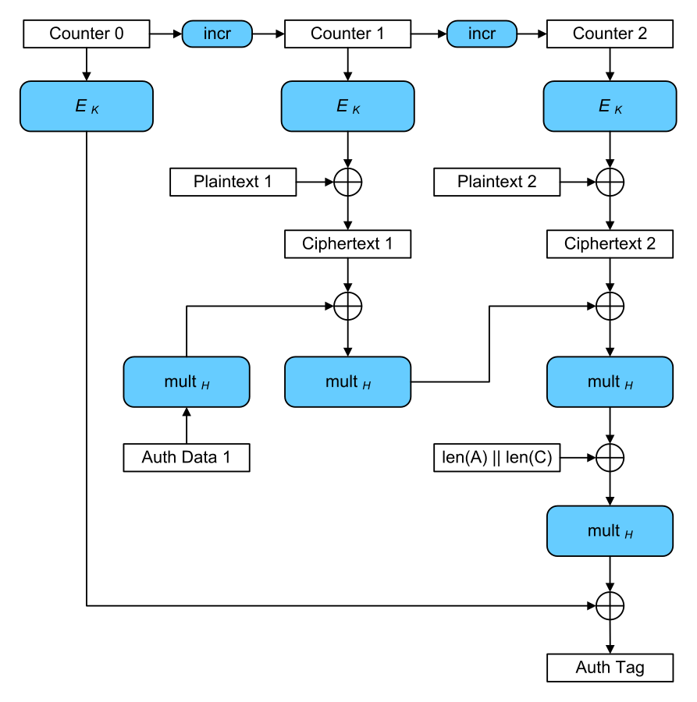
Complexity
Most AEADs are a bit harder to understand and hence their caveats are harder to explain and remember
The diagram shows AES-GCM
GCM = Galois Counter Mode
Implementing AEADs is a bit
more difficult but in any case
you SHOULD NOT be coding
this kind of thing – use a good
library!!
So internal-complexity is basically
hidden from our POV

Slide 70
Performance Aspects
AES-GCM allows for super-parallel and pipelined implementation, e.g. as would be needed in a high-speed router with many 10GB ports
AES-CCM (CCM = Counter with CBC-MAC) requires you know the lengths ahead of time, but is popular for smaller processors, e.g. as needed in WiFi and smaller client devices like Zigbee
ChaCha20-poly1305 – fast if you don’t have hardware support (many CPUs do have AES h/w support e.g. Intel AES-NI)
All AEAD modes add more overhead – nonces and tags which can be a pain if you have lots of small packets and are constrained by bandwidth or packet sizes, but mostly the overhead is ok

Slide 71
Patents
Lots of cryptographers like OCB (Offset Code Book) but there are patents which has killed adoption
Even though the inventor has tried hard to license liberally
AES-GCM, AES-CCM and ChaCha20-poly1305 are IPR “clean” as far as I know – though there are likely patents on some speed-up tricks, e.g. with highly parallel implementations of AES-GCM as used in high-end routers

Slide 72
Brittleness
AES-GCM has a “gotcha” - if you ever re-use the same key and nonce you’re screwed!
That’s because AES-GCM ends up behaving like a stream cipher
Any AEAD mode can have nonce-reuse brittleness
  Some are worse than others, but none are good
So don’t re-use nonces – ever

Slide 73
AEAD Summary
Don’t re-use nonces!
AES-GCM, AES-CCM and ChaCha20-poly1305 are good modes
AES-GCM is good for more capable devices/less-challenged situations
AES-CCM is widely supported on less-capable devices
ChaCha20-poly1305 is good if you don’t have h/w support
New AEAD modes will continue to be developed – don’t use them for a few years after they’re credible (same as all crypto!)

Slide 74
Algorithm Internals
We’ll look at some algorithm internals to get a feel for what’s happening under the hood...

Slide 75
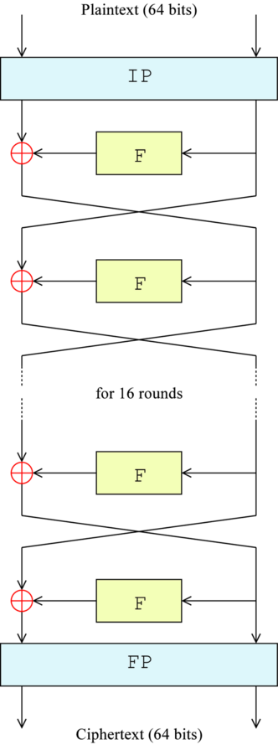
DES
1970’s era block-cipher...
56-bit key, 64-bit block
16 “rounds”
Initial Permutation (IP) and final permutation (FP)
“Feistel” function run in each round with 32 bits of (was-plaintext) input and 48 key bits
Encryption -> go “down” the ladder
Decryption -> go “up” the ladder

Slide 76
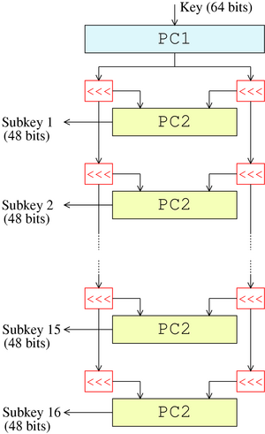
DES Key Schedule
Key Schedule: 56 key bits -> 48 key bits used at each “round”
Each time you use a new key, you have to calculate all 16 subkeys
Key schedule calculation overhead could be significant, e.g. if you changed key for every packet

Slide 77
Feistel Cipher Encryption
L_{n}
R_{n}
mangler
K_{n}
L_{n+1}
R_{n+1}

Slide 78
Feistel Cipher Decryption
L_{n}
R_{n}
mangler
K_{n}
L_{n+1}
R_{n+1}

Slide 79
Feistel Cipher Decryption
A
B
mangler
K_{n}
C
D

Slide 80
Why Feistel
So Mangler function doesn’t need to be reversible
DES is Feistel
AES, IDEA are not. All functions are reversible.

Slide 81
Triple DES (3DES)
Purpose: expand key size from 56 bits to >80 bits of “work”
Why not double DES?
  encrypt with K₁ twice. How much more work (over DES) for good guys? Bad guys?
  encrypt with K₁ then K₂. What is time/memory for bad guys? Good guys?
Notes:
twice with K1: twice the work for both the good guys and bad guys. Insignificant annoyance to bad guys. It just becomes a new 56-bit algorithm.
K1 then K2: meet-in-the-middle attack. Build table of 2⁵⁶ 64-bit entries. Assume have a few plaintext, ciphertext pairs (p1,c1), (p2,c2),(p3,c3). Encrypt p1 with all possible keys, store in table. Decrypt c1 with all possible keys, find expected 256 matches. Then try those approximately 256 keys on 2nd plaintext, ciphertext pair. Almost certainly narrow it down to one. (probability 1 -2⁻⁵⁶) (probability an incorrect key will map from plaintext to that ciphertext is 1 in 2⁶⁴). So time for bad guy isn’t 2¹¹². Instead it’s 2 times 2⁵⁶ DES operations. And memory is two times 2⁵⁶ 64-bit words..

Slide 82
Triple DES (3DES)
Defined as doing EDE with K1, K2, K3 (sometimes with K3==K1)
  reason: because of “meet-in-the-middle” attack, 3DES is considered to only have time-strength equal to 112 bit key, not 168.
  also, 112 bits was considered enough when 3DES was reasonable
Notes:
How to do brute force with only 2¹¹² operations. For each of the 2⁵⁶ possible K1s, solve double-DES with meet-in-middle attack requiring (twice) 2⁵⁶ time and space.
Probably too subtle for class: Homework shows it’s easy to find triple of keys if K1, K2, K3 are allowed to be different, so 3DES with K1=K3 is a much better hash because that homework problem shows that it’s easy to come up with a triple of keys that map a particular plaintext to a particular ciphertext. So suppose you have a hash where you take a fixed plaintext, say 0, and do 3DES with the quantity to be hashed (assuming it’s 168 bits), and the output of the hash is the resulting ciphertext. The problem is it would be easy to come up with two inputs that hash to the same thing if K1, K2, K3 are allowed to be different, but hard if K1=K3.

Slide 83
Why EDE instead of EEE?
Initial and final permututations would cancel each other out with EEE (minor advantage to EDE)
EDE compatible with single DES if K1=K2=K3.

Slide 84
AES Algorithm Description - General
Rijndael is the selected (NIST competition) algorithm for AES (Advanced Encryption Standard).
It is a block cipher algorithm, operating on blocks of data.
It needs a secret key, which is another block of data.
Performs encryption and the inverse operation, decryption (using the same secret key).
It reads an entire block of data, processes it in rounds and then outputs the encrypted (or decrypted) data.
Each round is a sequence of four inner transformations.
The AES standard specifies 128-bit data blocks and 128-bit, 192-bit or 256-bit secret keys.

Slide 85
Algorithm Description – Encrypt.
encryption
algorithm
structure of a
generic round
PLAINTEXT
SECRET KEY
INPUT DATA
ROUND 0
ROUND KEY 0
SUBBYTES
ROUND 1
ROUND KEY 1
SHIFTROWS
KEY SCHEDULE
MIXCOLUMNS
ROUND 9
ROUND KEY 9
ROUND KEY
ADDROUNDKEY
ROUND 10
ROUND KEY 10
OUTPUT DATA
ENCRYPTED DATA

Slide 86
Algorithm Description – Encrypt.
SubBytes
S-BOX
s₀
s₄
s₈
s₁₂
s'₀
s'₄
s'₈
s'₁₂
s₁
s₅
s₉
s₁₃
s'₁
s'₅
s'₉
s'₁₃
s₅
s'₅
s₂
s₆
s₁₀
s₁₄
s'₂
s'₆
s'₁₀
s'₁₄
s₃
s₇
s₁₁
s₁₅
s'₃
s'₇
s'₁₁
s'₁₅
state array
ShiftRows
state array
s₀
s₄
s₈
s₁₂
s₁₂
s₀
s₄
s₈
1 byte
s₁
s₅
s₉
s₁₃
s₅
s₉
s₁₃
s₁
2 bytes
s₂
s₆
s₁₀
s₁₄
s₁₀
s₁₄
s₂
s₆
3 bytes
s₃
s₇
s₁₁
s₁₅
s₁₅
s₃
s₇
s₁₁

Slide 87
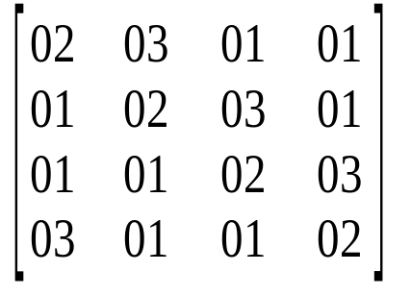
Algorithm Description – Encrypt.
MixColumns
coeff.s matrix
state array
s'₀
s'₄
s'₈
s'₁₂
s₀
s₄
s₈
s₁₂
s'₁
s'₅
s'₉
s'₁₃
=
⊗
s₁
s₅
s₉
s₁₃
s'₂
s'₆
s'₁₀
s'₁₄
s₂
s₆
s₁₀
s₁₄
s'₃
s'₇
s'₁₁
s'₁₅
s₃
s₇
s₁₁
s₁₅
AddRoundKey
state array
round key
s'₀
s'₄
s'₈
s'₁₂
s₀
s₄
s₈
s₁₂
k₀
k₄
k₈
k₁₂
s'₁
s'₅
s'₉
s'₁₃
=
s₁
s₅
s₉
s₁₃
k₁
k₅
k₉
k₁₃
s'₂
s'₆
s'₁₀
s'₁₄
s₂
s₆
s₁₀
s₁₄
k₂
k₆
k₁₀
k₁₄
s'₃
s'₇
s'₁₁
s'₁₅
s₃
s₇
s₁₁
s₁₅
k₃
k₇
k₁₁
k₁₅

Slide 88
AES is the Secret Key Algorithm De-Jure
Cute AES implementation as a spreadsheet
  https://www.nayuki.io/page/aes-cipher-internals-in-excel
  Intended for debugging, but gives a flavour of what happens internally when you change input bits
Use AES-128 or AES-256 if at all possible esp. If your CPU has AES hardware instructions (many do)
  If not, ChaCha20 is good
AES-256 is generally overkill (though some dispute that)
  Why?

Slide 89
Rolling your own...
Snakeoil from commercial enterprises is fairly common in this area
  Usually they claim to have developed a revolutionary new algorithm
Why should you not try to develop your own encryption algorithm?
How should you debunk such claims?
Notes:
Create message, but leave one block (anywhere) blank. Use any key K and any IV. Start from beginning, doing ordinary CBC residue until get to block left blank. Start from end, doing ordinary CBC decryption (since residue is constrained, you can work backwards from that and the plaintext blocks). Finally you will find two quantities that must be XOR’d together to yield the value that must be in the blank block.

Slide 90
Even More Cryptography
Hash and public key Algorithms.

Slide 91
Next hour...
Hash and public-key algorithms

Slide 92
Hash/Message Digest
takes arbitrary sized input, generates fixed size output
cryptographic hash/message digest
  one-way (computationally infeasible to find input for a particular hash value)
  collision-resistant (can’t find two inputs that yield same hash)
  output should look “random”

Slide 93
Uses of Hashes
Sign hash (digest) instead of message
Store digests of files, to look for changes (e.g., viruses). (Tripwire does this) Why wouldn’t CRC work?
With secret, can do anything a secret key algorithm can do (authenticate, encrypt, integrity-protect)
  Not all necessarily a good idea though
Notes:
CRC wouldn’t work because you can modify the file and ensure the same CRC.
Note: must store the digest in a safe place (like off-line) since a malicious program can also modify the file of digests.

Slide 94
Authentication with Hash
both know secret K
Alice
Bob
I’m Alice
R
compare:
hash(R,K)
or:
I’m Alice, f(K,timestamp)?
Notes:
Challenges with timestamp: if too small granularity, Bob can’t verify it efficiently. (you’d have to try out all acceptable timestamps). So a solution is to send it in the clear along with the hash of the time and the secret.

Slide 95
Creating Encryption with Hash
Create pad. First send IV in clear
  pad₁=hash(K,IV)
  pad₂=hash(K,pad₁)
  pad_{i}=hash(I,pad_{i-1})
Note, with IV, Alice can precompute pad, but Bob can’t

Slide 96
Create a hash with a secret key
Want it to be irreversible (infeasible to find a message with a particular hash)
How would you do this?
Notes:
So encrypting with a secret won’t do, since if anyone found out the secret, it would be reversible.
Solution: use message to be hashed as the secret, encrypt with that

Slide 97
What if msg large? Will this work?
constant
m₁
e
m₂
e
m_{i}
e
hash
Notes:
No it won’t, as shown on next slide.

Slide 98
Hash function properties
Pre-image resistance: Given a hash value h it should be difficult to find any message m such that h = hash(m). This concept is related to that of one-way function. Functions that lack this property are vulnerable to preimage attacks.
Second pre-image resistance: Given an input m1 it should be difficult to find different input m2 such that hash(m1) = hash(m2). Functions that lack this property are vulnerable to second-preimage attacks.
Collision resistance: It should be difficult to find two different messages m1 and m2 such that hash(m1) = hash(m2). Such a pair is called a cryptographic hash collision. This property is sometimes referred to as strong collision resistance. It requires a hash value at least twice as long as that required for preimage-resistance; otherwise collisions may be found by a birthday attack.
Speed.
Notes:
Create any message you want, but need to have 2 blocks at the end that will be garbage. Randomly choose 2³² blocks twice. Decrypt desired hash with each of 2³² of them, and encrypt intermediate result of hash after final block of message with 2³² trial things, and look for a match, where there probably will be one.

Slide 99
SHA1 Shambles
1995: SHA-1 proposed; RFC 3164 (2001) describes alg for implementers
2004/2005: Collision example shown in 2004 by Wang et al, paper in 2005
2011: Deprecated as NIST standard; RFC 6194 “don’t use that”
2017: “Practical” collision demonstrated
2020: “SHA-1 is a Shambles - First Chosen-Prefix Collision on SHA-1 and Application to the PGP Web of Trust” Gaëtan Leurent and Thomas Peyrin https://eprint.iacr.org/2020/014
  11k US$ for a collision, 45k US$ for a chosen-prefix collision
    given P, P’ find M, M’ s.t. H(P||M)==H(P’||M’)
  900 GPUs, 2 months elapsed time
  GnuPGP keyring demonstration (thanks gpg, for allowing images;-)
Today: git still depends on SHA-1, but “Walk, don’t run, to the exit”
HMAC-SHA1 still cryptographically ok, but do you want that sha1.c file in your code?

Slide 100
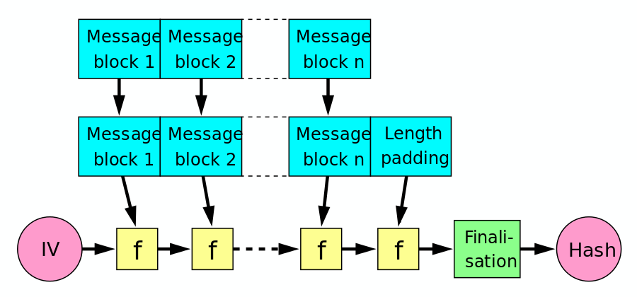
SHA-2
Designed by NSA
Merkle-Damgård design, same as MD5, SHA-1
SHA-2 family output lengths 224, 256, 384 or 512
Spec and code: RFC 6234
SHA-256: 64 rounds, 256 bit output, compression function ‘f’ is yet more complex bit fiddling
Init(); update(); final(); APIs
https://en.wikipedia.org/wiki/File:Merkle-Damgard_hash_big.svg
Notes:
Create any message you want, but need to have 2 blocks at the end that will be garbage. Randomly choose 2³² blocks twice. Decrypt desired hash with each of 2³² of them, and encrypt intermediate result of hash after final block of message with 2³² trial things, and look for a match, where there probably will be one.

Slide 101
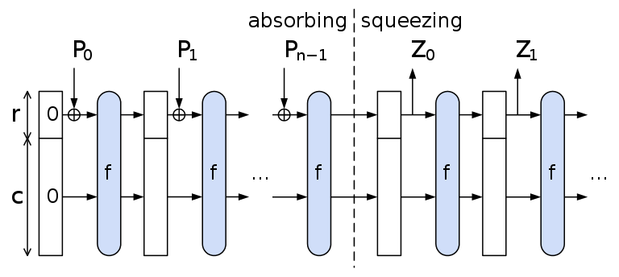
SHA-3/Keccak
https://en.wikipedia.org/wiki/File:SpongeConstruction.svg
Designed by Keccak team for
NIST competition (like AES)
https://keccak.team/index.html
Sponge design, not Merkle-Damgård
Block transformation function ‘f’ uses xor, not and and operations
Many variations (sigh): SHA-3-224, SHA-3-256, SHA-3-384, and SHA-3-512, SHAKE128, SHAKE256
Slower than SHA-256 (or SHA-2-256;-) in s/w
Not in widespread use; guessing: SHA-3-512 will get used
Loadsa slides: https://csrc.nist.gov/csrc/media/projects/hash-functions/documents/keccak-slides-at-nist.pdf
Notes:
Create any message you want, but need to have 2 blocks at the end that will be garbage. Randomly choose 2³² blocks twice. Decrypt desired hash with each of 2³² of them, and encrypt intermediate result of hash after final block of message with 2³² trial things, and look for a match, where there probably will be one.

Slide 102
Remember meet-in-middle attack
If hash is n bits, this allows work of 2^{n/2} to find a message with a particular hash
fix by XOR’ing input of previous stage with output
Has same effect as using K1=K3 in 3DES. Constrains it sufficient to avoid MITM
Notes:
Create any message you want, but need to have 2 blocks at the end that will be garbage. Randomly choose 2³² blocks twice. Decrypt desired hash with each of 2³² of them, and encrypt intermediate result of hash after final block of message with 2³² trial things, and look for a match, where there probably will be one.

Slide 103
How big does it need to be?
To find two messages with same n-bit hash, probably need to try square root of 2^{n} msgs, i.e., 2^{(n/2)}
If given one message, would take 2^{n} msgs about to find another with same hash
Some uses don’t need such collision resistance
Notes:
Birthday problem: with k things, there are k(k-1) pairs of things. Probability of a pair being the same value is 1/n, where n is the number of possible values. (this is an approximation). The exact right answer is 1-(n P k)/n^{k}
That’s the probability that there is at least one match. The (n P k)/n^{k} term is the probability that they are all distinct. ((n)*n-1)*n-2*…*(n-k+1)/n^{k}.
n P k is: n! divided by ((n-k)!)
nPk is # of ways to select k distinguishable objects out of n, where order matters
n^{k} is the number of ways you can assign k things a number from 1 to n

Slide 104
Salt
Protects a database of hashed passwords
Salt is non-secret, different for each user
Store hash(pwd, salt)
Users with same pwd have different hashes
Prevents intruder from computing hash of a dictionary, and comparing against all users
Password hashing is not the same as hashing
  Argon2!

Slide 105
Properties of password hashing function ‘f’?
Do we want ‘f’ to be speedy?
Do we want ‘f’ to use as little memory as possible?
Do we want ‘f’ to be easy to parallelise?
‘f’ is often called a password hashing algorithm but is really a verifier, the password hashing alg produces pv given p and s (and sometimes u)
  It’s ok to not be terminologically pure:-)
See https://password-hashing.net/ for much more on a recent competition related to that kind of function

Slide 106
MACs with hashes
Combine message with key and digest that
Collision resistance isn’t important here. (why?)

Slide 107
Possible problem
If do hash(key | message) and use entire result as MAC, many hash algorithms have an understandable issue
  Hash continuation for speed
  Most hash algorithms can continue from where they left off
  So even if you didn’t know the key, if you knew hash(key | message) you could continue
HMAC (RFC 2104) proven not to have this problem but HMAC is a bit more work
HMAC-H(K,text) = H(K XOR opad, H(K XOR ipad, text))
  Where ‘H’ is e.g. SHA-1 or SHA-256

Slide 108
The problem
Some (most) hash algorithms can continue from where they left off.
So even if you didn’t know the key, if you knew hash(key | message) you could continue
Other solutions would have worked. Suggestions?
Notes:
other solutions:
use only half the bits of the hash
hash (length | key | message)
hash (message | key) ;theoretical concern that if attacker knew of two messages with the same hash, and the messages were integral # of blocks, then even if he didn’t know the secret he could substitue one message for the other and the keyed hashes would be equal
hash(key | message | key)

Slide 109
If others, why HMAC
HMAC comes with a proof
  assuming underlying function is
    collision resistant
    if attacker doesn’t know K, cannot compute proper digest(K,x) even if sees arbitrary (y,digest(K,y))
Others likely just as secure, but no “proof”

Slide 110
Cryptographic proofs
Most cryptographers prefer to base their work on results that have mathematic proofs
Usually those end up depending on some hopefully reasonable underlying assumption, e.g. that discrete logarithms are hard.
Until recently the set of assertions for which we had proofs was fairly limited, mostly about internals of algorithms and not covering how those were used
That’s starting to improve (see TLS1.3 materials later)
Bottom line: basing your work on algorithms with associated proofs is usually better, though is no guarantee of security nor of correctness as implementation flaws are far more common than algorithm design flaws

Slide 111
How Public Key Algorithms Work
We want an algorithm with the following properties:
  two different numbers: e and d
  e and d are inverses; using one reverses the effect of the other
  you shouldn’t be able to compute d from e
  if must be efficient to find a matching pair of keys
  it must be efficient to encrypt and decrypt

Slide 112
Example (Insecure) Public Key Algorithm
Multiplication modulo p (where p is a prime)
For example, let p=127
Choose e and d so that e*d=1 mod 127
  e.g. e=53 and d=12
To encrypt a number, multiply by 53 mod 127
To decrypt a number, multiply by 12 mod 127
Decryption must restore the initial value!

Slide 113
Why Isn’t This Secure?
The number 127 is too small. You could compute d from e by trying all possible values
Modular division is possible - the inverse can be computed quickly even when p is large (Euclid’s algorithm…patent long expired)

Slide 114
Multi-precision arithmetic
Asymmetric crypto depends on multi-precision arithmetic, so… A very, very, very brief primer...
How long is the product of 2 32-bit numbers?
How long is the product of 2 1024-bit numbers?
If X,Y and P and are 1024-bits long, how long is:
  (X * Y) mod P?
  (X ^ Y) mod P?
Does calculating (X ^ Y) mod P require Y multiplications?

Slide 115
A Summary of RSA
Named after its inventors: Rivest, Shamir, and Adelman
Uses modular exponentiation
Choose a modulus n and a public exponent e
The modulus n is chosen as the product of two primes: p,q
We depend on factoring n being “hard”
Public key encryption is:
ciphertext = plaintext ^{e} mod n
Public key decryption is:
plaintext = ciphertext ^{d} mod n

Slide 116
So how RSA works...
Define phi(n) to be the # of integers < n and relatively prime to n
Euler proved: x ^{phi(n)} mod n = 1
So x ^{k.phi(n)} mod n = 1 and x ^{k.phi(n)+1} mod n = x
If we can find d*e = 1 mod phi(n), they’d be “exponentiative inverses”
Because:
  C=Me
  C^{d} = M^{e*d} = M^{(e*d mod phi(n))} = M

Slide 117
Computing phi(n)
If p is a prime, phi(p) = p-1
If n=p*q (p,q primes), phi(n)=(p-1)(q-1) (remove multiples of p and multiples of q)
Given e, phi(n), Euclid’s algorithm (aka long division) allows us to compute d such that
  d*e = 1 mod phi(n)
So, we can find d from e if we know phi(n)
We need to know how to factor n in order to know phi(n)

Slide 118
Why do we think RSA is secure?
If you can find d from e, why can’t someone else?
Factoring large numbers is hard (as far as we know)
Finding d from e is easy if you can factor n, but it’s hard if you can’t
Pick two large primes and multiply them together to get n. You can now factor n because you constructed n
After computing d from e, you can forget the factors of n (though in practice you don’t)

Slide 119
How to Find Large Primes
If factoring is hard, how do you find large primes?
It turns out you can test a number for primality easily even though factoring is hard!
Pick random large numbers and test them until you find a prime one
There are probabilistic tests and deterministic ones (some that can produce proofs)
State of the art is to use deterministic tests but we’ll only look at the basic probabilistic method as it’s easier to grok

Slide 120
How do you test for primality?
Fermat’s theorem (note: Fermat was born 100 years earlier than Euler..it’s a special case of Euler’s theorem)
x ^{p-1} mod p = 1 if p prime
So to test if n is a prime, pick x < p and raise x to the power of p-1. If the answer is not 1, n is definitely not prime
But can the result be 1 even if n not prime? Yes, but probably not
Worst case: 1/4 false positives, actually about 10⁻⁴ for candidate prime lengths of interest
Iterate with different x’s (maybe 10 or 20) until satisfied

Slide 121
Doing exponentiation
Can’t multiply something by itself a gazillion google times!
Solution: Repeated squaring
Result: a 512 bit exponent requires between 512 and 1024 multiplications (depending on the number of 1’s in the number) (instead of a trillion trillion trillion trillion google multiplications)

Slide 122
Optimizing Public Key ops
Turns out RSA secure even if e in (e,n) is small (like 3 or 2¹⁶+1)
Have to be somewhat careful if e=3
  if m is smaller than cube root of n
  if send same message to 3 people, all using e=3
    know public keys (3,n₁), (3,n₂), (3,n₃)
    know m³ mod each of n₁ , n₂ , n₃
    By CRT, can compute m³ mod n₁* n₂ * n₃
    Then just take cube root (n is smaller than each of the moduli so its cube will be less than n₁* n₂ * n₃

Slide 123
More problems with e=3
3 must be relatively prime to phi(n)
How do we ensure this?
Why are these problems not an issue with e=2¹⁶+1?
Notes:
make both p and q = 2 mod 3 so that p-1 and q-1 will be 1 mod 3
Not a problem with 2^16+1 because
. not many things that raised to 65537 will be sufficiently small not to need
to be reduced mod n
. not hard to avoid p and q = 1 mod 65537
. unlikely to send same msg to 65537 recipients, all of whom use 65537 as e

Slide 124
Optimizing Private Key ops
Use Chinese Remainder Theorem (CRT) and do arithmetic mod p and mod q, then combine
precompute what d is mod p and mod q
precompute p⁻¹ mod q

Slide 125
Other arcane RSA threats (Standards avoid these)
If you just encrypt a guessable plaintext, eavesdropper can verify a guess
Trivial to forge a signature if you don’t care what you’re signing
Smooth numbers (sign msg combo of other messages already signed)
If pad on right with random data, someone can choose padding such that msg will be perfect cube
Notes:
Choose any random R, and apply public key to get X. R is the signature on X.
To avoid this, pad anything you’re going to sign. It’s unlikely someone can find an R that when public key is applied, will have X of the correct format.

Slide 126
Smooth threat
Suppose you see signature on m₁ and on m₂. What’s the sig on m₁*m₂; m₁/m₂; m₁⁻¹?
Suppose you can factor the m’s, and see lots of signatures (like tens of thousands). Various combinations are likely to give you signatures on various primes, and then you can sign anything which has just those primes as factors

Slide 127
An Intuition for Diffie-Hellman
Allows two individuals to agree on a secret key, even though they can only communicate in public
Alice chooses a private number and from that calculates a public number
Bob does the same
Each can use the other’s public number and their own private number to compute the same secret
An eavesdropper can’t reproduce it

Slide 128
Why is D-H Secure?
We assume the following is hard:
  Given g, p, and g^{X} mod p, what is X?
  That’s the discrete log problem
With the best known mathematical techniques, this is somewhat harder than factoring a composite of the same magnitude as p
Subtlety: we haven’t proven that the algorithms are as hard to break as the underlying problem

Slide 129
Diffie-Hellman
Alice
agree on g,p
Bob
choose random A
choose random B
T_{A}=g^{A} mod p
T_{B}=g^{B} mod p
compute T_{B}^{A}
compute T_{A}^{B}
agree on g^{AB} mod p

Slide 130
Man in the Middle
Alice
Trudy
Bob
T_{A}=g^{A} mod p
T_{T}=g^{T} mod p
T_{T}=g^{T} mod p
T_{B}=g^{B} mod p
agree on g^{AT} mod p
agree on g^{TB} mod p
{data}g^{AT} mod p
{data}g^{TB} mod p
{data}g^{AT} mod p
{data}g^{TB} mod p

Slide 131
Signed Diffie-Hellman
(Avoiding Man in the Middle)
Alice
Bob
choose random A
choose random B
[T_{A}=g^{A} mod p] signed with Alice’s Private Key
[T_{B}=g^{B} mod p] signed with Bob’s Private Key
verify Bob’s signature
verify Alice’s signature
agree on g^{AB} mod p

Slide 132
If you have keys, why do D-H?
“Perfect Forward Secrecy” (PFS)
  Prevents me from decrypting a conversation even if I break into both parties after it ends (or if private key is escrowed)
Ex. non-PFS:
  A chooses key S, encrypts it with B’s RSA public key and sends it to B
Today we strongly encourage PFS in Internet security protocols (see later wrt snowdonia)

Slide 133
Cookie Mechanism:
Some Denial of Service Protection
Alice
Bob
I’m Alice
C
choose cookie C
C, [T_{A}=g^{A} mod p] signed with Alice’s Private Key
verify C
[T_{B}=g^{B} mod p] signed with Bob’s Private Key
verify Bob’s signature
verify Alice’s signature
agree on g^{AB} mod p

Slide 134
Stateless Cookies
It would be nice if Bob not only can avoid doing computation, but can avoid using any state until he knows the other side is sending from a reasonable IP address
A “stateless” cookie is one Bob can verify without maintaining per connection state
For instance, Bob can have a secret S, and cookie= {IP address}S

Slide 135
Diffie-Hellman for Encryption
Alice
Bob
choose g, p
choose random B
publish g, p, T_{B}=g^{B} mod p
choose random A
compute T_{A}=g^{A} mod p
compute T_{B}^{A}
encrypt message using g^{AB} mod p
send T_{A}, encrypted msg
compute T_{A}^{B}
decrypt message using g^{AB} mod p

Slide 136
Flavours of D-H
Above is called ephemeral-static D-H
  Alice's value (“A”) is ephemeral, and Bob's (“B”) is static/published
What would be the consequences of a static-static scheme?
  Hint: think about groups

Slide 137
Strong Password Protocols
…patents can be bad too

Slide 138
This hour
Strong password protocols
  Sometimes called “Password Authenticated Key Exchange” (PAKE) protocols
  EKE, SPEKE,….
System considerations
ACK: Some stolen slides! (From Radia Perlman’s presentation at the Summer ’05 IETF)
https://www.ietf.org/proceedings/63/slides/sacred-3/sld1.htm
https://en.wikipedia.org/wiki/Password-authenticated_key_agreement
https://www.jablon.org/passwordlinks.html

Slide 139
Materials
System level considerations:
  (Closed) IETF SACRED WG
    https://datatracker.ietf.org/wg/sacred/about/
Want more?
https://en.wikipedia.org/wiki/Password-authenticated_key_agreement
https://www.jablon.org/passwordlinks.html

Slide 140
Basic Problem
Using a password as a key in any protocol is vulnerable to a dictionary attack so long as there is any structure detectable in the data protected with the password-as-key
Unavoidable?
  Think D-H?

Slide 141
Diffie-Hellman
Alice
agree on g,p
Bob
choose random A
choose random B
T_{A}=g^{A} mod p
T_{B}=g^{B} mod p
compute T_{B}^{A}
compute T_{A}^{B}
agree on g^{AB} mod p

Slide 142
EKE (designed for mutual authentication)
Share W=h(pwd), g, p
Alice
Bob
Pick A
“Alice”, {g^{A} mod p}W
Pick B
Decrypt {g^{A} mod p}W
Calculate K=g^{AB} mod p
Choose challenge C1
{g^{B} mod p}W, {C1}K
Choose challenge C2
{C1,C2}K
{C2}K

Slide 143
SPEKE
Share W, p
Alice
Bob
Pick A
“Alice”, W^{A} mod p
Pick B
Calculate K=W^{AB} mod p
Choose challenge C1
W^{B} mod p, {C1}K
Choose challenge C2
{C1,C2}K
{C2}K

Slide 144
PDM (Password Derived Moduli)
Share p
Alice
Bob
Pick A
“Alice”, 2^{A} mod p
Pick B
Calculate K=2^{AB} mod p
Choose challenge C1
2^{B} mod p, {C1}K
Choose challenge C2
{C1,C2}K
{C2}K

Slide 145
System Considerations
Each of the protocols requires some shared information in addition to the password (e.g. EKE requires g & p)
In all cases, this is not human memorable information
  So some configuration or hard-coded values are required
People also cannot play the protocols themselves
  So some s/w is needed

Slide 146
Possible Solutions
Client side:
  User uses standard PC
    Install client code and configuration
  Users uses token or smart card
    Token/smart card contains configuration and code
  Issues?
Server side
  Database and s/w
What about account management?

Slide 147
Strong Password Protocol Conclusions
These protocols would probably be more widely used were it not for the IPR situation
  EKE patent (held by Lucent) U.S. Patent 5,241,599 expired in 2011
  Other IPR does exist in this space
  PAKEs still considered damaged goods by some though
Some others think there’s a useful role here for new device registration, e.g. into a public key infrastructure or symmetric key based system

Slide 148
ECC
Nice blog from Nick Sullivan
  https://blog.cloudflare.com/a-relatively-easy-to-understand-primer-on-elliptic-curve-cryptography/
Elliptic curve, e.g: y^2 = x^3 + ax +b
  x,y can be Real or members of finite groups (Fp or F2^m)
Points on curve form a group
  Group operation: addition P+P=2P etc.
Hard problem: EC discrete log problem
  Given P,Q on curve find k s.t. P=kQ

Slide 149
ECC - 2
Certicom IPR on lots of implementation related things (e.g. point compression)
  RFC 6090 based only on old references
  People finally seem ok with IPR now
Keys/signatures are smaller
  AES 128 ~ RSA 3072 ~ ECC 256
Run times
  Public/private operations same
  In the “middle” compared to RSA enc/dec
Starting to displace RSA and a lot of integer D-H

Slide 150
ECC – 3
Recently ECC deployment is increasing a lot
Doubts about NIST Curves (P256) are a part of that but not so much among those who understand stuff
  Non-deterministic signature schemes are worst aspect really
Mostly this is down to performance
Curve25519 and Ed25519 are 4x quicker
Curve448 and Ed448 are “turn it up to 11” settings
References:
  RFC 7638 (basic curve definitions)
  RFC 8032 (EdDSA)

Slide 151
ECDSA Signing
Sony’s “oops” in 2010:
  https://events.ccc.de/congress/2010/Fahrplan/attachments/1780_27c3_console_hacking_2010.pdf
  - local copy in “materials”
GOTO slide 122
  - explains ECDSA signing and issues with non-deterministic signatures
  - deterministic signatures: RFC 6979
Better mitigation: Use Ed25519 (RFC 8032)

Slide 152
Key Rotation
N-squared issue mentioned already – a KDC or CA or equivalent is needed
Symmetric algorithms all have a cryptographic limit to the number of times you should use one key
  A very large number, but very fast comms channels exist
Deployments however are vulnerable, so keys can leak out, e.g. on discarded hard disks, via ex-employees, backups, ...
Some (dim) vendors still ship products with hard-coded keys, even today
So you always want to rotate keys periodically, for every kind of key used in a system
And you need to build this in from the start, or the chances are very high that it won’t happen (so don’t depend on any manual interaction to rotate keys!)
This can become visible to the application layer, e.g. if you have some redundancy and use session-tickets; that’s a PITA, but you MUST handle it

Slide 153
Odds and Ends: 2 slides each
Identity Based Cryptography (IBC/IBE)
Secret Sharing
NUMS

Slide 154
IBC
Idea: Just use someone's name as the (public) key to encrypt something to them
Can work if there's a trusted (by the recipient) key generator where the sender has (a high integrity copy of) the KG's public value
Almost all schemes require that KG can decrypt all traffic (mandatory key escrow)
Functionally like RSA group-keys
Truth-in-advertising: you absolutely need more than just identities!

Slide 155
IBC - 2
IPR again: Voltage
Interesting math behind this: pairing based crypography
Discrete log again, and D-H but with two groups for which there's a bilinear mapping
  https://en.wikipedia.org/wiki/Pairing-based_cryptography
Not really mature enough (IMO) and encumbered up the wazoo so more of academic interest for now

Slide 156
Secret Sharing
What if I have a secret to share out among N entities so that any k of them can reconstruct the secret
Useful for ways to distribute things amongst partially trusted entities
  Long term secrets
  High availability solutions
  P2P schemes

Slide 157
Shamir Secret Sharing
Idea:
  Geometry!
    Knowing 2 points => know the line
    3 points => know the quadrtic
    k points => know the x^k polynomial
  Distribute N points of an x^k polynomial
  Can be used in real life!
https://en.wikipedia.org/wiki/Shamir%27s_Secret_Sharing

Slide 158
Nothing Up My Sleeve
In many crypto schemes if you can mess about with crypto parameters, then you can break many things
Examples: bad D-H parameters, IBE, Dual-EC
The absence of a detailed explanation for how the NIST curves (p256 etc) were generated has generated controversy
One approach is to reduce the wriggle-room available to designers is to pick (few) known constants (e.g. Pi, SQRT(2)) and derive “free” parameters from those
Surprisingly even that generated a big argument
Not a bad design pattern though

Slide 159
(Post-)Quantum Stuff
I’ll use the opening slides from the 2nd NIST conference
https://csrc.nist.gov/CSRC/media/Presentations/the-2nd-round-of-the-nist-pqc-standardization-proc/images-media/moody-opening-remarks.pdf
There’s a copy in the course materials

Slide 160
(Post-)Quantum Stuff
Important note about hash-based signature schemes:
  Yes, they are quantum resistant, so worth exploring, esp for things like software-signing where we won’t need too many signatures and sizes aren’t a big deal
  BUT they need a different cryptographic API as those private keys have a fixed, limited number of uses allowed, (maybe 2^10 or 2^20) and if you go over that limit, you lose all security (signatures could be forged)
  Also, if you EVER re-use a private key you’re hosed, so you need to be very very careful e.g. about reboots and state maintenance
  So you can’t just replace Ed25519 with XMSS or LMS without changes to applications/systems
  XMSS: RFC 8391
  LMS: RFC 8554

Slide 161
Embed PQ exchanges with classic DH
Likely TLS, IPsec and other “classic” key exchanges will be extended to allow mixing in of PQ key exchanges in addition to the classic DH exchange
This may involve betting on which algorithms you think may “win” the NIST competition (or just picking those you like)
One VPN operator I chatted with a while back is interested in embedding 3 different PQ key exchanges into wireguard (an IPsec alternative) as a hedge against future quantum attacks
Efficiency and scaling issues are tricky and not worked out yet really, and there’s IPR on some ways of mixing stuff in
Bottom line: wait a year or so more to start on this!

Slide 162
Crypto Overall Summary
Don't invent stuff
Algs de-jour: sha-256, aes-128, rsa-2048 or longer for long-term apps
RSA key transport being displaced by ECDH esp. P256 and curve25519
RSA signatures still rule the roost for authentication
Code/libraries exist: use them (properly!)
Key management is required and hardly ever easy
Don't invent stuff

