Slide 1
Exploratory Data Analysis NASA Asteroids - NeoWs(Near Earth Object Webservice)
Exploratory data analysis is a process for exploring datasets, answering questions, and visualizing results.
Done by:
Mangaiyarkarasi Rathnakumar
Nasiba Adilova

Slide 2
Steps we did:
Imported our api_key and all necessary libraries.
Retrieved the json data of Asteroids for October month 2021.
Created a Dictionary and then DataFrame.
Data Cleaning of our DataFrame
Calculated some statistics
Visualization of our data

Slide 3
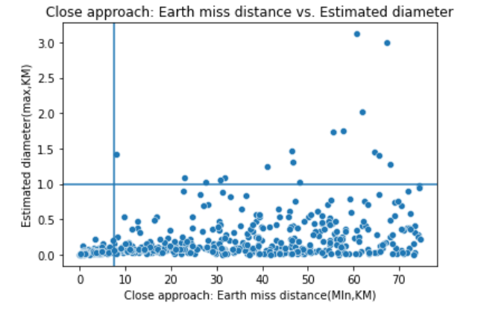
Question: Are asteroids coming closer to Earth typically larger or smaller in size than the ones that miss the earth at farther distances? How many asteroids with a diameter of 1 kilometer or more missed the Earth by 7.5 million kilometers or less?
Answer: There were zero asteroids with a diameter of 1 kilometer or more that missed the Earth by 7.5 million kilometers or less as it can be seen in the top-left quadrant of the below chart. Asteroids coming closer to Earth tend to be smaller than asteroids missing the earth at farther distances.

Slide 4
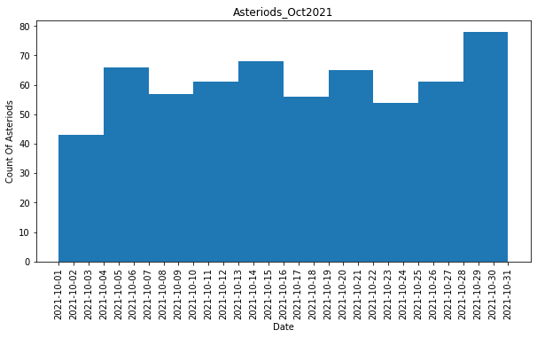
How many asteroids came near to earth in the month of October 2021? There are 612 asteroids came closer to earth in October month 2021.

Slide 5
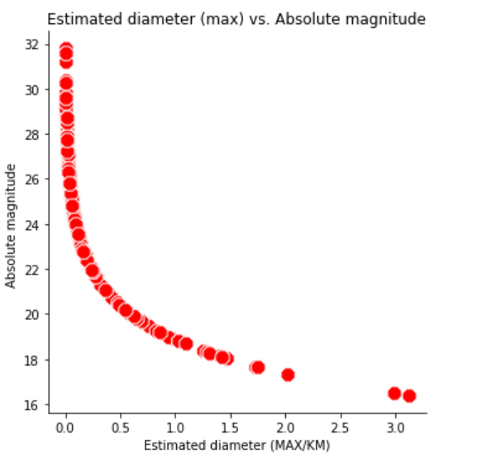
Question: Are brighter (with higher absolute magnitude) asteroids bigger in size than darker (with lower absolute magnitude)?
Answer: Brighter asteroids are generally smaller in size than darker asteroids. The relationship between absolute magnitude and asteroid diameter appears to be negative logarithmic.

Slide 6
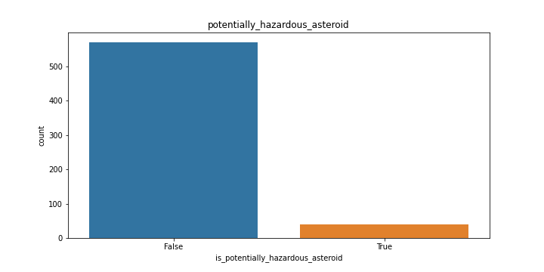
How many asteriods are potentially hazardous during the calculated period? Among 612 asteriods, 39 are hazardous and 573 are not potentially hazardous asteriods.

Slide 7
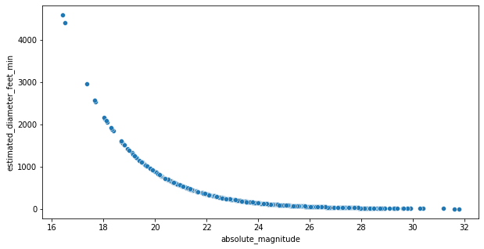
Correlation Correlation tells us how strong the relationship is between the variables. We have calculated correlation between absolute_magnitude and estimated_diameter_feet_min. Graph shows that as x increases, y decreases. Its called negative correlation.

