Slide 1
Exploratory Data Analysis NASA Asteroids - NeoWs(Near Earth Object Webservice)
Exploratory data analysis is a process for exploring datasets, answering questions, and visualizing results.
Done by:
Mangaiyarkarasi Rathnakumar
Nasiba Adilova

Slide 2
Steps we did:
Imported our api_key and all necessary libraries.
Retrieved the json data of Asteroids for October month 2021.
Created a Dictionary and then DataFrame.
Data Cleaning of our DataFrame
Calculated some statistics
Visualization of our data

Slide 5
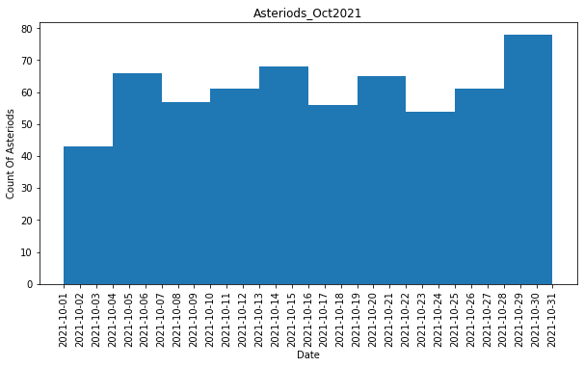
How many asteroids came near to earth in the month of October 2021? There are 612 asteroids came closer to earth in October month 2021.

Slide 6
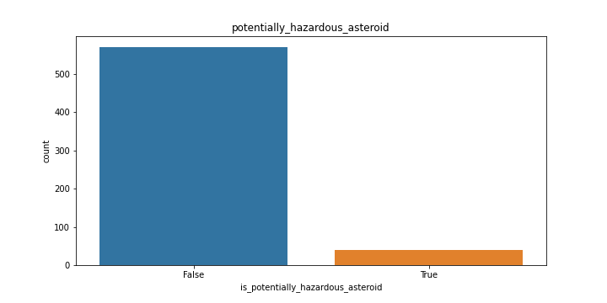
How many asteriods are potentially hazardous during the calculated period? Among 612 asteriods, 39 are hazardous and 573 are not potentially hazardous asteriods.

Slide 7
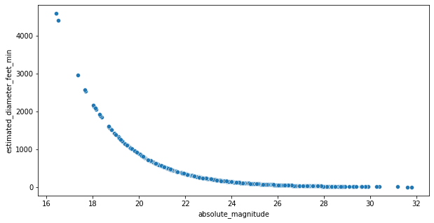
Correlation Correlation tells us how strong the relationship is between the variables. We have calculated correlation between absolute_magnitude and estimated_diameter_feet_min. Graph shows that as x increases, y decreases. Its called negative correlation.

