Slide 1


"We became friends "

Slide 2
Exploratory Data Analysis NASA Asteroids - NeoWs(Near Earth Object Webservice)
Exploratory data analysis is a process for exploring datasets, answering questions, and visualizing results.
Done by:
Mangaiyarkarasi Rathnakumar
Nasiba Adilova

Slide 3
Steps we did:
Imported our api_key and all necessary libraries.
Retrieved the json data of Asteroids for October month 2021.
Created a Dictionary and then DataFrame.
Data Cleaning of our DataFrame
Calculated few statistics
Visualization of our data

Slide 4
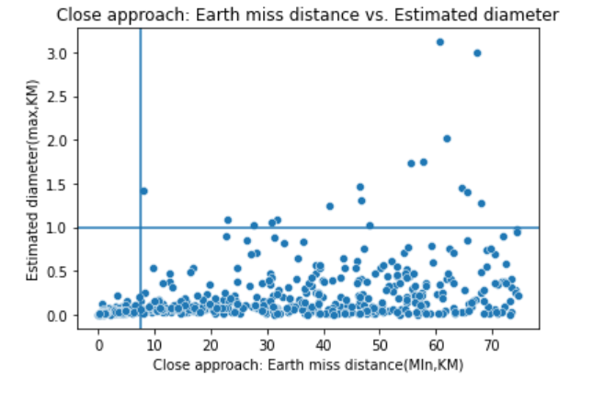
Question: Are asteroids coming closer to Earth typically larger or smaller in size than the ones that miss the earth at farther distances? How many asteroids with a diameter of 1 kilometer or more missed the Earth by 7.5 million kilometers or less?
Answer: There were zero asteroids with a diameter of 1 kilometer or more that missed the Earth by 7.5 million kilometers or less as it can be seen in the top-left quadrant of the below chart. Asteroids coming closer to Earth tend to be smaller than asteroids missing the earth at farther distances.

Slide 5
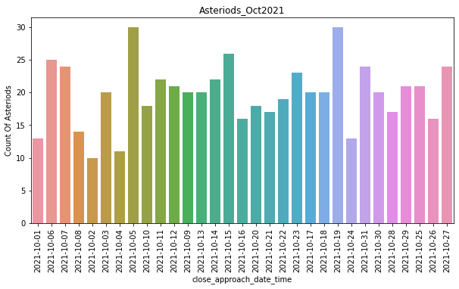
How many asteroids came near to earth in the month of October 2021? There are 615 asteroids came closer to earth in October month 2021.

Slide 6
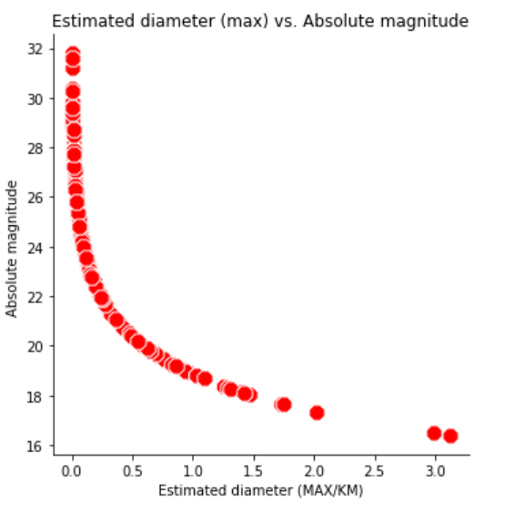
Question: Are brighter (with higher absolute magnitude) asteroids bigger in size than darker (with lower absolute magnitude)?
Answer: Brighter asteroids are generally smaller in size than darker asteroids. The relationship between absolute magnitude and asteroid diameter appears to be negative logarithmic.

Slide 7
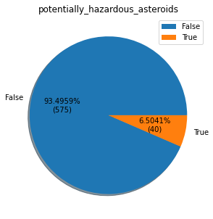
How many asteriods are potentially hazardous during the calculated period? Among 615 asteroids, 40 are hazardous and 575 are not potentially hazardous asteroids.

Slide 8
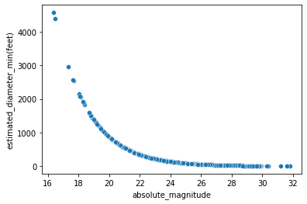
Correlation Correlation tells us how strong the relationship is between the variables. We have calculated correlation between absolute magnitude and estimated_diameter_feet_min. Graph shows that as x increases, y decreases. It is called negative correlation.

Slide 9
Conclusion
Asteroids with sizes anything larger than one to two kilometers could have worldwide effects. At 5.4 kilometers in diameter, the largest known potentially hazardous asteroid is Toutatis.
94% Asteroids are non-hazardous, only 6% of asteroids came near to earth during October 2021 are potentially hazardous. They might have released shock waves, heat radiation in smaller amount.
We are Safe :)

