Slide 1


Slide 2
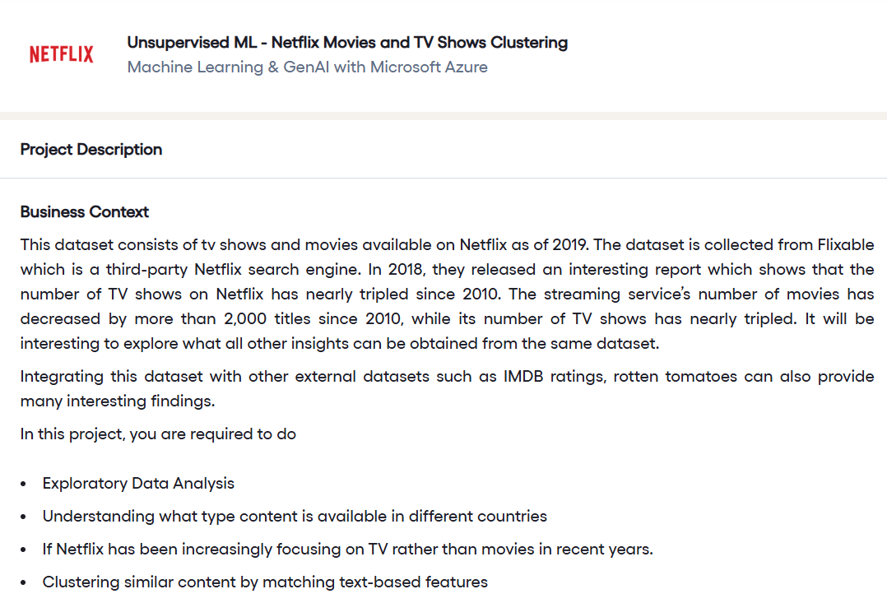

Slide 3
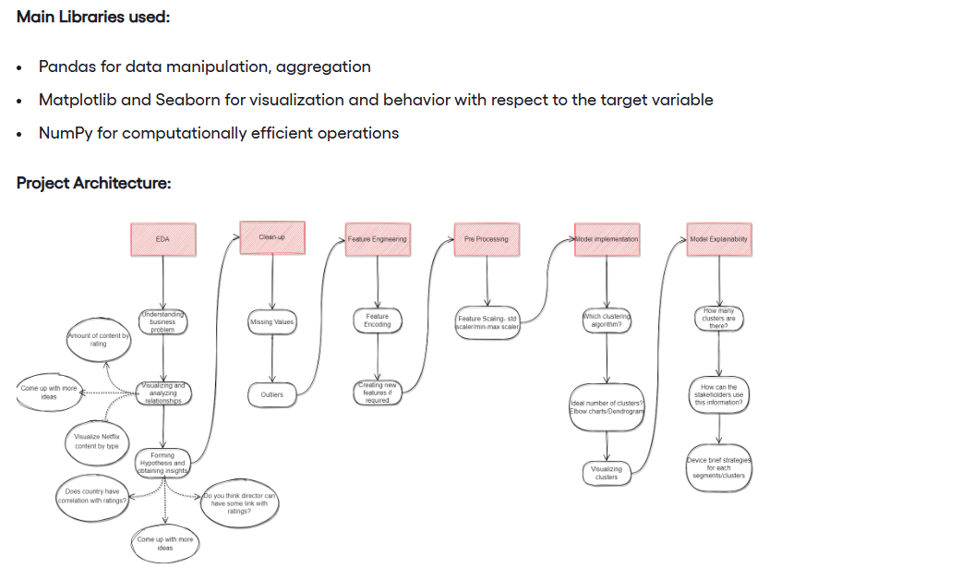

Slide 4
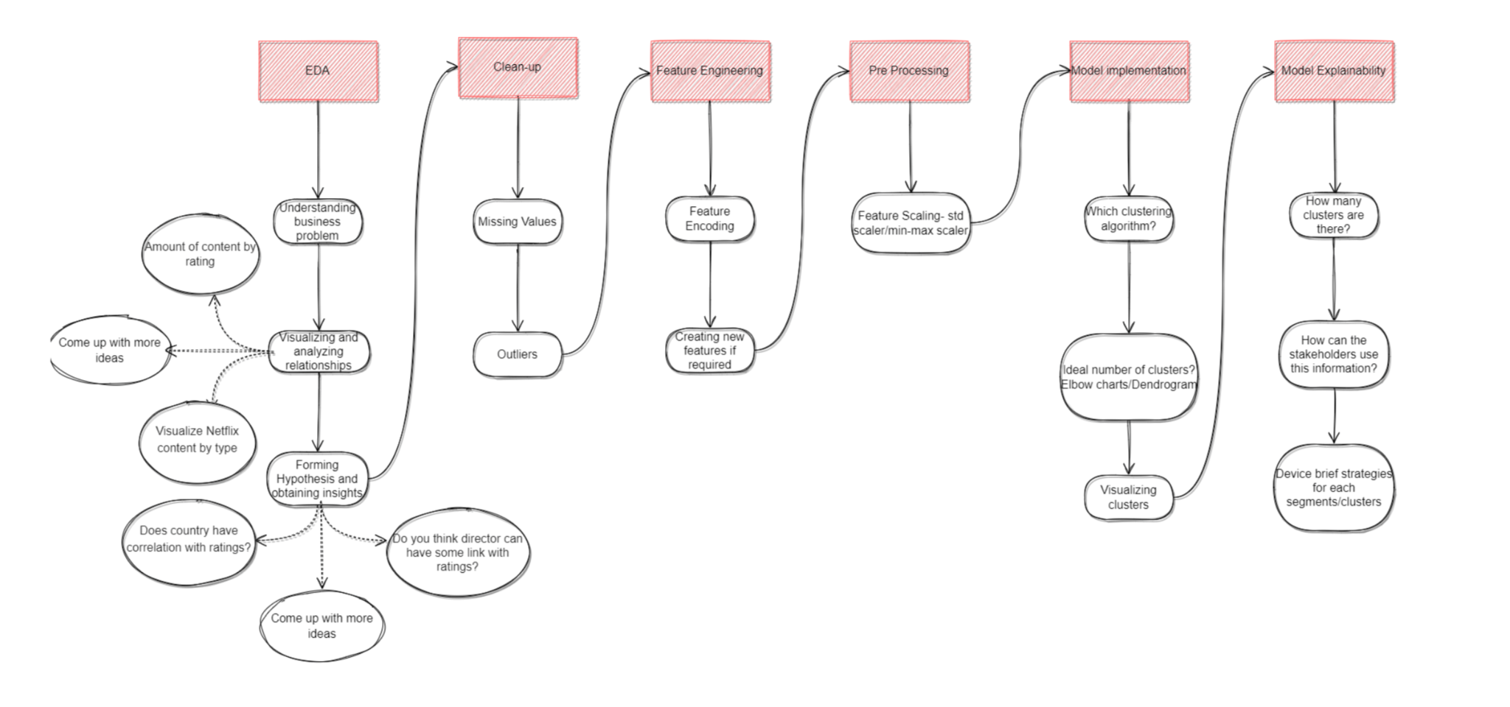

Slide 5
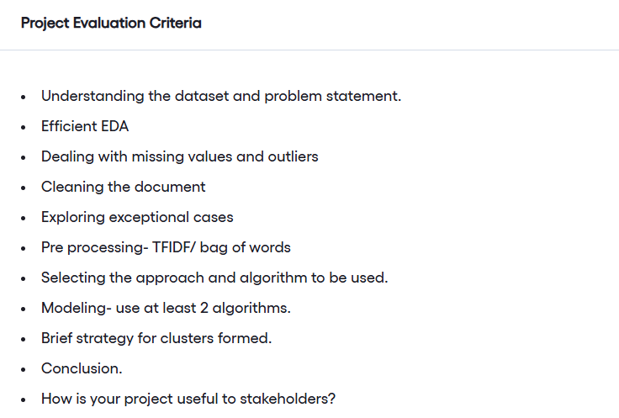

Slide 6
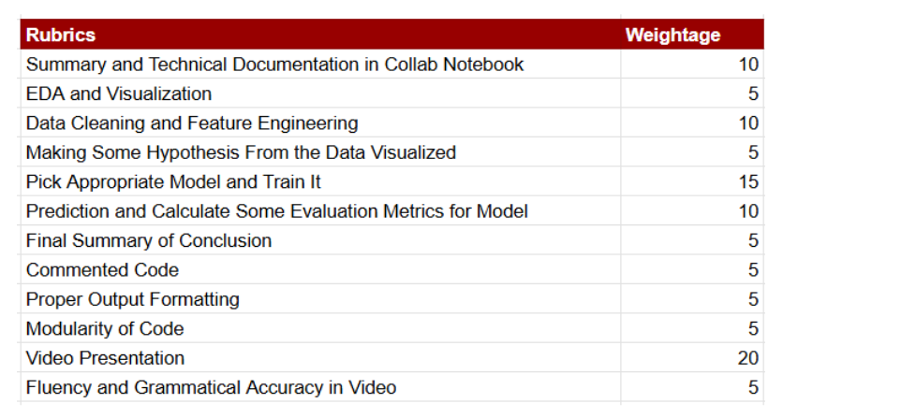

Slide 7
Dataset -
https://drive.google.com/file/d/1xJGllnE12mAggLuRo8b0oNSshUlG8GvF/view

Slide 8
Submission – deadline (5th Oct 2025)
create a drive folder → submit two files (ipynb, video) access everyone
ML submission template
Ipynb file
record a video
sample video submission - https://drive.google.com/file/d/1nsPJNSPf4qIChy4yC2KBhn__IJpKEXtD/view
video length → (more than 7mins), max → 20, 30mins
by 5th Oct, email → google form → fill that form → submit

