Slide 1
Bitcoins

Slide 2
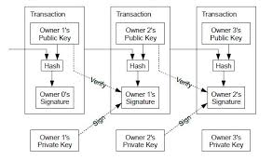
Transaction -> Cryptographically signed transfer of funds from one public key to another

Slide 3
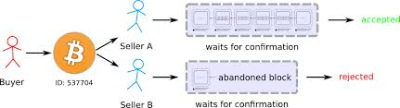

Slide 4
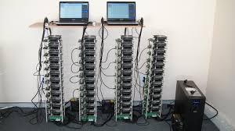
Miner - Computationally expensive to verify(mine) blocks.
As a reward, you get new bitcoins
Mining is like a competition. Everyone is trying to do it.

Slide 5
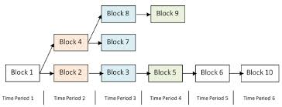
But Buyer can double spend by controlling network resources right?

Slide 6
How to get started ?
Go to an exchanger to get Bitcoins or mine them.
Store your Bitcoins in a wallet (store your unique public-private key)

Slide 7
Ownership of the money is anonymous.
But its flow is visible
Block chain - Currently 3 GB in compressed format
Transfers are irreversible.

Slide 8
Aim : not to de-anonymize all Bitcoin users.
Rather identify common patterns of use
All analysis - simple fact Block chain is public.
2 categories of bitcoin users
Casual and private

Slide 9
Facts
Validating block - difficult . very few users do it.
They join mining pool - deepbit
They buy bitcoins from exchanges MTGox and store in a wallet- on their computer or on the online wallets
Problem - multiple public keys. Given 2 public keys, how to pin them to the same user?

Slide 10
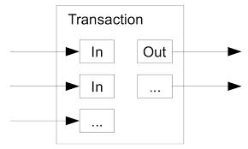
Heuristic 1
User “u” has 2 BTC that have value 10B(BTC1) and 20B(BTC2)
He wants to buy something for 25B from BTC(Dest)
Bitcoin clients choose a set of BTCs from u’s wallet and perform multi-input transaction. ie. transaction from multiple BTCs.
So, if we observe a multi input transaction from multiple BTCs they are from same user. (Different users cannot participate in a single transaction). So now we know that BTC1 and BTC2 are the same user !

Slide 11
Heuristic 2
To collect the change 5B, a “shadow” address is created for u. This BTC(Shadow) is created internally by bitcoin and is never reused.
So, we examine the output to a transaction. If one of the address is something that has never occurred in the chain before, we know it is a shadow address.
Therefore the transaction will be form
BTC1+BTC2 -> BTC(Shadow) ,BTC(Dest)
-So, now we know that BTC1, BTC2 and BTC(Shadow) are the same user!
But make sure that,
-BTC(Dest) != BTC1 || BTC2 || any other address of user u
- Transaction T is not a coin generation transaction.

Slide 12
Heuristic 3
Many sites like Silk Road publicize their bitcoin address (BTCDest).
As a seller, you have to provide a bitcoin address where buyers will pay you.
Thus we can know that user “u” bought drugs for 25B.
Then he collected 5 B and did something else with it.

Slide 13
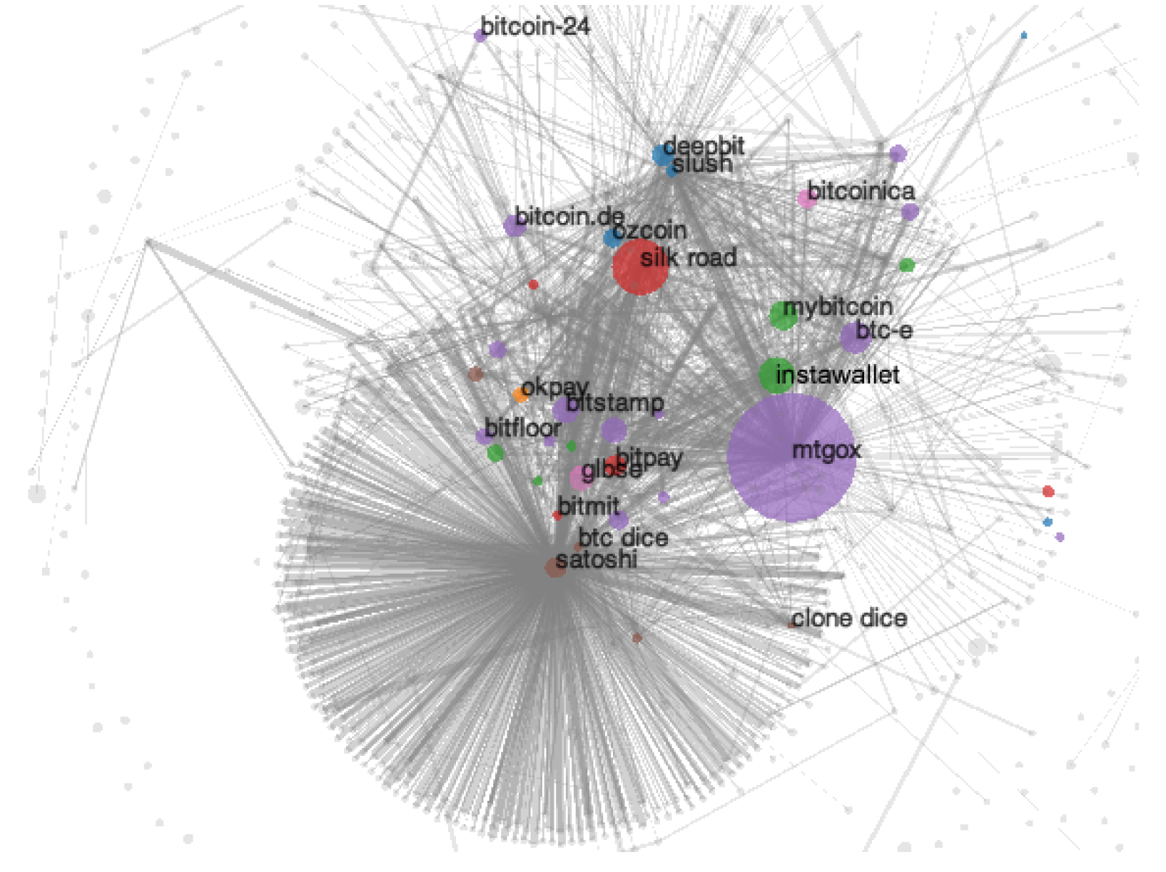

Slide 14
Bitcoin Exchanges like MtGox and Coinbase need your bank account and real name.
So, if the FBI investigates them, you are gone !!

Slide 15
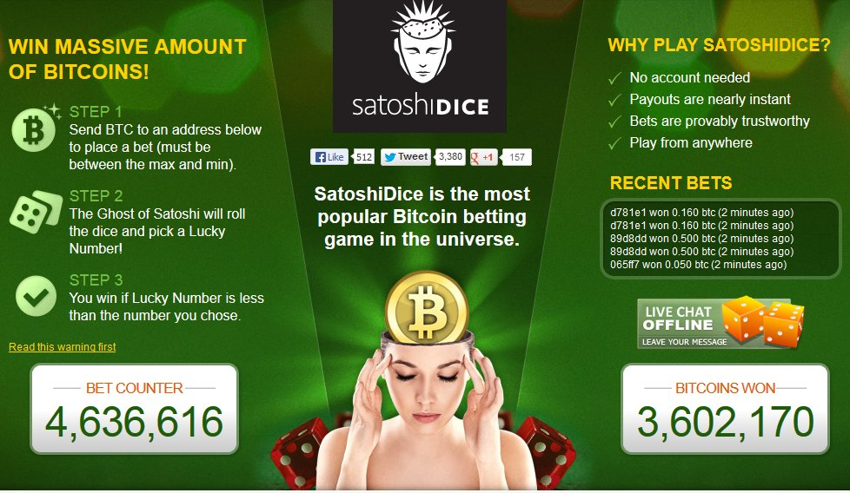

Slide 16
You send bets to many addresses (each of which has a probability associated with it. From 0.0015% chance of winning to 97% chance of winning)
Algorithm determines if you have won or not (using a random number)
If you win ,
Your reward = multiplier * your initial bet
Has led to the clogging of Bitcoin network. Almost 60 % !
Why ? Allows users to place very small bets 0.01 B
Company made over $500,000 in their first eight months

Slide 17
Just-Dice - competitor
off-block chain betting ?

