Slide 1

Vim
Mangala Gowri Krishnamoorthy, Kamran Nagiyev, Cleoniki Kesidis
[Image src : www.vim.org]

Slide 2
History of Vim
Vi IMitation, Vi IMprovement
Developed 1988, released 1991 by Bram Moolenaar on Amiga(a family of PCs)
Initially was just an extension of vi. But evolved into a separate entity
Most recent update (7) in 2006
Minor update 2010
Notes:
- Explains many unusual architectural aspects.
-It was never meant to be a separate application.
-So new features were just added on top of existing framework

Slide 3
Design Goals
vi compatible
Intentions
portable
maintainable
customizable
extensible
understandable
fast and small
consistent over many platforms
Notes:
- will discuss if it achieved those design goals in our opinions
- simple GUI as designers wanted portability

Slide 4
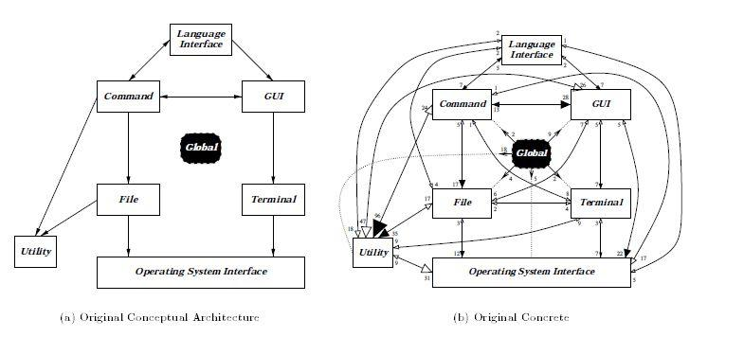
Existing Context: Vim as Repository Architecture
Source [6]
Notes:
- not following intended arch
- black arrows permitted, white arrows not
- everything depends on global (the repo in repo style)
- open source, old, starting to decay

Slide 5


Architectural Decay?
Notes:
- huge miscellaneous files
- saved from arch decay by repo style?
- mostly indep subsystems oriented around one global structure
- one author showed that it would be possible to create true repo style if split up misc1&2 and moved many files to global
- the functions do "fit elsewhere"

Slide 6
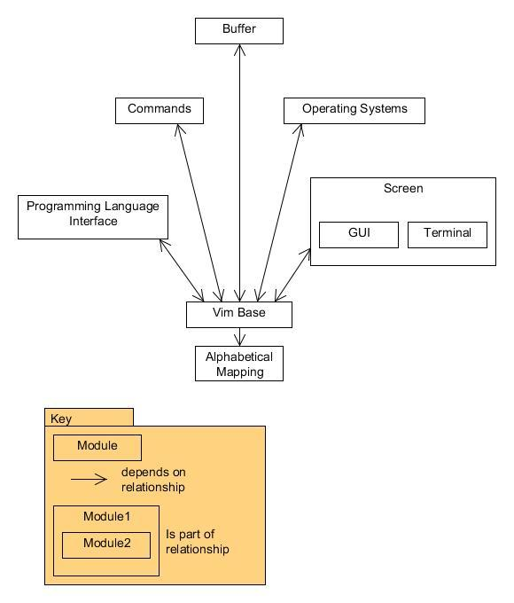
Module View
Notes:
- all depend on and are depended on by base
- base: main.c, vim.h, vimio.h, misc1&2, etc
- broken up based on file names, reading comments, README.txt in src folder
- dependency = #include
- almost every class #include vim.h, vim.h #include almost everything

Slide 7
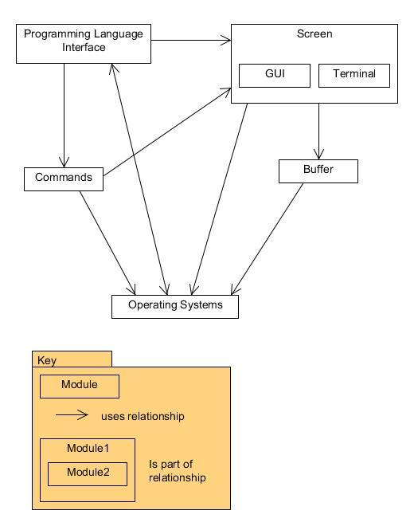
Uses View
Notes:
- vim base uses everything (main.c) and everything uses it (misc1&2)
- alphabetical mapping only used by vim base, uses nothing
- found using text searches of files to see what function they called in other files

Slide 8
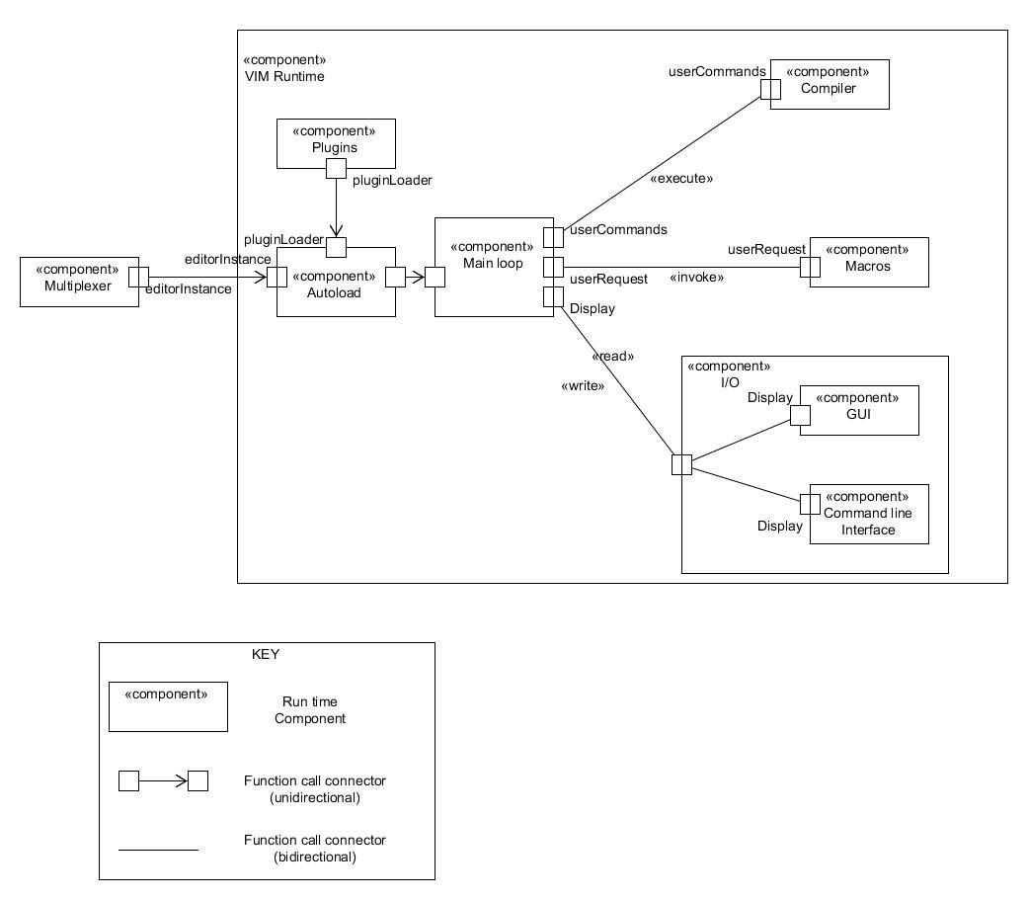
Components and Connectors
Notes:
- Connectors are procedure calls(read, execute etc.)
- Control is transferred to the component being called, and this component remains in control until its work has ended.

Slide 9
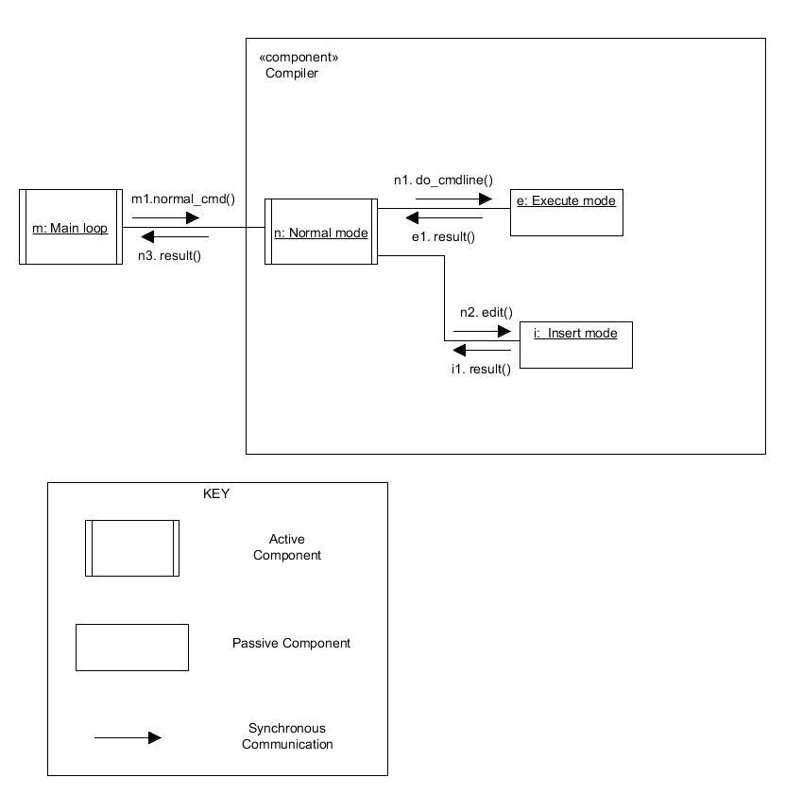
Concurrent Communication Diagram
Notes:
- component communication can be modeled using concurrent communication diagrams.
-A concurrent communication diagram depicts primarily active components
- An active component has its own thread of control and executes concurrently with other objects.
- A passive component executes only when another object

Slide 10
Overall Architecture
Repository?
Model-view-controller?
Pipe and filters?
Notes:
- repo, like existing context source
- mvc, many graphical editors, said in some sources
- pipe and filters, like Bash

Slide 11
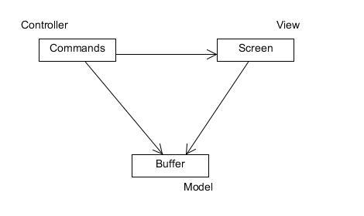
Model-View-Controller?
Notes:
- various definitions
- vim fits some
- our command not use buffer, control through screen
- messy because of base classes
- all modules depend on each other through vim base
- could be redesigned as mvc
- main.c to controller
- split up vim.h, misc1&2, etc.

Slide 12
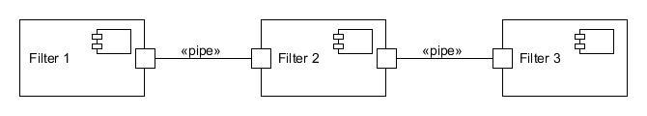
Pipe and Filters?
ordered sequence of pipes and filters
Vim is customizable
no set order

Slide 13
Repository Style?
centers on the file (buffer) being edited
edit through Buffer module or indirectly through Screen
all #include Vim Base
Notes:
- #include base for convenience or to access buffer (include vim.h, use vim.h to access Buffer)
- eroded over time to not have a perfect arch of any of these
- age, many developers, perhaps not a strong arch pattern at beginning
- repo most forgiving style = our choice

Slide 14
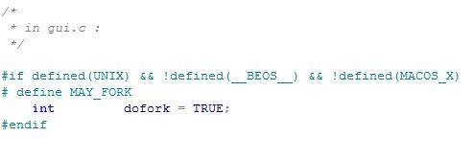
Scattered Operating System Concern
Notes:
- in os module: classes to interface with each os
- almost every module has checks for what os
- very difficult to add another os
- difficult to fix: would have to increase size of os, possibly change Vim functionality
- despite the fact that Vim said it should be consistent across platforms, in actuality has many features allowed only on certain os

Slide 15
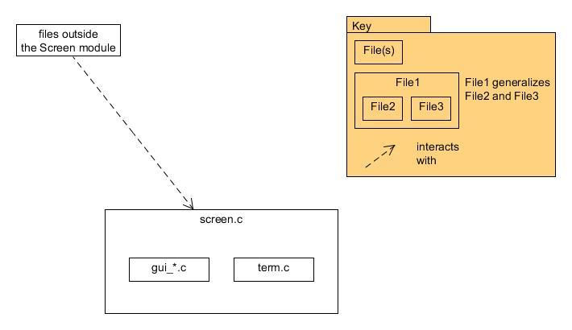
Generalization Style in Screen
Notes:
- screen.c has methods for things guis and terminal would do
- within screen.c determine if gui or terminal
- command module can access screen.c and not worry about implementation
- info hiding, present interface, decrease coupling
- prevent screen from being scattered concern

Slide 16
Quality Attributes
portability
extensibility
understandability/maintainability
Notes:
- portability - good - os, prog langs
- extensibility - worse - difficult to add os b/c scattered
-> portable currently but couldn't add more
- understandability - poor - non-standard comments, some files changed 'beyond recognition' of original authors

Slide 17
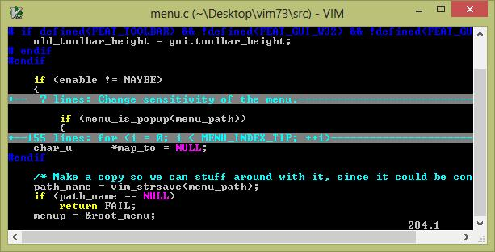
Folding
Convenient to temporarily hide parts of your file
Functions as filter between buffer and the screen

Slide 18
Conformance Checking
Understand for C
Java program to read exported csv for uses view
Java program to search source for module view

Slide 19
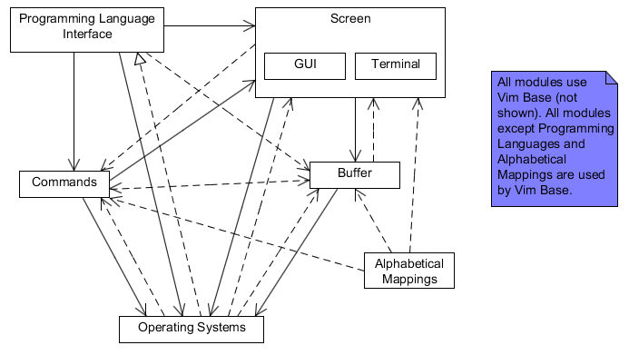
Uses Reflection Model
Notes:
solid arrows - convergence
dashed arrows - divergence
dashed arrows with closed head - absence

Slide 20
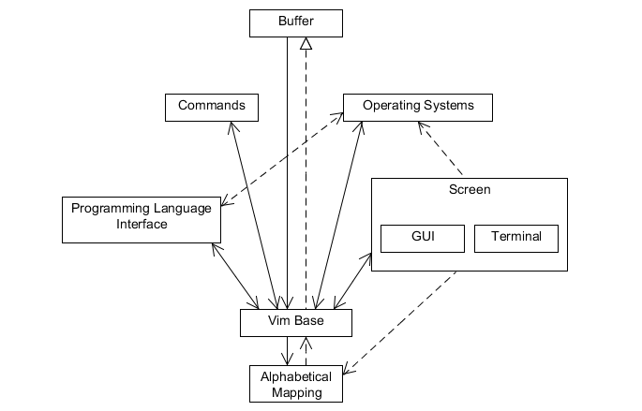
Module Reflection Model
Notes:
same key for the arrows

Slide 21
References
[1] H. Dayani-Fard, Y. Yu, J. Mylopoulos, and P. Andritsos. Improving the build architecture of legacy C/C++ software systems. 8th International Conference on Fundamental Approaches to Software Engineering (FASE), 04-08, April 2005 http://oro.open.ac.uk/24311/1/dayani-fard05fase.pdf
[2] M. W. Godfrey and E. H. S. Lee. Secrets from the Monster: Extracting Mozilla’s Software Architecture. The Second International Symposium on Constructing Software Engineering Tools, 15-23, June 2000 http://cpath.csi.muohio.edu/omeka/archive/files/a562e12fab321e2177dc44c5220e9336.pdf#page=15
[3] M Godfrey and Q Tu. Growth, Evolution, and Structural Change in Open Source Software. Proceedings of the 4th International Workshop on Principles of Software Evolution, 103-106, 2001. http://flosshub.org/system/files/tu2001.pdf
[4] B. Moolenaar. Vim Reference Manual. http://vimdoc.sourceforge.net/htmldoc/develop.html
[5] R. Paul. Two decades of productivity: Vim's 20th anniversary.
http://arstechnica.com/information-technology/2011/11/two-decades-of-productivity-vims-20th-anniversary/
[6] J. B. Tran, M. W. Godfrey, E. H. S. Lee, and R. C. Holt. Architecture Analysis and Repair of Open Source Software. 2000.
[7] University of Toronto. Tutorial II Vim Editor. CSC408H1F/CSC2105H1F Software Engineering, 2004-2005. http://www.cs.toronto.edu/~yijun/csc408h/handouts/tutorial2.pdf
[8] Vim’s web site. www.vim.org
[9] Hayco de Jong and Taeke Kooiker. My Favorite Editor Anywhere. CWI, Department of Software Engineering. oai.cwi.nl/oai/asset/11023/11023D.pdf

