Slide 1
CS 626 (Natural Language Processing)

Slide 2
Hidden Markov Model(viterbi)
A repositry is created based on the given training data
The repositry stores the observation table, transition table and corresponding probabilities
For given sentence, viterbi algorithm is used to find the best possible sequence
If the word is not present in the repository, X (no tag) is given to the word of the sentence.

Slide 3
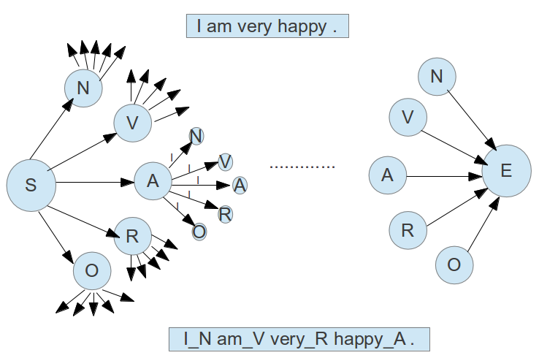
Viterbi Example

Slide 4
Observation
For 5 different dataset following results are obtained-
 | Precision | Recall | F value
Dataset 1 | 0.902314 | 0.685547 | 0.779134
Dataset 2 | 0.923387 | 0.792388 | 0.852886
Dataset 3 | 0.93099 | 0.716216 | 0.809602
Dataset 4 | 0.92840 | 0.822425 | 0.872209
Dataset 5 | 0.924008 | 0.792388 | 0.853151

Slide 5
Overall Accuracy
overall (N): 0.959376
overall (V): 0.879822
overall (A): 0.802856
overall (R): 0.616854
overall (O): 0.954762
overall: 0.921822

Slide 6
Confusion Matrix
Confusion Matrix for Dataset 1
 | N | V | A | R | O
N | 383 | 2 | 0 | 0 | 21
V | 23 | 265 | 1 | 0 | 6
A | 11 | 0 | 50 | 0 | 7
R | 5 | 0 | 1 | 53 | 33
O | 75 | 2 | 0 | 3 | 1004

Slide 7
Confusion Matrix
Confusion Matrix for Dataset 2
 | N | V | A | R | O
N | 428 | 2 | 3 | 0 | 11
V | 16 | 184 | 0 | 0 | 17
A | 3 | 3 | 54 | 0 | 7
R | 2 | 0 | 2 | 47 | 21
O | 21 | 5 | 1 | 0 | 661

Slide 8
Confusion Matrix
Confusion Matrix for Dataset 3
 | N | V | A | R | O
N | 351 | 2 | 1 | 0 | 10
V | 12 | 231 | 0 | 0 | 4
A | 3 | 2 | 47 | 1 | 2
R | 7 | 0 | 1 | 45 | 29
O | 31 | 1 | 2 | 2 | 810

Slide 9
Confusion Matrix
Confusion Matrix for Dataset 4
 | N | V | A | R | O
N | 497 | 0 | 0 | 0 | 20
V | 9 | 227 | 3 | 0 | 22
A | 6 | 1 | 78 | 0 | 11
R | 4 | 0 | 4 | 51 | 19
O | 18 | 8 | 0 | 0 | 768

Slide 10
Confusion Matrix
Confusion Matrix for Dataset 5
 | N | V | A | R | O
N | 428 | 2 | 3 | 0 | 11
V | 16 | 184 | 0 | 0 | 17
A | 3 | 3 | 54 | 0 | 7
R | 2 | 0 | 2 | 47 | 21
O | 20 | 5 | 1 | 0 | 661

Slide 11
BNC Dataset

Slide 12
Cleaning of BNC Dataset
BNC dataset contains all sentences in one line
The line is divided into sentences based on punctuation marks (., !, ?)
Code is written in clean_bnc.cpp (compiled to bnc when make is run)
The files are copied to *_CLEAN folder

Slide 13
Hidden Markov Model(viterbi)
A repositry is created based on the given data.
The repositry stores the observation table, transition table and corresponding probabilities.
For given sentence, viterbi algorithm is used to find the best possible sequence
Smoothing: If the word is not present in the repository, NOTAG is given to the word of the sentence.

Slide 14
Viterbi Example
They knew the limits .
PNP
PNP
VVD
VVD
I
.............
E
S
AT0
I
AT0
I
I
I
NN2
NN2
PUN
PUN
PNP_They VVD_knew AT0_the NN2_limits PUN_.

Slide 15
Composite Tag Handling
  Counts for both the tags are increased in the case of composite tags. For example-
    VVB_couple PRP-AVP_in AT0_the
  In transition table, counts for (VVB, PRP) and (VVB, AVP) are incremented
  In observation table, counts for (PRP, in) and (AVP, in) are incremented

Slide 16
Experiments
BNC dataset has many files
The files are divided in 2 groups by choosing files such that number of files in groups is in the ratio of 80:20 for training and testing respectively
This is done 5 times. All the files are considered for testing in one or the other dataset but exactly once

Slide 17
Observation (no merging)
For 5 different dataset following results are obtained-
 | Precision | Recall | F value
Dataset 1 | 0.614875 | 0.592801 | 0.603636
Dataset 2 | 0.673897 | 0.641724 | 0.657417
Dataset 3 | 0.626311 | 0.606999 | 0.616504
Dataset 4 | 0.646175 | 0.611554 | 0.628388
Dataset 5 | 0.582811 | 0.561997 | 0.572215

Slide 18
Observation (merging)
TO and IN tags are considered to be same. Results are as follows-
 | Precision | Recall | F value
Dataset 1 | 0.607761 | 0.585943 | 0.596652
Dataset 2 | 0.667482 | 0.635614 | 0.651158
Dataset 3 | 0.620145 | 0.601023 | 0.610435
Dataset 4 | 0.640408 | 0.606095 | 0.622779
Dataset 5 | 0.577028 | 0.556421 | 0.566537

Slide 19
Thank You

