Slide 1
Steganography
“Art of hiding messages”
Instructor:
Varsha Apte
Project by:
Aman Mangal
Sanket Totala

Slide 2
What is Steganography?
“Steganography is the art and science of writing hidden messages in such a way that no one, apart from the sender and intended recipient, suspects the existence of the message, a form of security through obscurity.”
-Wiki
Text and images can be hidden in cover images.
The hidden message can be retrieved by the recipient using a secret password shared between them.

Slide 3
What is accomplished
Text message can be hidden in a image with non-lossy compression.
A small image can be hidden in a larger image with non-lossy compression.
Huffman encoding is done to improve the payload.
Standard LSB insertion algorithm is used.
Password is used to secure the message.
There is no change in the size of the cover image.
The change in the image cannot be detected by a normal human eye.

Slide 4
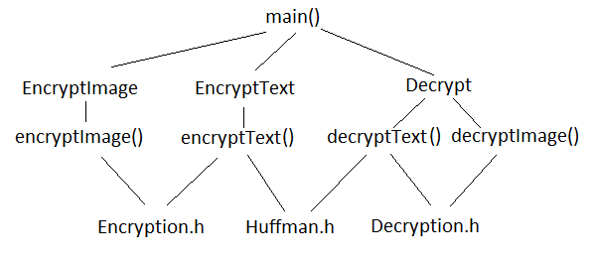
Structure of code

Slide 5
Huffman Compression
The number of characters that could be stored on an image is approximately (no_of_pixels/8).
Huffman Compression on an average compresses the file by 70% (by test cases).
Thus the payload increases by 1.43.

Slide 6
Image file size
The number of pixels of cover image required to store a pixel of hidden image is 24.
Therefore, given an cover image of h*w, we can hide an image of (h/5)*(w/5) in the cover image.

Slide 7

Sample input

Slide 8

Sample Output of Encrypted Image

Slide 9
Protection level
Invisibility-high
Only LSB is changed.
Only half the bits are changed.
Payload capacity-high
Huffman encoding is done to improve the payload.
Robustness against statistical attacks-high
Randomization makes the robustness higher.
Robustness against image manipulation-low
Modification in image can change the encrypted data.
Independent of file format-high
Support to multiple formats.
Eg: bmp, png, tiff, dib, etc.
Unsuspicious files-high
Size of the cover image is unchanged after encryption.

Slide 10
Packages and Data Structures
Packages
OpenCV
CodeBlocks IDE
Data Structures
Priority queue
List
Vector

Slide 11
Work Distribution
Aman
Encryption class
EncryptText
EncryptImage
Main()
Sanket
Decryption class
Decrypt class
Huffman class
50%-50%

Slide 12
Bibliography
Wikipedia
OpenCV wiki
Google

