Slide 1
Content Addressable Network
Submitted to: Dr. P. Sateesh Kumar

Slide 2
Introduction
The paper introduces the concept of a Content-Addressable Network (CAN) as a distributed
infrastructure that provides hash table-like functionality on Internet scales. The CAN is scalable, fault-tolerant and completely self-organizing.

Slide 3
Need for CAN
Internet systems that could potentially be improved by a CAN are peer-to-peer file sharing systems such as Napster and Gnutella .
Napster uses a peer-to-peer communication model for the actual file transfer, the process of locating a file is still centralized.
Gnutella floods network with request for a file, and flooding needs to be curtailed at some point of time, so it may fail to find content that is actually in the network.

Slide 4
Design
CANs resemble a hash table, the basic operations performed on a CAN are the insertion, lookup and deletion of (key,value) pairs.
CAN is composed of many individual nodes. Each CAN node stores a chunk (called a zone) of the entire hash table. In addition, a node holds information about a small number of “adjacent” zones in the table.
Requests (insert,lookup, or delete) for a particular key are routed by intermediate CAN nodes towards the CAN node whose zone contains that key.

Slide 5
Design
Design centers around a virtual d-dimensional Cartesian coordinate space on a d-torus(logical space).
This virtual coordinate space is used to store (key,value) pairs as follows: to store a pair (K1,V1), key K1 is deterministically mapped onto a point P in the coordinate space using a uniform hash function.
The corresponding (key,value) pair is then stored at the node that owns the zone within which the point P lies.
To retrieve the request must be routed through the CAN infrastructure until it reaches the node in whose zone P lies.

Slide 6
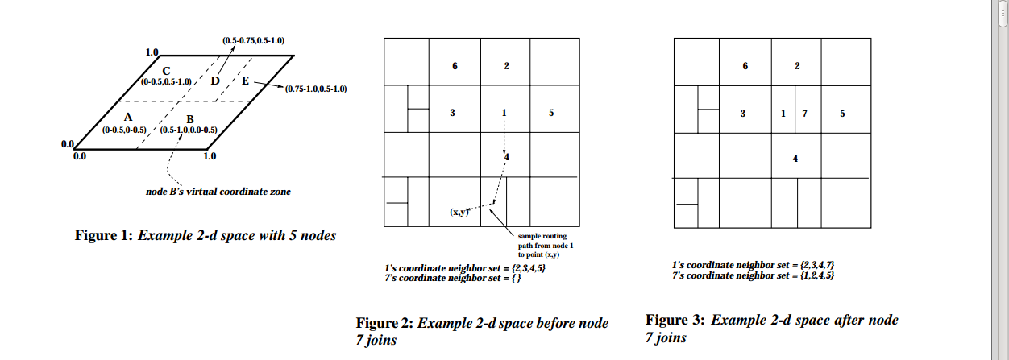
Design of Logical space

Slide 7
Construction
The entire CAN space is divided amongst the nodes currently in the system. A new node that joins the system must be allocated its own portion of the coordinate space.
Having obtained its zone, the new node learns the IP addresses of its coordinate neighbor set from the previous occupant. Finally, both the new and old nodes’ neighbors must be informed of this reallocation of space.
When nodes leave a CAN, we need to ensure that the zones they occupied are taken over by the remaining nodes. It is done explicitly by handing over its zone and the associated (key,value) database to one of its neighbors.

Slide 8
Routing
A CAN node maintains a coordinate routing table that holds the IP address and virtual coordinate zone of each of its immediate neighbors in the coordinate space. Two nodes are neighbors if their coordinate spans overlap.
Using its neighbor coordinate set, a node routes a message towards its destination by simple greedy forwarding to the neighbor with coordinates closest to the destination coordinates.
Different paths exist between two points in the space and so, even if one or more of a node’s neighbors were to crash, a node can automatically route along the next best available path. If a node loses all its neighbors in a certain direction then greedy forwarding may temporarily fail.

Slide 9
Conclusions
CAN provide a completely distributed infrastructure for P2P network, where indexing of file is also distributed.
CAN are scalable as they only maintain information about neighbouring nodes and each nodes contain information about neighbouring nodes.
CAN are fault tolerant as there exist multiple path from one node to destination node, despite one path failure it is able to route through the other path.
CAN are self-organising as the network splits in new zones on entry of new pear or merge multiple zones upon leaving of a node.

Slide 10
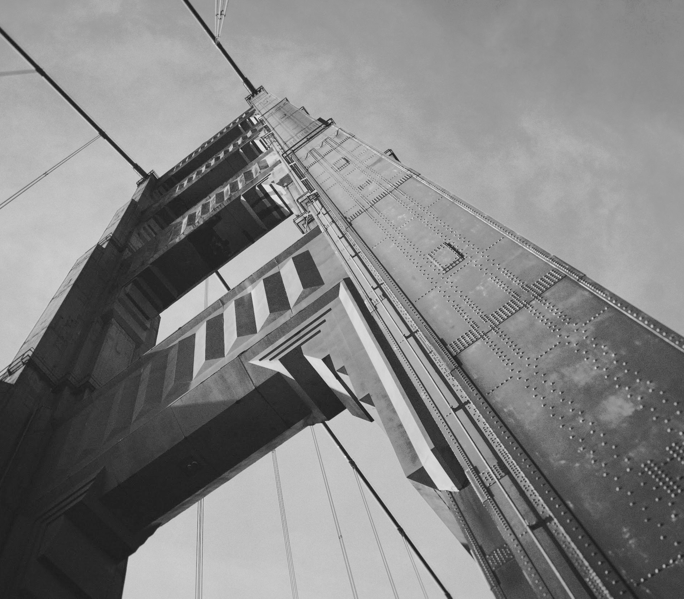
Thanks!
Aashutosh(15114001)
Abhishek Sharma(15114003)
Akshat Bhardwaj(15114005)
Sandeep Pal(15114063)
Utsav Mangal(15114075)

