Slide 1


FOREST FIRE RECOGNITION USING CNN
Presented by- Mangasamudram Sruthi
Student ID - MST03-0065
Guided by- Urooj Khan

Slide 2
WHAT IS FOREST FIRE RECOGNITION??
Forest fire recognition using convolutional neural networks (CNN) is a method that uses CNNs to automatically detect forest fires in images. CNNs are primarily used for image classification, and can identify important features to recognize objects in images. The goal of this method is to verify if a forest fire is visible in a picture.

Slide 3

WHAT IS CNN??
A Convolution Neural Networks(CNN) is a type of Deep learning algorithm that is particularly well-suited for image recognition and processing tasks. It is made up of multiple layers, including convolutional layers, pooling layers, and fully connected layers. The architecture of CNNs is inspired by the visual processing in the human brain, and they are well-suited for capturing hierarchical patterns and spatial dependencies within images.

Slide 4
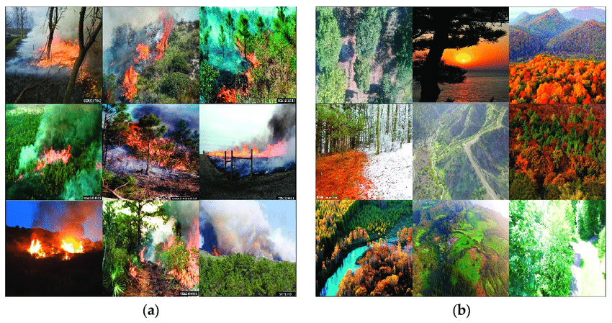
WHAT IS FOREST FIRE DATASET?
The dataset is designed for binary problem of Fire and No-Fire detection in the forests landscape
All images in the dataset are 3-channeled with resolution of 250 × 250.
The images were retrieved by searching various search terms in multiple search engines.

Slide 5
PREPARATION OF DATA-NORMALIZATION MAGIC :
Understanding the Dataset
Exploring the Data
Choosing the Normalization Method
Applying and verifying the results.

Slide 6

Prepare and preprocess the data, including resizing images to a uniform size, normalizing pixel values, and applying data augmentation techniques to enhance the dataset.
Design the CNN architecture with convolutional layers to extract features, pooling layers for down-sampling, and activation functions like ReLU. Include fully connected layers at the end for classification.
BUILDING
CNN
Compile the model by choosing a suitable loss function, an optimizer, and evaluation metrics .
Train the CNN on the training dataset, using a portion of the data for validation. Set parameters like epochs and batch size, and use data augmentation to prevent overfitting.
Evaluate the model.

Slide 7
REFINING THE MODEL-MONITORING PROGRESS AND EVALUATION :
Training and Validation Curves: We plot the training and validation loss/accuracy curves to track the model's progress.
Accuracy: We calculate the accuracy on the test set after training to assess the model's generalization ability on completely new data.

Slide 8
CONCLUSION
The custom CNN model designed for the forest fire classification task achieved high accuracy and performed well in distinguishing between fire and non-fire images. The use of convolutional layers allowed the model to effectively extract features from the images, leading to accurate classifications. Future improvements could include experimenting with different CNN architectures, adding more data augmentation techniques, or incorporating additional training data to further enhance the model's performance and generalization capability.

Slide 9
THANK YOU

