Slide 1

Pneumonia Detection by Chest X-Ray Images
Sibel Tanoglu
Notes:
Welcome to my capstone presentation which is about Pneumonia Detection by Chest X-ray Images.

Slide 2
Problem Statement
Goal
Pneumonia is an inflammatory condition of the lung affecting primarily the small air sacs known as alveoli caused by infection with viruses or bacteria.
Diagnosed by symptoms, physical examination, chest X-ray, blood tests.
Severity is variable especially in developing countries.
Early stage diagnosis is very crucial.
A robust convolutional neural network that will be trained with thousands of labeled chest X-ray images to provide fast and accurate diagnosis for the benefit of both patients and health professionals.
Notes:
What is pneumonia? It’s an inflammatory condition of the lung affecting primarily the small air sacs known as alveoli caused by infection with viruses or bacteria. Often diagnosed by symptoms, physical examination, chest X-ray, blood tests. Severity is variable especially in developing countries where people can’t have access to immediate medicare even though early stage diagnoses is very crucial. Especially for children and elderly people. My goal is to construct a robust convolutional neural network that will be trained with thousands of labeled chest X-ray images to provide fast and accurate diagnosis for the benefit of both patients and health professionals.

Slide 3
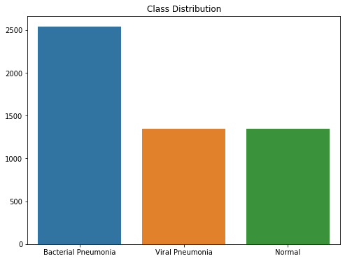
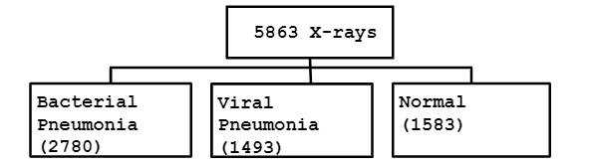
Data
Collected from Mendeley public datasets repository
Labeled Optical Coherence Tomography (OCT) and Chest X-Ray Images for Classification
Pediatric patients of one to five years old from Women and Children’s Medical Center, Guangzhou.
Notes:
I collected the data from Mendeley public datasets repository that consists of X-ray images of pediatric patients of one to five years old. There are 5863 images annotated as 3 classes: Bacterial Pneumonia, Viral Pneumonia, and Normal. Here is the class distribution chart which is slightly imbalanced. It’s a good thing that bacterial pneumonia has the largest sample size because it is the more catastrophic version of the disease.

Slide 4
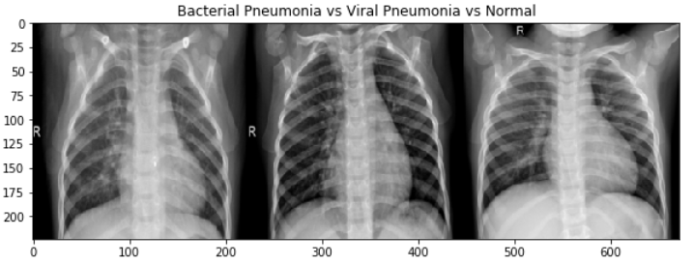
X-rays Visualization
Images are almost indifferentiable for non-experts
Pneumonia positive images seem to be slightly more faint due to soft tissue (water) around the lungs
Black: Air
Dark Grey: Fat
Light Grey: Soft tissue
Off white: Bone
Bright white: Metal
Notes:
Here is a side by side image plot from all three classes. First one is bacterial, second is viral, and third is normal. I found them indifferentiable as a non-expert. However, overall pneumonia positive images seem to be slightly fainter due to soft tissue around the lungs.

Slide 5
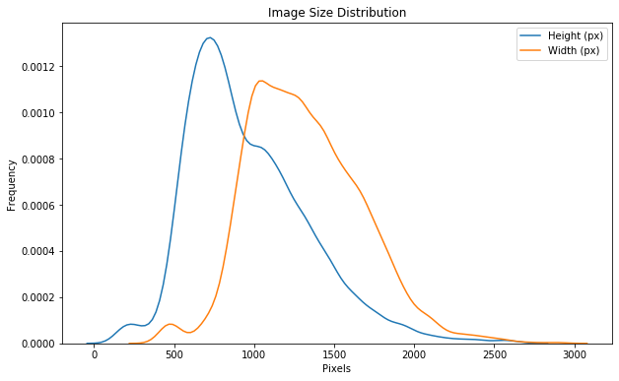
Image Size Distribution (px)
Most images are at least 256 × 256 pixels and RGB color channels
Smaller and grayscale images are removed from analysis
Downsized all images to 256x256x3 tensor
Multiplied channels by 1./255
Notes:
I checked the overall image sizes with distribution chart and most images are at least 256x256 pixels and RGB color channels. Smaller and grayscale images are later removed from analysis. During training process, all images were downsized to 256x256 and color channels were divided by 225 to combat extremely high output values.

Slide 6
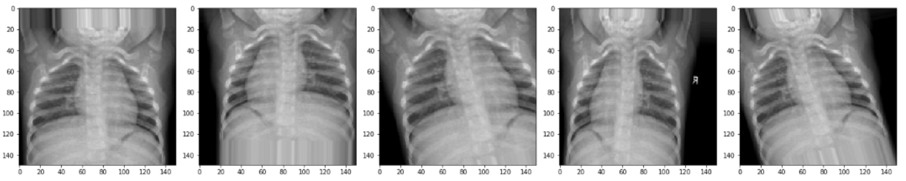
Data Augmentation
Problem: A lot of variations for such a small dataset (angle, opaqueness, body position, zooming etc) Solution: Image Data generator rotation_range=20, width_shift_range=0.1, height_shift_range=0.1, shear_range=0.1, zoom_range=0.2, horizontal_flip=True, fill_mode='nearest’ Different versions of same image:
Notes:
I looked at the data and noticed there is a lot of variations for such a small dataset in angle, opaqueness, body position, zooming and so on. So I used ImageDataGenerator method from Keras library to artificially increase the sample size. Generator passes a slightly different version of same image to every epoch based on parameter values provided. Here is a plot of different versions of same image.

Slide 7

Modeling
Notes:
Here comes the deep learning…

Slide 8
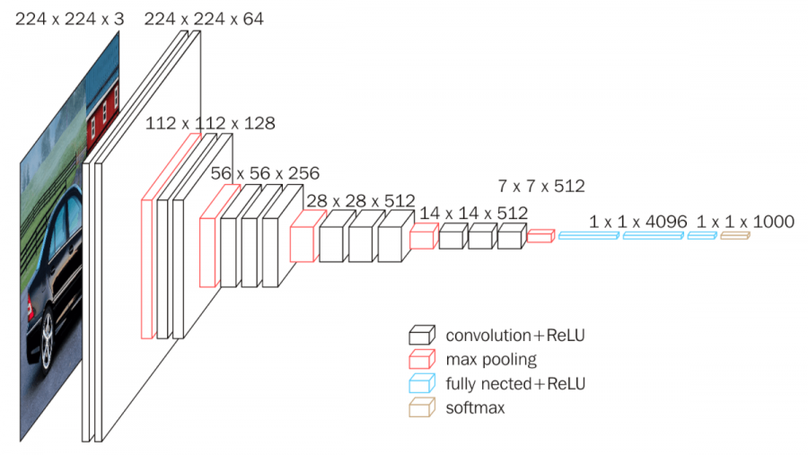
VGG16 (Transfer Learning)
ImageNet weights used only in first 2 layers (first few layers capture general details)
Binary classification (P/N)
Acc = 90.4%
Val Acc = 88.5%
Notes:
Before constructing a model most suitable for my data, I experimented transfer learning with VGG16 pre-trained model from ImageNet competition. This is rated as the best performing model that predicts 1000 classes from large dataset. I used the pre-trained weights only in first 2 convolutional layers since first few layers capture the general details like color blobs, patches and edges. Used it as a binary classification model with 25 epochs and reached to 91% validation accuracy.

Slide 9
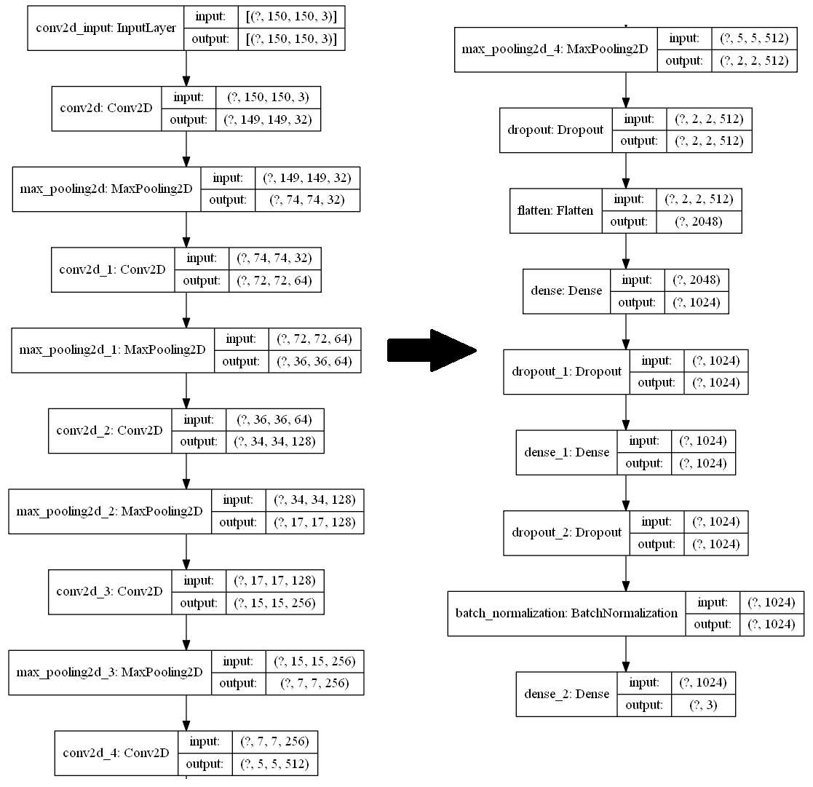

Final CNN
Notes:
After numerous optimizations, I came up with a custom convolutional neural network. Convolutional layers shrink the image size using a filter while maintaining the features. For example, in a picture of cat, it detects the eyes or ears as features and transfers to the next layer. I used 4 convolutional layers have 256x256x3 image size which was down-sampled to 16x16x3 pixels (neurons) so I could get away with small number of neurons in dense layers. Next is a flattening layer which is required by following 2 dense layers. I added high dropout rate after every dense layer to prevent overfitting and finally batch normalization to scale the activation so that no activation goes very high or very low. A simple example what normalization helps with.. If our model was trained with only black cats, it would still perform well predicting colored cats. And finally output layer with 3 classes with softmax activation.

Slide 10
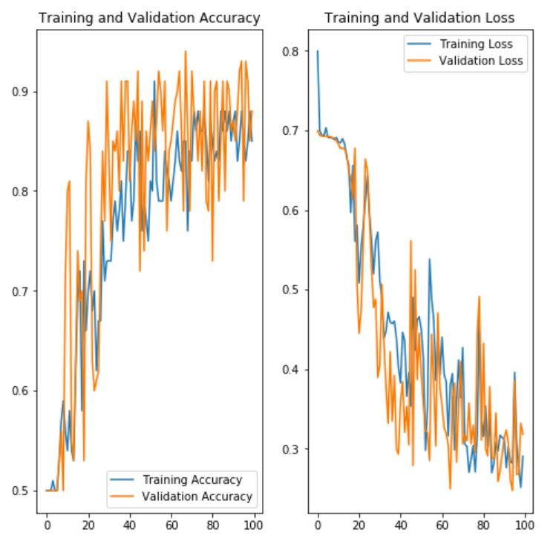
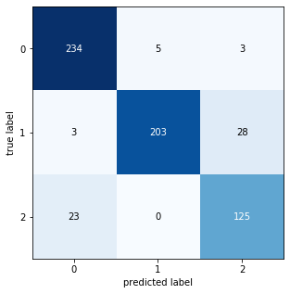
Model Evaluation
Accuracy = 92.4 %
Val Accuracy = 90.1 %
Confusion Matrix
0 = Bacteria 1 = Normal
2 = Virus
Notes:
I have been training my network for the last 3 days. This is a snapshot after second iteration of 100 epochs when it gradually reached 90% validation accuracy. The graphs shows a time series where there are sharp fluctuations through epochs due to high dropout rate. However, overall trend is upward with no overfitting. The last validation accuracy rate I got was 96% and I am planning to continue training to see if it can improve even more. And here is the confusion matrix that shows very low misclassification rate on test data.

Slide 11

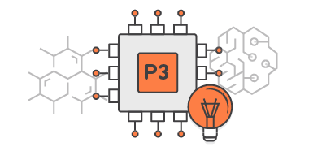
Workspace 1
AWS EC2 P3 Instance pre-configured with ML packages
Windows Server 2016
NVIDIA Tesla V100GPU / CUDA Runtime
64 GB RAM
100 GB HDD
Notes:
The first environment was AWS P3 instance with these specs….

Slide 12

Workspace 2
Notes:
Then I switched to google cloud because it’s free.

Slide 13
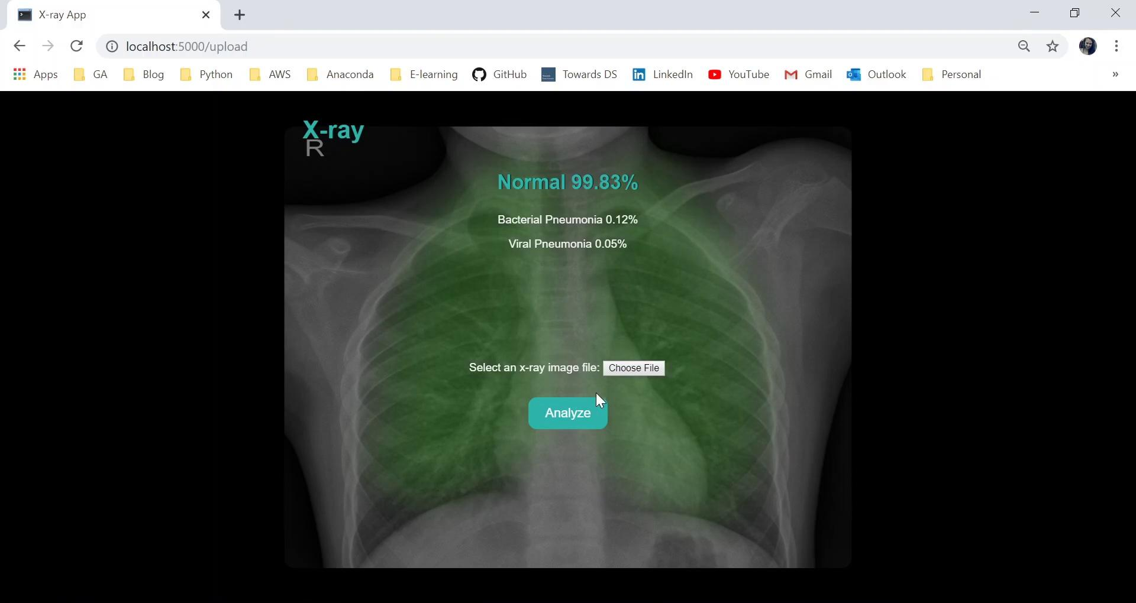
X-ray App Demo
Notes:
I created a Flask app to demonstrate my network’s performance… I will play it now.

Slide 14
Next Steps
Collecting more data.
Adding more complexity in model and using Keras gridsearch functionality.
Creating additional model with PyTorch library and compare the results.
Researching on how to detect most informative pixels on X-ray (highest weights) and emphasize (highlight) them on image.
Partnering with radiologists to classify same X-rays and compare model’s performance with professional interpretation.

Slide 15
Thank you...
Deep learning is shallow next to the depths of your greatness.
Repo: https://github.com/sibeltan/Capstone/

