Slide 1

Telco Customer Churn
Prediction
Capstone Project

Slide 2
Table Of Contents
1 . Agenda
2. Understanding the features
3. Process followed in the project
4. Deductions from EDA process
5. Illustration of plots
6. Feature Engineering
7. Model Evaluation
8. Conclusion

Slide 3
Agenda
For Telco companies it is key to attract new customers and at the same time avoid contract terminations (=churn) to grow their revenue generating base. Looking at churn, different reasons trigger customers to terminate their contracts, for example better price offers, more interesting packages, bad service experiences or change of customers’ personal situations.
Hence, This project aims at training a model that will predict churn on an customer basis .

Slide 4
Understanding the features
Classification labels
Churn — Whether the customer churned or not (Yes or No)
Customer services booked
PhoneService
MultipleLines
InternetService
OnlineSecurity
OnlineBackup
DeviceProtection
TechSupport
StreamingTV
StreamingMovies

Slide 5
Understanding the features
Customer account information
Tenure
Contract
PaperlessBilling
PaymentMethod
MonthlyCharges
TotalCharges
Customers demographic info
customerID
Gender
SeniorCitizen
Partner
Dependents
In this project , Churn has been taken as the dependent variable and all others are independent variables.

Slide 6
Process followed in the project
Step 1: Problem Definition
Step 2: Data Collection
Step 3: Exploratory Data Analysis (EDA)
Step 4: Feature Engineering
Step 5: Train/Test Split
Step 6: Model Evaluation Metrics Definition
Step 7: Model Selection, Training, Prediction and Assessment
Step 8: Hyperparameter Tuning/Model Improvement

Slide 7
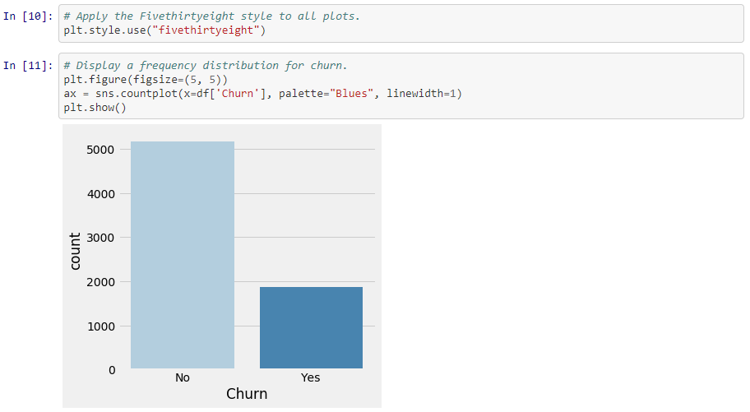
Illustration Of Plots
This Plot shows the class imbalance of the data between the churners and non-churners

Slide 8
Feature Engineering
Based on the data types and the values, following actions are defined to preprocess/engineer the features for machine readibility and further analysis:
Columns removed
Label Encoding
One-Hot Encoding
Min-Max Scaling

Slide 9
Model Evaluation
For performance assessment of the chosen models, various metrics are used:
Feature Weights
Confusion matrix
Accuracy Score
ROC curve
Precision Recall curve
F1 score

Slide 10
Model Evaluation
Several models are tested and measure their performance .These models will be optimized by tuning their hypermeters.
K Nearest Neighbors
Logistic Regression
Random Forest
Support Vector Machines
Feed Forward Neural Network(Add-On)

Slide 11
Conclusion
A basic machine learning pipeline based on a sample data set from Kaggle is build and performance of different model types is compared.
From the model results, the best accuracy on the test set is found to be neural network with 0.7946 .

Slide 12
THANK YOU
Done by,
Mangena Suswetha

