Slide 1
HOUSE PRICE PREDICTION
By:
MANGESH PATIL

Slide 2
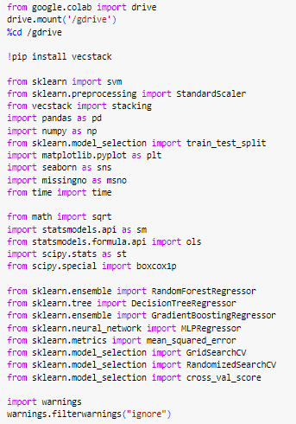
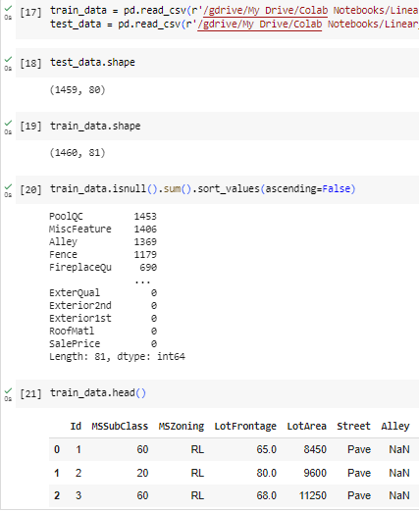
Step 1 : Importing all the required Libraries
Step 2 : Reading the data from files and Analyzing

Slide 3

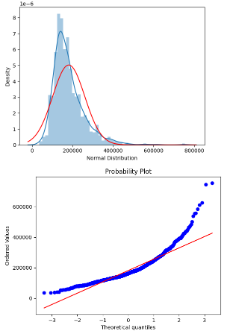
Step 3 : Combined Train & Test data
Analyzing the Target variable’s Distribution =>

Slide 4
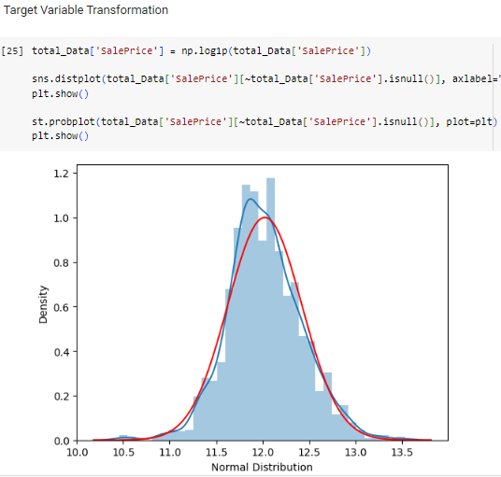
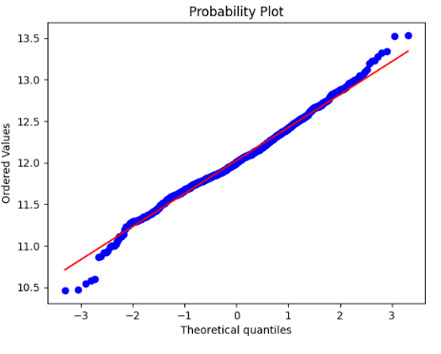
Step 4 : Target Variable Transformation

Slide 5

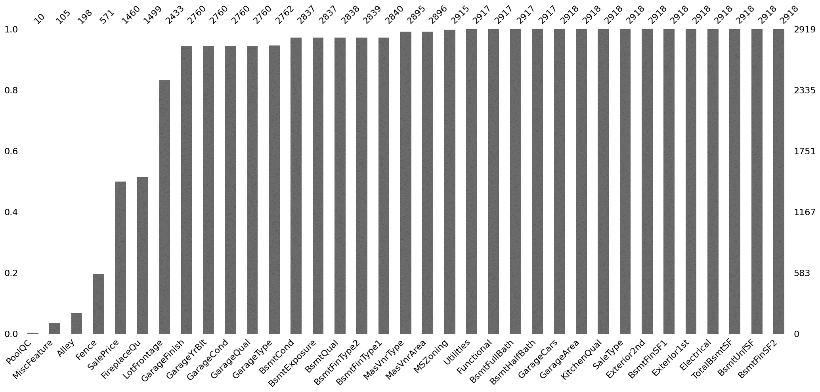
Total Missing Data after combining the train & test dataset :

Slide 6
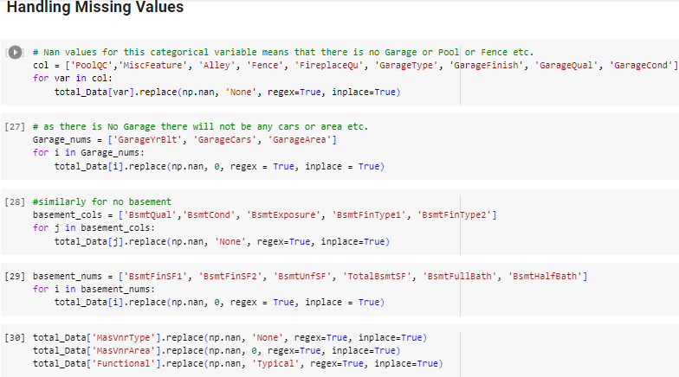
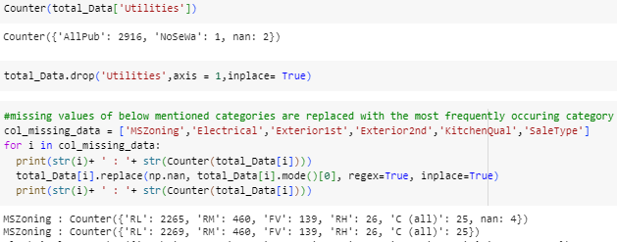
Step 5: Handling Missing Values

Slide 7
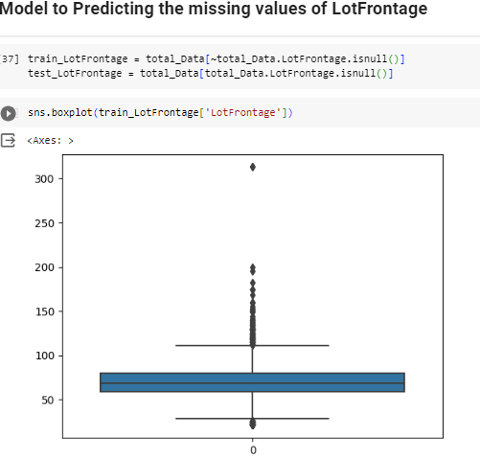
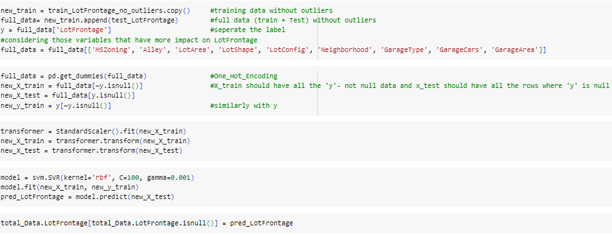

Slide 8
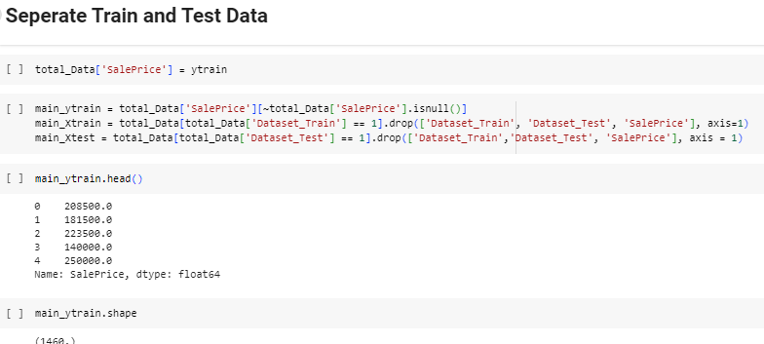
Step 6: Separating the data

Slide 9
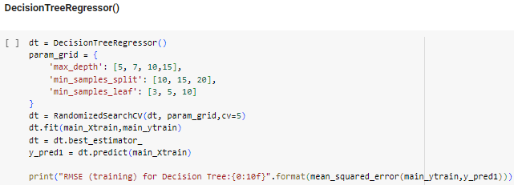
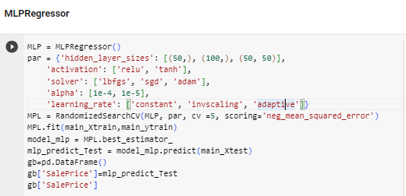
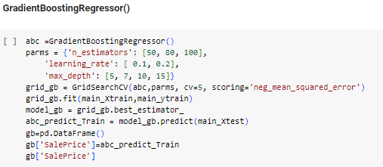
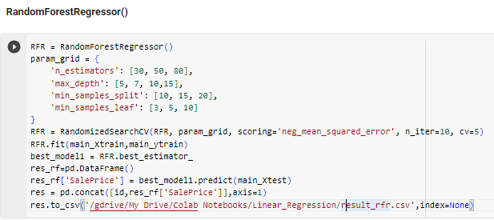
Regression Using Different Models

Slide 10
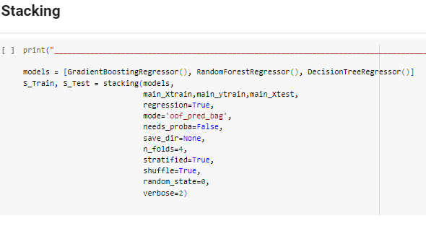
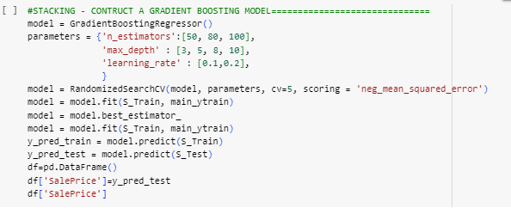

Slide 11
Results:
Hyper Tuned Model | RMSE
Stacked – Gradient Boosting Regressor | 0.13486
Gradient Boosting Regressor | 0.1305
Random Forest Regressor | 0.1506
Decision Tree Regressor | 0.18611
MLP Regressor | 0.38116
Best Model
In this Assignment we are performing the Regression which is different from previous assignments

Slide 12

Thank You!!

