Slide 1
Project Presentation AdventureHub -Outdoor Activity Discovery & Management System Presented By: Mangesh Dete Tejas Shinkar Gaurav Varade Rupesh Bhure

Slide 2
Overview
Introduction
Problem Statement
Objectives
Stakeholders & Target Users
System Architecture & Use Case Diagrams
Architecture
Use Case Diagrams
Technology Stack
Future Enhancements

Slide 3
Introduction
Lack of a centralized system for discovering and managing outdoor activities.
Tourists rely on outdated resources.
Organizers struggle to manage and promote events efficiently.
AdventureHub bridges this gap with a web-based solution.

Slide 4
Problem Statement
There is no centralized platform for discovering and managing outdoor activities. Tourists struggle to find reliable adventure options, while organizers face challenges in promoting and managing events. The lack of a seamless booking, cancellation, and notification system creates inconvenience for both users and event hosts.
AdventureHub solves this by providing a web-based platform that connects adventure seekers with event organizers, ensuring easy discovery, booking, and management of outdoor activities.

Slide 5
Objectives
Seamless Event Discovery & Registration – Allow users to search, filter, and register for activities effortlessly. Enable organizers to add, update, and manage their activities.
Organizer Management System – Enable organizers to create, update, and manage their events, participant lists, and schedules.
Tourism Engagement – Help boost adventure tourism by connecting tourists with local activity providers.
Verified Information & Notifications – Provide trusted details, event updates, and instant notifications for bookings and changes.

Slide 6
Stakeholders & Target Users
1. Customer (Tourists & Locals)
Search and register for outdoor activities.
Receive updates and notifications for events.
Provide feedback and ratings for activities.
2. Organizer
Create, publish, and manage adventure events.
Track participant registrations and communicate updates.
Handle event cancellations and refunds.
3. Admin
Oversee platform operations and ensure smooth functioning.
Manage user accounts (customers and organizers).
Monitor transactions, generate reports, and resolve disputes.

Slide 7
System Features & Functional Modules
A. Customer Module
Register/Login.
Search events by location, type, and date.
Book, cancel, and reschedule activities.
Receive updates & notifications.
View and submit reviews.

Slide 8
B. Organizer Module
Register/Login.
Create & manage adventure events.
Track registrations & send notifications.
Process cancellations and refunds.
C. Admin Module
Manage users & organizers.
Monitor system activities & generate reports.
Handle disputes & security monitoring.

Slide 9
Architecture
Used for
User interfacing
Basic data validation
Used for
Server-Side validations
Response handling
Business logic
Database operations
Front-end Layer
Used for
Permanent data storage
Database level validations
Database access using
Spring Boot and Dot Net
Discovery
Server
Auth Service
API
Gateway
Organiser
Service
Database Layer
Technologies used
HTML, CSS
JavaScript
ReactJS
Json
Technologies used
Spring Boot
Dot Net
Customer
Service
Technologies used
MySQL
Admin
Service

Slide 10
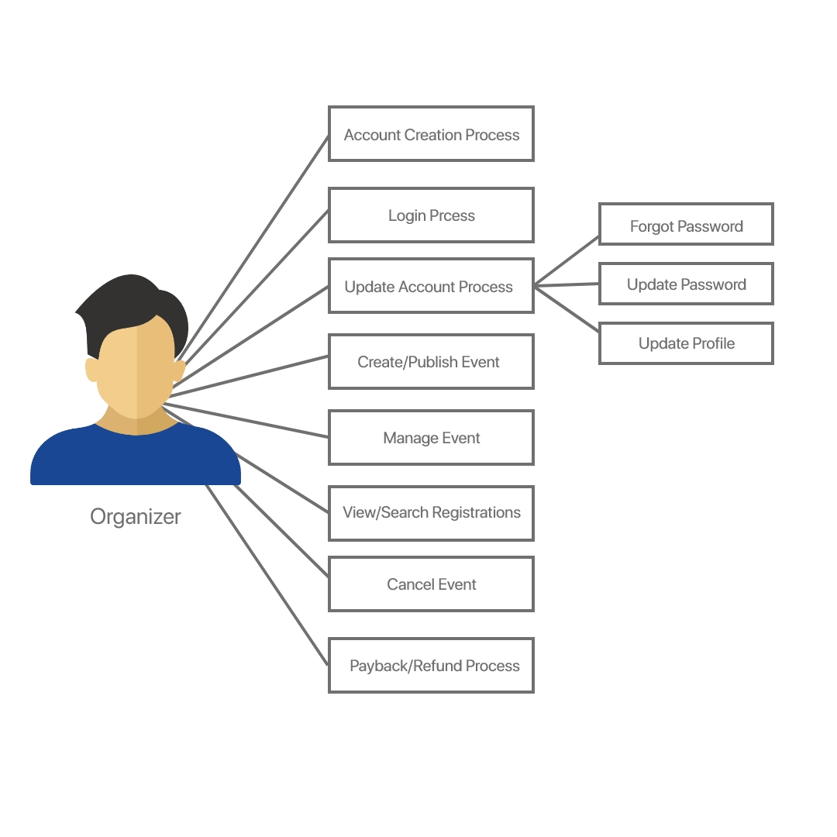
Use Case Diagrams

Slide 11
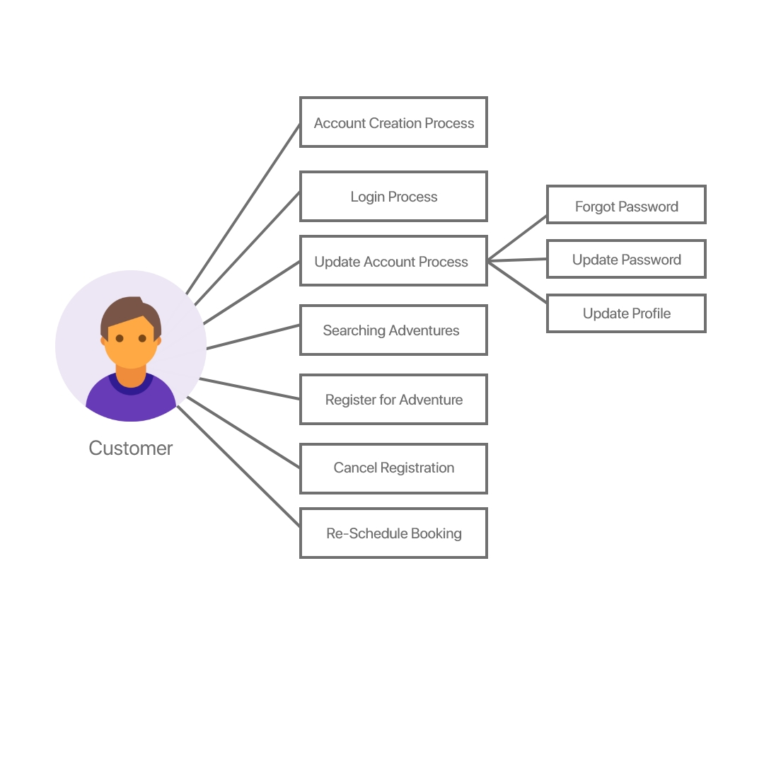
Use Case Diagrams

Slide 12
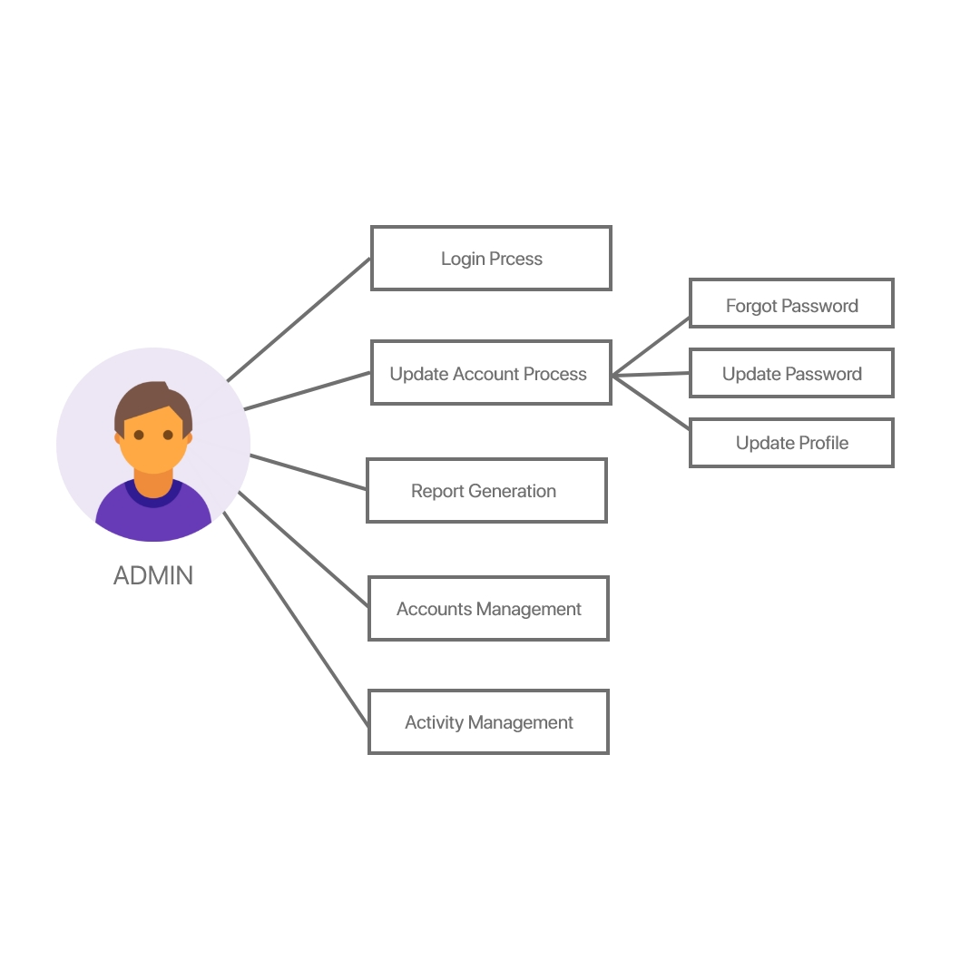
Use Case Diagrams

Slide 13
Technology Stack
Frontend: React.js
Backend: Spring Boot,Entity Framework
Database: MySQL
Authentication: JWT & OAuth2

Slide 14
Future Enhancements
Mobile App Development – Android & iOS apps for easy access.
AI-Based Recommendations – Personalized activity suggestions.
Payment Gateway Integration – Secure online payments.
Multi-Language Support – Accessibility for global users.
Enhanced User Engagement – Chat support & social media sharing

