Slide 1
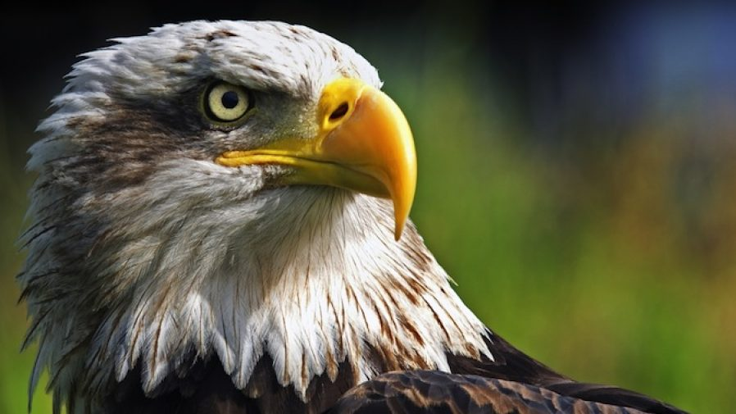
Eagle-Eye

Slide 2
Models
3 approaches :-
Purely Mathematical Model
Computer Vision + Projectile Motion
Computer Vision + Extrapolation

Slide 3
Assumptions
Gully cricketers…NO SPIN !! NO SWING !!
Zero air resistance
Scaled down model
COR between ball & ground = 0.65
COF = 0.6

