Slide 1
DATA ANALYTICS · MAJOR PROJECT · 2026
Credit Risk
Analysis & Prediction System
78.38%
0.85
33K
3
Accuracy
ROC-AUC
Customers
ML Models
Presented by Mangesh Nersekar
✉ mangeshnersekar44@gmail.com
in linkedin.com/in/mangesh-nersekar
⌥ github.com/mangeshnersekar44-web

Slide 2
Table of Contents
01
Introduction & Problem Statement
06
Methodology & Flowchart
02
Objectives of the Study
07
Predictive Modeling
03
Tools & Technologies
08
Model Evaluation
04
Dataset Description
09
Power BI Dashboard
05
Exploratory Data Analysis
10
Business Insights & Conclusion
Mangesh Nersekar · Credit Risk Analysis
2

Slide 3
Introduction & Problem Statement
INTRODUCTION
PROBLEM STATEMENT
Credit risk assessment is a crucial process in banking & finance to evaluate whether a borrower can repay a loan.
With digital banking growth,
institutions handle vast volumes of customer data that manual methods cannot process effectively.
This project builds
a Credit Risk Prediction System using Machine Learning (Logistic Regression), backed by MySQL for data management, Power BI for visualization, and Streamlit for real-time prediction.
"How can ML accurately predict loan defaults
to reduce credit risk for financial institutions?"
!
Incorrect lending decisions → financial losses & operational risk
!
Rule-based systems cannot handle large & complex datasets
!
Manual verification is inconsistent and time-consuming
!
Difficult to proactively identify high-risk borrowers
Mangesh Nersekar · Credit Risk Analysis
3

Slide 4
Objectives of the Study
01
Analyze Borrower Data
02
Build ML Model
03
Risk Categorization
Identify key factors influencing loan defaults from 33K historical records.
Develop Logistic Regression to predict loan default probability.
Classify borrowers into Low, Medium, and High Risk groups.
04
Evaluate Performance
05
Power BI Dashboard
Measure Accuracy (78.38%), ROC-AUC (0.85), and Confusion Matrix.
Create interactive dashboards to visualize credit risk insights.
Mangesh Nersekar · Credit Risk Analysis
4

Slide 5
Tools & Technologies
Python
Pandas & NumPy
Primary language for data analysis & ML development
Data manipulation, cleaning, and numerical computations
Scikit-Learn
Matplotlib & Seaborn
Logistic Regression, Random Forest, model evaluation
EDA charts, distribution plots, correlation heatmaps
MySQL
Power BI
Structured data storage, SQL queries, VIEW for Power BI
Interactive credit risk dashboards & visualizations
Streamlit
Scikit-Learn Metrics
Web app for real-time loan default prediction input
Accuracy, ROC-AUC, Confusion Matrix evaluation
Mangesh Nersekar · Credit Risk Analysis
5

Slide 6
Dataset Description
33,000
21.82%
7,108
80/20
Total Customers
Default Rate
Total Defaults
Train / Test Split
Key Dataset Variables
Variable | Description | Variable | Description
person_age | Age of the borrower | loan_amnt | Amount of loan taken
person_income | Annual income of borrower | loan_intent | Purpose of the loan
home_ownership | Own / Rent / Mortgage | loan_grade | Credit grade assigned (A–G)
loan_int_rate | Interest rate on loan | loan_status | Target: Default=1 / Non-Default=0
Mangesh Nersekar · Credit Risk Analysis
6

Slide 7
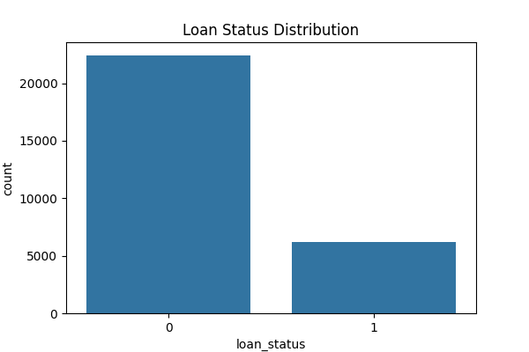
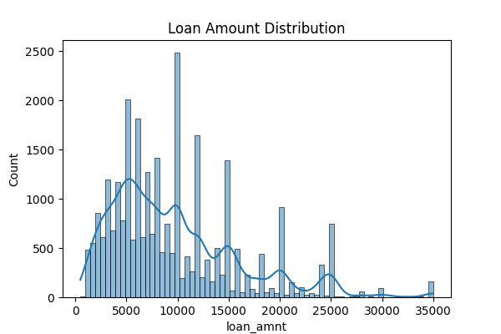
Exploratory Data Analysis — Loan Distribution
Loan Status Distribution
Loan Amount Distribution
Key Insight: ~78% borrowers repay loans (Class 0) vs 22% defaults (Class 1). Most loans are small-to-medium (₹1K–₹15K range) indicating working-class borrower profile.
Mangesh Nersekar · Credit Risk Analysis
7

Slide 8
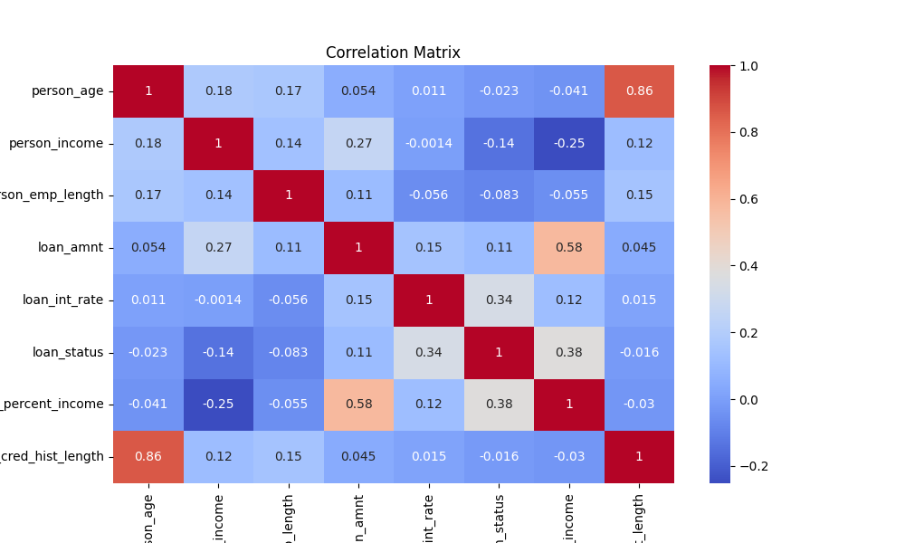
Exploratory Data Analysis — Correlation Matrix
Correlation Heatmap
Key Findings
Loan interest rate & loan_percent_income show moderate correlation with loan default (0.34, 0.38)
Loan amount is positively correlated with loan_percent_income (0.58) — larger loans = higher income burden
Person age & credit history length have strong positive correlation (0.86) — older borrowers have longer histories
Income negatively correlates with default (−0.14) — higher income reduces default risk
Mangesh Nersekar · Credit Risk Analysis
8

Slide 9
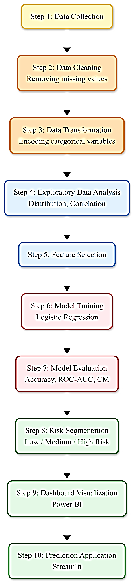
Methodology & System Flowchart
System Architecture Flowchart
01
Data Collection
02
Data Cleaning
03
Transformation
33K+ loan records loaded from MySQL database
Removed missing values (~3.2%), duplicates fixed
One-hot encoding of loan_intent, loan_grade, home_ownership
04
EDA
05
Feature Selection
06
Model Training
Distribution, correlation heatmap, SQL pattern analysis
Identified top predictors: loan % income, grade, interest rate
Logistic Regression + Random Forest on 80% training data
07
Evaluation
08
Risk Segmentation
09
Dashboard + App
Accuracy: 78.38%, ROC-AUC: 0.85, Confusion Matrix analyzed
Borrowers classified: Low / Medium / High Risk by probability score
Power BI dashboard + Streamlit web prediction interface deployed
Mangesh Nersekar · Credit Risk Analysis
9

Slide 10
Predictive Modeling
Logistic Regression
PRIMARY
Linear Regression
BASELINE
Random Forest
ENSEMBLE
Binary classification model (Default vs Non-Default)
Initially explored for variable relationship analysis
Multiple decision trees for improved accuracy
Trained on 80% data, tested on 20% holdout set
Not ideal for binary classification outcomes
Captures complex non-linear relationships in data
Achieved Accuracy: 78.38% and ROC-AUC: 0.85
Established a performance baseline only
Provides built-in feature importance scores
Outputs probability score per borrower
Helped confirm non-linear patterns in data
More robust to outliers and noisy features
Fast, interpretable, production-ready
Superseded by Logistic Regression for final model
Used for comparison and feature validation
Mangesh Nersekar · Credit Risk Analysis
10

Slide 11
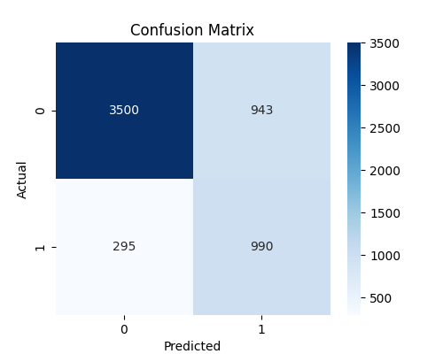
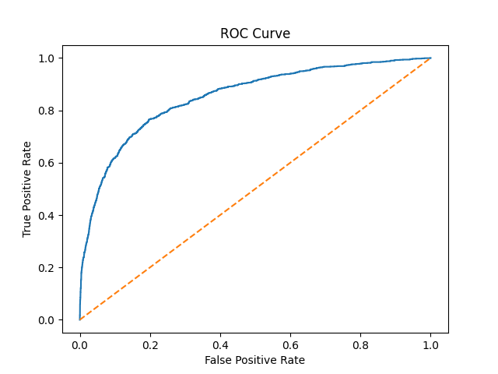
Model Evaluation & Performance
78.38%
0.85
3,500
990
295
943
Accuracy
ROC-AUC
True Negatives
True Positives
False Negatives
False Positives
Confusion Matrix
ROC Curve — AUC = 0.85
Mangesh Nersekar · Credit Risk Analysis
11

Slide 12
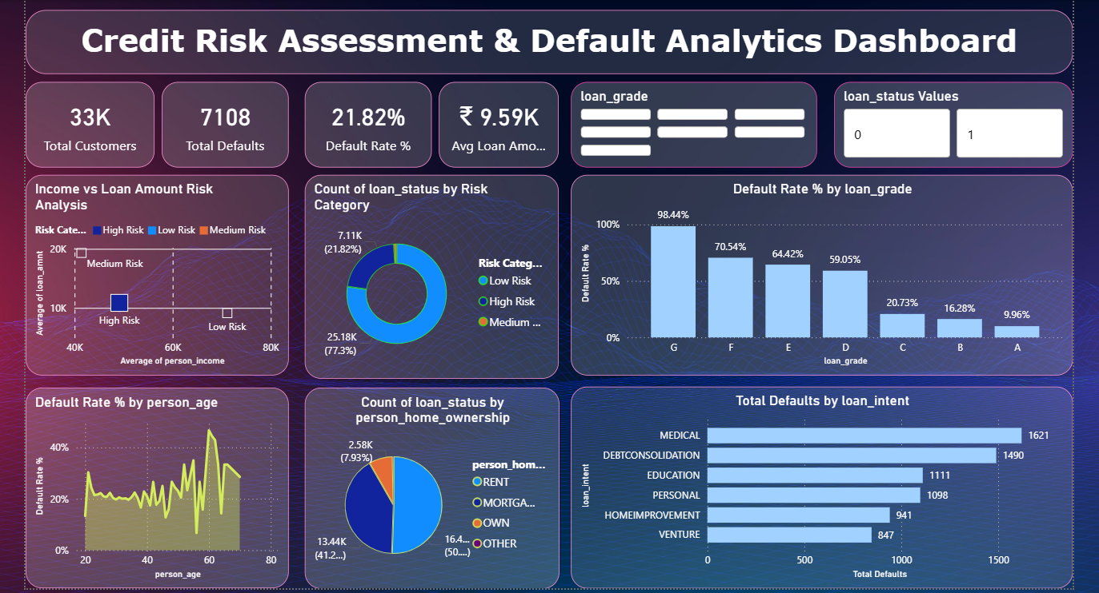
Power BI Dashboard — Credit Risk Assessment
KPI Summary
Risk Segments
Grade Analysis
Loan Intent
33K customers · 7,108 defaults · 21.82% default rate · Avg Loan ₹9.59K
Income vs Loan scatter: High Risk (low income, high loan), Low Risk (high income, low loan)
Grades G (98.44%) & F (70.54%) have highest defaults — key filter for loan rejection
Medical (1621) & Debt Consolidation (1490) top default categories by loan purpose
Mangesh Nersekar · Credit Risk Analysis
12

Slide 13
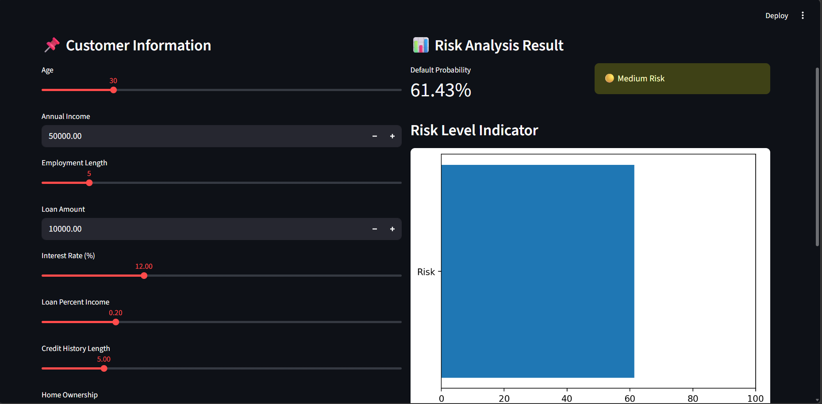
Streamlit — Credit Risk Prediction Interface
Customer Inputs
Default Probability
Risk Classification
Age, income, employment length, loan amount, interest rate, credit history via interactive sliders
ML model outputs exact probability score — shown as a percentage (e.g. 61.43%)
Automatically classifies as Low / Medium / High Risk with visual risk level indicator bar
Mangesh Nersekar · Credit Risk Analysis
13

Slide 14
Business Insights & Key Findings
▲
Loan Grade → Default Risk
▲
High Loan-to-Income Ratio
Borrowers in grades F & G have default rates of 70–98%. Grade is the single strongest rejection signal for lenders.
Borrowers with loan amount > 20–30% of income are far more likely to default. loan_percent_income = 0.34 importance.
▲
High Interest Rate = High Risk
▲
Medical & Debt Consolidation
Interest rate correlates with default probability (0.34). Lenders assign higher rates to risky borrowers unknowingly amplifying risk.
These loan intents account for 3,111 of 7,108 total defaults. Purpose of loan is a strong risk signal.
▼
Longer Credit History = Safe
▼
Stable Home Ownership
Older borrowers with longer credit histories (age–history correlation: 0.86) show consistently lower default rates.
Home ownership (own/mortgage) indicates financial stability and correlates with better loan repayment behaviour.
Mangesh Nersekar · Credit Risk Analysis
14

Slide 15
Conclusion & Future Scope
✔ CONCLUSION
→ FUTURE SCOPE
Developed a complete Credit Risk Prediction System using Logistic Regression achieving 78.38% accuracy and ROC-AUC of 0.85
01
Implement XGBoost & Gradient Boosting for higher prediction accuracy
Full end-to-end pipeline: Python (ML) → MySQL (storage) → Power BI (dashboard) → Streamlit (web app)
02
Integrate real-time banking data for instant credit evaluation
Borrowers successfully classified into Low, Medium, and High Risk categories
03
Apply Explainable AI — SHAP & LIME to make predictions transparent
System enables financial institutions to identify high-risk borrowers proactively and reduce loan losses
04
Deploy system on AWS/Azure cloud for scalable, production-ready access
Power BI dashboard provides real-time executive-level credit risk visibility
05
Extend to multi-class risk scoring with finer risk granularity levels
Mangesh Nersekar · Credit Risk Analysis
15

Slide 16
Thank You
Questions & Answers
78.38%
0.85
33K
21.82%
Accuracy
ROC-AUC
Customers
Default Rate
Mangesh Nersekar · Data Analytics Major Project
✉ Email
in LinkedIn
⌥ GitHub
mangeshnersekar44@gmail.com
linkedin.com/in/mangesh-nersekar-350750315
github.com/mangeshnersekar44-web

