Slide 1
PAYTM BUILD FOR INDIA AI HACKATHON | PUNE | SARVAM AI
Incident Desk
An AI on-call teammate using Sarvam to investigate checkout failures, with evidence for the operator.
Track 3: Autonomous AI Teammates
Replay demo: mangeshraut712.github.io/agent-console
Mangesh Raut
github.com/mangeshraut712 | mbr63@drexel.edu | github.com/mangeshraut712/agent-console
Notes:
Paytm Build for India AI Hackathon, Track 3: Autonomous AI Teammates. Sarvam integration is local in this Patym checkout. The public GitHub Pages link is a replay demo, not the new server-side Sarvam deployment.

Slide 2
PROBLEM STATEMENT
Checkout latency: an incident worth investigating
4.2 seconds
An operator needs to distinguish checkout failures from a slow dependency before choosing a fix.
Incident evidence is spread across service health, logs and runbooks.
Incident Desk gathers that evidence into a reviewable verdict. Remediation stays with the operator.
Checkout p99 in the seeded demo, against an 800 ms SLO. The alert starts with a payments deploy.
Demo evidence: payments-db has 98 of 100 connections in use. Logs link pool saturation to deploy payments-7f3c.
Seeded example, not Paytm production telemetry
Incident Desk | 2 / 7
Notes:
Source: agent-console/src/agent/incidents.ts, checkout-latency seed. These are synthetic demo values, not measurements from Paytm. This replaces the original external market-volume statistic with evidence demonstrated by this project.

Slide 3
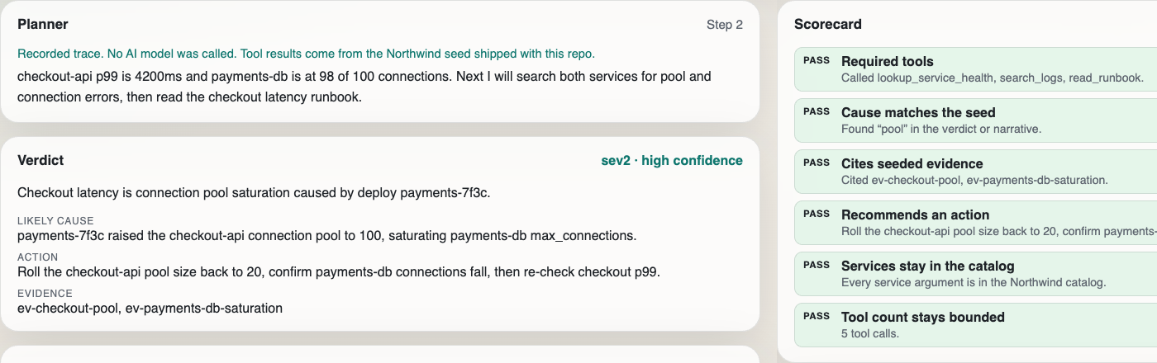
PROPOSED SOLUTION
AI does the digging; a person gets the evidence
1
Alert comes in
Pick a seeded incident or type a checkout, login or queue alert.
2
Sarvam plans the steps
Sarvam chooses the next service, log search or runbook lookup.
3
Calls its tools
Service health, log search, runbook, and optional web search.
Checkout replay: planner, evidence-linked verdict and 6/6 scorecard. This recorded trace demonstrates the workflow; it is not a live Sarvam result.
4
Writes a verdict
Severity, likely cause, a concrete action and the evidence IDs.
Live Sarvam uses a server-side key and credits. The latest request returned 402: no credits available. Replay remains separately labelled.
5
Scorecard checks it
Six pass/fail checks on the trace. A person makes the change.
Incident Desk | 3 / 7
Notes:
Replay observed locally: five tool calls and 6/6 checks. Sarvam live request last checked 13 November 2026: HTTP 402, no credits available. The screenshot is a recorded replay, not a Sarvam-generated answer. Do not imply a successful live model run.

Slide 4
TECH STACK
Sarvam runs the investigation loop
App | Next.js 16, React 19, TypeScript
AI model | Sarvam AI · sarvam-105b-conversations via chat completions with function calling
Agent tools | Service health, log search, runbook lookup (seeded data), and Tavily web search when a key is set
Streaming | NDJSON investigation events; WebSocket console with ordered replay and reconnect recovery
Safety | Server-side keys only, secret redaction, request guards, bounded tool calls, read-only tools
Quality and deploy | Vitest, TypeScript and production build; protocol and chaos checks; Docker Compose / Vercel config
Incident Desk | 4 / 7
Notes:
Sarvam API: https://docs.sarvam.ai/api-reference/chat/chat-completions-v1 . Local implementation: src/agent/sarvam.ts and src/agent/loop.ts. The service rejected reasoning_effort=none despite the published enum; low was accepted through validation and returned a credit error. Keys stay on the server. The legacy Nebius provider is retained as an explicitly selectable option.

Slide 5
USP
Evidence an operator can inspect
Operator question
Incident Desk response
What did the agent do?
Shows every planning step and tool call on screen
Where did the cause come from?
The verdict includes evidence IDs for operator review
Does the result match the incident?
Six pass/fail checks score the finished trace
Was this a live model run?
Replay is labelled; live errors never substitute a replay
Who approves a change?
Tools only read; a person makes the change
Incident Desk | 5 / 7
Notes:
Tools read seeded service health, logs and runbooks. Optional web search requires Tavily credentials. The model verdict and evidence IDs require operator review; scorecard checks do not guarantee a correct diagnosis.

Slide 6
IMPACT & BENEFITS
Works on seeded data today, built for payments
Replay
3
6 / 6
5
public demo; no API key or credits needed
seeded incidents: checkout, login, queue
scorecard checks pass on the checkout replay
tool calls to reach the checkout verdict
These numbers come from the recorded replay, not live production data.
On-call engineers
Merchants
Customers
Get a first investigation with evidence attached, instead of starting from a blank dashboard.
Checkout problems can be traced and fixed sooner, so fewer sales are lost.
Fewer stuck or failed payments at the moment they try to pay.
The benefits above are the goal. They have not been measured on Paytm systems.
Incident Desk | 6 / 7
Notes:
Replay measurements only: three seeded scenarios, checkout replay 6/6 checks and five tool calls. Intended customer benefits have not been measured in production. No Paytm production data or payment connector is integrated.

Slide 7
BUSINESS MODEL
Free core today; paid team version is the plan
Today
Next (plan)
Revenue (plan)
Open source, MIT licence
Sarvam tool loop and tests added
Live request: 402, no credits
No users or revenue yet
Complete a live Sarvam run after credits arrive
Add UPI timeout and settlement scenarios
Connect real logs; measure diagnosis time
Free open-source core
Paid hosted version priced per team
On-premise option for regulated payment companies
Hackathon focus: demonstrate an inspectable AI teammate for checkout incidents. Payment integrations and production impact remain future work.
Incident Desk | 7 / 7
Notes:
As of the latest live request on 13 November 2026, Sarvam credits are unavailable. Complete a successful live run before presenting Sarvam-generated results. UPI, settlement and gateway-specific scenarios are planned, not implemented. Revenue model is a proposal, not traction.

