Slide 1
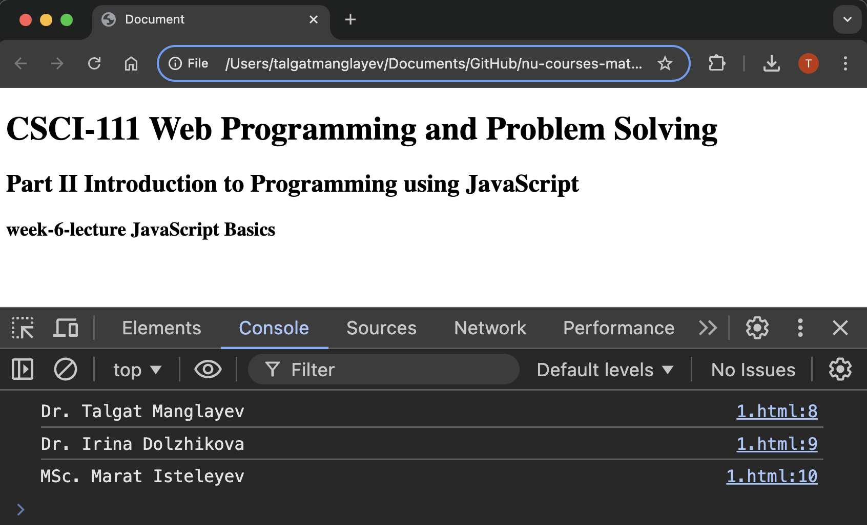
weeks [6-11]

Slide 2
Content
<!DOCTYPE html>
<html lang="en">
<head>
<meta charset="UTF-8">
<title>Document</title>
<script>
console.log("Dr. Talgat Manglayev")
console.log("Dr. Irina Dolzhikova")
console.log("MSc. Marat Isteleyev")
</script>
</head>
<body>
<h1>CSCI-111 Web Programming and Problem Solving</h1>
<h2>Part II Introduction to Programming using JavaScript</h2>
<h3>week-6-lecture JavaScript Basics</h3>
</body>
</html>
Introduction
Variables
Types
Operators
Arrays
Objects

Slide 3

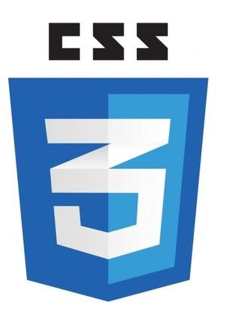

HTML, CSS, JavaScript
Hyper-Text Markup Language (HTML) is the standard markup language for
documents designed to be displayed in a web browser.
It describes the structure of the web page
Cascading Style Sheets (CSS) is a stylesheet language used to describe
the presentation of a document written in HTML.
It describes the style of the web page
JavaScript (JS) is a lightweight and interpreted programming (or scripting)
language for Web pages.
It adds behavior to the web page

Slide 4

Brief History
Brendan Eich (/ˈaɪk/), born July 4, 1961,
cofounder of the Mozilla project,
CEO of Brave Software,
created the JavaScript language in 1995.
ECMAScript (ES) is a JavaScript standard
intended to ensure the interoperability of web pages
across different browsers.
ECMA 262, …, ES5, ES6, …, ES2022

Slide 5
What is JavaScript used for?
• Change the behavior of the web application:
• Change HTML content
• Change HTML attribute values
• Change HTML styles (CSS)
• Hide/Show HTML elements
• Do other computations

Slide 6
How to use JavaScript ?
Browsers understand JavaScript by default, so there is no need to install anything
To incorporate your JavaScript program in your web page:
1. wrap it with <script> tag in the <head> or <body> sections
2. link it as an external file in the <head> section:
<script src=“my_java_script.js”></script>

Slide 7
How to use JavaScript ?
Browsers understand JavaScript by default, so there is no need to install anything
To incorporate your JavaScript program in your web page:
1. wrap it with <script> tag in the <head> or <body> sections
2. link it as an external file in the <head> section:
<script src=“my_java_script.js”></script>
example-1.html and example-1.js

Slide 8
How to see the output?
Programs can output the intermediate results or other information to users (e.g. debugging):
To the browser’s console using console.log() function
>>> console.log(“Hello, World!”)
Directly into HTML, using innerHTML property
>>> document.getElementById("demo").innerHTML = “Hello, World!”
In pop up message using alert() function
>>> alert(“Hello, World!”))
example-2.html and example-2.js

Slide 9
Variables
Variables are store data values of the program
They can be declared automatically or using keywords let, const or var (outdated)
They must have unique names (identifiers)
- Names can contain letters, digits, underscores, and dollar signs.
- Names must begin with a letter.
- Names can also begin with $ and _ (but we will not use it in this tutorial).
- Names are case sensitive (y and Y are different variables).
- Reserved words (like JavaScript keywords) cannot be used as names.
example-3.html and example-3.js

Slide 10
Variables
Variable declarations:
var x = 3 + 2; // x is 5
let y = 10; // y is 10
const PI = 3.14; // PI is “3.14”
msg = “Hello!”; // msg is “Hello!”
Variables declared with let and const cannot be redeclared.
example-5.html, example-6.html

Slide 11
Data types
There are six primitive data types:
[in JavaScript data types are not declared in code]
• Number: integer or decimal numbers a = 20, b = 3.5
• String: some text s = "Hello, World!" or empty string t = ""
• Boolean: true or false y = true
• undefined: a variable which is declared but doesn’t contain value let x;
• null: a variable with no value assigned to it p = null
• Symbol: unique symbolic value (not covering here)
example-7.html

Slide 12
Operators
Assignment Operators
let name = "Tom"; x = 3; y = name;
SELF STUDY: increment, decrement, remainder, exponentiation
example-8.html

Slide 13
Operators
Arithmetic Operators
a = 2 + 3;
b = 4 * 5 / 2 - 1;
x = "Hello";
y = "World";
z = x + y;
example-8.html

Slide 14
Operators
Comparison Operators
a > 0; a < 0; a == 0;
example-8.html

Slide 15
Arrays
Array is a data type to store ordered values (possibly different).
To create an array, use square brackets:
const array = ["David Malan", "Harvard CS 50", 2024]
example-9.html

Slide 16
Arrays
Elements in the array are indexed by numbers (starting from 0):
let x = array[0] // x stores "David Malan"
example-9.html

Slide 17
Arrays
Changing values in the array:
array[0] = "David J Malan"
//array = ["David J Malan", "Harvard CS 50", 2024]
example-9.html

Slide 18
Arrays
Adding new element in the array:
array.push("https://www.youtube.com/watch?v=4vU4aEFmTSo&list=PLhQjrBD2T381WAHyx1pq-sBfykqMBI7V4&index=3");
or
array[7] = "12 Lectures"
example-9.html

Slide 19
Arrays
The number of elements:
let n = array.length
const k = array[n -1]
example-9.html

Slide 20
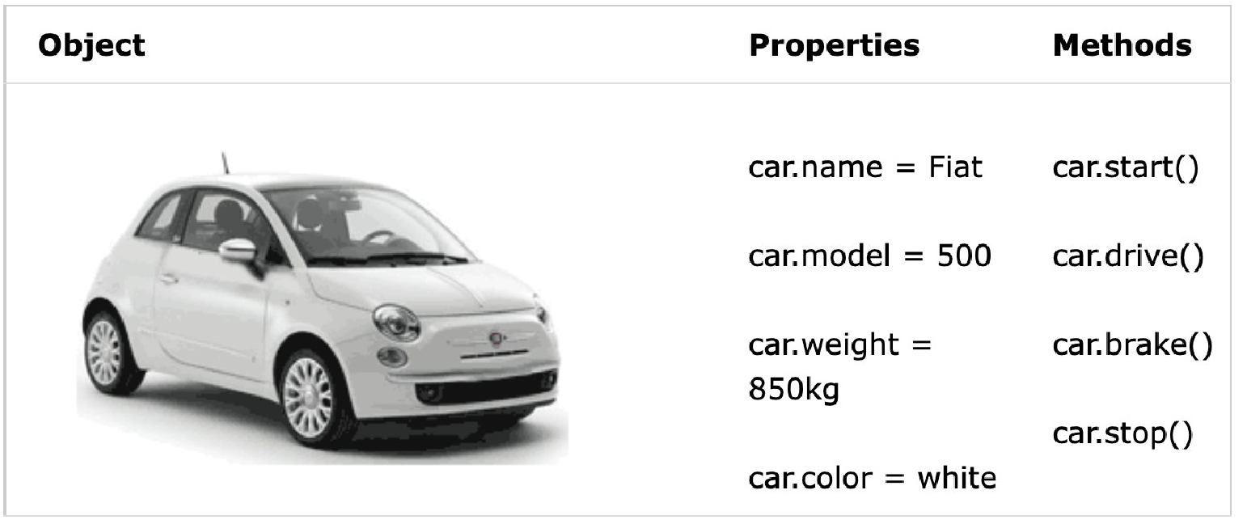
Objects
https://www.w3schools.com/js/js_objects.asp

Slide 21
Objects
Complex data type which stores values by their keys.
The objects may have properties and methods.
https://www.w3schools.com/js/js_objects.asp

Slide 22
Objects
To create an object, use curly brackets and key:value pairs:
const car =
{
name: "Fiat", // note ending comma
color: "white"
}
example-10.html
https://www.w3schools.com/js/js_objects.asp

Slide 23
Objects
To access properties, use dot notation or square brackets:
let x = car.name;
car["color"] = "black";
example-10.html
https://www.w3schools.com/js/js_objects.asp

Slide 24
Summary
There are several ways to output data and info
Variables are used to store values in program
There are six primitive data types
Operators can be used to manipulate data
Arrays can store ordered list of values
Objects can store values by their keys

Slide 25
bonus info

