Slide 1
CSCI 325
Parallel Systems and GPU Programming
Lecture 2
C++ Multithreading
Dr. Talgat Turanbekuly

Slide 2
Table of contents
Multithreading
Thread States
Concurrency
Sharing data among threads
Thread Synchronization
Concurrency (Liveness) problems
Deadlock, Livelock, Starvation

Slide 3
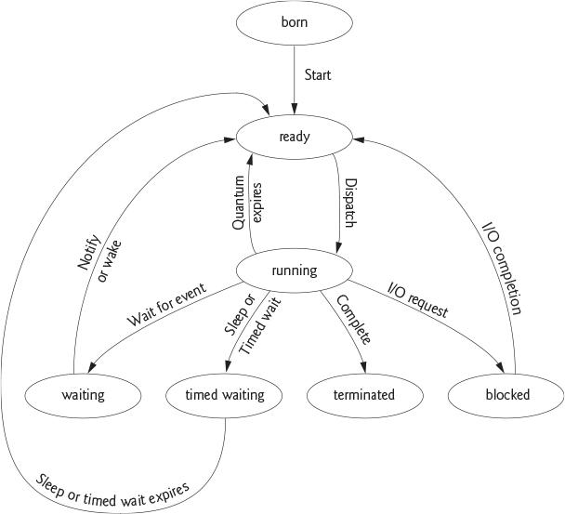
C++ thread states
Born - thread begins its life cycle and remains until the program starts.
Ready - OS allocates processor time (quantum/timeslice) and sends the thread to Running state. Then the thread returns to the Ready state. Another thread is assigned to the processor.
Thread scheduling - allocating threads per time.
Waiting - thread A is paused until thread B completes and notifies thread A or specific time is passed.
Timed waiting - thread is in the state until time interval is passed or specific task is completed.
Blocked - the thread is waiting until I/O task is completed.
Terminated - when the thread completes its task.
Harvey Deitel, Paul Deitel and David Choffnes, “Chapter 4, Thread Concepts.” Operating Systems, 3/e, p. 153. Upper Saddle River, NJ: Prentice Hall, 2004.

Slide 4
C++ multithreading
Example 1
Example 2

Slide 5
Thread Synchronization
It is possible to run parallel threads and execute several tasks.
What if several threads try to change value of the same object?

Slide 6
Data Race
Thread-1 gets value of an object in order to change.
Thread-2 changes the value before thread-1 saves the object.
In this case thread-1 works with old value of the object.
THREAD 1
THREAD 2
OBJECT

Slide 7
Data Race
A ‘race condition’ may arise when two or more threads concurrently access the same memory location and at least one of the threads updates the location. It may lead to wrong results.

Slide 8
Thread Synchronization
problem solution:
Ensure only one thread at a time can access the object -
acquire the lock on the object.
One thread
1) gets value of the object
2) changes the value
3) saves new updated value to the object.
These three steps form atomic operation and cannot be divided.

Slide 9
Thread Synchronization
In order to manage multiple threads trying access one object:
Only one thread is given access to the object
and
the rest threads are waiting.
thread synchronization
mutual exclusion

Slide 10
Concurrency Problems Deadlock
Two or more threads get some resources (lock) and then wait each other indefinitely to release the lock. It happens when threads acquire the lock in different order.
T1
synchronize(A)
{
synchronize(B)
{
}
}
T2
synchronize(B)
{
synchronize(A)
{
}
}

Slide 11
Concurrency Problems Deadlock Example
C++ Deadlock example
offer your solutions

Slide 12
Concurrency Problems Deadlock Solutions
Try not to use block threads within each other (cycles, nests)
Use timed waiting to avoid indefinite block
Any other?

Slide 13
Concurrency Problems Livelock
THREAD 1
while(y < 2)
{
synchronized
{
x++;
y = x;
}
}
THREAD 2
while(y > -2)
{
synchronized
{
x--;
y = x;
}
}
possible output
THREAD 1
x = 0;
x = 1;
THREAD 2
x = 0;
x = -1;
THREAD 1
x = 0;
THREAD 2
x = -1;
THREAD 1
x = 0;
x = 1;
…

Slide 14
Concurrency Problems Livelock Example
C++ Livelock Example
How to figure out the error?
Offer solutions to the problem

Slide 15
Concurrency Problems Livelock Solutions
Identify livelock:
What if use counters for repeated situations?
Solution depends to the problem:
Use different timed waiting for concurrent threads;

Slide 16
Concurrency Problems Starvation
THREAD 1
while(x < 4)
{
synchronized(sharedObject)
{
x++;
}
}
THREAD 2
while(x < 4)
{
synchronized(sharedObject)
{
x++;
}
}
THREAD N
while(x < 4)
{
synchronized(sharedObject)
{
x++;
}
}
possible output
THREAD 1
x = 1;
x = 2;
x = 3;
x = 4;
THREAD 2
x = 1;
x = 2;
x = 3;
x = 4;
THREAD N
x = 1;
x = 2;
x = 3;
x = 4;

Slide 17
Concurrency Problems Starvation Example
C++ Starvation Example

Slide 18
Concurrency Problems Starvation Solutions
Identify starvation:
Are threads running randomly or in particular order?
Solution:
Use scheduling

Slide 19
Summary
There are several ways to declare and operate threads in C++;
Thread synchronization allows only one thread to work with data;
Thread synchronization prevents unpredictable results;
Threads organization is important to avoid liveness problems: deadlock, livelock and starvation;
Famous problems in concurrency: Producer-Consumer Relationship (bounded-buffer problem), dining philosophers, readers-writers problem etc. have several solutions each.

Slide 20
Class work and Homework
Read about liveness problems: deadlock, livelock and starvation
Understand and implement reasons and solutions
Please check if cuda is installed on your PC
Sign up to learn.nvidia.com

Slide 21
Resources
Paul J. Deitel. C++20 Fundamentals, 3rd Edition. 2024;
Harvey Deitel, and Paul J. Deitel. C++20 for Programmers: An Object's-Natural Approach, 3rd Edition, 2022;
Anthony Williams. C++ Concurrency in Action, Second Edition, 2019;

Slide 22
HPC, CUDA internships, jobs
https://scholarshipdb.net/scholarships?q=cuda&listed=Last-24-hours
https://scholarshipdb.net/scholarships?q=gpu&listed=Last-24-hours
sign up to learn.nvidia.com

