Slide 1
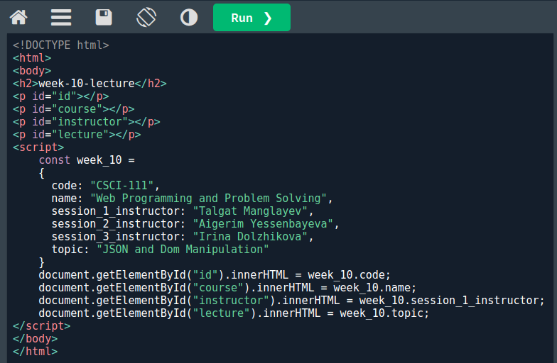
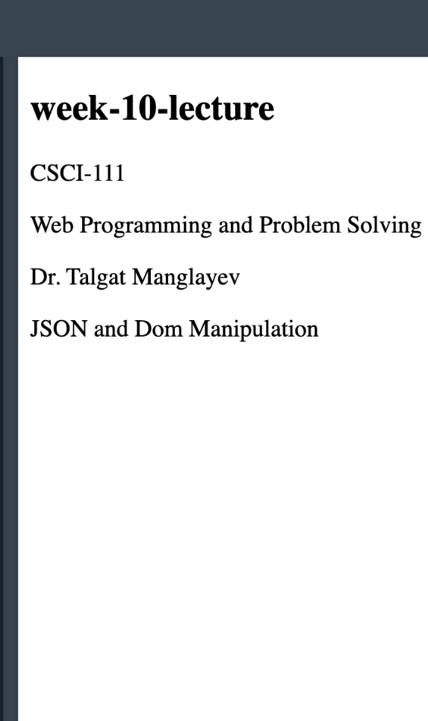

Slide 2
Content
• What is Dom?
• Finding elements
• Element manipulation
• Content manipulation
• Attribute manipulation
• Style manipulation
• Class manipulation

Slide 3
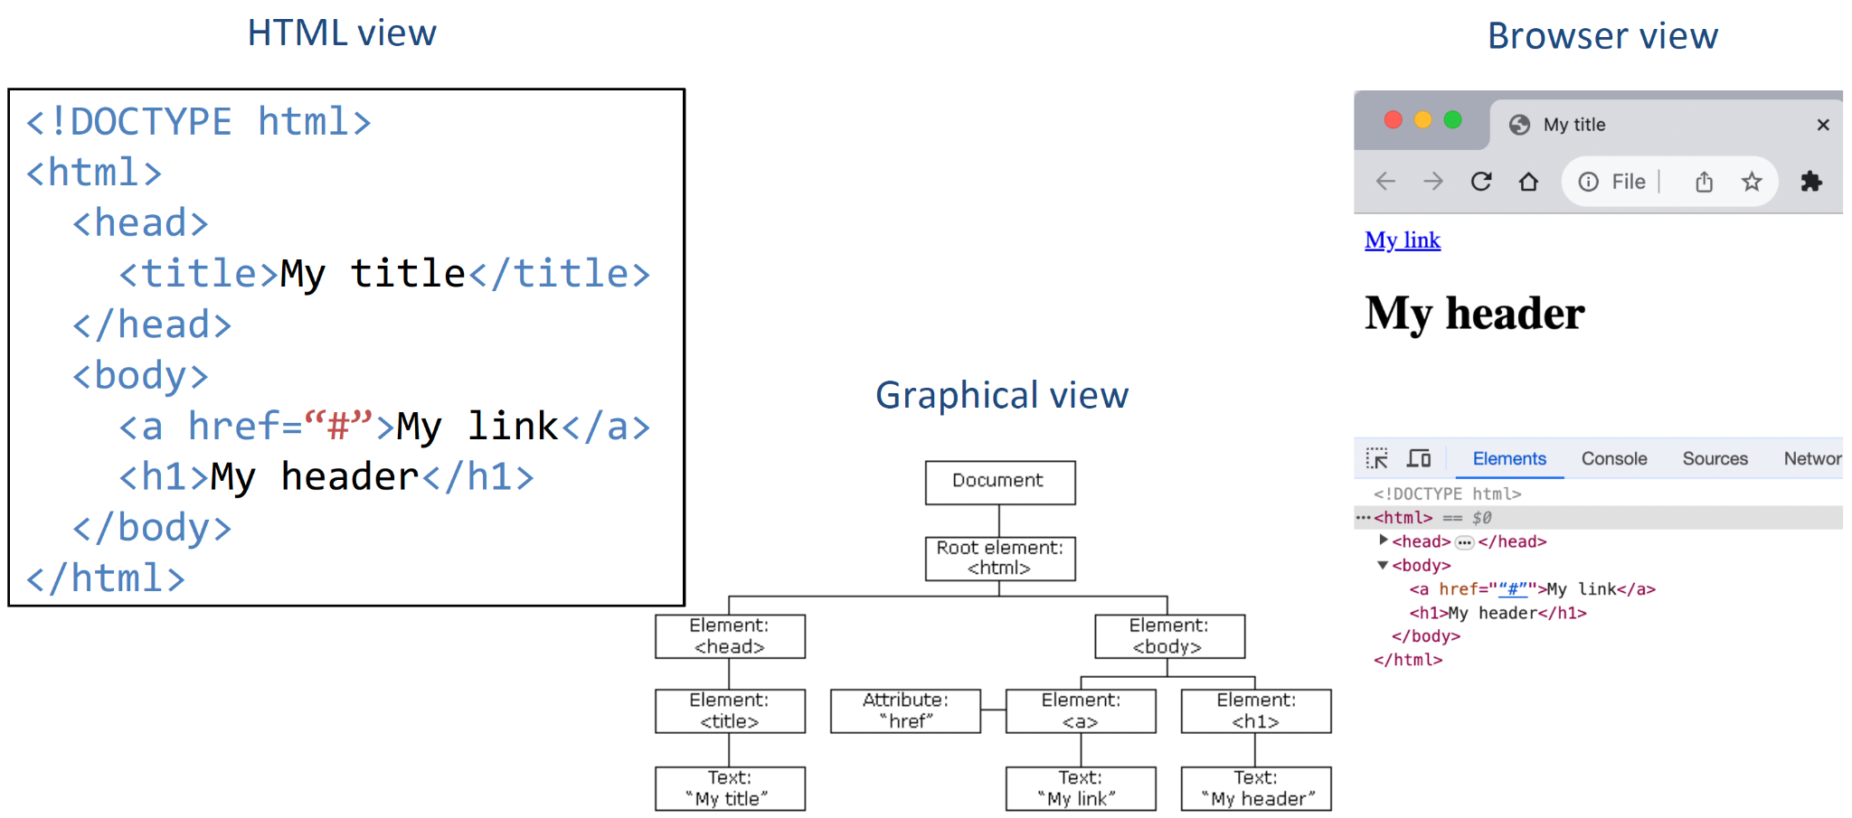
What is Dom?

Slide 4
What is HTML Dom?
Standard object model and programming interface for HTML document.
DOM defines:
- The HTML elements as objects
- The properties of all HTML elements
- The methods to access all HTML elements
- The events for all HTML elements

Slide 5
Document Object
The main object in the DOM.
All the elements are accessible via document object.
Main methods to access elements:
- Finding elements
- Creating elements
- Adding elements
- Deleting elements

Slide 6
Finding elements
The elements in DOM can be found by element’s
id: document.getElementById(<element_id>)
tag: document.getElementsByTagName(<tag_name>)
class name:document.getElementsByClassName(<class_name>)
CSS selector: document.querySelectorAll(<CSS selector>)
Note that the last three methods return an array of objects.

Slide 7
Element manipulation
The main methods to work with elements are:
document.createElement(<element>)
document.removeChild(<element>)
document.appendChild(<element>)
document.replaceChild(<new_element, old_element>)

Slide 8
Element manipulation
Example: Adding a header element to the body
// print the initial document object
console.log(document)
// create an HTML element - h1
let h1 = document.createElement("h1")
// append the h1-element to the bodyelement
document.body.appendChild(h1)
// print the final document object
console.log(document)
Note that the header element has no text, i.e. it is empty

Slide 9
Content manipulation
Two basic properties to manipulate content of the elements: innerText, innerHTML.
// print the initial document object
console.log(document)
// create an HTML element - h1
let h1 = document.createElement("h1")
// create an HTML element - h1
h1.innerText = "<i>Header Text</i>"
// append the h1-element to the body-element
document.body.appendChild(h1)
// print the final document object
console.log(document)
NOTE:
innerHTML - the content is treated as content, i.e. properly decoding HTML tags.
innerText - the content is treated as text.

Slide 10
Attribute manipulation
The attribute of an HTML element can be accessed and manipulated using:
getAttribute(<attribute_name>)
setAttribute(<attribute_name>, <attribute_value>)
// create an HTML element - a
let a1 = document.createElement("a")
a1.setAttribute("href", "https://w3schools.com")
a1.innerText = "W3Schools"
document.body.appendChild(a1)
Note: getAttribute() methods returns null if there is no requested attribute

Slide 11
Style manipulation
To change CSS styles of an element, style property (attribute) can be used.
CSS property with dash are converted to camel case:
background-color → backgroundColor
let p1 = document.createElement("p")
p1.innerText = "This is the first paragraph!"
p1.style.color = "red"
p1.style.backgroundColor = "yellow"
document.body.appendChild(p1)

Slide 12
Class manipulation
The element might define several classes which can be accessed using classList property
classList returns the list of all classes
classList itself has methods: add(), remove() and toggle() a class
// add and remove a class to the element
let btn1 = document.getElementById("btn1")
console.log(btn1.classList)
btn1.classList.add("btn")
console.log(btn1.classList)
btn1.classList.remove("btn")
console.log(btn1.classList)

Slide 13
Objects
Objects
Object Properties
Object Methods
Object Display
Object Constructor

Slide 14
JSON
Intro
Syntax
Data Types
Parse
Stringify
Objects
Arrays

Slide 15
Summary
- DOM is a standard way to work with HTML document
- Document object is used to access other elements
- JavaScript allows to access and manipulate elements, their content, attributes and styles

