Slide 1
CSCI 111 Web Programming and Problem Solving
Section 1
PART III Artificial Intelligence
Weeks [12 - 15]
Week-12-lecture-2: Machine Learning
Instructor: Dr. Talgat Manglayev

Slide 2
CONTENT
Introduction
Supervised Learning
Regression
Classification
Unsupervised Learning
Clustering
Dimensionality reduction
Generative ML
Reinforcement Learning

Slide 3

Introduction
STORE DATA
PROCESS DATA
MAKE DECISION
STORE DATA
PROCESS DATA
Machine Learning
MAKE DECISION

Slide 4
INTRODUCTION
Predicting house prices based on the house’s size, number of rooms, and location
Predicting today’s stock market prices based on yesterday’s prices and other factors of the market
Detecting spam and non-spam emails based on the words in the e-mail and the sender
Recognizing images as faces or animals, based on the pixels in the image
Processing long text documents and outputting a summary
Recommending videos or movies to a user (e.g., on YouTube or Netflix)
Building chatbots that interact with humans and answer questions
Training self-driving cars to navigate a city by themselves
Diagnosing patients as sick or healthy
Segmenting the market into similar groups based on location, acquisitive power, and interests
Playing games like chess or Go

Slide 5
INTRODUCTION
Supervised learning
Regression
Classification
Unsupervised learning
Clustering
Dimensionality reduction
Generative ML
Reinforcement learning

Slide 6
INTRODUCTION. Terms.
Data - any information we use to build model
Feature - properties of the data
Label - a particular feature to be predicted by the model
Prediction - the “guess” of the model

Slide 7
INTRODUCTION. Terms.
Data - any information we use to build model
Labeled data - has useful information
Unlabeled data - has no useful information relevant to the model
Feature - properties of the data
Label - a particular feature to be predicted by the model
Prediction - the “guess” of the model

Slide 8
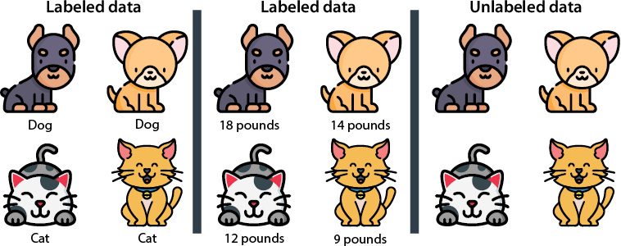
INTRODUCTION. Terms.
Data - any information we use to build model
useful information
no useful information relevant to the model
Serrano, L., 2021. Grokking machine learning. Simon and Schuster.

Slide 9
Supervised Learning - predict using labeled data
Classification model use categorical data
Regression model use numerical data
Serrano, L., 2021. Grokking machine learning. Simon and Schuster.

Slide 10
Supervised Learning Regression
Housing Prices - predict price of a new house, based on prices and features of existing houses
Stock Market - predict price of a certain stock
Medicine - predict expected recovery time
Sales - predict expected amount of money customer will spend
Video Recommendation - predicted the expected amount of time a user will watch
Decision tree
Random Forests
AdaBoost
Gradient Boost Trees
XGBoost
etc.
Examples
Methods

Slide 11
Supervised Learning Classification Examples
Predict the type of pet (cat, dog)
Predict if email is spam (spam or not)
Image recognition MNIST
Image recognition CIFAR
Website traffic (whether user will follow the link)
Social Media (whether user will be friend)
Video Recommendation (whether user will watch video)
The Naive Bayes Algorithm
Support Vector Machines
etc.
Examples
Algorithms

Slide 12
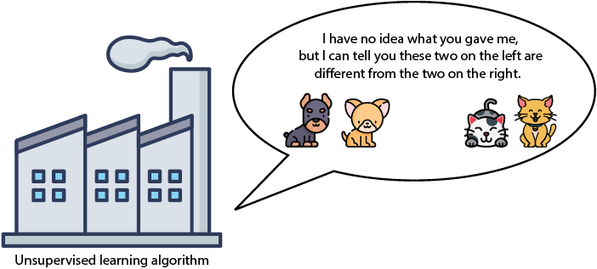
Unsupervised Learning
Extract as much as possible information from data.
Group the images based on similarity.
Separate the dog images from the cat images, or even group each of them by breed!
Serrano, L., 2021. Grokking machine learning. Simon and Schuster.

Slide 13
Unsupervised Learning
Clustering algorithms group data into clusters based on similarity;
Dimensionality reduction algorithms simplify data and describe it with fewer features;
Generative algorithms generate new data points that resemble the existing data.
Use unsupervised learning techniques on data to preprocess
Apply supervised learning methods more effectively
K-means clustering
Hierarchical clustering
Density based spatial clustering
Gaussian mixture models
etc.
Main branches
Algorithms

Slide 14
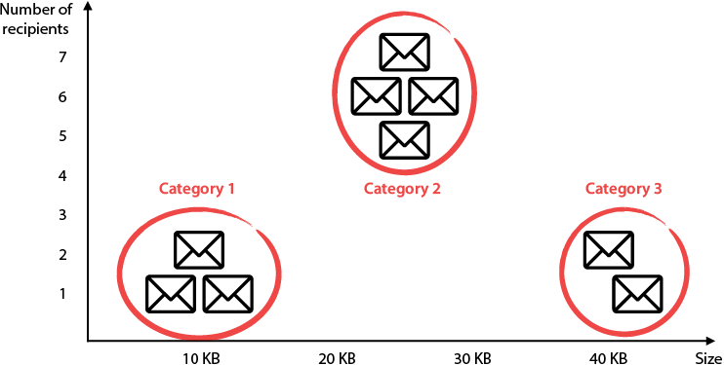
Unsupervised Learning. Clustering algorithm
Example about spam emails. Group emails by the size, sender, links in email, attachments etc.
Serrano, L., 2021. Grokking machine learning. Simon and Schuster.

Slide 15
Unsupervised Learning. Dimensionality reduction.
Preprocessing step to simplify data prior to other techniques.
Selling houses dataset:
Size
Number of bedrooms
Number of bathrooms
Crime rate in the neighborhood
Distance to the closest school

Slide 16
Unsupervised Learning. Dimensionality reduction.
Preprocessing step to simplify data prior to other techniques.
Selling houses dataset:
Size
Number of bedrooms
Number of bathrooms
Crime rate in the neighborhood
Distance to the closest school
General size
Neighbourhood quality

Slide 17
Unsupervised Learning. Dimensionality reduction.
Preprocessing step to simplify data prior to other techniques. Selling houses dataset:
Size | Number of bedrooms | Number of bathrooms | Crime rate in the neighborhood | Distance to the closest school
General size |  | Neighbourhood quality

Slide 18
Unsupervised Learning. Dimensionality reduction.
Self study:
Matrix factorization
Singular value decomposition

Slide 19

Unsupervised Learning. Generative ML.
input dataset output new similar data sample
image
video
music
story
poetry etc.
Popular algorithms:
Generative Adversarial Networks (GANs) by Ian Goodfellow and his coauthors
Variational autoencoders by Kingma and Welling
Restricted Boltzmann machines (RBMs) by Geoffrey Hinton
As you can imagine, generative learning is quite hard. For a human, it is much easier to determine if an image shows a dog than it is to draw a dog. This task is just as hard for computers. Thus, the algorithms in generative learning are complicated, and lots of data and computing power are needed to make them work well. Because this book is on supervised learning, we won’t cover generative learning in detail, but in chapter 10, we get an idea of how some of these generative algorithms work, because they tend to use neural networks. Appendix C contains recommendations of resources, including a video by the author, if you’d like to explore this topic further.
https://news.ubc.ca/wp-content/uploads/2023/08/AdobeStock_559145847.jpeg

Slide 20
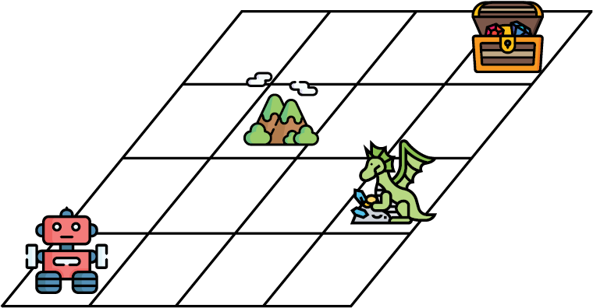
Reinforcement Learning
INPUT:
No data.
An environment with rewards and punishments
An agent with goal to navigate in this environment.
OUTPUT: Perform a task.
Games: teach computers how to win at Go, Chess, Breakout, Super Mario etc. games.
Robotics: help robots picking up boxes, cleaning a room, or even dancing!
Self-driving cars: path planning or behaving in particular environments.
Serrano, L., 2021. Grokking machine learning. Simon and Schuster.

Slide 21
Machine Learning
Supervised learning
Regression
Classification
Unsupervised learning
Clustering
Dimensionality reduction
Generative ML
Reinforcement learning

Slide 22
Predicting house prices based on the house’s size, number of rooms, and location
Predicting today’s stock market prices based on yesterday’s prices and other factors of the market
Detecting spam and non-spam emails based on the words in the e-mail and the sender
Recognizing images as faces or animals, based on the pixels in the image
Processing long text documents and outputting a summary
Recommending videos or movies to a user (e.g., on YouTube or Netflix)
Building chatbots that interact with humans and answer questions
Training self-driving cars to navigate a city by themselves
Diagnosing patients as sick or healthy
Predicting whether a credit card transaction is legitimate or fraudulent
Segmenting the market into similar groups based on location, acquisitive power, and interests
Playing games like Chess or Go

Slide 23
Summary
Major types of machine learning: supervised learning, unsupervised learning, and reinforcement learning.
Data can be labeled or unlabeled. Labeled data contains a special feature that we aim to predict.
Supervised learning is used on labeled data and consists of building models that predict the labels for unseen data.
Unsupervised learning is used on unlabeled data and consists of algorithms that simplify our data without losing a lot of information. Unsupervised learning is often used as a preprocessing step.
Two common types of supervised learning algorithms are called regression and classification.
Regression models are those in which the answer is any number.
Classification models are those in which the answer is of a type or a class.
Two common types of unsupervised learning algorithms are clustering and dimensionality reduction.
Clustering is used to group data into similar clusters to extract information or make it easier to handle.
Dimensionality reduction is a way to simplify our data, by joining certain similar features and losing as little information as possible.
Matrix factorization and singular value decomposition are other algorithms that can simplify our data by reducing both the number of rows and columns.
Generative machine learning is an innovative type of unsupervised learning, consisting of generating data that is similar to our dataset. Generative models can paint realistic faces, compose music, and write poetry.
Reinforcement learning is a type of machine learning in which an agent must navigate an environment and reach a goal. It is extensively used in many cutting-edge applications.

