Slide 1
CSCI 111 Web Programming and Problem Solving
Section 1
PART III Artificial Intelligence
Weeks [12 - 15]
Week-13-lecture: Machine Learning. Regression.
Instructor: Dr. Talgat Manglayev

Slide 2
CONTENT
The problem: Predict the price of a house
The solution: Building a regression model for housing prices
The linear regression algorithm
How do we measure our results? The error function
Polynomial regression
Parameters and hyper parameters
Underfitting and overfitting data
Regularization

Slide 3
The problem: Predict the price of a house
What would be the price for a house with 4 rooms?
Rooms | Price
1 | 10
2 | 15
3 | 20
4 | ?
5 | 30
6 | 35
7 | 40

Slide 4
The problem: Predict the price of a house
What would be the formula for price for a house?
Price = 5 + 5 x number_of_rooms
Rooms | Price
1 | 10
2 | 15
3 | 20
4 | ?
5 | 30
6 | 35
7 | 40

Slide 5
The problem: Predict the price of a house
What would be the formula for price for a house?
Price = 10 + 5 x number_of_rooms
model
prediction
Rooms | Price
1 | 15
2 | 20
3 | 25
4 | ?
5 | 35
6 | 40
7 | 45
weight
bias
feature

Slide 6
The problem: Predict the price of a house
The model to predict price for a house
Price = 10 + 5 x number_of_rooms
model
prediction
bias
weight
feature

Slide 7
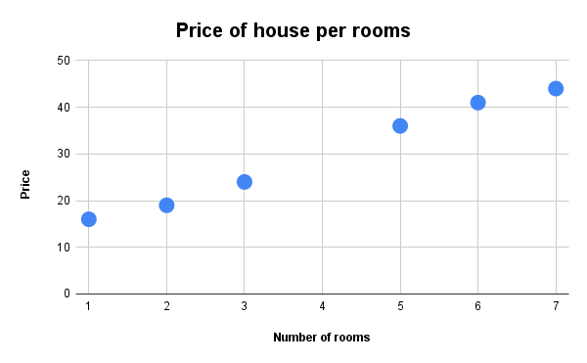
The problem: Predict the price of a house
Rooms | Price
1 | 16
2 | 19
3 | 24
4 | ?
5 | 36
6 | 41
7 | 44

Slide 8
The problem: Predict the price of a house
Price = 10 + 5 x number_of_rooms + (small_error)
Rooms | Price
1 | 16
2 | 19
3 | 24
4 | ?
5 | 36
6 | 41
7 | 44

Slide 9
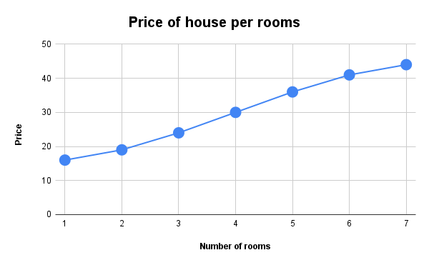
The problem: Predict the price of a house
Price = 10 + 5 x number_of_rooms + (small_error)
Rooms | Price
1 | 16
2 | 19
3 | 24
4 | 30
5 | 36
6 | 41
7 | 44

Slide 10
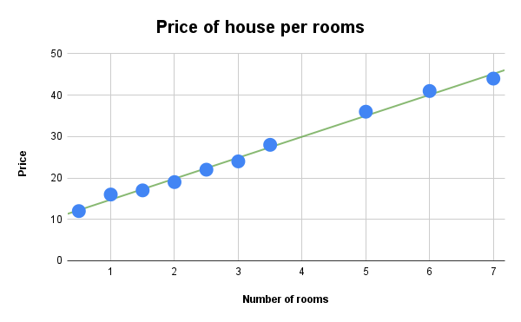
The problem: Predict the price of a house
Price = 10 + 5 x number_of_rooms + (small_error)
The goal of linear regression is to draw the straight line that passes as close as possible to these points.
Rooms | Price
1 | 16
2 | 19
3 | 24
4 | 30
5 | 36
6 | 41
7 | 44

Slide 11
The problem: Predict the price of a house
The model to predict price for a house
Linear equation
Price = 10 + 5 x number_of_rooms
model
prediction
bias
weight
feature
y = b + mx

Slide 12
Multivariate linear regression
Price = 5 x number_of_rooms + 1.5 x size - 2 x age + 2 x number_of_schools + 10
feature
weight value -
how important is the feature to determine the price
sign affects whether the price rises (+) or fails (-)

Slide 13
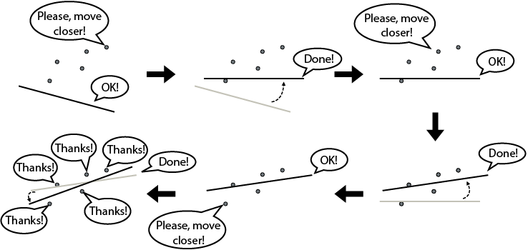
The linear regression algorithm
Pick a random line.
Repeat many times:
Pick a random data point.
Move the line a little closer to the point.
Return the line you’ve obtained.
Serrano, L., 2021. Grokking machine learning. Simon and Schuster.

Slide 14
The linear regression algorithm
Pick a model with random weights and a random bias.
Repeat many times:
Pick a random data point.
Slightly adjust the weights and bias to improve the prediction for that particular data point.
Return the model you’ve obtained.
Serrano, L., 2021. Grokking machine learning. Simon and Schuster.

Slide 15
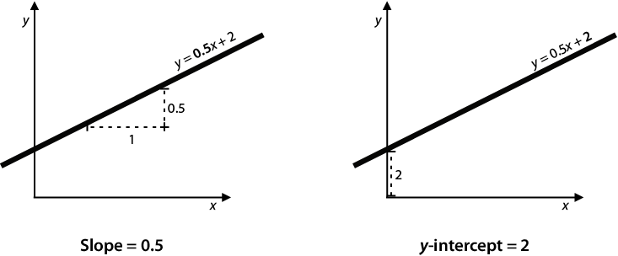
The linear regression algorithm
Serrano, L., 2021. Grokking machine learning. Simon and Schuster.

Slide 16
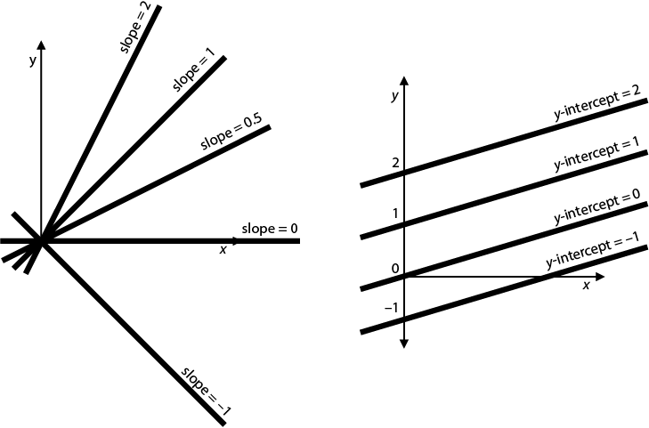
The linear regression algorithm
Serrano, L., 2021. Grokking machine learning. Simon and Schuster.

Slide 17
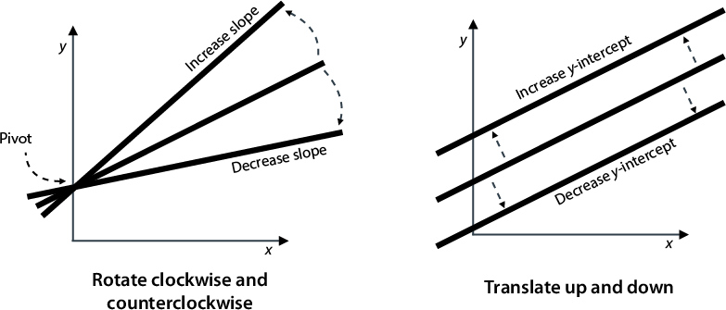
The linear regression algorithm
If we increase the slope of a line, the line will rotate counterclockwise.
If we decrease the slope of a line, the line will rotate clockwise.
Serrano, L., 2021. Grokking machine learning. Simon and Schuster.

Slide 18
The linear regression algorithm
If we increase the y-intercept of a line, the line is translated upward.
If we decrease the y-intercept of a line, the line is translated downward.
Serrano, L., 2021. Grokking machine learning. Simon and Schuster.

Slide 19
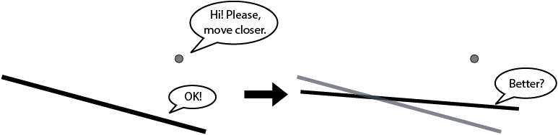
The linear regression algorithm
Serrano, L., 2021. Grokking machine learning. Simon and Schuster.

Slide 20
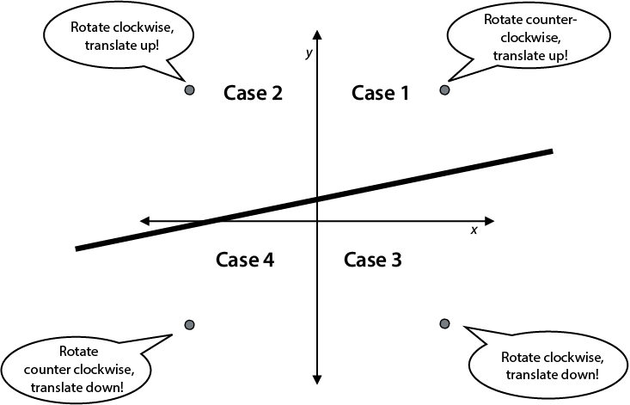
The linear regression algorithm
Serrano, L., 2021. Grokking machine learning. Simon and Schuster.

Slide 21
The linear regression. Simple Trick
input: y = mx + b, (x, y)
Pick two very small random numbers: η1 and η2
output: y' = m'x + b' closer to (x, y)
m' = m - η1.
b' = b + η2.
m' = m + η1.
b' = b + η2.
m' = m + η1.
b' = b - η2.
m' = m - η1.
b' = b - η2.

Slide 22
The linear regression. Simple Trick
input: y = mx + b, (x, y)
Pick two very small random numbers: η1 and η2
output: y' = m'x + b' closer to (x, y)
If the model gave us a price for the house that is lower than the actual price, add a small random amount to the price per room and to the base price of the house.
If the model gave us a price for the house that is higher than the actual price, subtract a small random amount from the price per room and the base price of the house.
m' = m - η1.
b' = b + η2.
m' = m + η1.
b' = b + η2.
m' = m + η1.
b' = b - η2.
m' = m - η1.
b' = b - η2.

Slide 23
The linear regression. Square trick
Move the line closer to point:
find values with the correct signs (+ or –) to add to the slope and the y-intercept.

Slide 24
The linear regression. Square trick
Observation 1: In the simple trick, when the point is above the line, we add a small amount to the y-intercept. When it is below the line, we subtract a small amount.
Serrano, L., 2021. Grokking machine learning. Simon and Schuster.

Slide 25
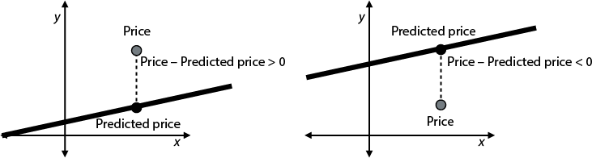
The linear regression. Square trick
Observation 2: If a point is above the line, the value y - y' (the difference between the price and the predicted price) is positive. If it is below the line, this value is negative.
Serrano, L., 2021. Grokking machine learning. Simon and Schuster.

Slide 26
The linear regression. Square trick
if we add the difference y - y' to the y-intercept, the line will always move toward the point
Serrano, L., 2021. Grokking machine learning. Simon and Schuster.

Slide 27
The linear regression. Square trick
if we add the difference y - y' to the y-intercept, the line will always move toward the point
learning rate - A very small number η, which is set before training model to keep the changes in very small amounts by training. The value η⋅(y - y') is added to the y-intercept to move the line in the direction of the point.
Serrano, L., 2021. Grokking machine learning. Simon and Schuster.

Slide 28
The linear regression. Square trick
Observation 3: In the simple trick, when the point is in scenario 1 or 4 (above the line and to the right of the vertical axis, or below the line and to the left of the vertical axis), we rotate the line counterclockwise. Otherwise (scenario 2 or 3), we rotate it clockwise.
Serrano, L., 2021. Grokking machine learning. Simon and Schuster.

Slide 29
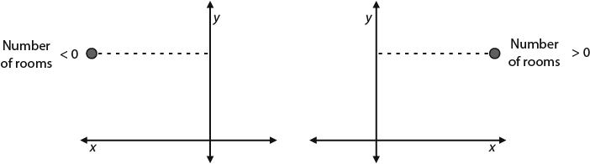
The linear regression. Square trick
Observation 4:
If a point (x, y) is to the right of the vertical axis, then x is positive.
If the point is to the left of the vertical axis, then x is negative.
Serrano, L., 2021. Grokking machine learning. Simon and Schuster.

Slide 30
The linear regression. Square trick
if
( x > 0 and (y - y') > 0 )
or
( x < 0 and (y - y') < 0 )
⇒ x⋅(y - y') > 0
η⋅x⋅(y - y')
Makes the value small
Moves the line to the direction of the point
Serrano, L., 2021. Grokking machine learning. Simon and Schuster.

Slide 31
The linear regression. Square trick
input:
y = mx + b, (x, y), η
steps:
m' = m + η⋅x⋅(y - y') (rotate).
b' = b + η⋅(y - y') (translate).
output:
price per room and base price: m', b'

Slide 32
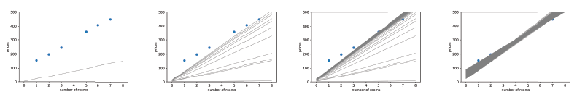
The linear regression
example-2.html
Repeat the square trick many times to move the line closer to the points.
Input: a dataset of houses with number of rooms and prices
Procedure:
Random values for m and b.
Repeat many times:
Pick a random data point.
Update the slope and the y-intercept using the square trick.
Output: y' = m'x + b'
Serrano, L., 2021. Grokking machine learning. Simon and Schuster.

Slide 33
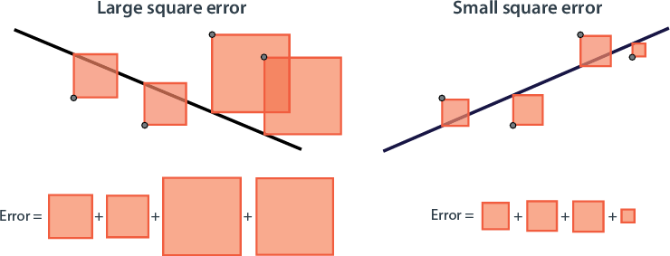
Root mean square error. (RMSE)
The model makes an error of around RMSE for any prediction we make.
Serrano, L., 2021. Grokking machine learning. Simon and Schuster.

Slide 34
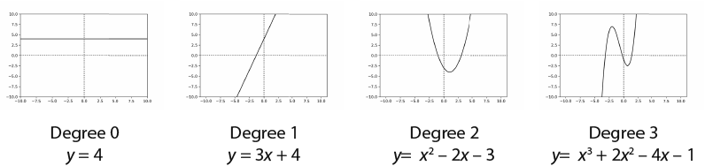
Polynomial regression
If graph plotted from data is not a line, but a curve.
Function for nonlinear data - polynomial.
Serrano, L., 2021. Grokking machine learning. Simon and Schuster.

Slide 35
Parameters
Quantity that the model creates/modifies during the training - parameter.
Quantity that you set before the training process - hyperparameter.
function linear_regression(features, labels, learning_rate = 0.01, epochs = 100)
{ … }
Price = 10 + 5 x number_of_rooms
model
prediction
bias weight
parameters
feature
hyper parameters

Slide 36
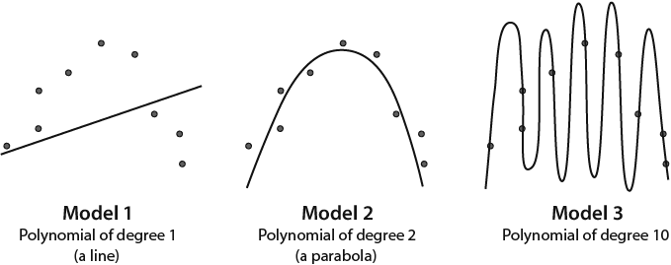
Underfitting and overfitting data
simple models tend to underfit and complex models tend to overfit
Serrano, L., 2021. Grokking machine learning. Simon and Schuster.

Slide 37
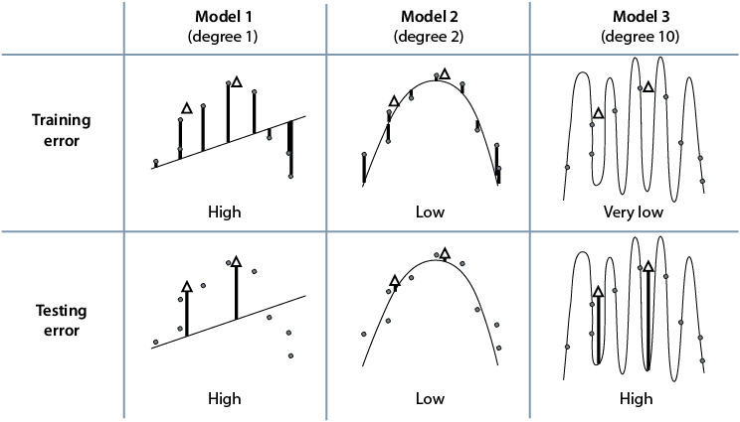
Underfitting and overfitting data
Serrano, L., 2021. Grokking machine learning. Simon and Schuster.

Slide 38
Training, Validation, Testing
80 % - training set: for training all models
10 % - validation set: for making decisions on which model to use
10 % - testing set: for checking how well the model did
Serrano, L., 2021. Grokking machine learning. Simon and Schuster.

Slide 39
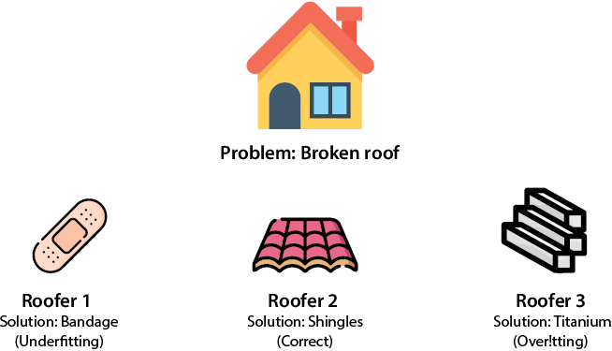
Regularization example 1
LEAK:
1000 mL
1 mL
0 mL
COST:
1 $
100$
100 000$
Regularization:
LEAK+COST:
1001
101
100000
Serrano, L., 2021. Grokking machine learning. Simon and Schuster.

Slide 40
Regularization example 2 (recommend movie)
ŷ = w₁x₁ + w₂x₂ + w₃x₃+ w₄x₄ + w₅x₅ + w₆x₆ + w₇x₇ + w₈x₈ ++ w₉x₉ + w₁₀x₁₀ + b
xᵢ - the amount of time the user watched the movie for i = 1,10
ŷ - the amount of time the model predicts that the user will watch movie 11
wᵢ - is the weight associated to movie i
b - bias
Model 1: ŷ = 2x₃ + 1.4x₇ – 0.5x₉ + 4
Model 2: ŷ = 22x₁ – 103x₂ – 14x₃ + 109x₄ – 93x₅ + 203x₆ + 87x₇ – 55x₈ + 378x₉ – 25x₁₀ + 8
Serrano, L., 2021. Grokking machine learning. Simon and Schuster.

Slide 41
Regularization Complexity
L1 and L2 - the model performance and complexity
L1 norm - sum absolute coefficient; L2 norm - square coefficient.
Model 1: ŷ = 2x₃ + 1.4x₇ – 0.5x₉ + 4
Model 2: ŷ = 22x₁ – 103x₂ – 14x₃ + 109x₄ – 93x₅ + 203x₆ + 87x₇ – 55x₈ + 378x₉ – 25x₁₀ + 8
L1 norm:
Model 1: |2| + |1.4| + |–0.5| = 3.9
Model 2: |22| + |–103| + |–14| + |109| + |–93| + |203| + |87| + |–55| + |378| + |–25| = 1089
L2 norm:
Model 1: 22 + 1.42 + (–0.5)2 = 6.21
Model 2: 222 + (–103)2 + (–14)2 + 1092 + (-93)2 + 2032 + 872 + (–55)2 + 3782 + (–25)2 = 227,131

Slide 42
Regularization
λ - regularization parameter (10, 1, 0.1, 0.01)
Error = Regression error (RMSE) + λ * Regularization term (L1 or L2)
L1 - Turns some of the coefficients into zero. If we have too many features and we’d like to get rid of most of them.
L2 - Shrinks all the coefficients but rarely turns them into zero. If we have only few features and believe they are all relevant, then L2 regularization is what we need

Slide 43
Regularization
Method 1: if(weight > 0) weight = weight - λ,
else if(weight < 0) weight = weight + λ
Method 2: if λ = 0.01, weight x (1 – λ) ≈ weight x 1.
ŷ = 2x₃ + 1.4x₇ – 0.5x₉ + 4, λ = 0.01
Method 1: 1.99, 1.39, 0.06
Method 2, 1.98, 1.386, and -0.495
Serrano, L., 2021. Grokking machine learning. Simon and Schuster.

Slide 44
Self study
Serrano, L., 2021. Grokking machine learning. Simon and Schuster., Chapter 3, Chapter 4
Video lectures: chapter 1, 2, chapter 3;
Serrano, L., 2021. Grokking machine learning. Simon and Schuster., Chapter 4

Slide 45
Summary
Regression is an important part of machine learning. It consists of training an algorithm with labeled data and using it to make predictions on future (unlabeled) data.
Labeled data is data that comes with labels, which in the regression case, are numbers. For example, the numbers could be prices of houses.
In a dataset, the features are the properties that we use to predict the label. For example, if we want to predict housing prices, the features are anything that describes the house and which could determine the price, such as size, number of rooms, school quality, crime rate, age of the house, and distance to the highway.
The linear regression method for predicting consists in assigning a weight to each of the features and adding the corresponding weights multiplied by the features, plus a bias.
Graphically, we can see the linear regression algorithm as trying to pass a line as close as possible to a set of points.
The way the linear regression algorithm works is by starting with a random line and then slowly moving it closer to each of the points that is misclassified, to attempt to classify them correctly.

Slide 46
Summary
Two problems that come up quite often are underfitting and overfitting.
Underfitting - very simple model to fit dataset. Overfitting - an overly complex model to fit dataset.
An effective way to tell overfitting and underfitting apart is by using a testing dataset.
Split the data into two sets to test a model: a training set and a testing set. The training set - train the model, and the testing set - evaluate the model.
Never use testing data for training or making decisions in models.
The validation set is another portion of dataset used to make decisions about the hyperparameters in model.
A model that underfits will perform poorly in the training set and in the validation set. A model that overfits will perform well in the training set but poorly in the validation set. A good model will perform well on both the training and the validation sets.
The model complexity graph is used to determine the correct complexity of a model, so that it doesn’t underfit or overfit.
Regularization is a very important technique to reduce overfitting in machine learning models. It consists of adding a measure of complexity (regularization term) to the error function during the training process.
The L1 and L2 norms are the two most common measures of complexity used in regularization.
Using the L1 norm leads to L1 regularization, or lasso regression. Using the L2 norm leads to L2 regularization, or ridge regression.
L1 regularization is recommended when our dataset has numerous features, and we want to turn many of them into zero. L2 regularization is recommended when our dataset has few features, and we want to make them small but not zero.

