Slide 1

Exploring: Microsoft® Excel® 2016 Comprehensive
First Edition
Chapter 2
Formulas and Functions Performing Quantitative Analysis
Copyright © 2017 Pearson Education, Inc. All Rights Reserved
Notes:
If this PowerPoint presentation contains mathematical equations, you may need to check that your computer has the following installed:
1) MathType Plugin
2) Math Player (free versions available)
3) NVDA Reader (free versions available)
Exploring: Microsoft® Excel® 2016 Comprehensive
In Chapter 2, you will learn how to use formulas and functions to calculate and analyze data.

Slide 2
Objectives
Use Relative, Absolute, and Mixed Cell References in Formulas
Insert a Function
Insert Basic Math and Statistics Functions
Use Date Functions
Determine Results with the IF Function
Use Lookup Functions
Notes:
The objectives for this chapter are:
Use Relative, Absolute, and Mixed Cell References in Formulas
Insert a Function
Insert Basic Math and Statistics Functions
Use Date Functions
Determine Results with the IF Function
Use Lookup Functions
Calculate Payments with the PMT function

Slide 3
Objective 1: Use Relative, Absolute, and Mixed Cell References in Formulas
Skills:
Use a Relative Cell Reference
Use an Absolute Cell Reference
Use a Mixed Cell Reference
Notes:
In this section, the skills include:
Use a Relative Cell Reference
Use an Absolute Cell Reference
Use a Mixed Cell Reference

Slide 4
Use Relative, Absolute, and Mixed Cell References in Formulas (1 of 4)
Relative cell reference—default method of referencing
Absolute cell reference—provides a constant reference to a specific cell
Mixed cell reference—combines absolute and relative cell references
F4—toggles through relative, absolute, and mixed references
Notes:
A relative cell reference is the default method of referencing in Excel. It indicates a cell’s relative location, such as five rows up and one column to the left, from the original cell containing the formula.
An absolute cell reference provides a constant reference to a specific cell, and when a formula containing an absolute cell reference is copied, the cell reference in the copied formula does not change.
A mixed cell reference combines an absolute and a relative cell reference.
Press F4 to toggle through relative, absolute, and mixed references within a cell.

Slide 5
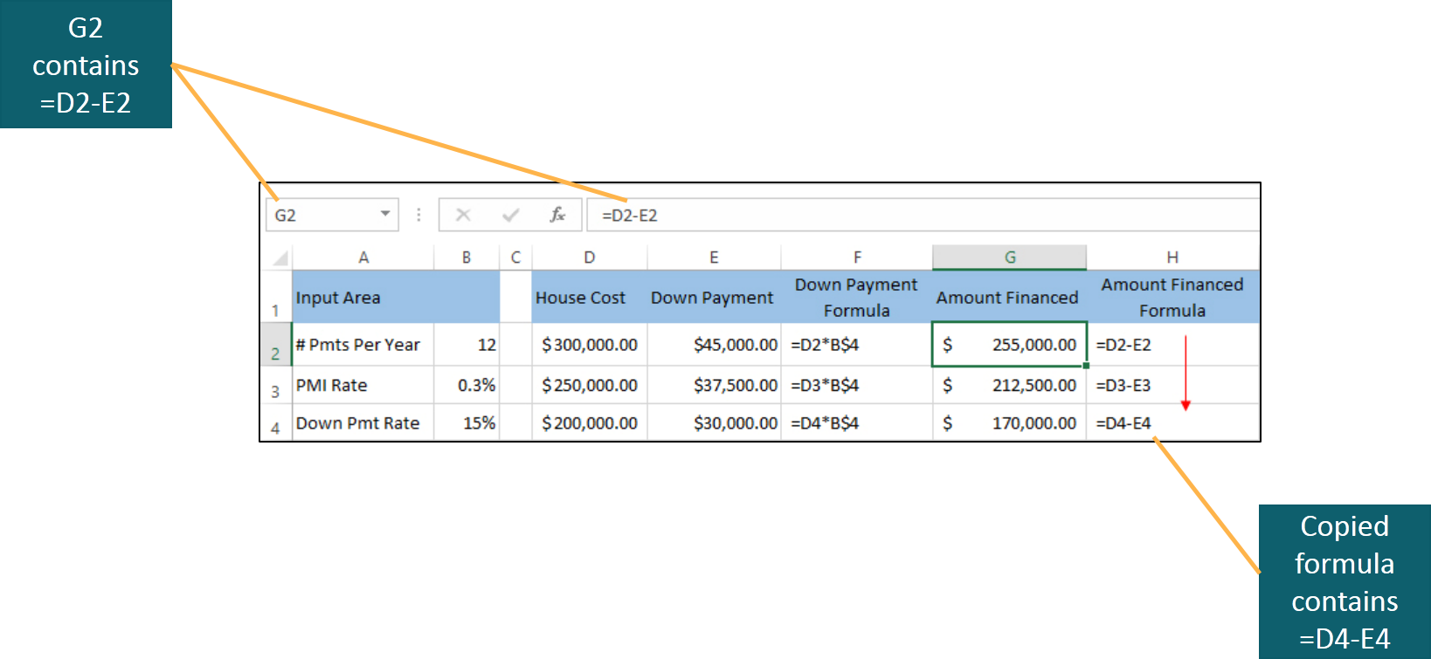
Use Relative, Absolute, and Mixed Cell References in Formulas (2 of 4)
Notes:
The formula in cell G2 is =D2-E2 and uses relative cell referencing. When the formula is copied to cell G4, it becomes =D4-E4.

Slide 6
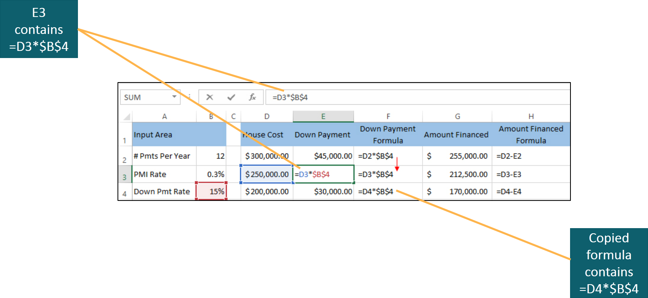
Use Relative, Absolute, and Mixed Cell References in Formulas (3 of 4)
Notes:
The formula in cell E3 is =D3*$B$4 and uses absolute cell referencing for cell B4. When the formula is copied to cell E4, it becomes =D4*$B$4. The reference to cell D3 was relative, so it changed to D4, but the reference to cell B4 remains the same. Note the use of the $ character to denote an absolute address.

Slide 7
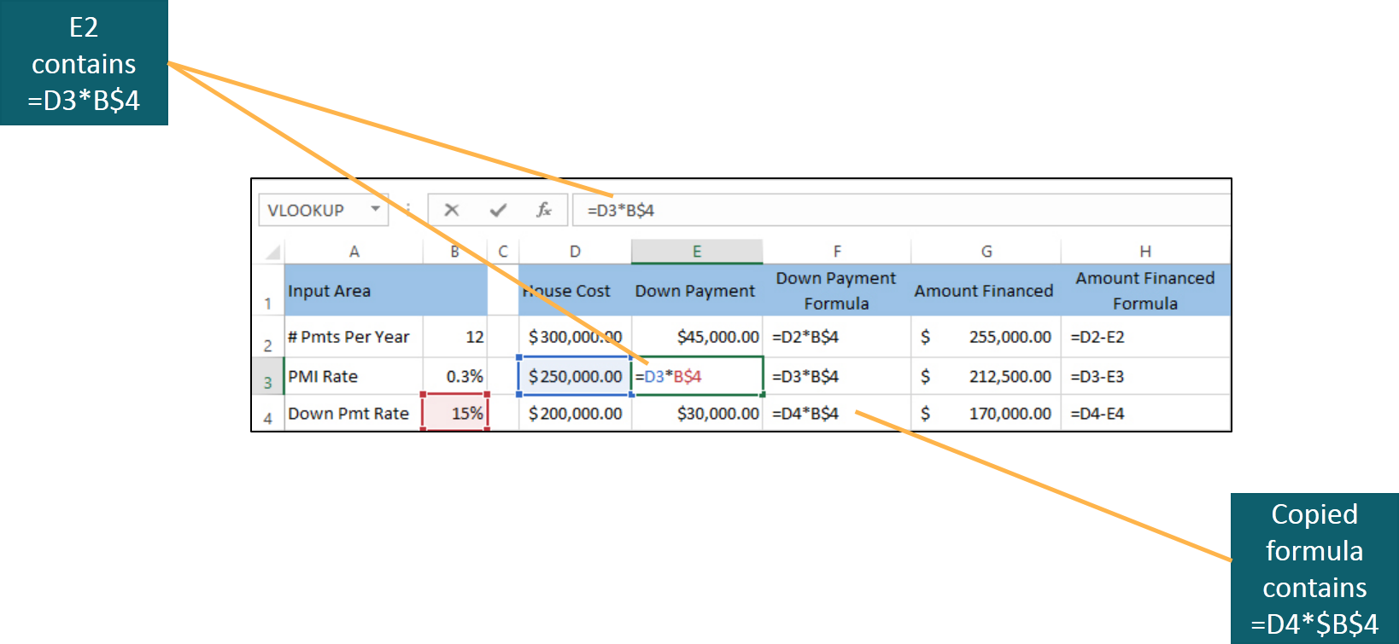
Use Relative, Absolute, and Mixed Cell References in Formulas (4 of 4)
Notes:
The formula in cell E3 is =D3*B$4 and uses mixed cell referencing for cell B4. When the formula is copied to cell E4, it becomes =D4*B$4. The reference to cell D3 was relative, so it changed to D4, but the reference to cell B4 remains the same. Note the $ was only used on row 4 and remains the same. There was no $ on the B, but because the formula was copied to row E—the same column in which the original formula was located—it remains B. Had the formula been copied to another column, the column letter would have changed.

Slide 8
Objective 2: Insert a Function
Skills:
Insert a Function
Insert a Function Using Formula AutoComplete
Use the Insert Function Dialog Box
Notes:
In this section, the skills include:
Insert a Function
Insert a Function Using Formula AutoComplete
Use the Insert Function Dialog Box

Slide 9
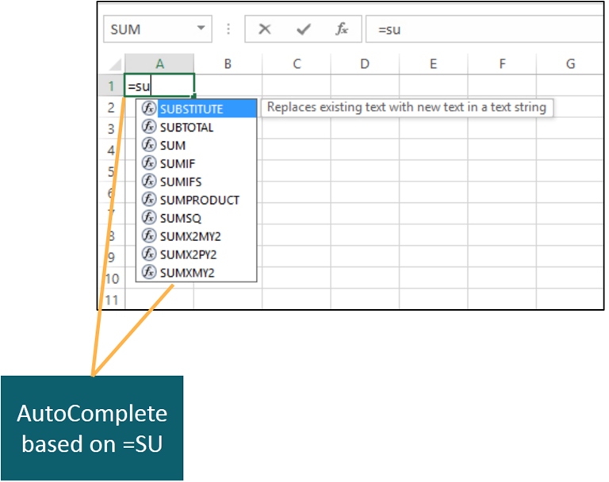
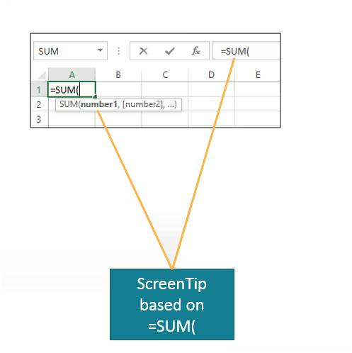
Insert a Function (1 of 3)
Notes:
In Excel, a function is a predefined computation that simplifies creating a formula that performs a complex calculation.
A function’s arguments identify the inputs—cells, values, or arithmetic expressions—that are required to complete the operation. Some functions require no arguments and some require multiple arguments separated by commas.
Excel’s Formula AutoComplete feature displays a list of functions and defined names that match letters as you type a formula.
After the function name and opening parenthesis have been typed, Excel displays a function ScreenTip, which is a small pop-up description that displays the function’s arguments.

Slide 10
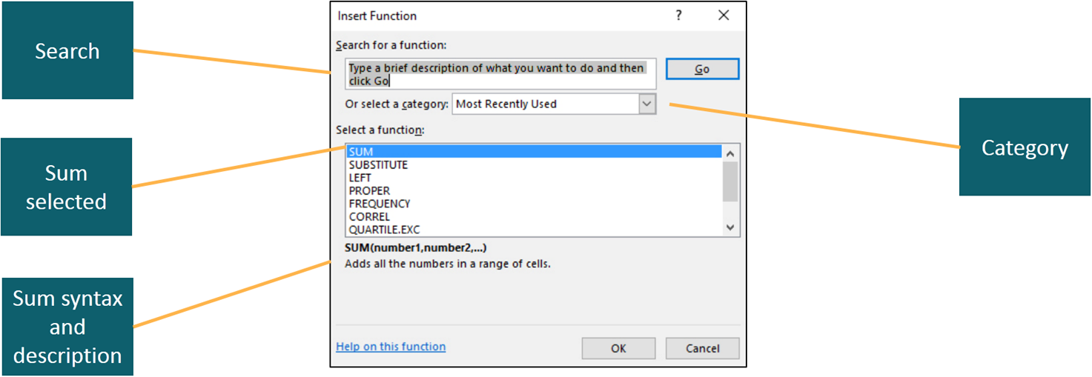
Insert a Function (2 of 3)
Notes:
An additional method of entering a function into a cell is to use the Insert Function dialog box. The easiest way to display is to click Insert Function, which is located between the Name Box and Formula Bar. You can type the name of the function in the Search for a Function box or scroll through the list of functions determined by the category that you select. Once a function has been selected, the syntax and a description of the function are listed. Once the desired function has been determined, click OK.

Slide 11
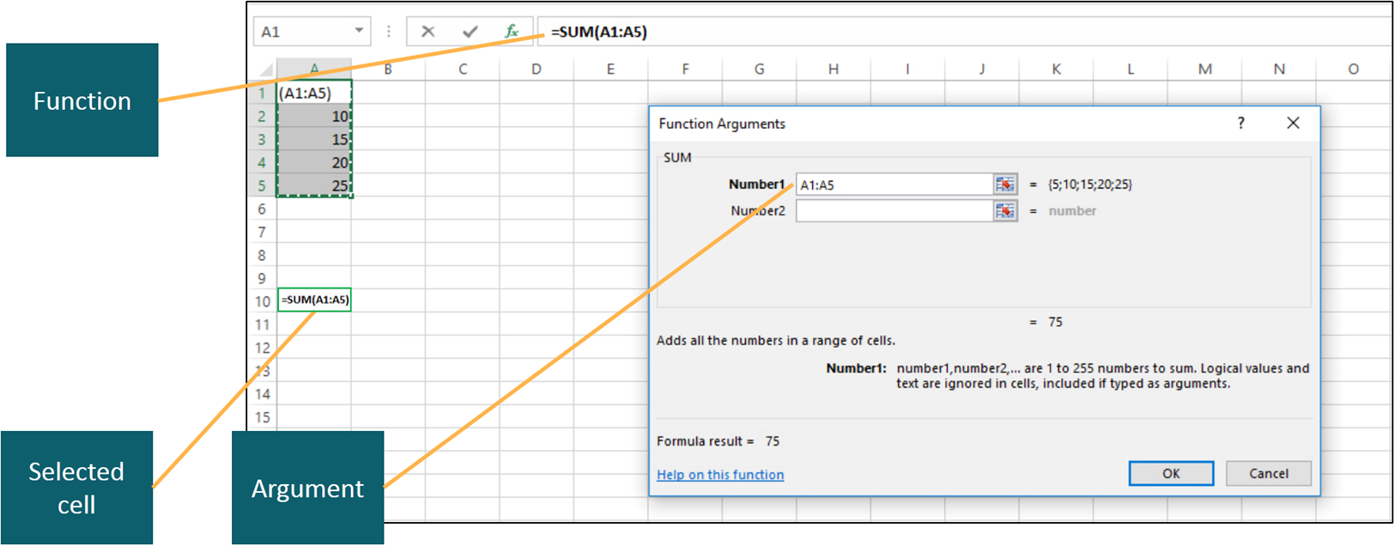
Insert a Function (3 of 3)
Notes:
Clicking OK displays the Function Arguments dialog box in which the arguments are entered. As you enter values in the argument boxes, Excel constructs the formula in the Formula Box, and when OK is clicked, the constructed formula is inserted in the selected cell. In this figure, cell A10 contains =SUM(A1:A5).

Slide 12
Objective 3: Insert Basic Math and Statistics Functions
Skills:
Use the Sum Function
Use the Average and Median Functions
Use the Min and Max Functions
Use the Count Functions
Perform Calculations with Quick Analysis Tools
Notes:
In this section, the skills include:
Use the SUM Function
Use the AVERAGE and MEDIAN Functions
Use the MIN and MAX Functions
Use the COUNT Functions
Perform Calculations with Quick Analysis Tools

Slide 13
Insert Basic Math and Statistics Functions (1 of 2)
=SUM(number1, [number2], …)
=SUM(A1,A2,A5)
=AVERAGE(number1, [number2], …)
=AVERAGE(B10:B20)
=MEDIAN(number1, [number2], …)
=MEDIAN(A2:A14,F2:F14)
=MIN(number1, [number2], …)
=MIN(A1,B10:C25)
Notes:
The SUM function totals values in one or more cells and displays the result in the cell containing the function.
The AVERAGE function calculates the arithmetic mean, or average, for the values in a range of cells.
The MEDIAN function finds the midpoint value, which is the value that one half of the data set is above or below.
The MIN function analyzes the range of cells in its argument list and determines the lowest value.
In the examples shown on the slide, the brackets [ ] denote optional arguments.

Slide 14
Insert Basic Math and Statistics Functions (2 of 2)
=MAX(number1, [number2], …)
=MAX(A1,B10:C25)
=COUNT(number1, [number2], …)
=COUNT(B10:G50)
=COUNTBLANK(number1, [number2], …)
=COUNTBLANK(B10:G50)
=COUNTA(number1, [number2], …)
=COUNTA(B10:G50)
Notes:
The MAX function analyzes the range of cells in its argument list and determines the highest value.
There are three COUNT functions:
The COUNT function tallies the number of cells in a range that contain values that can be used in calculations.
The COUNTBLANK function tallies the number of cells in a range that are blank.
The COUNTA function tallies the number of cells in a range that are not blank.

Slide 15
Objective 4: Use Date Functions
Skills:
Use the Today Function
Use the Now Function
Notes:
In this section, the skills include:
Use the TODAY Function
Use the NOW Function

Slide 16
Use Date Functions
=TODAY()
Displays a result like: 2/9/2018
=NOW()
Displays a result like: 2/9/2018 14:09
Notes:
The TODAY function displays the current date in a cell. Excel updates the TODAY function each time the workbook is opened or printed.
The NOW function uses the computer’s clock to display the current date and military time that the workbook was last opened. 14:09 military time represents 2:09 PM.
Notice that these two functions do not require an argument. However, the empty parentheses are required.

Slide 17
Objective 5: Determine Results with the IF Function
Skills:
Use the IF Function
Notes:
In this section, the skill is:
Use the IF Function

Slide 18
Determine Results with the IF Function (1 of 2)
=IF(logical_test,[value_if_true],[value_if_false])
=IF(E2>B$2, B$3,0)
Operator | Description
= | Equal to
<> | Not equal to
< | Less than
> | Greater than
<= | Less than or equal to
>= | Greater than or equal to
Notes:
The IF function tests the specified criteria to see if it is true or false, then returns one value when a condition is met, or is true, and returns another value when the condition is not met, or is false.
The first argument for the IF function is the logical test, which contains either a value or an expression that evaluates to true or false.
The second and third arguments of an IF function can contain text, cell references, formulas, or constants.
Remember in Chapter 1, there were arithmetic operators and most of them were familiar to you, such as the plus (+) and minus (-) signs. Excel also has operators used in logical tests as shown in the table.

Slide 19
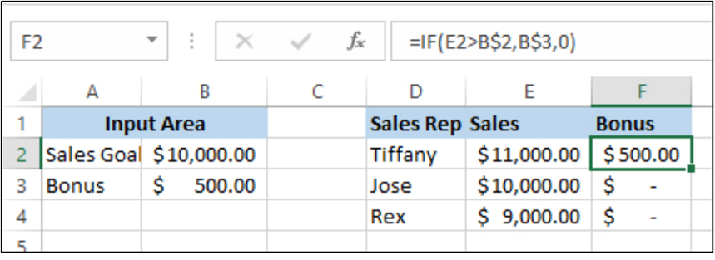
Determine Results with the IF Function (2 of 2)
=IF(logical_test,[value_if_true],[value_if_false])
=IF(E2>B$2, B$3,0)
Notes:
The IF function tests the specified criteria to see if it is true or false, then returns one value when a condition is met, or is true, and returns another value when the condition is not met, or is false.
The formula shown in the figure is in cell F2 and tests to see if salary E2 is greater than the sales goal B$2. If it is, then the bonus of $500—the value in B$3—is placed in the Bonus column. If not, then the bonus is $0. Notice that Jose and Rex do not receive a bonus. Why does Jose not receive a bonus? Let’s see if you understand the IF function. What is the formula in cell F3?

Slide 20
Objective 6: Use Lookup Functions
Skills:
Use the Vlookup Function
Create the Lookup Table
Use the Hlookup Function
Notes:
In this section, the skills include:
Use the VLOOKUP Function
Create the Lookup Table
Use the HLOOKUP Function

Slide 21
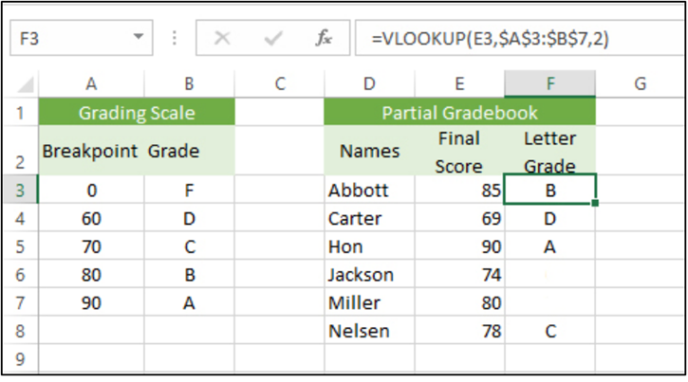
Use Lookup Functions (1 of 2)
=VLOOKUP(lookup_value,table_array,col_index_num,[range_lookup])
=VLOOKUP(E3,$A$3:$B$7,2)
Notes:
The VLOOKUP function accepts a value and looks for the value in the left column of a specified table array and returns another value located in the same row from a specified column.
The lookup value is the cell reference that contains the value to look up, which is E3 in the formula shown.
The table array is the range that contains the lookup table, which is $A$3:$B$7. Absolute cell referencing is used so the table is always referenced correctly.
The column index number is the column number in the lookup table that contains the return values, which is 2.
Range_lookup is optional and this argument determines how the VLOOKUP function handles lookup values that are not an exact match for the data in the lookup table.
Consider the following grading example. This is Figure 2.22 from the textbook, but the grades for Jackson and Miller have been removed. Based on their Final Score, see if you can determine their Letter Grade. If you determined that Jackson receives a C and Miller a B, then you successfully performed a VLOOKUP yourself!

Slide 22
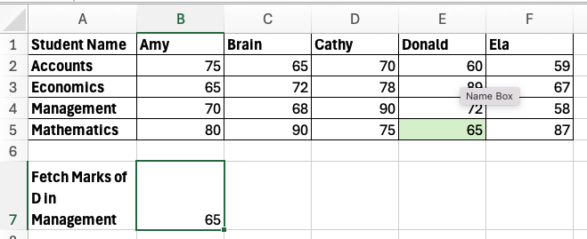
Use Lookup Functions (2 of 2)
=HLOOKUP(lookup_value,table_array,row_index_num,[range_lookup])
=HLOOKUP("D*"; A1:F5; 5; FALSE)
Notes:
Note that, with the exception of the third argument, which refers to a row index instead of a column index, the HLOOKUP function performs similarly, but on a vertical table. This figure shows a table for which the HLOOKUP function would be used.
This table shows the data for different regions (North, South, East, and West) over four quarters (Qtr1, Qtr2, Qtr3, Qtr4). The numbers likely represent some form of performance, such as sales, revenue, or production units, for each region during each quarter. Here's a breakdown:
North Region: There is a steady increase in performance from Qtr1 (3495) to Qtr3 (4982), and a small increase in Qtr4 (5010).
South Region: Performance is highest in Qtr1 (8044) but drops significantly in Qtr4 (6252). Qtr2 and Qtr3 show some decline as well.
East Region: Performance rises from Qtr1 (5081) to Qtr2 (6089), then dips slightly in Qtr3 (5982), before increasing again in Qtr4 (6500).
West Region: There’s a gradual increase in Qtr1 through Qtr3 (4278 to 4387), but Qtr4 sees a sharp rise to 7857, suggesting a major spike in performance.
The table suggests fluctuations in performance across the regions, with the West region experiencing a strong increase in Qtr4, while the South region sees a notable decline in Qtr4 compared to the previous quarters.

Slide 23
Summary
By using Excel formulas and functions, you can perform complicated data analyses
There are three types of cell references—relative, absolute, and mixed
Excel functions include math and statistics, date, logical, and lookup
Notes:
By using Excel formulas and functions, you can perform complicated data analyses with ease.
When using formula or functions, there are three types of cell references—relative, absolute, and mixed.
The Excel functions studied in this chapter were for such diverse areas as: math and statistics, date, logical, lookup, and financial.

Slide 24

Questions
Notes:
It is important to understand the skills learned in this chapter so you can build on these in future PowerPoint chapters. Are there any questions?

Slide 25

Copyright

