Slide 1
CSCI 111: Web Programming and Problem Solving
Lecture 1: Introduction
Instructors:
Dr. Irina Dolzhikova,
Dr. Talgat Manglayev,
Aigerim Yessenbayeva

Slide 2
Outline
Introduction
About the Course
Class Policies
How does the web work
IP addresses and Domain names
DNS and getting domain
Client-Server Model
Websites and their architecture
HTML, CSS, JavaScript

Slide 3
About the Course
Instructor:
Talgat Manglayev
Email: talgat.manglayev@nu.edu.kz
Office: 7e428
Office Hours: TBD
Grading:
Course Project: 35%
Quizzes (3): 30%
Lab Assignments: 30%
Attendance: 5%

Slide 4
About the Course
This is a basic introduction to Web Programming
What you are expected to learn:
Understand how does the web works
Create web pages using HTML and CSS
Add some interactivity to the web pages with JavaScript
Solve problems using Excel and use data in your web pages

Slide 5

Course Materials
Extensive online digital resources (readings, references, tutorials) will be utilized throughout the course.
Recommended resources:
Lecture notes on Moodle
A book: Creating a website
Tutorials: w3schools.com or developer.mozilla.org
HTML CSS and JavaScript for Beginners - A Web Design Course

Slide 6
Deadlines are important!
• There will be Soft and Hard Deadlines
• Late submissions (later than 60 minutes) after the Soft deadline
are penalized by 50%
• Late submissions after the Hard deadline are not accepted

Slide 7
Plagiarism
• “A piece of writing that has been copied [or closely paraphrased] from
someone else and is presented as being your own work”
• “The act of plagiarizing; taking someone's words or ideas as if they were your own”
• Plagiarism results in an automatic F in the course and may result in your suspension from the program!
• Whenever in doubt, ask the instructor

Slide 8
Class Behaviour
• Personal responsibility (Self study!!!)
• Behave professionally & respectfully
• In class: English only
• You will make mistakes (and that’s okay)
• Get involved and have fun!

Slide 9
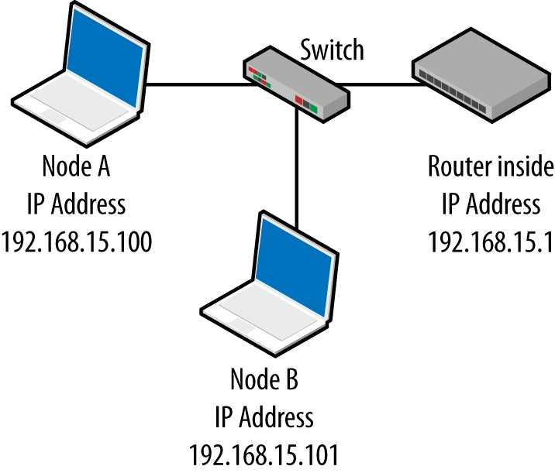
IP addresses
An Internet Protocol (IP) address is a unique identifier of a particular device on the Internet network
• PC, mobile, router, smart watch, TV
• Example: 178.91.253.180 [ Format is A.B.C.D ]
• IP addresses are mathematically produced and allocated by the Internet Assigned Numbers Authority (IANA)
• Types of IP addresses:
• public/private (global/local)
• static/dynamic
• dedicate/shared

Slide 10
Domain Names
A domain name (or domain) is a text string (name) that’s associated with an IP address on the Internet.
• It is a unique name
• Easy to remember for human
• Example: nu.edu.kz, google.com
Types of Domain names:
• Root domain (top-level) – .com, .org, .kz, .ru,
• Subdomains (other levels) – google.com, nu.edu.kz, library.nu.edu.kz

Slide 11
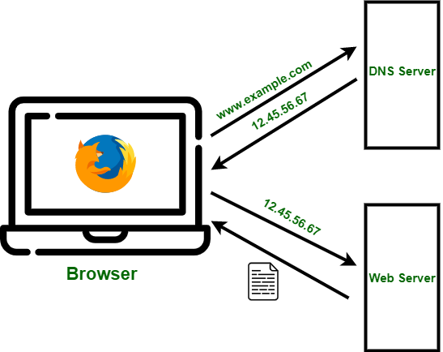
Domain Name System
The Domain Name System (DNS) is the hierarchical and decentralized naming system (database) used to identify computers reachable through the Internet or other Internet Protocol (IP) networks. [Wikipedia]
DNS is a “phonebook” or ”librarian” that converts domain names to IP
addresses
• nu.edu.kz --> 178.91.253.180
There are WHOIS services to lookup domains
• godaddy.com, hoster.kz, domaintoipconverter.com
The browser does a domain lookup for you

Slide 12
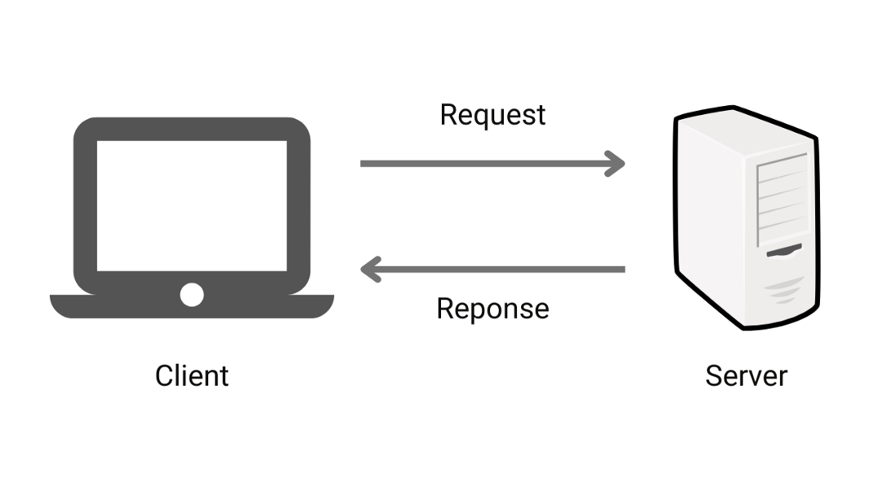

Client-Server Model

Slide 13
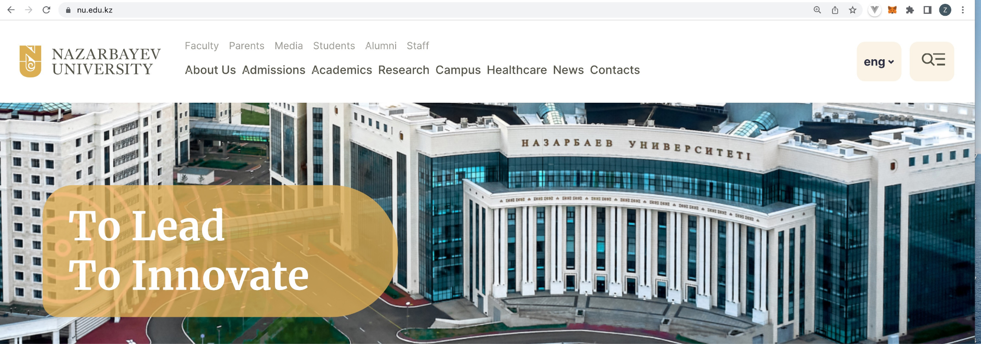
Websites
A website is a collection of web pages and related content that is identified by a common domain name and published on at least one web server with an IP address.
Domain: nu.edu.kz
IP address: 178.91.253.180
Web pages and their URLs:
• About Us - https://nu.edu.kz/about)
• Admission - https://nu.edu.kz/admissions
• Academics - https://nu.edu.kz/academics
• etc.

Slide 14
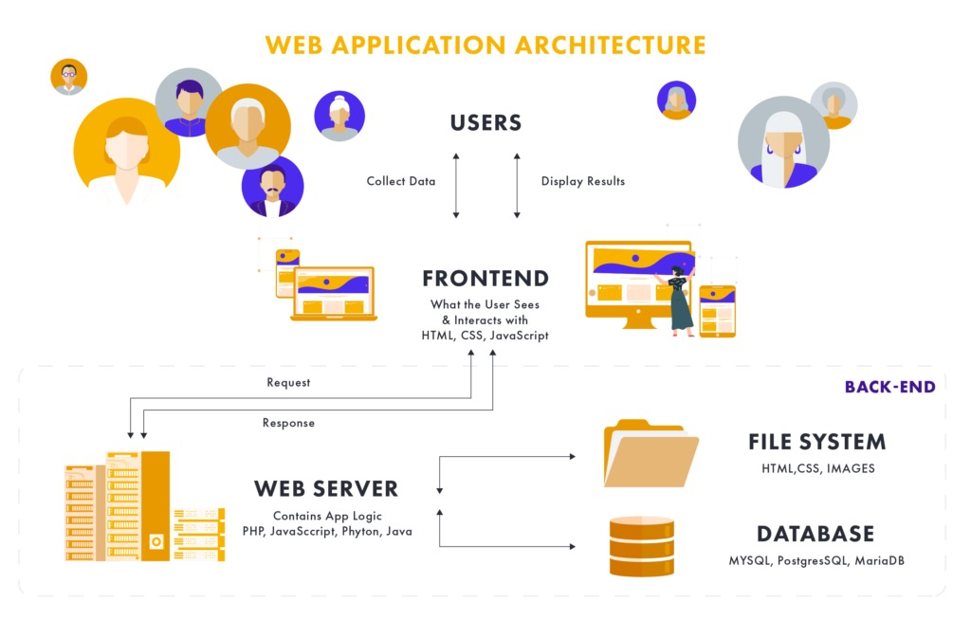
Website Architecture
A typical architecture of a website consists of:
Front-end part (user interface): HTML, CSS, JavaScript
Back-end part (business logic): Python, Java, PHP, etc.
Database: MySQL, PostgreSQL, MS SQL, Oracle
File System: images, audio, video, web pages
Front-end: what users see and interact with.
Back-end: the underlying system that supports
and processes user interactions.
A website can be static or dynamic depending on the content generated.

Slide 15

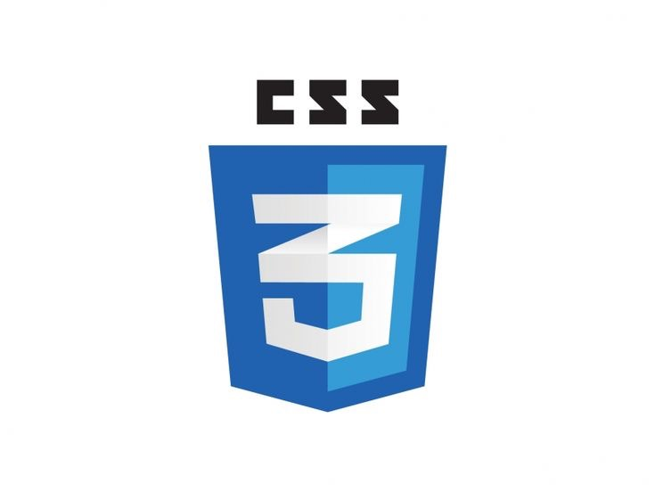

HTML, CSS, Javascript
Hyper-Text Markup Language (HTML) is the standard markup language for documents designed to be displayed in a web browser.
It describes the structure of the web page
Cascading Style Sheets (CSS) is a stylesheet language used to
describe the presentation of a document written in HTML.
It describes the style of the web page
JavaScript (JS) is a lightweight and interpreted programming (or
scripting) language for Web pages.
It adds interactivity to the web page

Slide 16
Key takeaways
IP address
Domain name
DNS
Client-Server Model
Web Server
Websites
Web Architecture
Frontend/Backend
HTML, CSS, JavaScript

Slide 17
Thanks for Attention!

