Slide 1
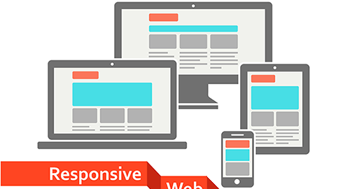
<!DOCTYPE html>
<html>
<head>
<title>CSCI 111 Web Programming and Problem Solving</title>
</head>
<body>
<h1>Week-5-Lecture</h1>
<h2>Responsive Web Design</h2>
<ul>
<li>Dr. Talgat Manglayev</li>
<li>Dr. Irina Dolzhikova</li>
<li>Marat Isteleyev</li>
</ul>
</body>
</html>

Slide 2
outline
<h1>Responsive Web Design</h1>
<ol>
<li>What is RWD?</li>
<li>Main Strategies
<ol>
<li>Viewport</li>
<li>Grid View</li>
<li>Media Queries</li>
<li>Flexible Layouts</li>
<li>Responsive Images</li>
<li>Relative Units</li>
</ol>
</li>
</ol>
https://www.w3schools.com/html/html_responsive.asp

Slide 3
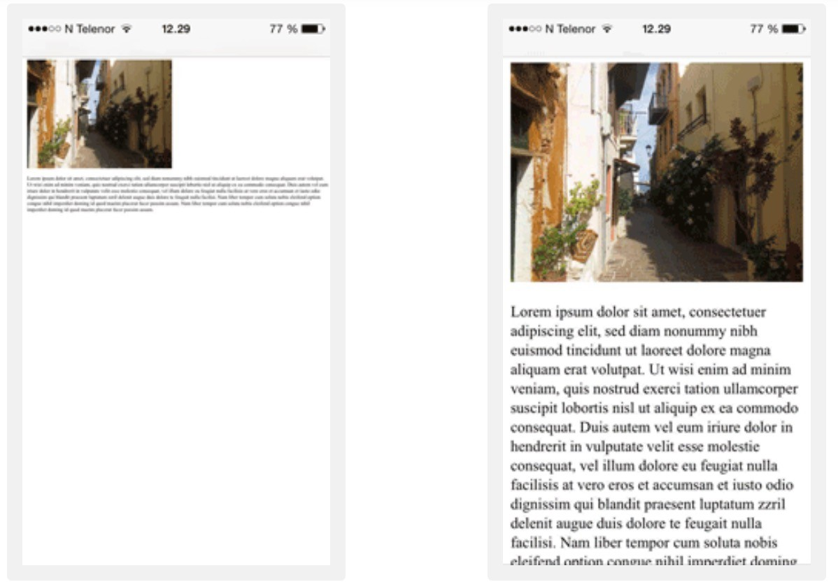
What is Responsive Web Design

Slide 4

What is Responsive Web Design? “Be Water”

Slide 5
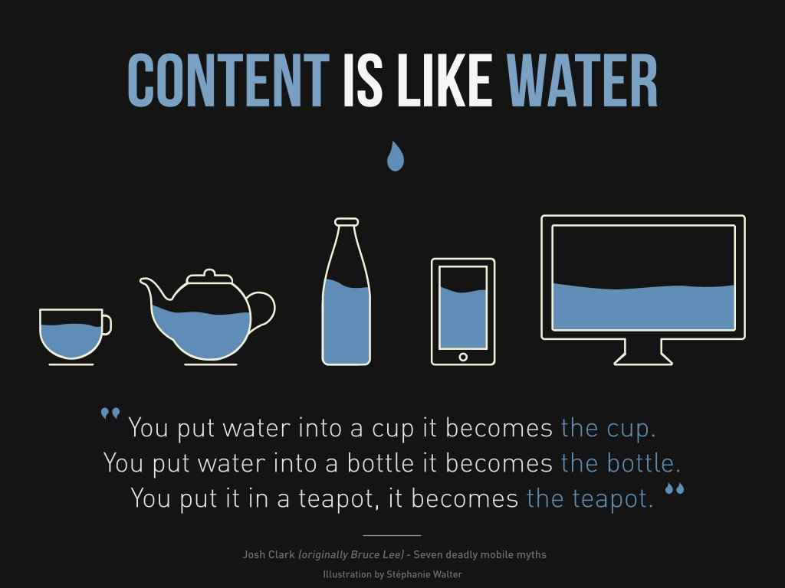
What is Responsive Web Design? “Be Water”
Responsive web design refers to a design strategy to make websites render correctly for various devices (mobile, tablet, laptop and desktop). It uses only HTML and CSS.
It is called Responsive Web Design when you use CSS and HTML to resize, hide, shrink, enlarge, or move the content to make it look good on any screen.

Slide 6
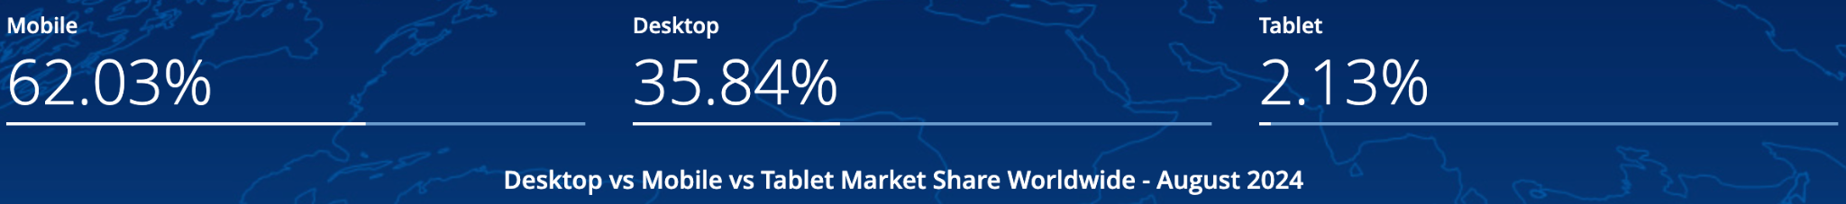
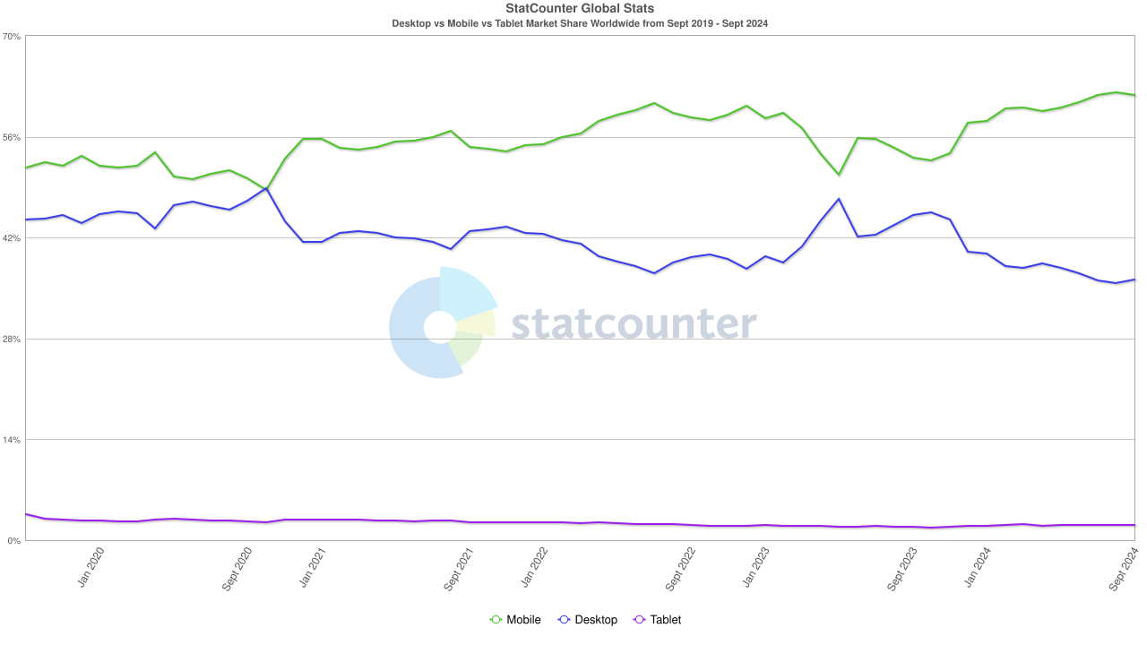
Device Statistics
https://gs.statcounter.com/platform-market-share/desktop-mobile-tablet/worldwide/#monthly-201909-202409

Slide 7
Main Strategies
Viewport
Grid View
Media queries
Flexible layouts
Responsive images
Relative units

Slide 8
Viewport
RWD strategy Viewport is added by:
<meta name="viewport"
content="width=device-width, initial-scale=1.0">
The viewport is the user's visible area of a web page.
Content is sized to the viewport and the scaling factor set to 1
Some key points to follow:
Do NOT use large fixed width elements
Do NOT let the content rely on a particular viewport width to render well
Use CSS media queries to apply different styling for small and large screens

Slide 9

Grid View
Many web pages are based on a grid-view and divided into columns:
a responsive grid-view often has 12 columns
the percentage for one column: 100% / 12 columns = 8.33%
the columns should be floating to the left and other elements cleared
make one class for each of the 12 columns: .col-1 {width: 8.33%;}, etc.
The columns should be wrapped with a row, where they add up to 12

Slide 10
Media Queries
Media queries are @media rules used to change CSS properties if some conditions are true
@media not|only mediatype and (mediafeature and|or|not mediafeature)
{
CSS-Code;
}
mediatype: all, print, screen, speech
mediafeature: max-width, min-width, orientation, etc.

Slide 11
Media Queries
Media queries use breakpoints (screen sizes) to decide how content needs to be rendered
Common breakpoints (in pixels):
Mobile: up to 767
Tablet: 768 – 1023
Desktop: 1024 – 1179
Desktop (extra): 1200 +
@media screen and (min-width: 768px)
{
p
{
width: 100%;
background-color: lightblue;
}
}

Slide 12
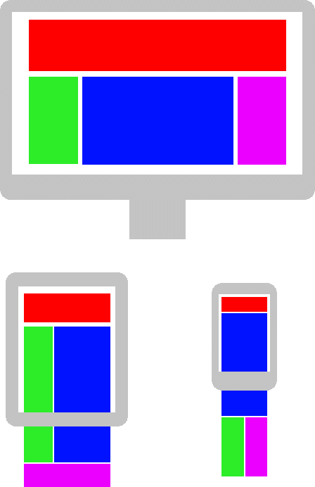
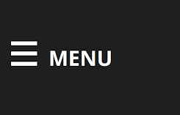
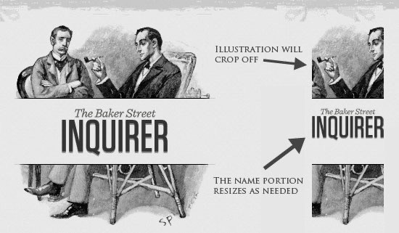
Flexible Layout
Website layout can be optimized for a device’s screen size:
reposition elements
resize elements (images)
hide or partially show elements

Slide 13
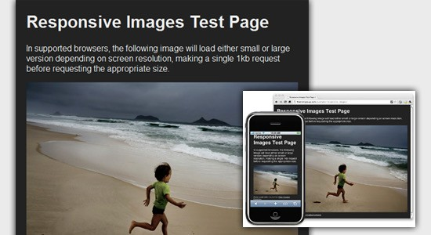
Responsive images
Some techniques to make images responsive:
Set max-width and height
Use picture and srcset
Vectors (svg) vs Bitmap (jpg)
img
{
max-width: 100%;
height: auto
}
<picture>
<source srcset="small.jpg" media="(max-width: 768px)">
<source srcset="medium.jpg" media="(max-width: 1024px)">
<source srcset="large.jpg">
<img src=”medium.jpg" alt=”Medium image">
</picture>

Slide 14
Relative Units
Use relative units for width/height, font size, etc.
percentage (width: 100%)
em (font size: 1 em)
vw, vh, vmin, vmax (height: 100vh)

Slide 15
Summary
Content is like water, so target all types of devices (mobile, tablet, laptop, desktop)
To make your website responsive, use RWD strategies:
Viewport
Grid view
Media queries
Flexible layouts
Responsive images
Relative units

Slide 16
bonus info

