Slide 1
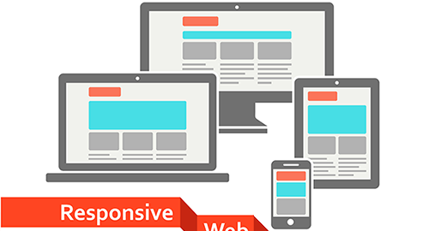
<!DOCTYPE html>
<html>
<head>
<title>CSCI 111 Web Programming and Problem Solving</title>
</head>
<body>
<h1>Week-5-Lecture</h1>
<h2>Responsive Web Design</h2>
<ul>
<li>Talgat Manglayev</li>
<li>Irina Dolzhikova</li>
<li>Aigerim Yessenbayeva</li>
</ul>
</body>
</html>

Slide 2
outline
<h1>Responsive Web Design</h1>
<ol>
<li>What is RWD?</li>
<li>Main Strategies
<ol>
<li>Viewport</li>
<li>Grid View</li>
<li>Media Queries</li>
<li>Flexible Layouts</li>
<li>Responsive Images</li>
<li>Relative Units</li>
</ol>
</li>
</ol>
https://www.w3schools.com/html/html_responsive.asp

Slide 3
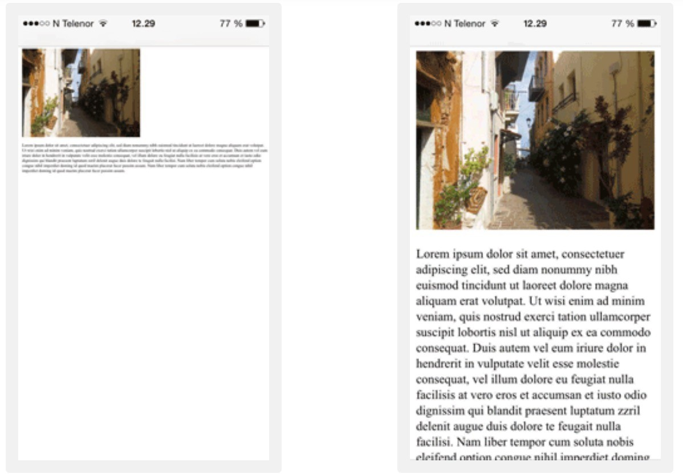
What is Responsive Web Design

Slide 4

What is Responsive Web Design? “Be Water”

Slide 5
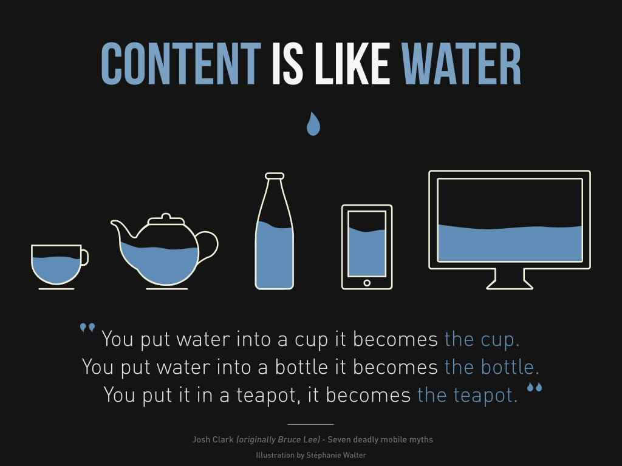
What is Responsive Web Design? “Be Water”
Design strategy to make websites render correctly for devices with various display size (mobile, tablet, laptop and desktop).
It uses only HTML and CSS.
It is called Responsive Web Design when you use CSS and HTML to resize, hide, shrink, enlarge, or move the content to make it look good on any screen.

Slide 6
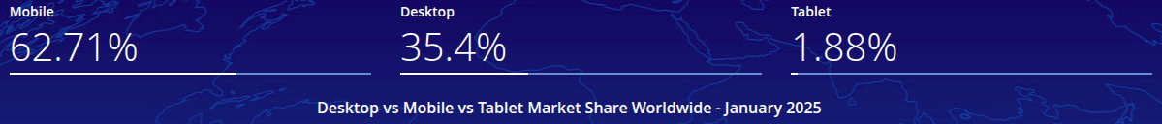
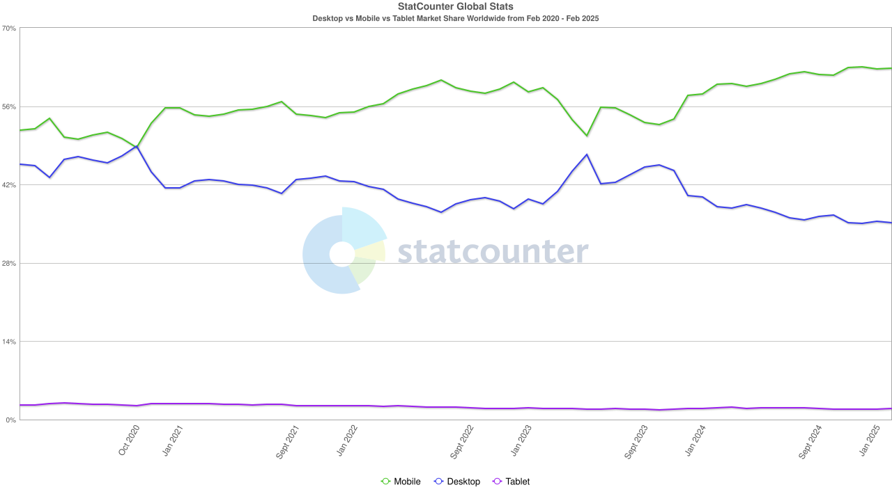
Device Statistics
https://gs.statcounter.com/platform-market-share/desktop-mobile-tablet/worldwide/#monthly-202002-202502

Slide 7
Main Strategies
Viewport
Grid View
Media queries
Flexible layouts
Responsive images
Relative units

Slide 8
Viewport
1-viewport-example.html
1-image-resize-example.html
RWD strategy Viewport is added by:
<meta name="viewport"
content="width=device-width, initial-scale=1.0">
The viewport is the user's visible area of a web page.
content is sized to the viewport and the scaling factor set to 1
Some key points to follow:
Do NOT use large fixed width elements
Do NOT let the content rely on a particular viewport width to render well
Use CSS media queries to apply different styling for small and large screens

Slide 9

Grid View
2-grid-view-example.html
Many web pages are based on a grid-view and divided into columns:
a responsive grid-view often has 12 columns
the percentage for one column: 100% / 12 columns = 8.33%
the columns should be floating to the left and other elements cleared
make one class for each of the 12 columns: .col-1 {width: 8.33%;}, etc.
The columns should be wrapped with a row, where they add up to 12

Slide 10
Media Queries
3-media-query-example.html
Media queries are @media rules used to change CSS properties if some conditions are true
@media not|only mediatype and (mediafeature and|or|not mediafeature)
{
CSS-Code;
}
mediatype: all, print, screen, speech
mediafeature: max-width, min-width, orientation, etc.

Slide 11
Media Queries
Media queries use breakpoints (screen sizes) to decide how content needs to be rendered
Common breakpoints (in pixels):
Mobile: up to 767
Tablet: 768 – 1023
Desktop: 1024 – 1179
Desktop (extra): 1200 +
@media screen and (min-width: 768px)
{
p
{
width: 100%;
background-color: lightblue;
}
}

Slide 12
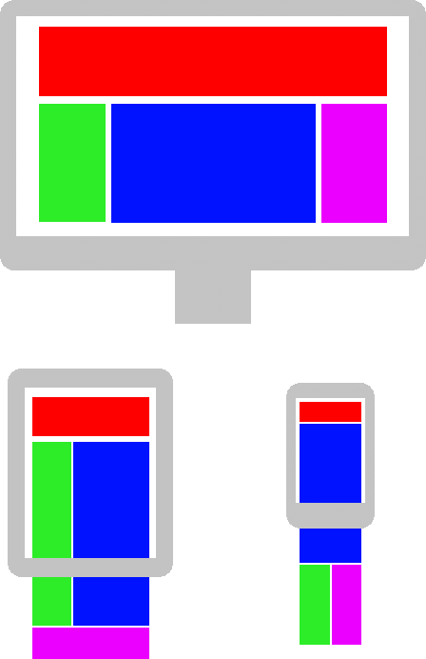
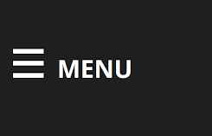
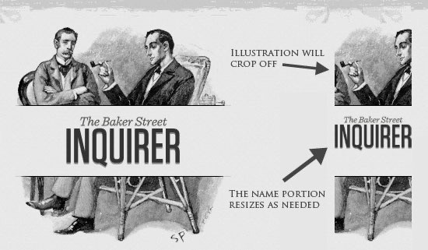
Flexible Layout
Website layout can be optimized for a device’s screen size:
reposition elements
resize elements (images)
hide or partially show elements

Slide 13
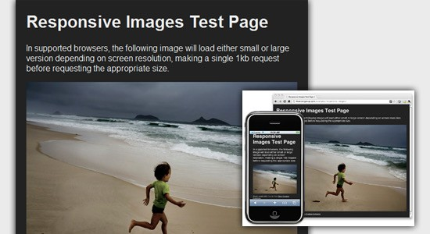
Responsive images
Some techniques to make images responsive:
Set max-width and height
Use picture and srcset
Vectors (svg) vs Bitmap (jpg)
img
{
max-width: 100%;
}
<picture>
<source srcset="small.jpg" media="(max-width: 768px)">
<source srcset="medium.jpg" media="(max-width: 1024px)">
<source srcset="large.jpg">
<img src=”medium.jpg" alt=”Medium image">
</picture>
https://www.w3schools.com/html/tryit.asp?filename=tryhtml_responsive_picture

Slide 14
Relative Units
Use relative units for width/height, font size, etc.
percentage (width: 100%)
em (font size: 1 em)
vw, vh, vmin, vmax (height: 100vh)
https://www.w3schools.com/cssref/css_units.php

Slide 15
Summary
Content is like water, so target all types of devices (mobile, tablet, laptop, desktop)
To make your website responsive, use RWD strategies:
Viewport
Grid view
Media queries
Flexible layouts
Responsive images
Relative units

Slide 16
Website templates
You can develop website layout using popular bootstrap 3 framework.
It has HTML, CSS and JavaScript.
There are lots of free ready to use website templates for desktop and for mobile devices.
You are recommended to use templates in your course project.
But html and css code that is already in templates is not counted for grading.

Slide 17
bonus info

