Slide 1
CSCI 111: Web Programming and
Problem Solving
Lecture 2: Basics of HTML
Instructors:
Dr. Irina Dolzhikova,
Dr. Talgat Manglayev,
MSc. Marat Isteleyev

Slide 2
Outline
Introduction
History of HTML
What is HTML
HTML document
HTML elements
HTML attributes
Document Object Model
Useful HTML Resources

Slide 3
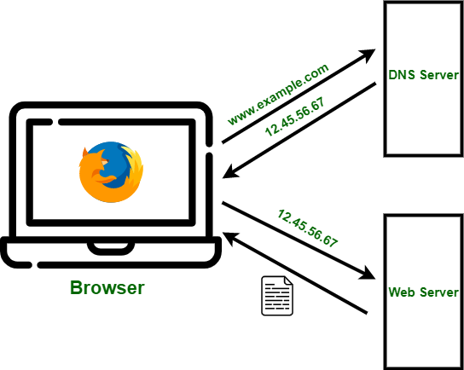
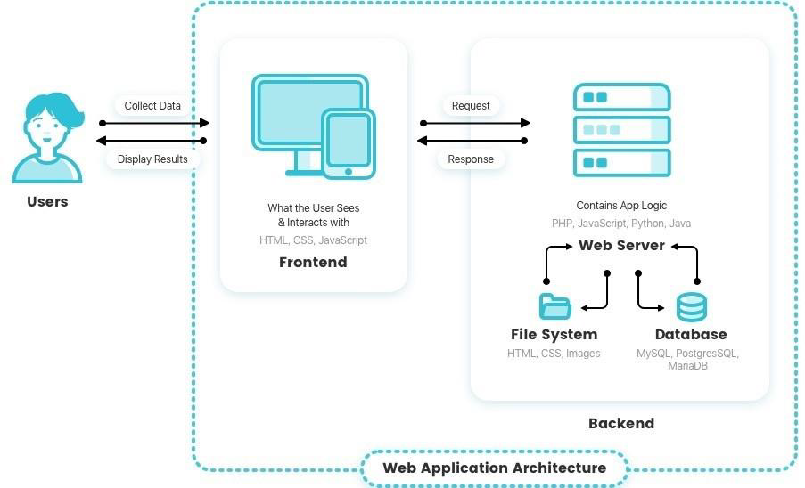
Introduction
•To access a website:
•Retrieve IP by Domain name (DNS)
•Access the Web server by IP
To serve the website:
•Implement Frontend: HTML, CSS, JS
Fig.1 -Before reaching the web server
Fig.2 -After reaching the web server

Slide 4

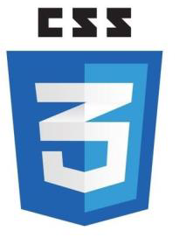

HTML, CSS, Javascript
Hyper-Text Markup Language (HTML) is the standard markup language for documents designed to be displayed in a web browser.
It describes the structure of the web page
Cascading Style Sheets (CSS) is a stylesheet language used to describe the presentation of a document written in HTML.
It describes the style of the web page
JavaScript (JS) is a lightweight and interpreted programming (or scripting) language for Web pages.
It adds behavior to the web page

Slide 5

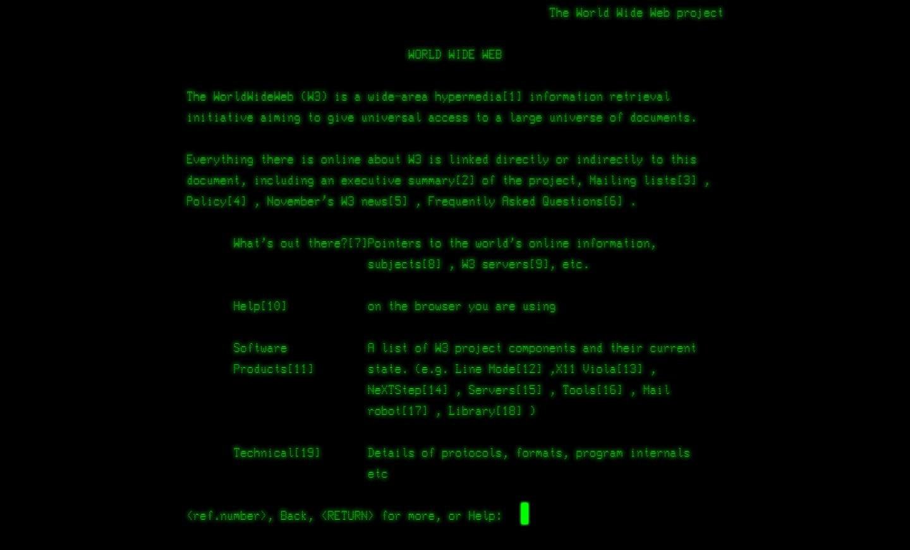
History of HTML
1989
Invention of WWW, HTTP, HTML
•Tim Berners-Lee (CERN)
Release of WWW software (CERN)
World Wide Web Consortium (W3C)
XHTML 1.0 based on XML (W3C)
WHATWG (Mozilla, Opera, and Apple)
HTML5 release (WHATWG, W3C)
HTML5.1, HTML5.2 and HTML5.3
2011
Sir Timothy John Berners-Lee
(8 June 1955), TimBL, is an English computer scientist, professor at MIT, and the director of the World Wide Web Consortium (W3C).
1993
1994
2000
http://info.cern.ch/ -home
2004
2007
2011

Slide 6
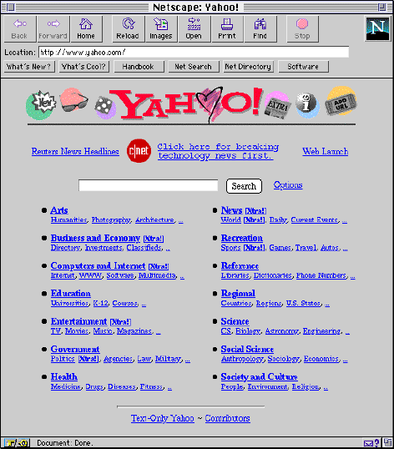

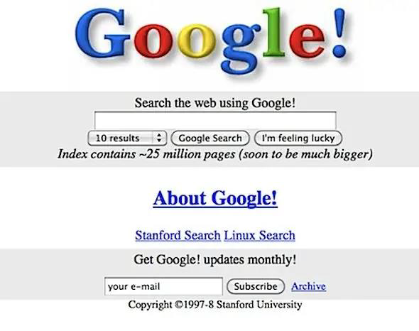
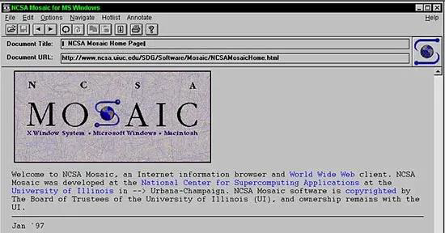
History of HTML
Amazon (1995)
Yahoo (1994)
Google (1998)
eBay (1995)

Slide 7
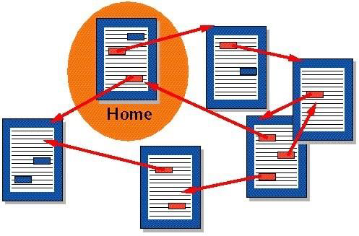
What is HTML?
Hyper-Text Markup Language (HTML)
Hyper-Text – a document with hyperlinks (references) to other documents
Markup – a system (set of tags) of text annotation to control its structure, formatting and relationships between its parts
MS Word: Bold Text
Markdown: ** Bold Text **
LaTeX: \textbf{ Bold Text }
HTML: <strong> Bold Text </strong>
WhatsApp: *Bold text*
Language – a structured system of communication with its alphabet, vocabulary and a grammar (specific set of rules)

Slide 8
HTML Document
What is a HTML document?
Text file with an extension “.htm” or “.html”
Can be created in a text editor: Notepad, TextEdit, Sublime, VS Code, WebStorm
Contains markup tags (elements) which direct how a page is to be displayed by browsers
Must have proper text encoding (UTF-8)
HTML is not case sensitive (head = HEAD)
Example: index.html
<!DOCTYPE html>
<html>
<head>
<meta charset="UTF-8">
<title>My Website</title>
</head>
<body>
<h1>Hello, World!</h1>
</body>
</html>

Slide 9
HTML Document
HTML document consists of elements
DOCTYPE – type of document
<!DOCTYPE html> - stands for HTML5
html – root element of a HTML document
head – section for meta information
(encoding, display settings, other resources)
title – title of a document, shown in browser’s Tab
body – section for main content of a webpage
h1 – defines a heading (h1-h6)
p – defines a paragraph
<!DOCTYPE html>
<html>
<head>
<meta charset="UTF-8">
<title>My Website</title>
</head>
<body>
<h1>Hello, World!</h1>
<p>Some paragraph</p>
</body>
</html>

Slide 10
HTML Elements
HTML elements must follow specific structure and rules to be correctly processed and shown in browsers
Elements consist of opening tag, content and closing tags (except for some elements):
<h1>Hello, World!</h1> - no spaces after < and </
<hr>, <br> <meta> - no closing tags, no content
Elements must be correctly nested
CORRECT: <body> <h1> Hello, World! </h1> </body>
WRONG: <body> <h1> Hello, World! </body> </h1>
Special element for comments: <!--Browsers don’t show this content -->

Slide 11
HTML Attributes
Elements may have attributes that come in name="value” pairs
<meta charset="UTF-8">
Attributes provide additional information about elements
Attributes are always specified in the opening tag
<h1 color=‘blue’> Hello, World! </h1>
Attribute values must be in quotes (single or double)

Slide 12
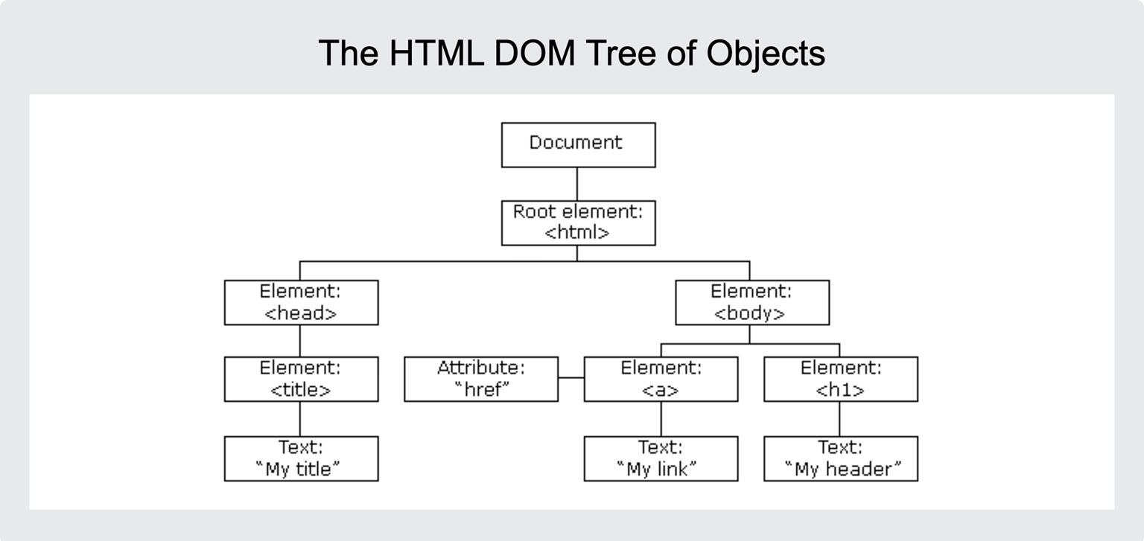
Document Object Model
When a web page is loaded, the browser creates a Document Object Model (DOM) of the page.
The HTML DOM model is constructed as a Tree of Objects.
HTML Elements can be found and accessed with JavaScript:
Finding elements by id
Finding elements by tag name
Finding elements by class name
Finding elements by CSS selectors

Slide 13
Summary
Web technology (frontend) is based on HTML5, CSS3 and JavaScript
HTML Documents are specially written text files
HTML elements and attributes direct browsers how to display a web page
Document Object Model is a tree like structure associated with HTML document
self-study:
https://www.w3schools.com/html/default.asp

Slide 14
Thanks for Attention!

