Slide 1
CSCI 111
Web Programming and Problem Solving
Week-2-Lecture-1 HTML basics
Talgat Manglayev
Irina Dolzhikova
Aigerim Yessenbayeva

Slide 2
Outline
HTML Content Model
H1 vs. Div
Semantic tags
Links
Menu
Displaying Images
Escape Characters

Slide 3
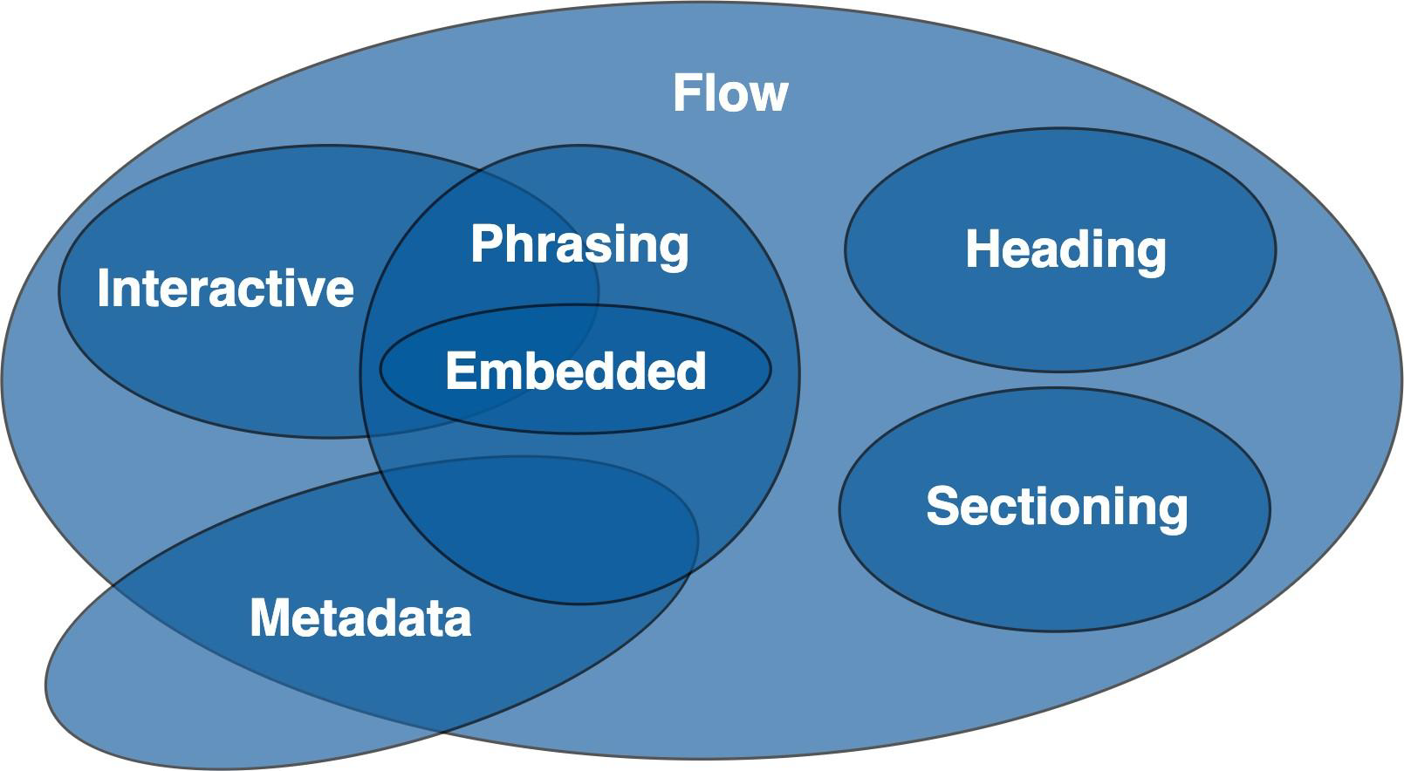
HTML Content Model
Each element in HTML falls into zero or more categories that group elements with similar characteristics together:
• Metadata content
• Flow content
• Sectioning content
• Heading content
• Phrasing content
• Embedded content
• Interactive content
https://www.w3.org/TR/2011/WD-html5-20110525/content-models.html#content-models

Slide 4
HTML Content Model
Inline elements
• Placed on the same line line (by default)
• May include only other inline elements
• Roughly corresponds to Phrasing content
• eg.: span, strong, a
Block-level elements
• Placed on a new line (by default)
• Occupies full width of the line
• May include other block-level or inline elements
• Roughly corresponds to Flow content
• eg.: h1, div, p, ul, ol
https://www.w3schools.com/html/html_blocks.asp

Slide 5
H1 vs. Div
H1 tag
Needs to reflect the content of the page
Helps SEO (Search Engine Optimization)
DIV tag
Block-level element – universal tag
Can be styled with CSS to look like any other element
Mostly used with class and id attributes as in my.nu.edu.kz

Slide 6
Semantic tags
Semantic elements’ name imply some meaning to the content
Human/machines can better understand the structure of a document
Some useful tags:
header, footer
nav
section, article, aside
1.html

Slide 7
Links
Fragment links
<a href="#some_element_name">Page Fragment</a>
<div id="some_element_name">…</div>
Internal links
<a href="some_page.html">Some internal page</a>
External links
<a href="http://w3.org">Some external link</a>
Image links
<a href="http://w3.org"><img src="w3.org.png" width="50px"></a>
Email links
<a href="mailto:email">Email link</a>
1.html

Slide 8
Links
Use target attribute of <a> tag to:
open in the new window
<a href="some_url" target="_blank">….</a>
open in the current window
<a href="some_url" target="_self">….</a>
1.html

Slide 9
Menu
To create a menu for a website use:
semantic tag <nav> to wrap menu items
unordered list to wrap each menu item
apply CSS and JS to style a menu (later)
<nav>
<ul>
<li><a href="1.html">Menu Item 1</a></li>
<li><a href="2.html">Menu Item 2</a></li>
<li><a href="3.html">Menu Item 3</a></li>
</ul>
</nav>
1.html

Slide 10
Displaying Images
Some useful notes on <img> tag
remember that <img> is an inline element
use src attribute is similar to href attribute
the attribute alt is required for visually impaired people
use width and height attributes to allocate space on the page
Images can be used as links (as logo)
<a href="http://w3.org"><img src="w3.org.png" width="50px"></a><br>
2.html

Slide 11
Escape characters
There are 3 main characters to be escaped:
use &lt; to escape < symbol
use &gt; to escape > symbol
use &amp; to escape & symbol
Useful escape symbols:
&quot; - to make a quotation
&nbsp; - non-breaking space
&copy; – copyright symbol
2.html

Slide 12
Summary
• Use h1 tag for a page to convey the topic of the content
• Use semantic tags whenever possible to improve your SEO
• Use different types of links for your needs
• Use unordered lists for menu items
• Use width and height attributes of <img> tag accurately
• Use escape character not to break your HTML code

