Slide 1
<!DOCTYPE html>
<html>
<head>
<title>CSCI 111 Web Programming and Problem Solving</title>
</head>
<body>
<h1>Week-2-Lecture</h1>
<h2>Introduction to CSS</h2>
<ul>
<li> Dr. Talgat Manglayev</li>
<li> Dr. Irina Dolzhikova</li>
<li> Dr. Syed Muhammad Umair Arif</li>
</ul>
</body>
</html>

Slide 2
outline
<ol>
<li>What is CSS?</li>
<li>CSS syntax</li>
<li>CSS selectors</li>
<li>Debugging CSS</li>
<li>Resources</li>
</ol>

Slide 3



HTML, CSS, JavaScript
Hyper-Text Markup Language (HTML) is the standard markup language for documents designed to be displayed in a web browser.It describes the structure of the web page
Cascading Style Sheets (CSS) is a stylesheet language used to describe the presentation of a document written in HTML. It describes the style of the web page
JavaScript (JS) is a lightweight and interpreted programming (or scripting) language for Web pages.It adds behavior to the web page

Slide 4

CSS is …
a stylesheet language used to describe the presentation of a document written in HTML;
one of the main technologies of the Web together with HTML and JavaScript;
proposed by Hakon Wium Lie, a Norwegian web pioneer, while working with Tim Berners-Lee at CERN in 1994;
maintained by World Wide Web Consortium (W3C).

Slide 5
Adding CSS to HTML page
There are three ways to add CSS to your HTML file:
Inline styles - inside an HTML element
Internal styles - inside an HTML document
External styles - external file(s) linked to an HTML document
There are also browser’s default styles (external)

Slide 6
Adding CSS to HTML inline
<h1 style="color : red;">Week-2-Lecture-2</h1>
html element
css
property name
css
property value
colon
quotations start
semi-colon
quotations end
page-1.html

Slide 7
Adding CSS to HTML internal or external
<head>
<style>
p
{
color : blue;
font-weight: bold;
}
</style>
<head>
selector
curly braces start
property name
property value
curly braces end
page-1.html

Slide 8
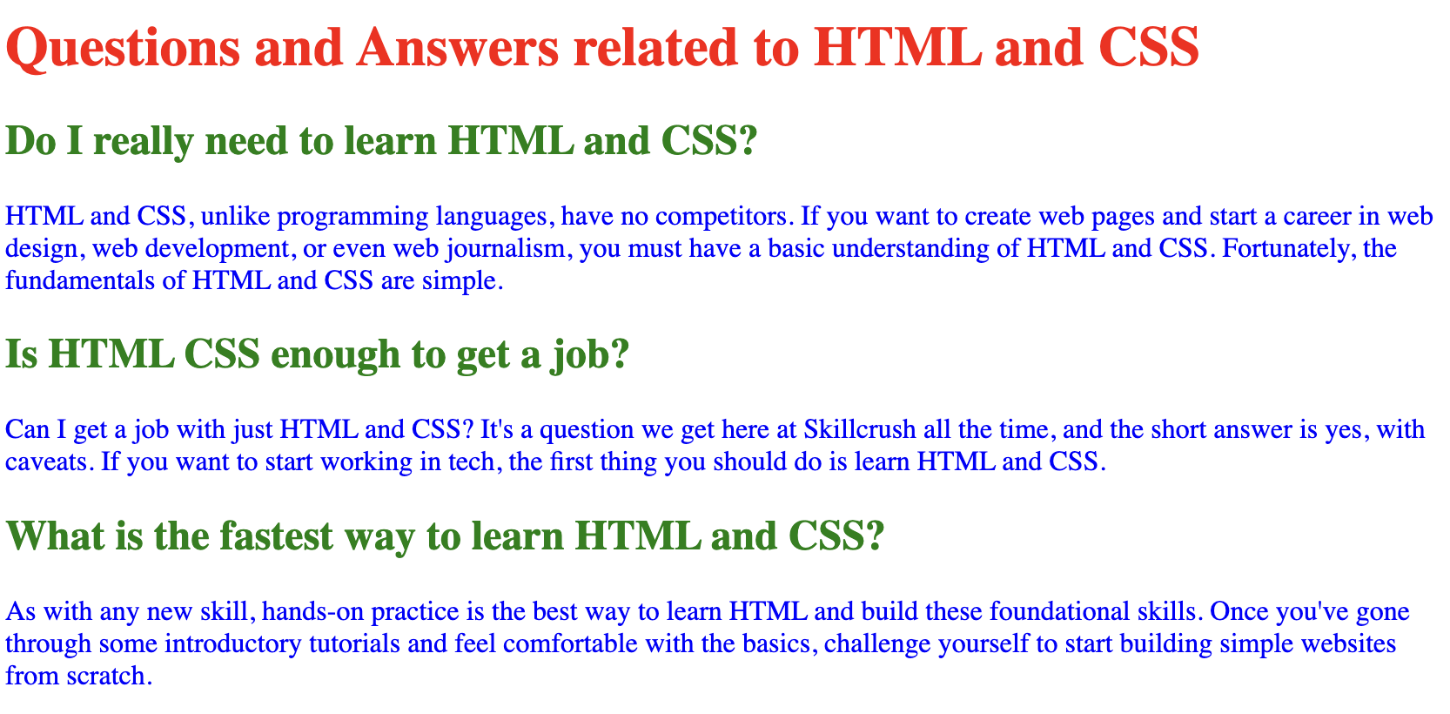
CSS Syntax
What if we want to change a particular paragraph? How do we select a specific element?
What if one element is changed in several places? How to resolve the conflicts?
<style>
p { color : blue; }
h1 { color : red; }
h2 {color: green;}
</style>

Slide 9
CSS selectors
To distinguish between elements, we use selectors:
Element Types (Tags)
Element Classes
Element Attributes
Element IDs
Element positions in DOM

Slide 10
Element Selectors
Selection of one or more elements:
body
{
margin: 0;
padding: 0;
}
h1, p
{
color: blue; font-size: 12pt;
}
Selects and changes the properties of body element
Selects and changes the properties of h1 and p elements (Note the comma in between)
page-2.html

Slide 11
Class Selectors
Class - identifier that can group together multiple elements.
<p class="second"> … </p>
<li class="second item"> … </li>
.second { color: red; }
li.item { color: purple; }
Definition of the class second for two elements. Elements can belong to several classes.
Selects the elements with the specified class (second or item)
Note a dot before class name
page-3.html

Slide 12
Attribute Selectors
h1[style]
{
text-align: center;
}
li[name]
{
color: gray;
}
li[name="item1"]
{
color: orange;
}
Selects all h1 tags with their style attribute defined
Selects all li elements with their name attribute defined as well as those which have
specific values for name attribute
page-4.html

Slide 13
ID Selectors
ID is an identifier of an element unique within the document
Assignment of ID to the element
<p id="last"> … </p>
Selects the elements by its ID Note a hash before the ID
#last
{
color: red;
font-size: 15pt;
}
page-5.html

Slide 14
Debugging CSS
To inspect and debug CSS, the browsers have a special instrument called Developer Tools
Chrome: View -> Developer -> Developer Tools
Safari: Develop -> Show Web Inspector ( Option + Command + I )
If you don’t see the Develop menu in the menu bar, choose Safari > Preferences, click Advanced,
then select “Show Develop menu in menu bar.”

Slide 15
Resources
Best resources for tutorials and references:W3schools: https://www.w3schools.com/css/
MDN Web Docs:https://developer.mozilla.org/en-US/docs/Web/CSS/
CSS-TRICKS:https://css-tricks.com/
W3.org: https://www.w3.org/Style/CSS/
In Russian: https://htmlacademy.ru

Slide 16
Summary
CSS uses special rules to select and change the parameters
The selection can be done by:
Element names
Class names
Attribute name and their values
IDs of the elements
For debugging CSS, we use browser’s Developer Tools
To improve our CSS skills, we use and read online resources

