Slide 1
<!DOCTYPE html>
<html>
<head>
<title>CSCI 111 Web Programming and Problem Solving</title>
</head>
<body>
<h1>Week-3-Lecture</h1>
<h2>Introduction to CSS Part II</h2>
<ul>
<li> Dr. Talgat Manglayev</li>
<li> Dr. Irina Dolzhikova</li>
<li> Dr. Syed Muhammad Umair Arif</li>
</ul>
</body>
</html>

Slide 2
outline
<ol>
<li>CSS selectors</li>
<ol>
<li>DOM based</li>
<li>Pseudo class</li>
<li>Pseudo elements</li>
</ol>
<li>Conflict Resolution</li>
<ol>
<li>Cascade</li>
<li>Inheritance</li>
<li>Specificity</li>
</ol>
<li>Important</li>
</ol>

Slide 3
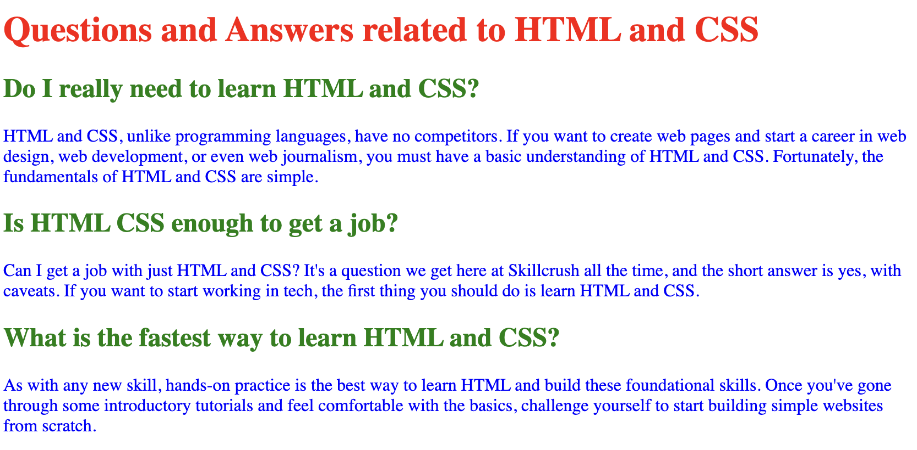
CSS Syntax
What if we want to change a particular paragraph? How do we select a specific element?
What if one element is changed in several places? How to resolve the conflicts?
<style>
p { color : blue; }
h1 { color : red; }
h2 {color: green;}
</style>

Slide 4
CSS selectors
To distinguish between elements, we use selectors:
Element Types (Tags)
Element Classes
Element Attributes
Element IDs
DOM based
pseudo-class
pseudo-elements

Slide 5
Element Selectors
Selection of one or more elements:
body
{
margin: 0;
padding: 0;
}
h1, p
{
color: blue; font-size: 12pt;
}
Selects and changes the properties of body element
Selects and changes the properties of h1 and p elements (Note the comma in between)
page-2.html

Slide 6
Class Selectors
Class - identifier that can group together multiple elements.
<p class="second"> … </p>
<li class="second item"> … </li>
.second { color: red; }
li.item { color: purple; }
Definition of the class second for two elements. Elements can belong to several classes.
Selects the elements with the specified class (second or item)
Note a dot before class name
page-3.html

Slide 7
Attribute Selectors
h1[style]
{
text-align: center;
}
li[name]
{
color: gray;
}
li[name="item1"]
{
color: orange;
}
Selects all h1 tags with their style attribute defined
Selects all li elements with their name attribute defined as well as those which have
specific values for name attribute
page-4.html

Slide 8
ID Selectors
ID is an identifier of an element unique within the document
Assignment of ID to the element
<p id="last"> … </p>
Selects the elements by its ID Note a hash before the ID
#last
{
color: red;
font-size: 15pt;
}
page-5.html

Slide 9
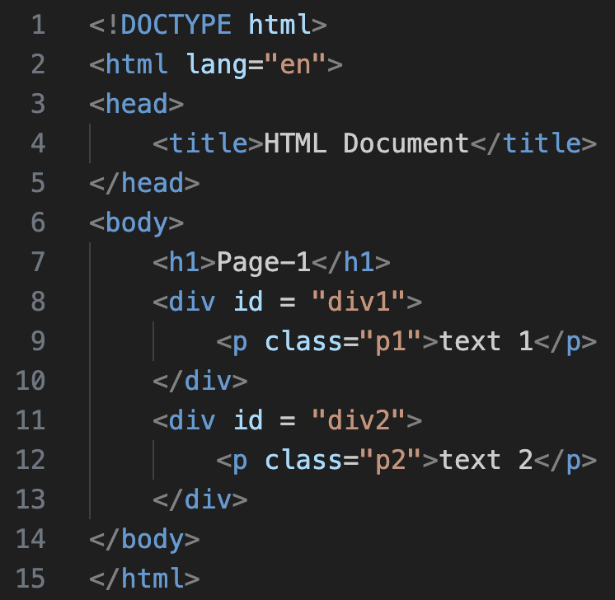
DOM based
HTML document can be viewed as a tree-like structure.
This structure is represented as Document Object Model (DOM) in memory
Elements are called nodes
root
DOCUMENT
parent
HTML
child
head
body
siblings
title
h1
div id=div1
div id=div2
HTML Document
Page-1
p class="p1"
p class="p2"
text 1
text 2

Slide 10
Children selectors
/*selects all li elements of div */
div li
{
font-size: large;
}
/*selects only the direct h2 elements of div */
div > h2
{
font-size: xx-large;
}
/*selects only the direct h2 elements of div */
body > h2
{
color: green;
}
<body>
<h1>Global Rankings</h1>
<div id="div-1">
<h2>Ranking of countries by area</h2>
<ol class="countries area">
<li>Russia</li>
<li>Canada</li>
<li>China</li>
<li>United States</li>
<li>Brazil</li>
</ol>
</div>
<h2>Resources:</h2>
<ul>
<li><a href="https://www.worldometers.info">Largest Countries in the World (by area)</a>
</li>
</ul>
</body>
page-6.html

Slide 11
Pseudo-Class Selectors
states of tag a
/* unvisited link */
a:link
{
color: red;
}
/* visited link */
a:visited
{
color: green;
}
/* mouse over link */
a:hover
{
color: hotpink;
}
/* selected link */
a:active
{
color: blue;
}
A pseudo-class is used to define a special state of an element.
selector:pseudo-class
{
property: value;
}
https://developer.mozilla.org/en-US/docs/Web/CSS/Pseudo-classes
page-7.html

Slide 12
Pseudo-Class Selectors
To select the first child of an element:
ul li:first-child
{
color: blue;
}
To select the n-th child of an element:
ul li:nth-child(3)
{
color: blue;
}
https://developer.mozilla.org/en-US/docs/Web/CSS/Pseudo-classes
page-8.html

Slide 13
Pseudo-Element Selectors
p::first-letter
{
color: red;
}
p::first-line
{
color: green;
}
p::selection
{
color: red;
background: yellow;
}
::marker
{
color: orange;
}
A pseudo-element is used to style specified parts of an element.
selector::pseudo-element
{
property: value;
}
https://developer.mozilla.org/en-US/docs/Web/CSS/Pseudo-elements
page-9.html

Slide 14
Conflict Resolution
Application of CSS rules depends on three main concepts:
Cascade
Specificity
Inheritance
To resolve the conflicts, we need to understand them well.
https://developer.mozilla.org/en-US/docs/Learn_web_development/Core/Styling_basics/Handling_conflicts

Slide 15

Cascade
concept which means that the origin and the order of CSS rules matter, i.e. the latest rule is applied.
<head>
<style>
h1
{
color: blue;
}
/* this rule overrides the previous rule */
h1
{
color: green;
}
</style>
</head>
<body>
<h1>How to quickly master novel skills</h1>
</body>
page-10.html

Slide 16
Specificity
weight that the browser uses to decide which property value is applied to an element.
The weight is composed of 3 numbers based on the location of a rule and the number of appearance of the selectors.
Inline style has more weight than id, and not included into calculation.
id
class
pseudo-class
attribute
element
page-13.html
page-12.html
page-11.html
More important
Less important

Slide 17
Specificity
id
class
pseudo-class
attribute
element
page-11.html
<style>
/*p > span has more weigh as it has two element selectors p and span*/
p > span
{
color: red;
}
/*span has less weigh as it has only one element selectors span*/
span
{
color: blue;
}
</style>
0 0 2
0 0 1

Slide 18
Specificity
id
class
pseudo-class
attribute
element
page-12.html
The battle for the font color. Class vs. Element selectors.
<style>
.list-1 { font-size: xx-large; }
ul { font-size: xx-small; }
</style>
010
001
<ul class="list-1">
<li id="item-1-li" name="item-1">North</li>
<li class="list-2">South</li>
<li>East</li>
<li name="item-4">West</li>
</ul>

Slide 19
Specificity
id
class
pseudo-class
attribute
element
page-12.html
The battle for the font color.
012
ul li:last-child { color: blue; }
li:last-child { color: yellow; }
li[name]{ color: red; }
li{color: green; }
011
011
001
<ul class="list-1">
<li id="item-1-li" name="item-1">North</li>
<li class="list-2">South</li>
<li>East</li>
<li name="item-4">West</li>
</ul>

Slide 20
Specificity
id
class
pseudo-class
attribute
element
page-13.html
<p>
<span class="spanClass" id="last">This text is going to be tested</span>
</p>
<style>
#last
{
color: blue;
}
.spanClass
{
color: red;
}
p > span
{
color: green;
}
</style>
100
010
002

Slide 21
Cascade works if Specificity weight is the same

Slide 22
Inheritance
Elements can inherit the properties defined in their parents or ancestors.
Some properties can’t be inherited like weight or margin.
CSS provides special property values for elements:
inherit – turn on inheritance
initial – default of property
unset – set to inherit or initial
revert – browser's default
revert layer– previous cascade layer
page-14.html
page-15.html
page-16.html

Slide 23
!important
Importance is the mechanism to apply a rule no matter what the order specificity or inheritance of other rules.
h1
{
color: blue !important;
}
/* this rule is not applied */
h1
{
color: green;
}
However, it is not recommended
to use it unless really necessary
page-17.html

Slide 24
Summary
The selection can be done:
using element’s type, class, attributes and ID
based on DOM (structure of HTML)
using pseudo-classes and pseudo-elements
Three concepts are important in conflict resolution
Cascade
Specificity
Inheritance
Use important keyword only when really necessary

Slide 25
bonus info

