Slide 1
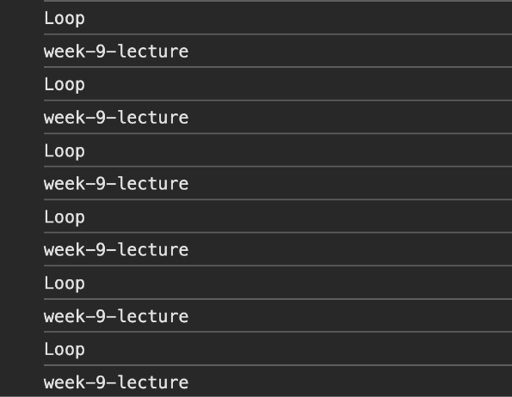
<!DOCTYPE html>
<html lang="en">
<head>
<meta charset="UTF-8">
<meta name="viewport" content="width=device-width, initial-scale=1.0">
<title>Document</title>
</head>
<body>
<script>
/* CSCI-111 Web Programming and Problem Solving */
const instructors = ["Talgat Manglayev", "Irina Dolzhikova", "Syed Muhammad Umair Arif"]
while(true)
{
console.log("week-9-lecture")
console.log("Loop")
}
</script>
</body>
</html>

Slide 2
Content
Introduction
For loop
While loop
Break and Continue statements

Slide 3
Introduction
Problem: Calculate the average grade for lab 1

Slide 4
Introduction
Problem: Calculate the average grade for lab 1
(student_1.lab_1 + student_2.lab_1 + student_3.lab_1 + … + student_39.lab_1)
n
let lab_1_average =

Slide 5
Introduction
Problem: Calculate the average grade for lab 1
(student_1.lab_1 + student_2.lab_1 + student_3.lab_1 + … + student_n.lab_1)
n
What if there are 500 students in class?
let lab_1_average =

Slide 6
Introduction
To perform some repetitive tasks we use loops.
Loops are JavaScript constructs that allow us to perform the repetitive tasks:
for a specified number of times;
while a specified condition holds true.

Slide 7
For Loop
Syntax:
for (expression 1; expression 2; expression 3)
{
// code block to be executed
}
where:
Expression 1 is executed (one time) before the execution of the block code.
Expression 2 defines the condition for executing the code block.
Expression 3 is executed (every time) after the code block has been executed.
1.html, 2.html

Slide 8
For Loop
let lab_1 = [4, 5 ,0 ,4 ,5 ,10 ,10]
let sum = 0;
for (let i = 0; i < lab_1.length; i++)
{
sum = sum + lab_1[i];
}
console.log("sum = "+ sum)
i - loop iterable
Three steps of the loop:
1) let i = 0 - initialization
2) i < lab1_1.length - stop condition
3) i++ - update rule
3.html, 4.html

Slide 9
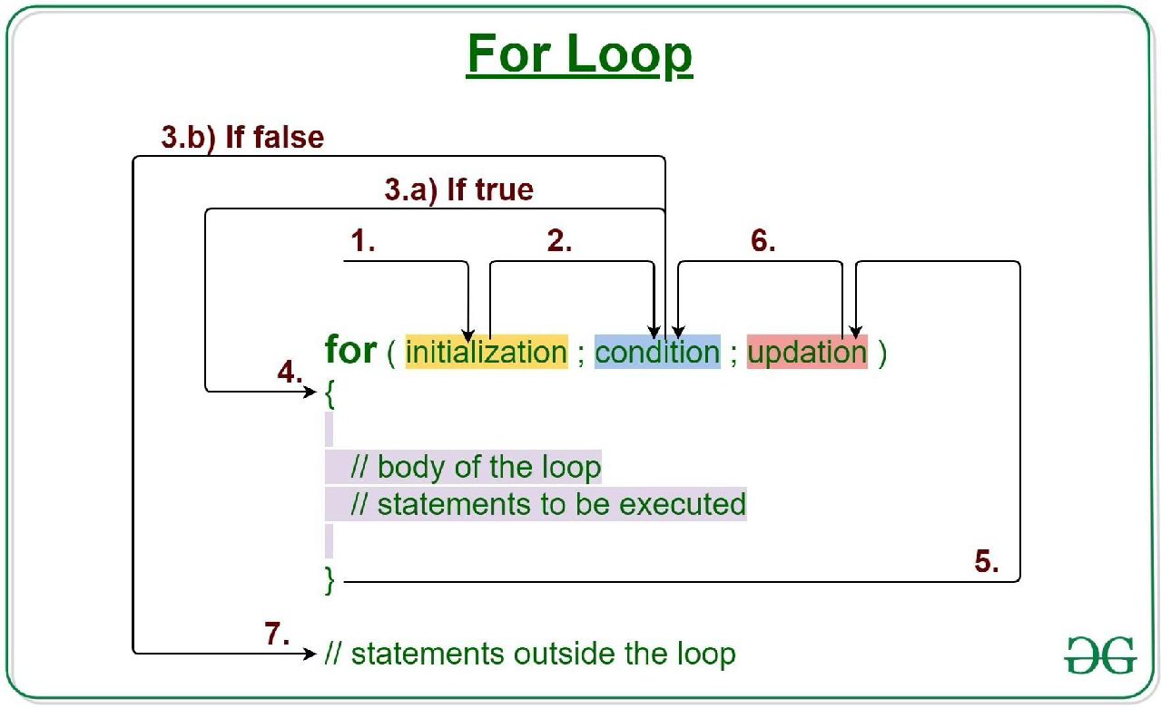
For Loop

Slide 10
Nested For Loop
for (let i = 0; i < 5; i++)
{
for (let j = 0; j < 10; j++)
{
console.log("Hello, World!")
}
}
5.html

Slide 11
While Loop
Syntax:
while (condition)
{
// code block to be executed
}
where:
Condition is a logical expression for executing the code block
6.html, 7.html

Slide 12
While Loop
let lab_1 = [4, 5 ,0 ,4 ,5 ,10 ,10];
let sum = 0;
let i = 0; // initialization of loop variable
while (i < lab_1.length)// stop condition
{
sum += lab_1[i]; // body of the loop
i++; // update the loop variable
}
console.log("sum = "+ sum)
There are also three steps of the loop:
1) let i = 0 - initialization
2) i < lab_1.length - stop condition
3) i++ - update rule
8.html, 9.html

Slide 13
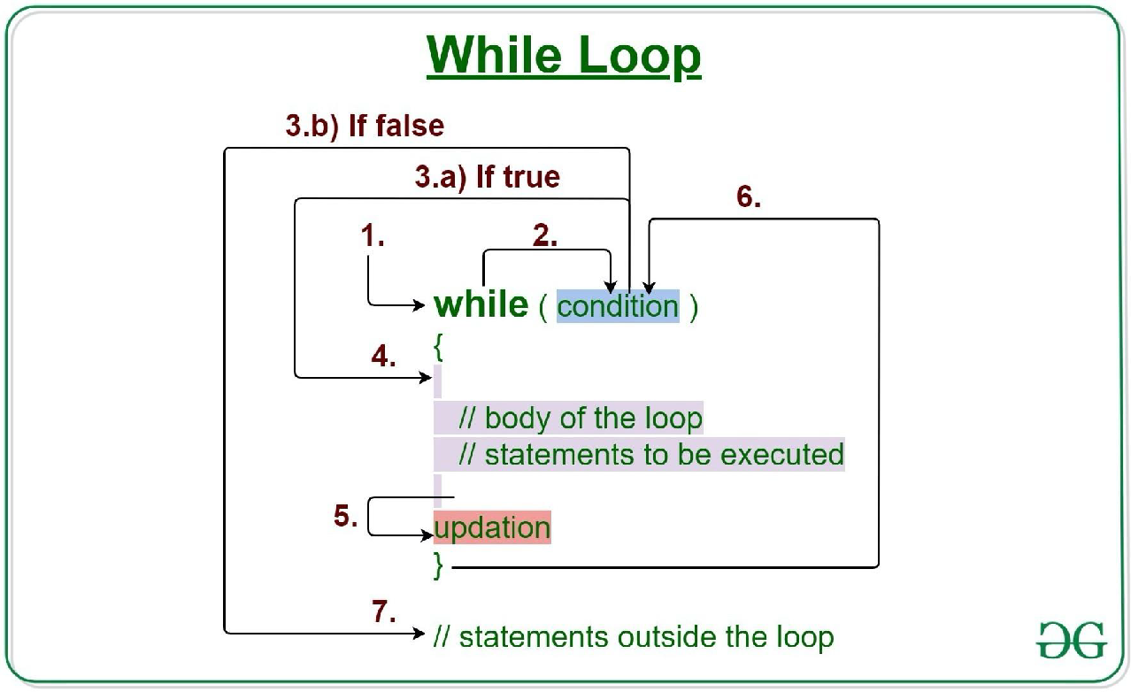
While Loop

Slide 14
While Loop
let i = 0;
while (i < 100)
{
console.log("Hello, World!")
i++;
}
What does this loop do?

Slide 15
While vs. For Loop
let i = 0;
while (i < 100)
{
console.log("Hello, World!")
i++;
}
for (let i = 0; i < 100; i++)
{
console.log(“Hello, World!”)
}
Compare
What do these loops do?

Slide 16
For vs. While Loop
Use for-loop when you know in advance the number of steps to do
Otherwise use while-loop

Slide 17
Break and Continue
10.html
– The break statement exits the loop.
– The continue statement skips one iteration in the loop
for (let i = 0; i < 10; i++)
{
if (i == 4)
{
continue;
}
if (i == 8)
{
break;
}
console.log(i + " Hello, World!")
}

Slide 18
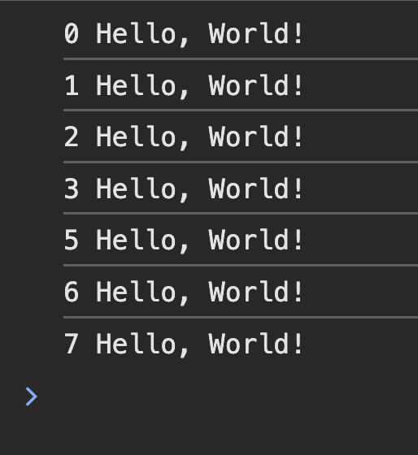
Break and Continue
10.html
– The break statement exits the loop.
– The continue statement skips one iteration in the loop
for (let i = 0; i < 10; i++)
{
if (i == 4)
{
continue;
}
if (i == 8)
{
break;
}
console.log(i + " Hello, World!")
}

Slide 19
Break and Continue
10.html
– The break statement exits the loop.
– The continue statement skips one iteration in the loop
for (let i = 0; i < 10; i++)
{
if (i == 4)
{
continue;
}
if (i == 8)
{
break;
}
console.log(i + " Hello, World!")
}
LET US REWRITE THIS EXAMPLE WITH WHILE LOOP!

Slide 20


for(let i = 0; i < 10; i++)
{
console.log("i = "+i);
}
Change the code in the left to print the output below (reverse order)

Slide 21
Summary
- To perform repetitive tasks, use loops. There are two types of loops:
- for a specified number of times.
- while a specified conditions holds.
- Don’t forget about three steps of the loops:
- Initialize the loop variables before the loop.
- Setup the condition to exit the loop.
- Update the value of the loop variables.
- Use break and continue commands if needed.

