Slide 1

Exploring: Microsoft® Excel® 2016 Comprehensive
First Edition
Chapter 1
Introduction to Excel Creating and Formatting a Worksheet
Copyright © 2017 Pearson Education, Inc. All Rights Reserved
Notes:
If this PowerPoint presentation contains mathematical equations, you may need to check that your computer has the following installed:
1) MathType Plugin
2) Math Player (free versions available)
3) NVDA Reader (free versions available)
Exploring: Microsoft® Excel® 2016 Comprehensive
In Chapter 1, you will demonstrate an understanding of relational databases. In particular, you will learn how to use Microsoft® Access, a database management system included in the Office 2016 suite, so that you can open and enable content in a database, and then modify data in a table by adding or deleting records. You will learn how to use database utilities and work with filters and sorts. You will also create a database of your own.

Slide 2
Objectives (1 of 2)
Explore the Excel Window
Enter and Edit Cell Data
Create Formulas
Display Cell Formulas
Manage Columns and Rows
Select, Move, Copy, and Paste Data
Notes:
The objectives for this chapter are:
Explore the Excel Window
Enter and Edit Cell Data
Create Formulas
Display Cell Formulas
Manage Columns and Rows
Select, Move, Copy, and Paste Data
Additional objectives are listed on the next slide.

Slide 3
Objectives (2 of 2)
Apply Cell Styles, Alignment, and Font Options
Apply Number Formats
Manage Worksheets
Select Page Setup Options
Preview and Print a Worksheet
Notes:
Additional objectives for this chapter are:
Apply Cell Styles, Alignment, and Font Options
Apply Number Formats
Manage Worksheets
Select Page Setup Options
Preview and Print a Worksheet

Slide 4
Objective 1: Explore the Excel Window
Skills:
Identify Excel Window Elements
Identify Columns, Rows, and Cells
Navigate In and Among Worksheets
Notes:
In this section, the skills include:
Identify Excel Window Elements
Identify Columns, Rows, and Cells
Navigate In and Among Worksheets

Slide 5
Explore the Excel Window (1 of 4)
Spreadsheet—electronic file that:
Contains a grid of columns and rows
Displays results of calculations
Enables interpretation of quantitative data
Notes:
A spreadsheet is an electronic file that:
Contains a grid of columns and rows used to organize related data
Displays the results of calculations
Enables interpretation of quantitative data for decision making

Slide 6
Explore the Excel Window (2 of 4)
Worksheet—single spreadsheet that contains:
Descriptive labels
Numeric values
Formulas, functions
Graphical representations of data
Notes:
A worksheet is a single spreadsheet that typically contains:
Descriptive labels
Numeric values
Formulas, functions
Graphical representations of data, such as charts

Slide 7
Explore the Excel Window (3 of 4)
Workbook—collection of one or more related worksheets
Cell—intersection of a column and a row
Identification:
Columns use letters—A
Rows use numbers—10
Cells use a combination of a letter and a number—A10
Notes:
A workbook is a collection of one or more related worksheets contained within a single file.
A cell is the intersection of a column and a row.
Columns are identified by letters—A
Rows are identified by numbers—10
Cells are identified by a combination of a letter and a number—A10

Slide 8
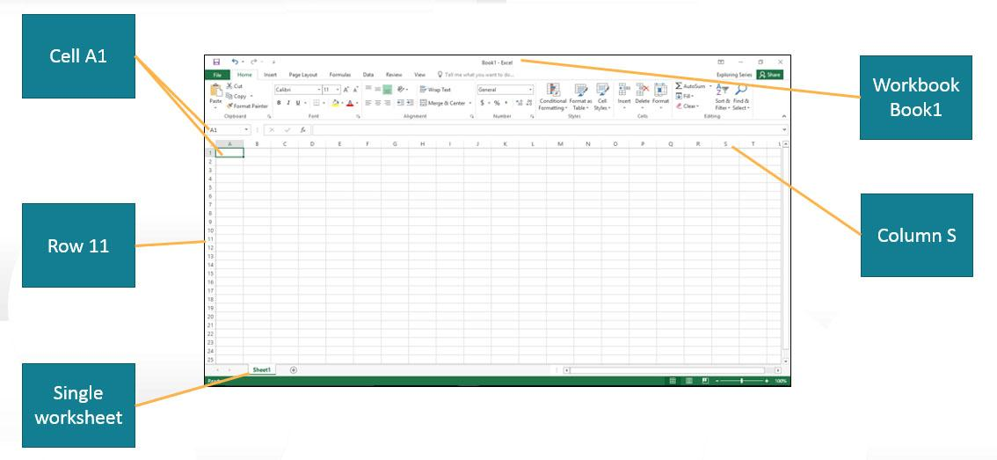
Explore the Excel Window (4 of 4)
Notes:
Some of the objects in this slide are:
The active cell with its cell address A1 shown in the Name Box
A row with a heading of 11
A worksheet tab indicating the worksheet named Sheet1. For workbooks with multiple worksheets, clicking a worksheet tab navigates to that worksheet.
A workbook named Book1
A column with a heading of S

Slide 9
Objective 2: Enter and Edit Cell Data
Skills:
Enter Text
Use Auto Fill to Complete a Sequence
Enter Values
Enter a Date
Clear Cell Contents
Notes:
In this section, the skills include:
Enter Text
Use Auto Fill to Complete a Sequence
Enter Values
Enter a Date
Clear Cell Contents
Auto fill usage: https://www.youtube.com/watch?v=Ww56q-BSSXw

Slide 10
Enter and Edit Cell Data (1 of 2)
Data types:
Text—combination of letters, numbers, symbols, and spaces
Values—numbers used as the basis of calculations
Dates and times—entered in a variety of formats
Auto Fill—feature that completes a sequence of words or values
Notes:
Some Excel data types:
Text is any combination of letters, numbers, symbols, and spaces not used in calculations.
Values are numbers that represent a quantity or a measurable amount that can be the basis of calculations.
Dates and times can be entered into a worksheet in a variety of formats.
Auto Fill is a feature that helps you complete a sequence of words or values.

Slide 11
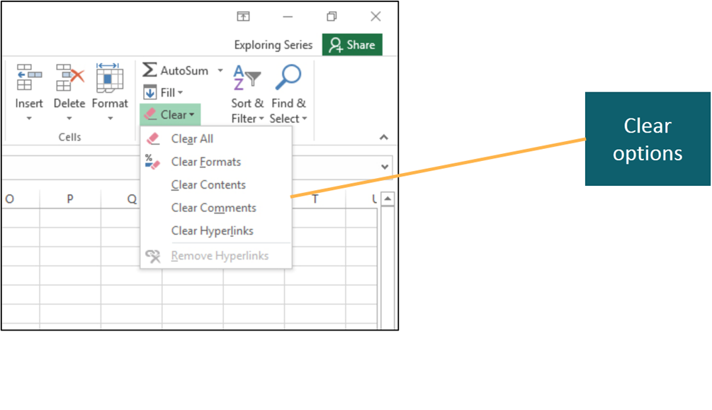
Enter and Edit Cell Data (2 of 2)
Notes:
To edit the contents of a cell, click in the cell, click the Formula Bar, and type your changes.
To delete the contents of a cell, you can select the contents and press Delete. As shown in the slide, when clearing a cell using Clear, there are several options.

Slide 12
Objective 3: Create Formulas
Skills:
Use Cell References in Formulas
Apply the Order of Operations
Use Semi-Selection to Create a Formula
Copy Formulas
Notes:
In this section, the skills include:
Use Cell References in Formulas
Apply the Order of Operations
Use Semi-Selection to Create a Formula
Copy Formulas

Slide 13
Create Formulas (1 of 2)
Formula—used to perform calculation, such as =A1 + 3
Order of operations—rules in which arithmetic operations are performed
Some unfamiliar operators:
* for multiplication
^ caret for exponentiation
Semi-selection—selects cell or range of cells as formula is built
Notes:
A formula combines cell references, arithmetic operations, values, and/or functions used to perform a calculation, such as =A1 + 3. (Note the use of the = sign. Formulas must begin with =.)
Order of operations are the rules that control the sequence in which arithmetic operations are performed. These are the same rules that you learned in your mathematics classes.
Some unfamiliar operators are the asterisk for multiplication and the caret for exponentiation.
Semi-selection is the process of selecting a cell or range of cells for entering cell references as you build a formula.

Slide 14
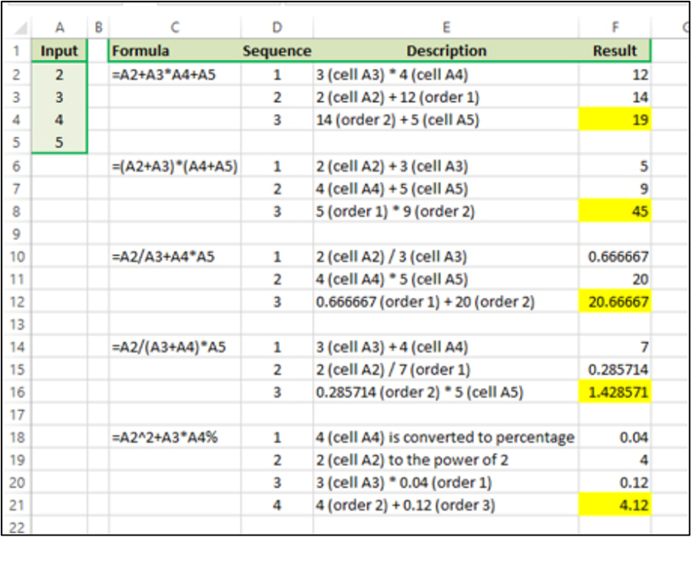
Create Formulas (2 of 2)
Notes:
This slide shows some operators and shows the correct answers when the order of operations are correctly performed. Study each example so you understand how each result was determined.

Slide 15
Objective 4: Display Cell Formulas
Skills:
Display Cell Formulas
Notes:
In this section, the skill is:
Display Cell Formulas

Slide 16
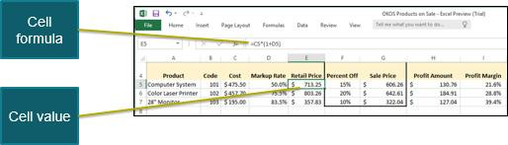
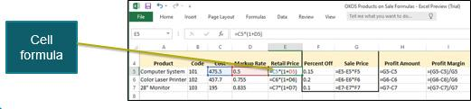
Display Cell Formulas
Notes:
Excel displays the value of a formula in a cell. How do you see the formula? For example, consider cell E5 shown in the slide.
You can select the cell and see the formula in the formula bar, but this has to be done for each formula.
To see all the formulas, you can press Ctrl + ‘. This is also referred to as the tilde key and is located below the Esc key.

Slide 17
Objective 5: Manage Columns and Rows
Skills:
Insert Cells, Columns, and Rows
Delete Cells, Columns, and Rows
Hide a Column or Row
Adjust Column Width
Adjust Row Height
Notes:
In this section, the skills include:
Insert Cells, Columns, and Rows
Delete Cells, Columns, and Rows
Hide a Column or Row
Adjust Column Width
Adjust Row Height

Slide 18
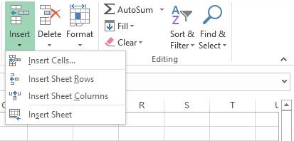
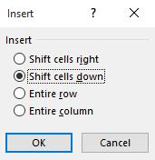
Manage Columns and Rows (1 of 5)
Notes:
After a worksheet has been constructed, you might need to modify it by inserting cells, columns, rows, or even an additional worksheet to accommodate new data.
To insert a new cell, column, or row, select the location of the new object and click Insert in the Cells group on the Home tab. As seen in the slide, you select which object you want to insert. If a column is to be inserted, it is inserted to the left of the selected column. If a row is to be inserted, it is inserted above the selected row.
If a cell is to be inserted, a dialog box from which you select what action is taken to accommodate the new cell is displayed.

Slide 19
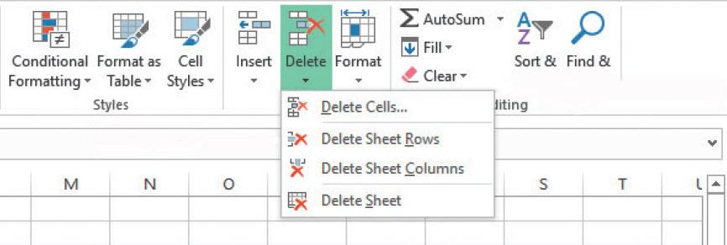
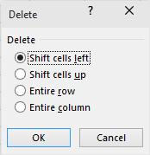
Manage Columns and Rows (2 of 5)
Notes:
In a similar fashion, you might have to delete unneeded cells, columns, or rows.
To delete a cell, column, or row, select the location of the new object, click Delete in the Cells group on the Home tab. As seen in the slide, you select which object you want to delete. If a column is to be deleted, it is deleted and the columns to the right are moved to the left. If a row is to be deleted, it is deleted and the rows below are moved up.
If a cell is to be deleted, a dialog box is displayed from which you select what action is taken to replace the deleted cell.

Slide 20
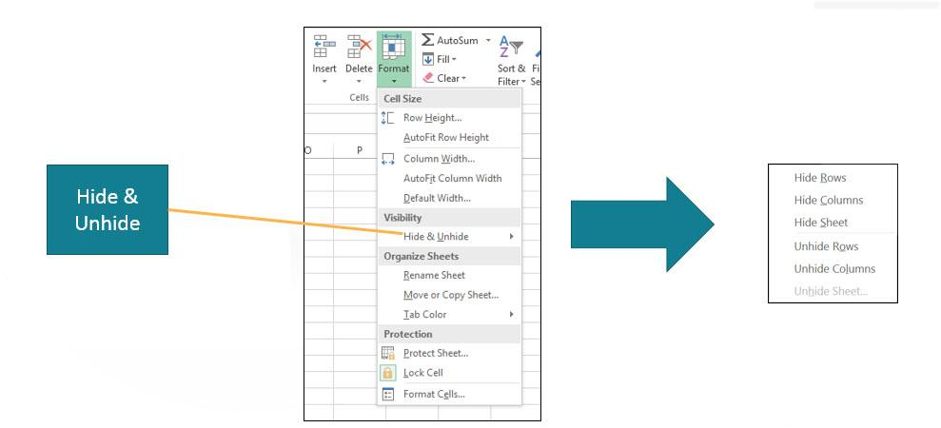
Manage Columns and Rows (3 of 5)
Notes:
If a worksheet contains information that should not be displayed, columns and/or rows can be hidden before a copy is printed for public distribution. The column or row is not deleted, it is simply not seen. To hide a column or row, select the object, then to display the menu, click Format in the Cells group on the Home tab. You can also right-click the object and select Hide from the menu.
To unhide a column or row, repeat the process, selecting Unhide instead.

Slide 21
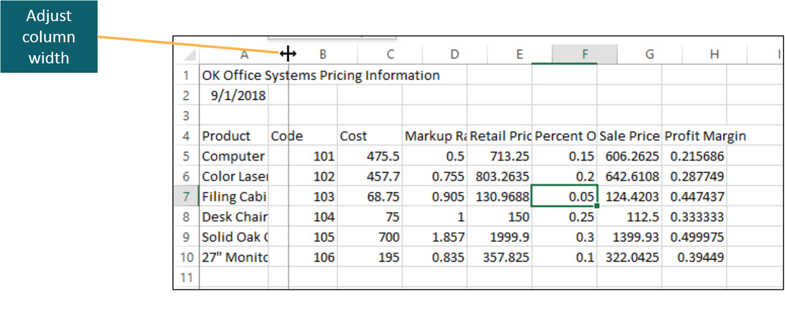
Manage Columns and Rows (4 of 5)
Notes:
After data has been entered in a column, you might need to adjust the column width—the horizontal measurement of a column in a table or a worksheet. This frequently happens if you have long descriptive labels. Note when a series of pound signs ###### is displayed in a cell, it indicates that a cell is too narrow to display the value of the cell.
As seen the slide, you can adjust the width of a column to accommodate the widest cell by double-clicking the right column border. You can adjust the width of a column by dragging the left border to the desired measurement. This is often difficult to do, so there is another option, as discussed on the next slide.

Slide 22
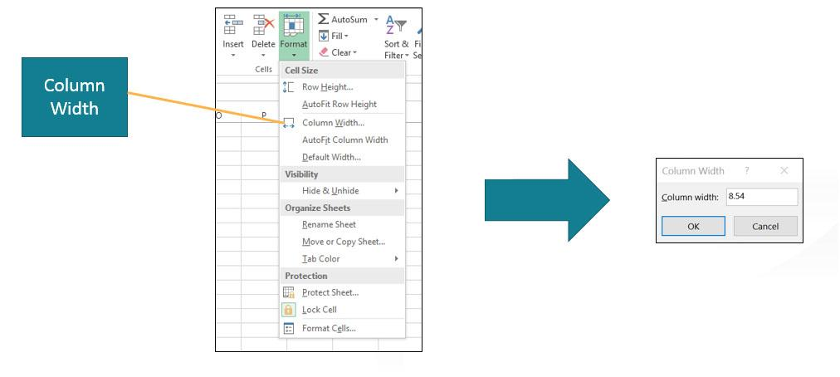
Manage Columns and Rows (5 of 5)
Notes:
To display the Column width dialog box, you open the familiar menu by clicking Format in the Cells group on the Home tab and then clicking Column width. Column widths are measured in the number of characters or pixels.
Changing row height is done in a similar manner. As seen in the slide, the option to adjust row height is two options above the column width option. A similar dialog box for rows enables you to select the exact row height. Unlike column widths, row heights are measured in points and pixels.

Slide 23
Objective 6: Select, Move, Copy, and Paste Data
Skills:
Select a Range
Move a Range
Copy and Paste a Range
Use Paste Options and Paste Special
Notes:
In this section, the skills include:
Select a Range
Move a Range
Copy and Paste a Range
Use Paste Options and Paste Special

Slide 24
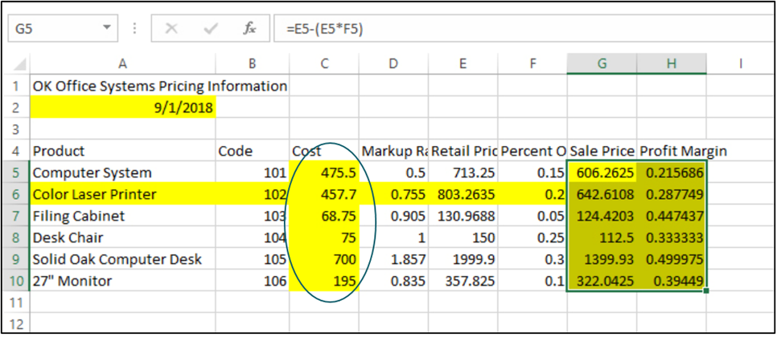
Select, Move, Copy, and Paste Data (1 of 3)
Notes:
Range refers to a group of adjacent or contiguous cells in a worksheet and is indicated using a colon. An example is G5:H10, which is shaded in the slide.
What is the range of the yellow highlighted cells enclosed in the oval?

Slide 25
Select, Move, Copy, and Paste Data (2 of 3)
To move, copy, or paste data:
Select range
Select Cut or Copy
Move to new location
Select Paste and the paste option
Notes:
If you have moved, copied, or pasted blocks of text in a word processing application, then you already know how to perform these actions in Excel with data.
Select the range—a single cell or range of cells.
Select Cut to move or Copy to copy.
Move to new location.
Select Paste and the appropriate paste option.

Slide 26
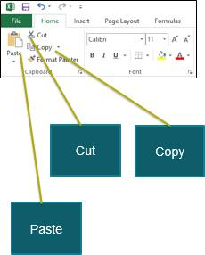
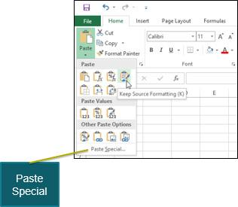
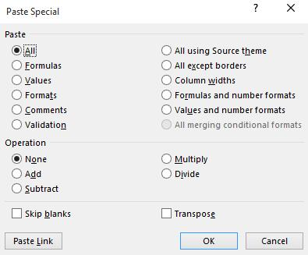
Select, Move, Copy, and Paste Data (3 of 3)
Notes:
To copy or cut a range, you click Cut or Copy in the Clipboard group on the Home tab. Remember, cutting a range removes the selected range and copying places a copy of the selected range in the Clipboard. When pasting an object, there are several options so that you can paste the selection using a different format than the source. See Table 1.5 in the textbook for a detailed explanation of each Paste Special option.

Slide 27
Objective 7: Apply Cell Styles, Alignment, and Font Options
Skills:
Apply a Cell Style
Merge and Center Data
Change Cell Alignment
Wrap Text
Increase Indent
Apply a Border
Apply Fill Color
Notes:
In this section, the skills include:
Apply a Cell Style
Merge and Center Data
Change Cell Alignment
Wrap Text
Increase Indent
Apply a Border
Apply Fill Color

Slide 28
Apply Cell Styles, Alignment, and Font Options (1 of 5)
Cell style—collection of format settings that provide a consistent appearance
Cell styles control:
Font
Font color and size
Borders and fill colors
Alignment
Number formatting
Notes:
A cell style is a collection of format settings that you use to provide a consistent appearance within a worksheet and among similar workbooks.
Cell styles control the following formats:
Font
Font color
Font size
Borders and fill colors
Alignment
Number formatting

Slide 29
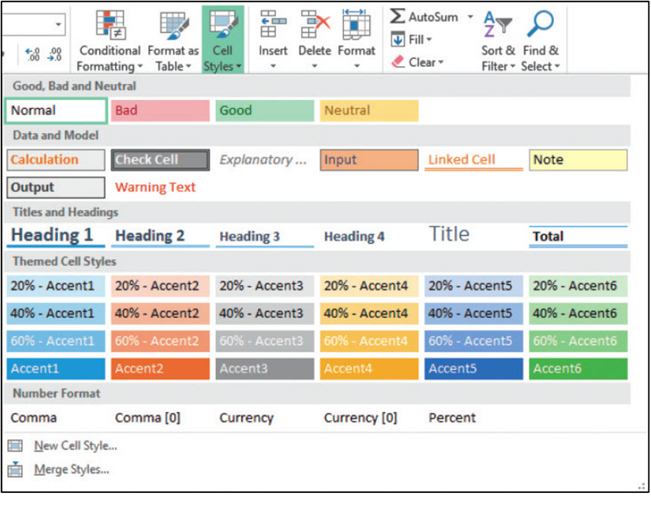
Apply Cell Styles, Alignment, and Font Options (2 of 5)
Notes:
This slide shows the Cell Styles gallery, which is displayed by clicking Cell Styles in the Styles group on the Home tab.

Slide 30
Apply Cell Styles, Alignment, and Font Options (3 of 5)
Alignment—how data are positioned within boundaries of cell
Data type default alignments:
Text—aligns at left cell margin
Dates and values—align at right cell margin
Horizontal alignment—position of data between left and right cell margins
Vertical alignment—position of data between top and bottom cell margins
Notes:
Alignment refers to how data are positioned in the boundaries of a cell.
Each type of data has a default alignment:
Text aligns at the left cell margin.
Dates and values align at the right cell margin.
Horizontal alignment identifies the position of data between the left and right cell margins. Vertical alignment identifies the position of data between the top and bottom cell margins.

Slide 31
Apply Cell Styles, Alignment, and Font Options (4 of 5)
Merge and center—merges selected cells together into one cell
Wrap text—data appears on multiple lines in cell
Indent—offset of data from current alignment
Border—line that surrounds cell or range of cells
Fill color—background color that displays behind data
Notes:
Merge and center merges the selected cells together into one cell, and data are centered within the merged cell.
Wrap text makes data appear on multiple lines by adjusting the row height to fit the cell contents within the column width.
Indent refers to the offset of data from its current alignment.
A border is a line that surrounds a cell or a range of cells.
Fill color is a background color that displays behind the data in a cell.

Slide 32
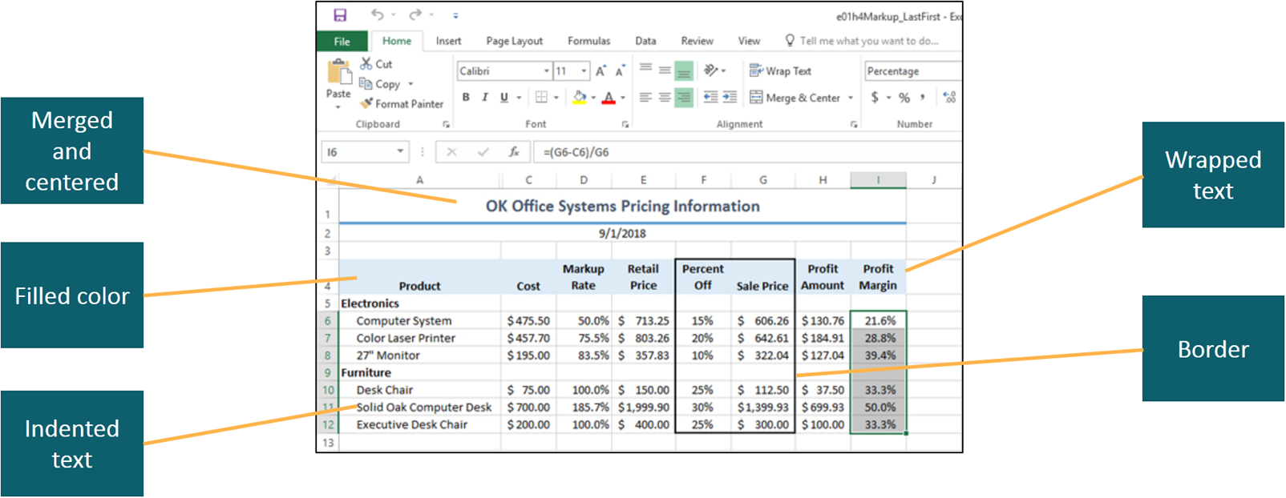
Apply Cell Styles, Alignment, and Font Options (5 of 5)
Notes:
The Alignment group on the Home tab contains several commands used to align and format data.

Slide 33
Objective 8: Apply Number Formats
Skills:
Apply Number Formats
Increase and Decrease Decimal Places
Notes:
In this section, the skills include:
Apply Number Formats
Increase and Decrease Decimal Places

Slide 34
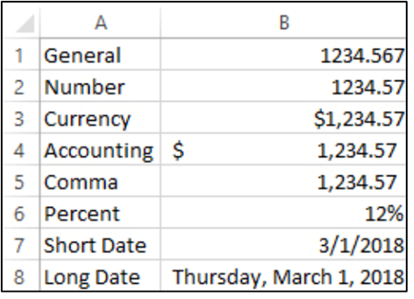
Apply Number Formats
Notes:
Number formats are settings that determine how a value is displayed in a cell. See Table 1.7 in the textbook for a detailed description of each format style.
This slide shows how numerical and date information can be formatted using different format styles. In addition to determining the format of numerical data, you can also increase or decrease the number of decimal places that are displayed.
Video related to this slide: https://www.youtube.com/watch?v=2suE4YmZu_Q

Slide 35
Objective 9: Manage Worksheets
Skills:
Insert a Worksheet
Delete a Worksheet
Copy or Move a Worksheet
Rename a Worksheet
Group Worksheets
Notes:
In this section, the skills include:
Insert a Worksheet
Delete a Worksheet
Copy or Move a Worksheet
Rename a Worksheet
Group Worksheet
Grouping worksheets: https://www.youtube.com/watch?v=lsV6VRpXFJk

Slide 36
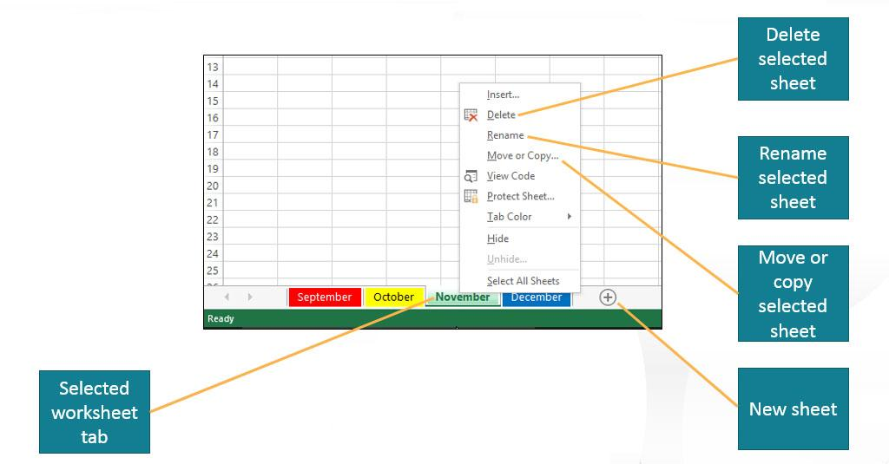
Manage Worksheets (1 of 2)
Notes:
When you start a new blank workbook in Excel, the workbook contains a single worksheet named Sheet1. As a workbook becomes more complicated, you may need to create a multiple-worksheet workbook. This takes some planning and maintenance, and your worksheet tab names should indicate the contents of the respective worksheets. To add an additional worksheet, you click New sheet and its tab is inserted to the right of the selected worksheet. The simplest way to delete a worksheet is to right-click its tab and click Delete. To rename a worksheet, right-click its tab and click Rename. To move or copy a worksheet, right-click its tab and click Move or Copy.

Slide 37
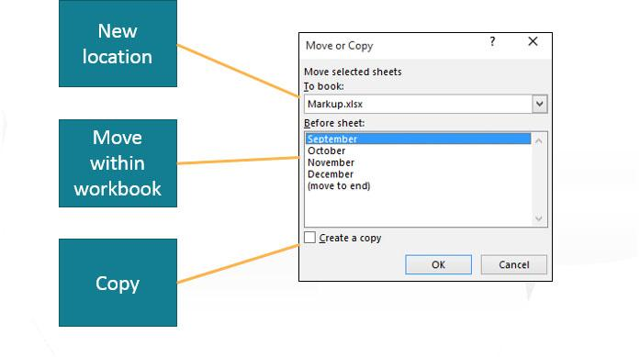
Manage Worksheets (2 of 2)
Notes:
As shown in the Move or Copy dialog box, you can move or copy a worksheet to another workbook or specify its new location within the current workbook. To copy instead of move a worksheet, you select the Create a copy check box. Notice the option to place the worksheet at the end. If you are moving a worksheet within a workbook, the easiest method is to simply drag the worksheet tab to the desired location.

Slide 38
Objective 10: Select Page Setup Options
Skills:
Set Page Orientation
Select Scaling Options
Set Margin Options
Create a Header or Footer
Select Sheet Options
Notes:
In this section, the skills include:
Set Page Orientation
Select Scaling Options
Set Margin Options
Create a Header or Footer
Select Sheet Options

Slide 39
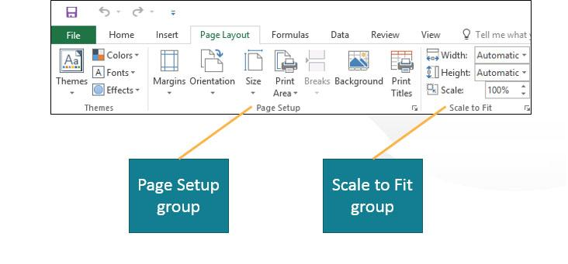
Select Page Setup Options (1 of 3)
Notes:
The Page Layout contains several groups that are used for selecting page setup options. The two main groups are:
Page Setup group that contains options to set the margins, select orientation, specify page size, select the print area, and apply other options.
Scale to Fit group that contains options for adjusting the scaling of the spreadsheet on the printed page.
See Table 1.8 in the textbook for detailed descriptions of the Page Setup group commands.

Slide 40
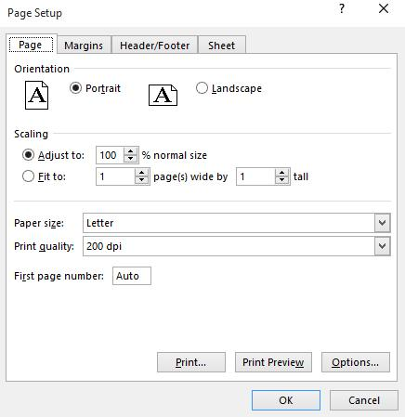
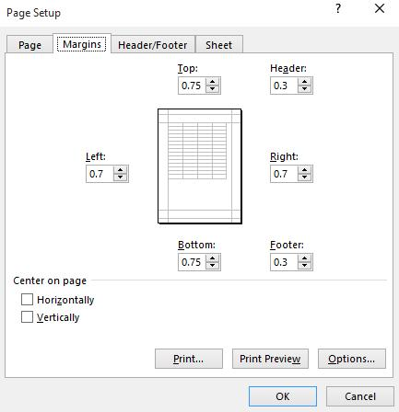
Select Page Setup Options (2 of 3)
Notes:
If you want to apply several page setup options at once or access options not found on the Ribbon, click the Page Setup Dialog Box Launcher. As shown in the slide, you have direct access to several page setup options by selecting the appropriate tab. The figure shows the page options. Clicking the Margins tab displays margin settings, which also include the horizontal and vertical centering of the worksheet on the printout. Clicking the Header/Footer tab displays the header and footer options.

Slide 41
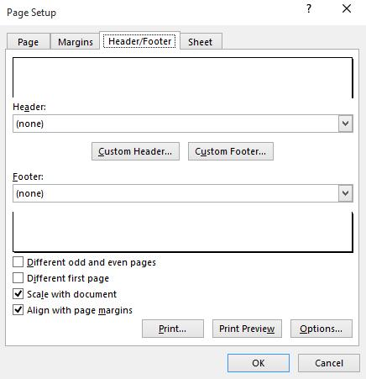
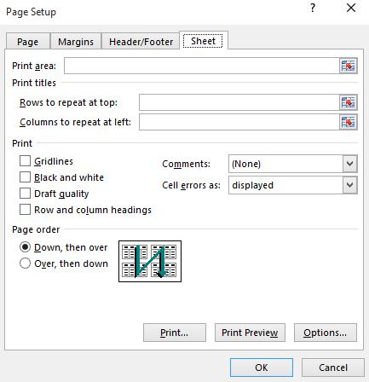
Select Page Setup Options (3 of 3)
Notes:
A header or footer appears at the top and/or bottom of every printed page. See Table 1.9 for a detailed description of header and footer elements.
The Sheet tab contains options for setting the print area, print titles, print options, and page order.

Slide 42
Objective 11: Preview and Print a Worksheet
Skills:
View in Print Preview
Set Print Options
Print a Worksheet
Notes:
In this section, the skills include:
View in Print Preview
Set Print Options
Print a Worksheet

Slide 43
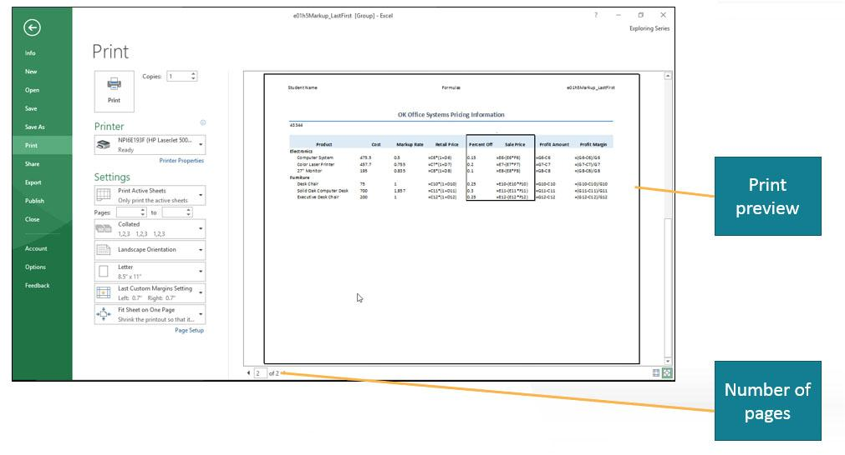
Preview and Print a Worksheet
Notes:
Microsoft Office Backstage view displays print options and displays the worksheet in print preview mode, which helps you see what your printed copy will look like before you actually print it. Note in this print preview, the worksheet has be configured to print the cell formulas instead of the cell values. The bottom of the Print window indicates how many pages will print, and as shown in the slide, we are looking at the second of two pages.

Slide 44
Summary (1 of 2)
A workbook can consist of multiple worksheets, divided into columns, rows, and cells
Cells contain text, values, or formulas, with contents entered by typing, copying and pasting, and using Auto Fill
Columns, rows, and cells can be added or deleted, copied, or moved
Styles, alignment, and formatting can be applied to cells
Formatting can be applied to numerical values
Notes:
An Excel workbook can consist of multiple worksheets, which are divided into columns, rows, and cells.
Cells can contain text, values, and formulas. Cell contents can be enter by typing, copying and pasting, and by using Auto Fill.
Once data have been entered, columns, rows, and cells can be added or deleted, copied, or moved.
Cells can have styles applied to them, their text contents can be aligned and formatted, and formatting can be applied to numerical values.

Slide 45
Summary (2 of 2)
Worksheets can be inserted, deleted, renamed, copied, and moved
A worksheet can have orientation and margins changed, headers and footers added, and scaling adjusted
Before printing, a worksheet can be previewed and final printing options selected
Notes:
Worksheets can be inserted, deleted, renamed, copied, and moved.
A worksheet can have its orientation and margins changed, headers and footers added, and its scaling adjusted.
Before printing, a worksheet can be previewed and final printing options can be selected.

Slide 46

Questions
Notes:
It is important to understand the skills learned in this chapter so you can build on these in future PowerPoint chapters. Are there any questions?

Slide 47

Copyright

