Slide 1

Exploring: Microsoft® Excel® 2016 Comprehensive
First Edition
Chapter 3
Charts Depicting Data Visually
Copyright © 2017 Pearson Education, Inc. All Rights Reserved
Notes:
If this PowerPoint presentation contains mathematical equations, you may need to check that your computer has the following installed:
1) MathType Plugin
2) Math Player (free versions available)
3) NVDA Reader (free versions available)
Exploring: Microsoft® Excel® 2016 Comprehensive
In Chapter 3, you will learn how to display data in charts.

Slide 2
Objectives
Select the Data Source
Choose a Chart Type
Move, Size, and Print a Chart
Add, Edit, and Format Chart Elements
Apply a Chart Style and Colors
Modify the Data Source
Create and Customize Sparklines
Notes:
The objectives for this chapter are:
Select the Data Source
Choose a Chart Type
Move, Size, and Print a Chart
Add, Edit, and Format Chart Elements
Apply a Chart Style and Colors
Modify the Data Source
Create and Customize Sparklines

Slide 3
Objective 1: Select the Data Source
Skills:
Select an Adjacent Range
Select a Nonadjacent Range
Notes:
In this section, the skills include:
Use a Relative Cell Reference
Use an Absolute Cell Reference
Use a Mixed Cell Reference

Slide 4
Select the Data Source (1 of 4)
Chart—visual representation of numerical data
Data point—cell containing a value
Data series—group of related data points
Notes:
A chart is a visual representation of numerical data that compares data and reveals trends or patterns to help people make informed decisions.
A data point is a cell containing a value.
A data series is a group of related data points that display in row(s) or column(s) in a worksheet.

Slide 5
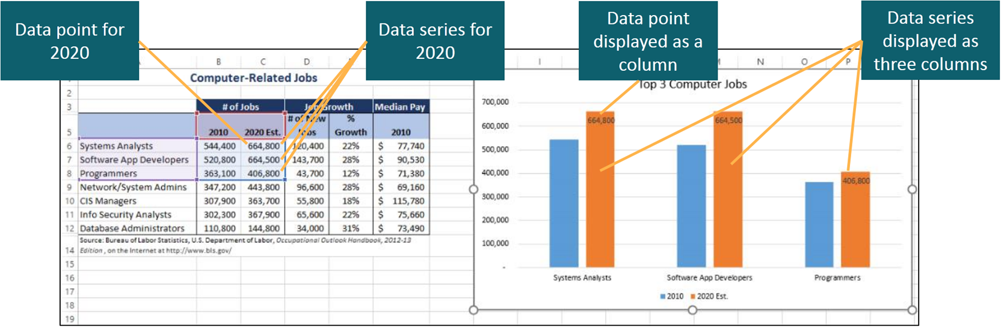
Select the Data Source (2 of 4)
Notes:
This slide shows how a data point and data series in a table are depicted in a chart.

Slide 6
Select the Data Source (3 of 4)
Chart elements:
Chart area
Plot area
X-axis
Y-axis
Legend
Notes:
Charts are composed of chart elements:
Chart area is the container for the entire chart and all of its elements.
Plot area is the region containing the graphical representation of the values in the data series. Two axes form a border around the plot area.
X-axis is the horizontal border that provides a frame of reference for measuring data from left to right.
Y-axis is the vertical border that provides a frame of reference for measuring data up and down.
Legend is a key that identifies the color, gradient, picture, texture, or pattern assigned to each data series in a chart.

Slide 7
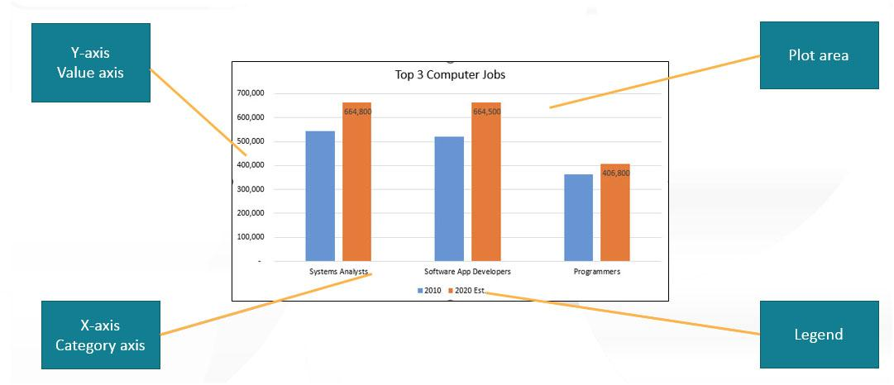
Select the Data Source (4 of 4)
Notes:
The entire figure is the Chart area containing the other chart elements.
The category axis is the axis that displays descriptive labels for the data points plotted in a chart.
The value axis is the axis that displays incremental numbers to identify the approximate of data points in a chart.

Slide 8
Objective 2: Choose a Chart Type
Skills:
Create a Clustered Column Chart
Create a Bar Chart
Change the Chart Type
Create a Line Chart
Create a Pie Chart
Create a Combo Chart
Create an Area Chart
Create a Scatter Chart
Create a Stock Chart
Notes:
In this section, the skills include:
Create a Clustered Column Chart
Create a Bar Chart
Change the Chart Type
Create a Line Chart
Create a Pie Chart
Create a Combo Chart
Create an Area Chart
Create a Scatter Chart
Create a Stock Chart

Slide 9
Choose a Chart Type (1 of 9)
Chart types:
Column—displays values in vertical columns and categories along horizontal axis
Bar—displays values in horizontal bars and categories along vertical axis
Line—displays category data on horizontal axis and value data on vertical axis
Pie—shows proportion of individual data points to the total
Notes:
Common chart types:
Column—displays values in vertical columns where the height represents the value and categories display along the horizontal axis.
Bar—displays values in horizontal bars where the length represents the value and categories display along the vertical axis.
Line—displays category data on the horizontal axis and value data on the vertical axis. Used to show continuous data to depict trends over time.
Pie—shows proportion of individual data points to the total or whole of all the data points.
Additional chart types are listed on the next slide.

Slide 10
Choose a Chart Type (2 of 9)
Chart types:
Combo—combines two chart types
Area—similar to a line chart
Scatter—shows relationship between two numerical variables
Stock—shows fluctuations in stock prices
Notes:
Common chart types:
Combo—combines two chart types to plot different data types.
Area—similar to a line chart, however, the area chart displays colors between the lines to help illustrate the magnitude of changes.
Scatter—shows a relationship between two numerical variables using their X and Y coordinates.
Stock—shows fluctuations in stock prices.

Slide 11
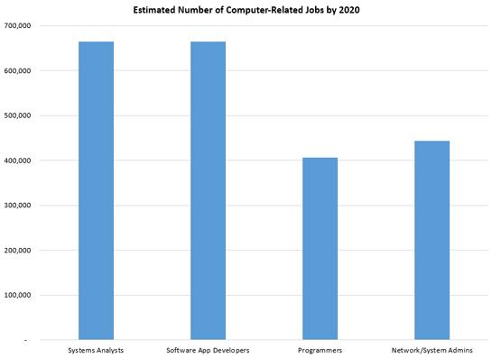
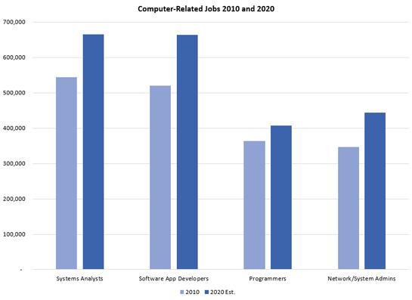
Choose a Chart Type (3 of 9)
Notes:
A column chart compares values across categories, such as job titles, using vertical columns. The vertical axis displays values, and the horizontal axis displays categories. A column chart is shown on the left.
A clustered column chart, shown on the right, compares groups of columns set side by side. The clustered column chart enables quick comparisons across data series and is effective for comparing several data points among categories.

Slide 12
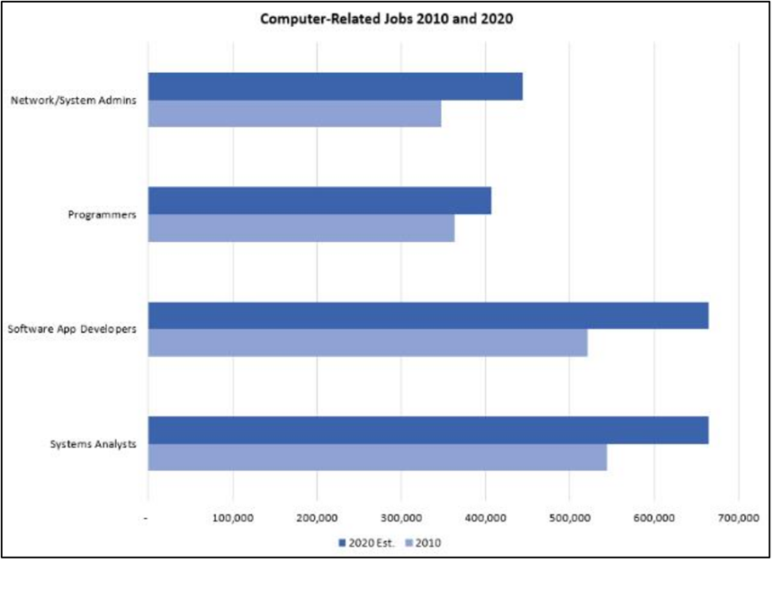
Choose a Chart Type (4 of 9)
Notes:
A bar chart compares values across categories using horizontal bars. The horizontal axis displays values, and the vertical axis displays categories.
Bar charts and column charts both compare categories of data. A bar chart is preferable when category names are long. Note how easily the long category names are accommodated.
The slide depicts a clustered column chart.

Slide 13
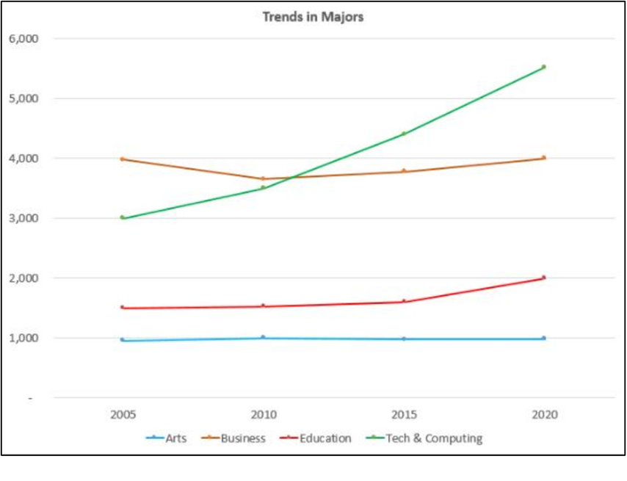
Choose a Chart Type (5 of 9)
Notes:
A line chart displays lines connecting data points to show trends over equal time periods. The category axis (X-axis) represents time, whereas the value axis (Y-axis) represents a value.

Slide 14
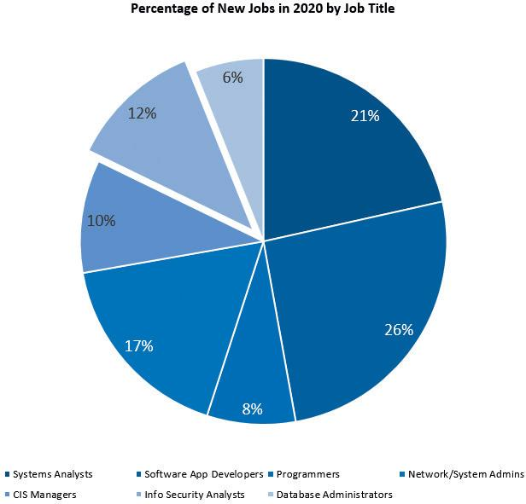
Choose a Chart Type (6 of 9)
Notes:
A pie chart shows each data point as a proportion to the whole data series. The pie chart displays as a circle, or “pie,” where the entire pie represents the total value of the data series and each slice represents a single data point. The slide depicts an exploded pie chart, with one section moved slightly out of the pie.

Slide 15
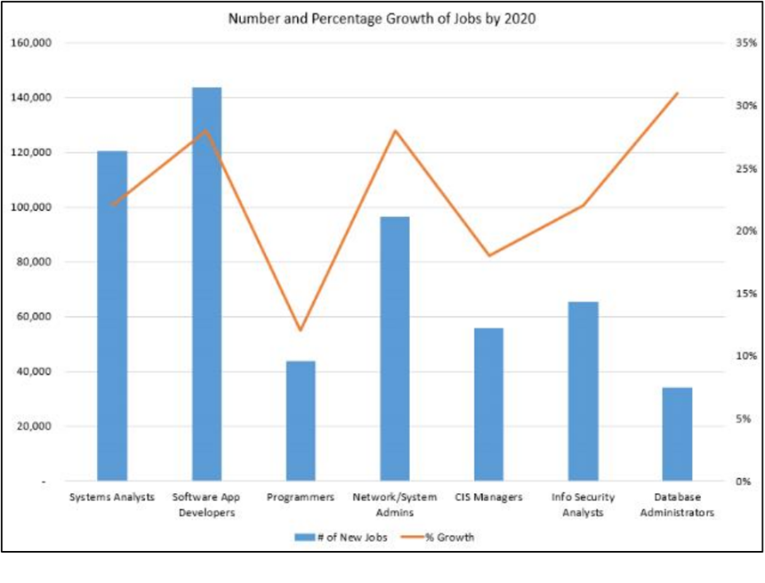
Choose a Chart Type (7 of 9)
Notes:
A combo chart combines two chart types, such as the column and line charts shown in the slide. This type of chart is useful to show two different but related data types—column chart for the number of positions and line chart for the percent of growth.

Slide 16
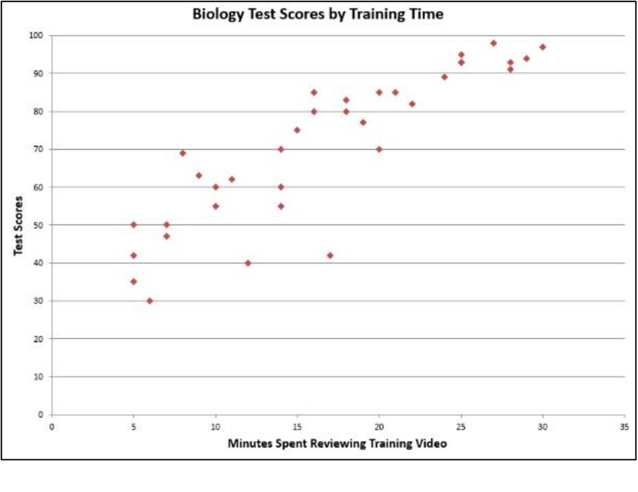
Choose a Chart Type (8 of 9)
Notes:
An X Y (scatter) chart shows a relationship between two numerical variables using their X and Y coordinates. Scatter charts are often used to represent data in educational, scientific, and medical experiments. This chart plots the minutes spent viewing a training video versus test scores. Do you see any correlation between the times and scores?

Slide 17
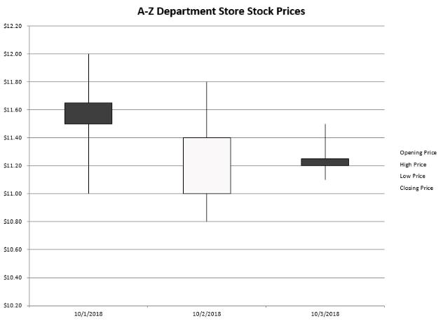
Choose a Chart Type (9 of 9)
Notes:
A stock chart shows fluctuations in stock prices. Excel has four stock subtypes: High-Low-Close, Open-High-Low-Close, Volume-High-Low-Close, and Volume-Open-High-Low-Close.
The High-Low-Close stock chart marks a stock’s trading range on a given day with a vertical line from the lowest to the highest stock prices. Rectangles mark the opening and closing prices. The slide shows three days of stock prices for a particular company.

Slide 18
Objective 3: Move, Size, and Print a Chart
Skills:
Move a Chart to a New Chart Sheet
Move a Chart Within a Worksheet
Size a Chart
Notes:
In this section, the skills include:
Move a Chart to a New Chart Sheet
Move a Chart Within a Worksheet
Size a Chart

Slide 19
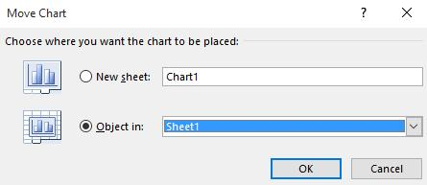
Move, Size, and Print a Chart (1 of 2)
Notes:
When you create a chart, it is inserted as an embedded object in the current worksheet. After a chart is inserted, you usually need to move it to a different location and adjust its size. You can drag a chart on the worksheet, but sometimes it is advantageous to place it on its own worksheet called a chart sheet. Right-click in the chart and select Move Chart. This opens the Move Chart dialog box, where you can create and move the chart to a new sheet, or you can place it in another sheet in the workbook.
To print a chart or the chart and its data source, click the File tab and click Print. Select which—data, chart, data and chart—select Print Selection, and click Print.

Slide 20
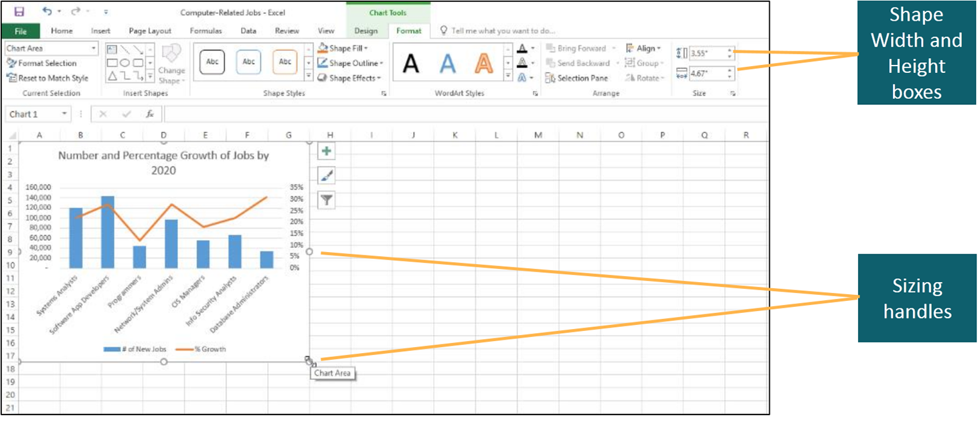
Move, Size, and Print a Chart (2 of 2)
Notes:
To adjust the size of a chart, you can drag one of the sizing handles or specify the exact size by entering values in the Shape Width and Height boxes. The sizing boxes are on the Format tab in the Size group when the chart is selected.

Slide 21
Objective 4: Add, Edit, and Format Chart Elements (1 of 2)
Skills:
Edit and Format Chart Titles
Add and Format Axes Titles
Format Axes
Add, Position, and Format Data Labels
Format and Position the Legend
Apply a Quick Layout
Format the Chart Area
Notes:
In this section, the skills include:
Edit and Format Chart Titles
Add and Format Axes Titles
Format Axes
Add, Position, and Format Data Labels
Format and Position the Legend
Apply a Quick Layout
Format the Chart Area

Slide 22
Objective 4: Add, Edit, and Format Chart Elements (2 of 2)
Format the Plot Area
Format a Data Series
Format the Gridlines
Format a Data Point
Notes:
Format the Plot Area
Format a Data Series
Format the Gridlines
Format a Data Point

Slide 23
Add, Edit, and Format Chart Elements (1 of 4)
Chart elements:
Axis title—describes category or value axes
Chart title—describes entire chart
Data label—shows exact value or name of data point
Data table—grid that contains data source values and labels
Notes:
A chart element is a component that completes or helps clarify the chart.
Axis title—label that describes the category or value axes.
Chart title—label that describes the entire chart and should reflect the purpose of the chart.
Data label—descriptive label that shows the exact value or name of a data point.
Data table—a grid that contains the data source values and labels.
Additional chart elements are listed on the next slide.

Slide 24
Add, Edit, and Format Chart Elements (2 of 4)
Chart elements:
Error bars—visuals indicating statistics for data point or marker
Gridlines—horizontal or vertical lines
Legend—identifies attributes assigned data series
Trendline—line that depicts trends
Notes:
A chart element is a component that completes or helps clarify the chart.
Error bars—visuals that indicate the standard error amount, a percentage, or a standard deviation for a data point or marker.
Gridlines—horizontal or vertical lines that display in the plot area, designed to help people identify the values plotted by the visual elements.
Legend—a key that identifies the color, gradient, picture, texture, or pattern assigned to each data series.
Trendline—a line that depicts trends or helps forecast future data.

Slide 25
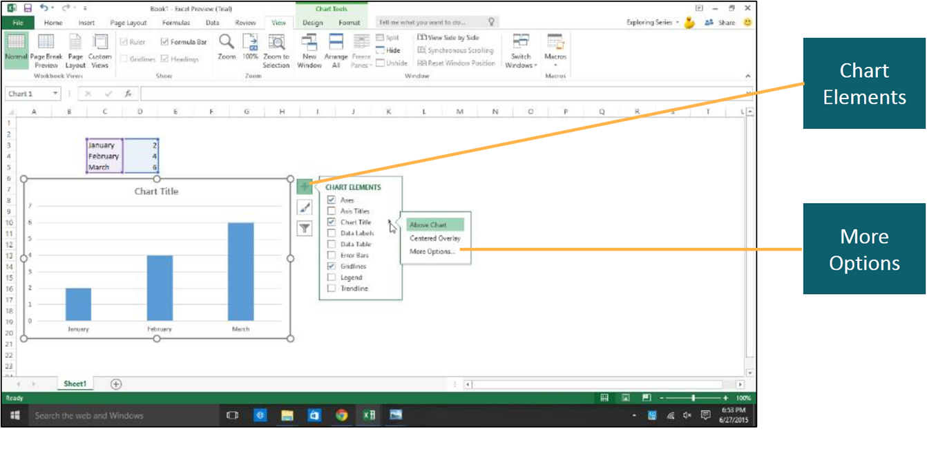
Add, Edit, and Format Chart Elements (3 of 4)
Notes:
Editing and formatting the chart title improves the readability of the chart. Select the title and type the desired text. To format the text, select it and use the formatting options on the Home tab. To change the title’s position, click Chart Elements, click Chart Title, and select the option. Clicking More Options opens the Format Chart Title pane. Most chart elements have a formatting pane associated with them.

Slide 26
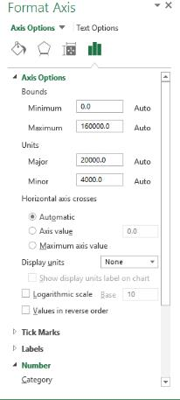
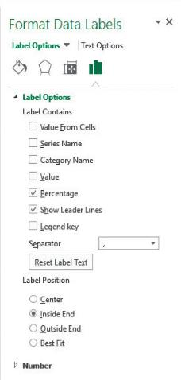
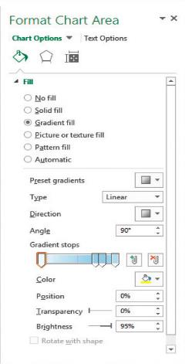
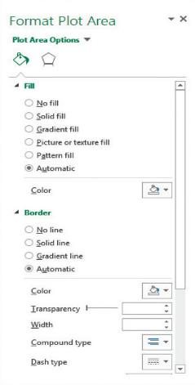
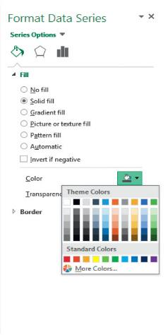
Add, Edit, and Format Chart Elements (4 of 4)
Notes:
You can add an axis title by clicking Chart Elements, checking Axis Titles, and then entering the axis title text for the desired axis. To position and format an axis title, double-click it to display the Format Axis Title pane. From this pane, you can format the Fill & Line, Effects, and Size & Properties by clicking their respective icons.
In a similar manner, you can format other chart elements, by double-clicking the object to open its format pane. The following format panes are shown:
Axis
Data Labels
Chart Area
Plot Area
Data Series

Slide 27
Objective 5: Apply a Chart Style and Colors
Skills:
Apply a Chart Style
Change Colors
Notes:
In this section, the skills include:
Apply a Chart Style
Change Colors

Slide 28
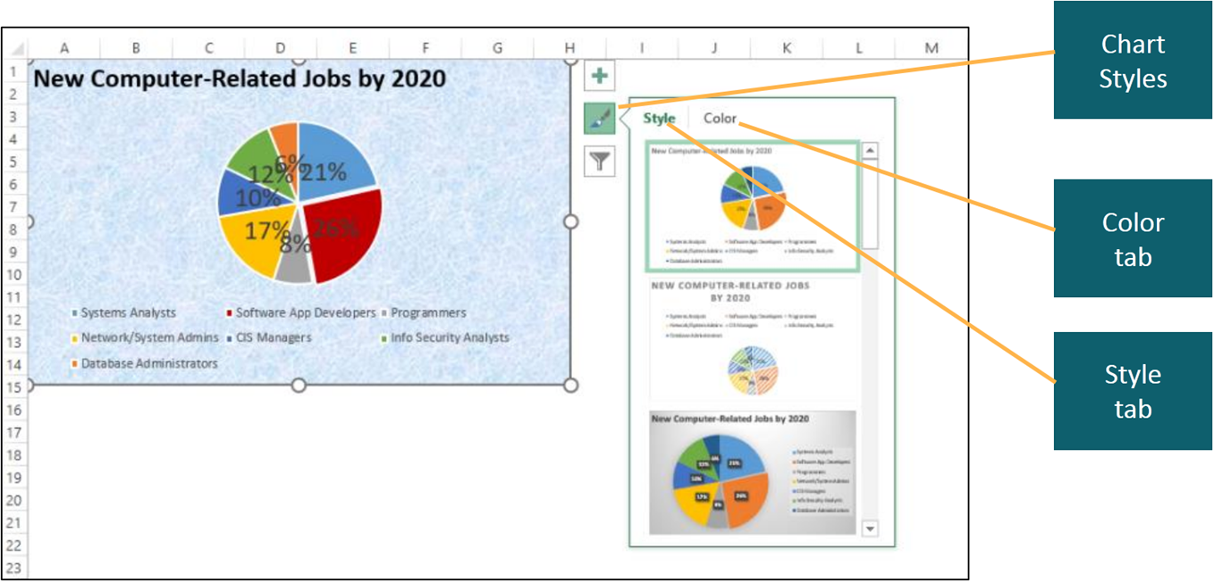
Apply a Chart Style and Colors
Notes:
A chart style is a collection of formatting that controls the color and effects applied to the chart area, plot area, and data series.
To apply a style, click Chart Styles to display the Chart Styles gallery, or click the Design tab and select the desired style from the Chart Styles group. You can change the color by clicking the Color tab on the Chart Styles gallery or by clicking Change Colors in the Chart Styles group.
This slide shows the styles options for the pie chart. The styles that are displayed depend on the chart type, a pie chart in this case.

Slide 29
Objective 6: Modify the Data Source
Skills:
Apply Chart Filters
Switch Row and Column Data
Notes:
In this section, the skills include:
Apply Chart Filters
Switch Row and Column Data

Slide 30
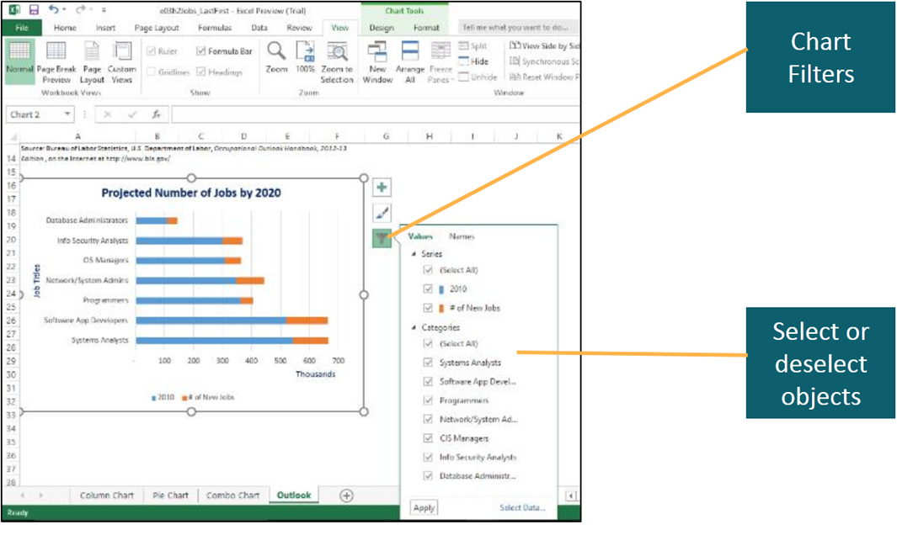
Modify the Data Source (1 of 3)
Notes:
A chart filter determines which data series and categories are displayed in a chart. By default, all the selected data used to create the chart are used to construct the data series and categories.
The are two ways that you can use to determine what data are displayed. You can click Chart Filters and then select or deselect the series or categories.

Slide 31
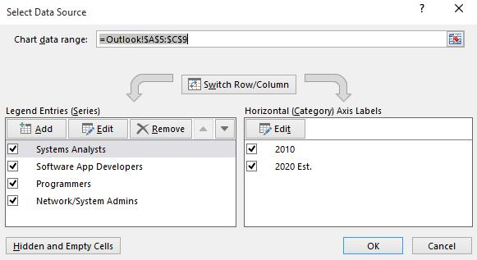
Modify the Data Source (2 of 3)
Notes:
The second way is to open the Select Data Source dialog box by clicking Select Data in the Data group on the Design tab. In addition to filtering which categories and data series are displayed in a chart, this dialog box enables you to change the chart data range, as well as add, edit, or remove data that is being used to create the chart.

Slide 32
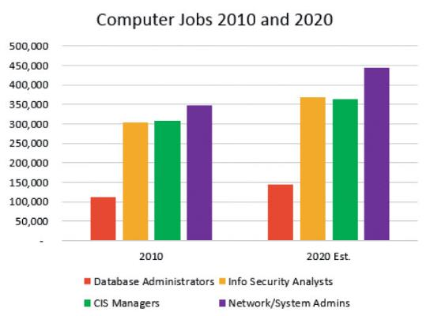
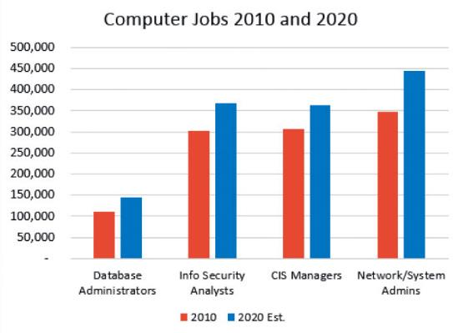
Modify the Data Source (3 of 3)
Notes:
Data can be switched to give a different perspective and to change the focus on the data.
The chart shown on the left uses the job titles as the data series and compares the different years on the horizontal axis, whereas the chart shown on the right, uses the years as the data series and compares the different job titles on the horizontal axis.

Slide 33
Objective 7: Create and Customize Sparklines
Skills:
Insert a Sparkline
Customize Sparklines
Notes:
In this section, the skills include:
Insert a Sparkline
Customize Sparklines

Slide 34
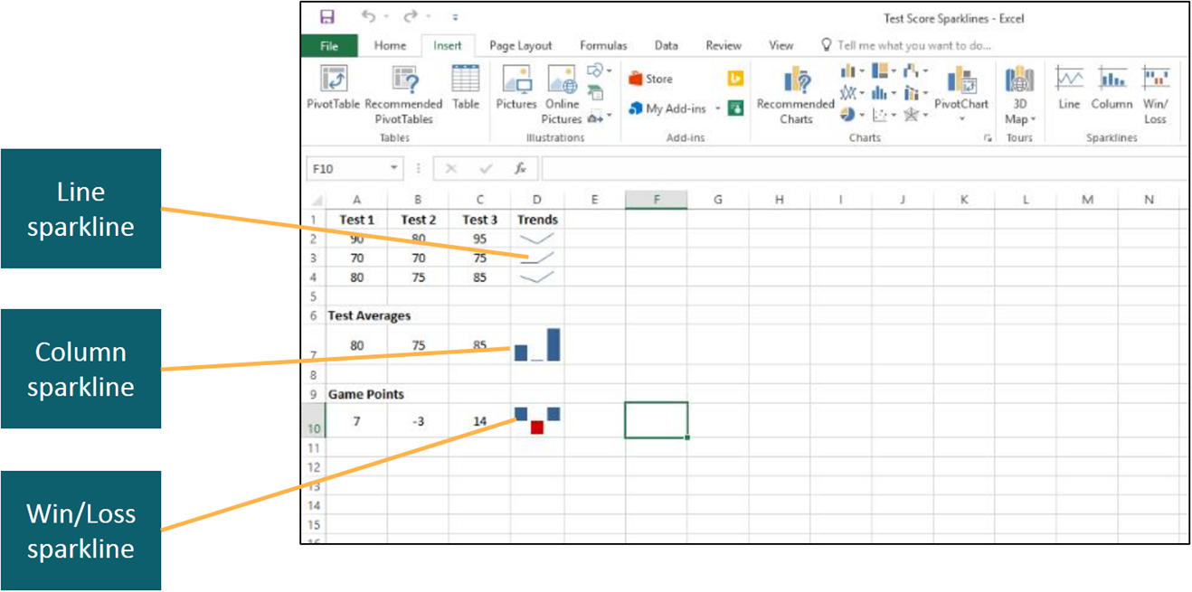
Create and Customize Sparklines (1 of 3)
Notes:
A sparkline is a small line, column, or win/loss chart contained in a single cell that displays a condensed, simple, and concise visual illustration of the data.
There are three types of sparklines—line, column, and win/loss. In the figure shown on the slide, the line sparkline shows trends over time, such as each student’s trends in test scores. The column sparkline compares test averages, and the win/loss sparkline depicts how many points a team won or lost each game.
To insert a sparkline, click the Insert tab and click the desired sparkline type to open the Create Sparklines dialog box.

Slide 35
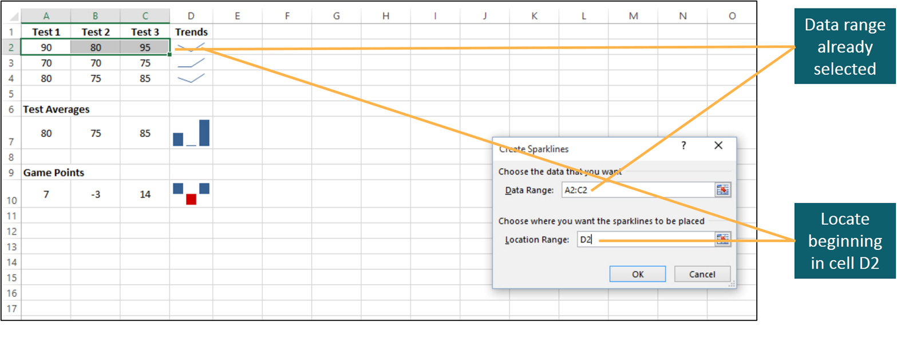
Create and Customize Sparklines (2 of 3)
Notes:
When inserting a sparkline, you can select the data before clicking the desired sparkline type as shown in this slide, or you can select the data by entering the range in the Data Range box. The dialog box also enables you to select where the sparklines will be displayed.

Slide 36
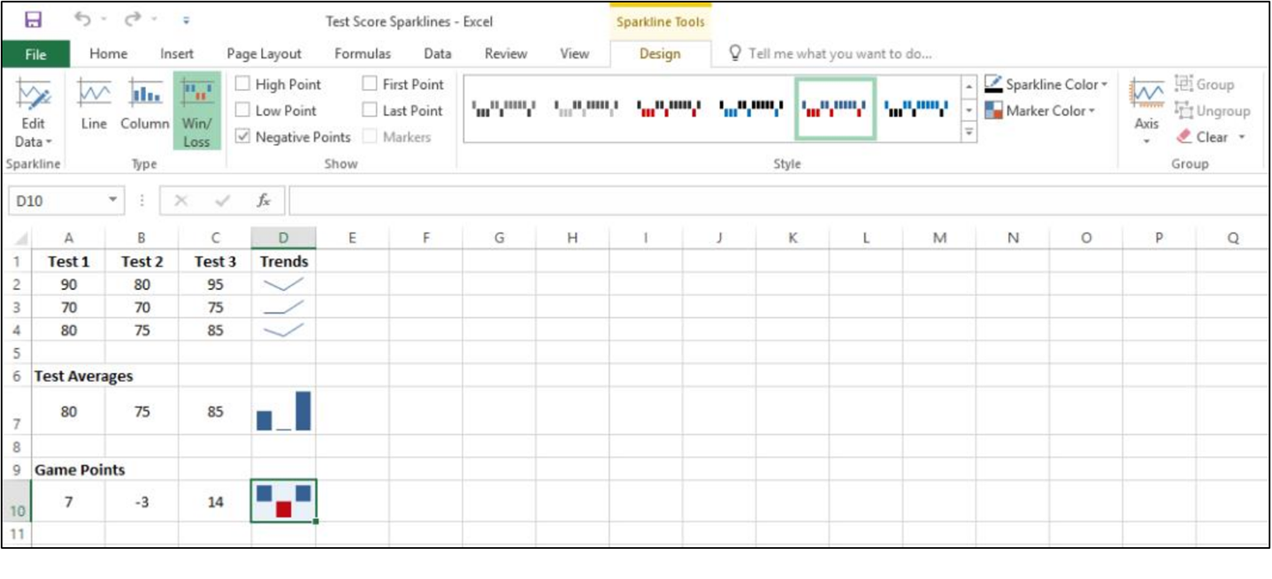
Create and Customize Sparklines (3 of 3)
Notes:
Once a sparkline has been inserted, the Sparkline Tools Design tab displays with options to customize the sparkline. There are five groups on the tab:
Sparkline—used to edit the location and data source for a group or an individual data point.
Type —changes the selected sparkline type.
Show—displays points, such as the high points, or markers within a sparkline.
Style—changes the sparkline style, sparkline color, or the marker color.
Group—specifies the horizontal and vertical axis settings, groups or ungroups objects, and clears sparklines.

Slide 37
Summary
Charts and sparklines visually represent data
Excel provides numerous chart types and several sparkline types
Charts and sparklines, and their elements, can be edited and formatted
Filters can be applied to a chart to focus on specific data elements
Notes:
By using Excel charts, you can create charts and sparklines to visually represent your data.
Excel provides numerous chart types and several sparkline types and you select the one that best represents your data.
Once a chart or sparkline has been added, you can edit and format it and its elements to have the desired appearance.
You can apply filters to a chart to focus on specific data elements.

Slide 38

Questions
Notes:
It is important to understand the skills learned in this chapter so you can build on these in future PowerPoint chapters. Are there any questions?

Slide 39

Copyright

