Slide 1
<script>
/*
CSCI-111 Web Programming and Problem Solving
*/
function week_7_lecture(session)
{
console.log("JavaScript Functions")
const instructors =
{
section_1: "Dr. Irina Dolzhikova",
section_2: "Dr. Talgat Manglayev",
section_3: "Dr. Syed Muhammad Umair Arif"
}
console.log(instructors[session])
}
week_7_lecture("section_2")
</script>

Slide 2
Content
Comparison
Logical operators
Functions
Function declaration and call
Arguments and parameters
Scope

Slide 3
Comparison
Greater than | a > b
Lower than | a < b
Greater than or equal to | a >= b
Lower than or equal to | a <= b
1.html, 2.html

Slide 4
Comparison
Equal value | a == b
Value and data type are equal | a === b
Not equal value | a != b
Not equal value or data type | a !== b
3.html, 4.html

Slide 5
Comparison
if (condition)
statement
if(hiddenNumber > enteredNumber)
console.log("The hidden number is larger")
if condition in brackets is true
execute the statement
5.html

Slide 6
Comparison
if (condition)
{
statement 1
statement 2
}
if(hiddenNumber > enteredNumber)
{
console.log("The hidden number is larger")
console.log("Try again")
}
if condition in brackets is true execute the statements 1 and 2
{} are mandatory for more than one statement
5.html

Slide 7
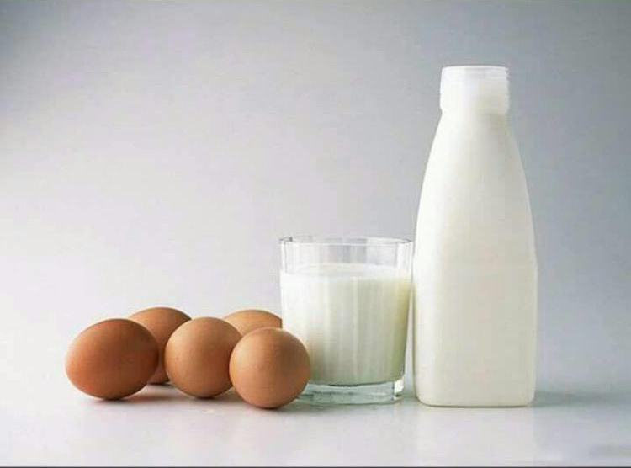
Comparison
Mom: "Honey, please go to the market and buy 1 bottle of milk.
If they have eggs, bring 6".
I came back with 6 bottles of milk.
Mom: "Why did you buy 6 bottles of milk?"
Me: "Because they had eggs"
5.html

Slide 8
Comparison
if(eggs == true)
{
buy 6 bottles of milk }
else
{
buy 1 bottle of milk
}
Mom: "Honey, please go to the market and buy 1 bottle of milk.
If they have eggs, bring 6".
I came back with 6 bottles of milk.
Mom: "Why did you buy 6 bottles of milk?"
Me: "Because they had eggs"
5.html

Slide 9
Comparison
if (condition)
{
statement 1
}
statement 2
if(hiddenNumber > enteredNumber)
{
console.log("The hidden number is larger")
}
console.log("Try again")
logic error
if condition in brackets is true execute the statement 1
then (even if condition is false) execute the statement 2
5.html

Slide 10
Comparison
if(condition)
{
statement 1
}
else
{
statement 2
}
if condition in brackets is true execute the statement 1
otherwise
execute the statement 2
{} are optional for one statement

Slide 11
Comparison
if(hiddenNumber == enteredNumber)
{
console.log("Congratulations!")
console.log("You have found the hidden number!")
}
else
{
console.log("It is not the hidden number!")
console.log("Try Again!")
}

Slide 12
Logical Operators
and | (a > 0) && (a < 10)
or | (a > 0) || (a < 10)
not | ! (a == 10)
6.html, 7.html, 8.html

Slide 13
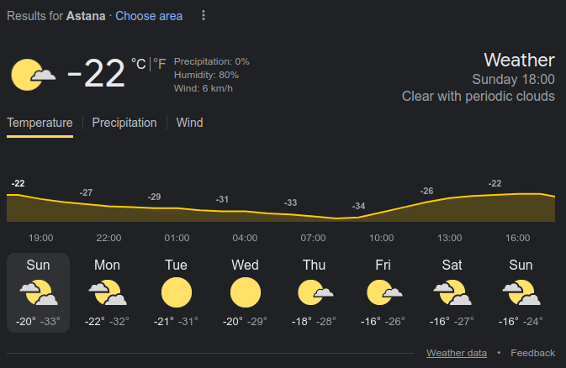
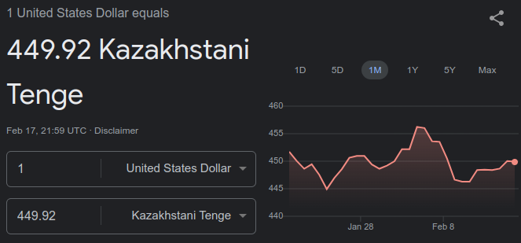
Functions
When we consume service:
we are not interested in the way it is done;
we can call it multiple times;

Slide 14
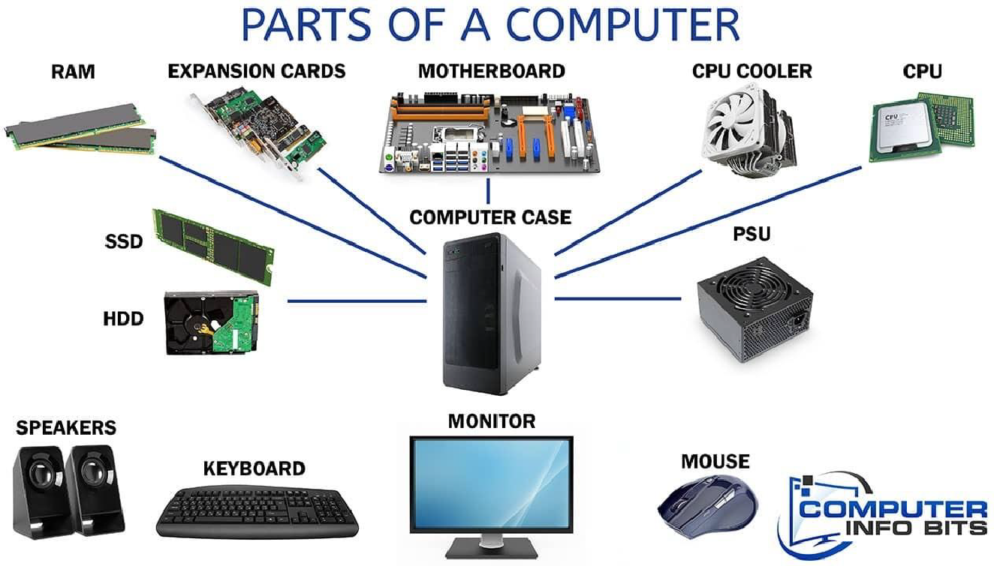
Introduction
Example 1: Parts of a Computer that perform some specific task

Slide 15
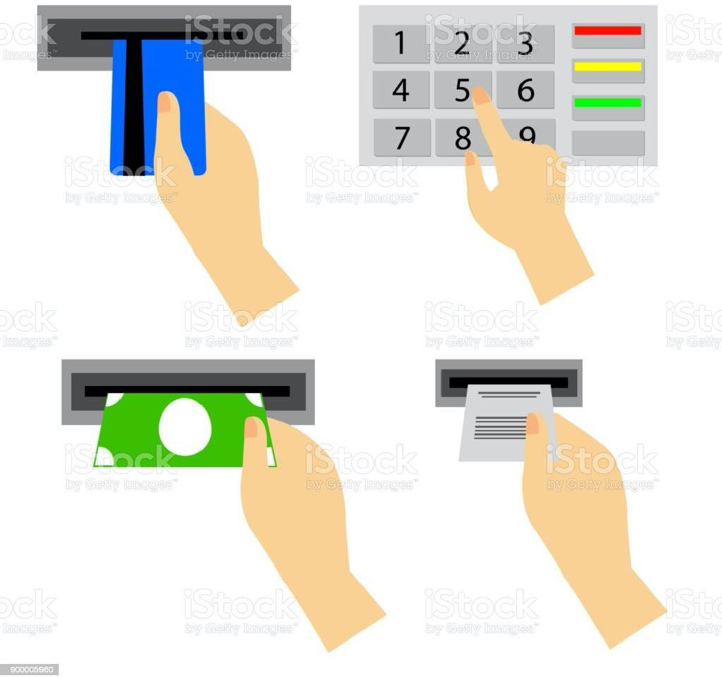
Introduction
Example 2: ATM machine

Slide 16
What is JavaScript function?
A function is a block of a program code designed to perform a specific task.
The functions are used to provide:
- Reusability: to use the same code multiple times in the program
- Abstraction: to hide the internals of the code for end user
- Modularity: to organize and divide the program into sub tasks

Slide 17
Function usage
The usage of a function is a two phase process:
1 – Function declaration (or definition)
2 – Function invocation (or execution, or call)

Slide 18
Function declaration
function multiplyByTwo(a)
{
return a * 2;
}
9.html

Slide 19
Function call
function multiplyByTwo(a)
{
return a * 2;
}
let a = 3;
let b = multiplyByTwo(a);
console.log(b);

Slide 20
Function declaration
const multiplyByThree = function(a)
{
return a * 3;
}
10.html

Slide 21
Function call
const multiplyByThree = function(a)
{
return a * 3;
}
let a = 3;
let b = multiplyByThree(a);
console.log(b);

Slide 22
Function declaration and call comparison
function multiplyByTwo(a)
{
return a * 2;
}
let a = 3;
let b = multiplyByTwo(a);
console.log(b);
const multiplyByThree = function(a)
{
return a * 3;
}
let a = 3;
let b = multiplyByThree(a);
console.log(b);
9.html, 10.html

Slide 23
Function parameters and arguments
function functionName(parameter)
{
//do something
return something;
}
let a = 3;
let b = functionName(argument);
function declaration
function call
https://www.w3schools.com/js/js_function_parameters.asp

Slide 24
Function arguments
The arguments are passed by values and not visible to the outside of the function
If a function changes an object property, it changes the original value
The functions can be passed as the arguments
11.html

Slide 25
Scope
Scope determines the accessibility (visibility) of variables.
JavaScript has 3 types of scope:
Global scope – visible everywhere
Block scope – visible within a block “{}”
Function scope – visible within a function
https://www.w3schools.com/js/js_scope.asp

Slide 26
Scope
Global Scope. A variable declared outside a function, have Global Scope. Global variables can be accessed from anywhere in a JavaScript program.
Block Scope. Let and Const variables declared inside a { } block cannot be accessed from outside the block.
Function Scope. Variables declared within a JavaScript function, can only be accessed from within the function.
*variables assigned without var, let and const automatically have a global scope;
https://www.w3schools.com/js/js_scope.asp
12.html, 13.html

Slide 27
Summary
Key takeaways:
• A function is block of code to perform specific task and used for:
reusability, abstraction and modularity
• Remember 2-step function usage: declare and call
• The arguments are passed by value, though object and array arguments can be
changed inside a function
• JavaScript has 3 types of scope: block, function, global
• Visibility of variables differs depending on scope

