Slide 1
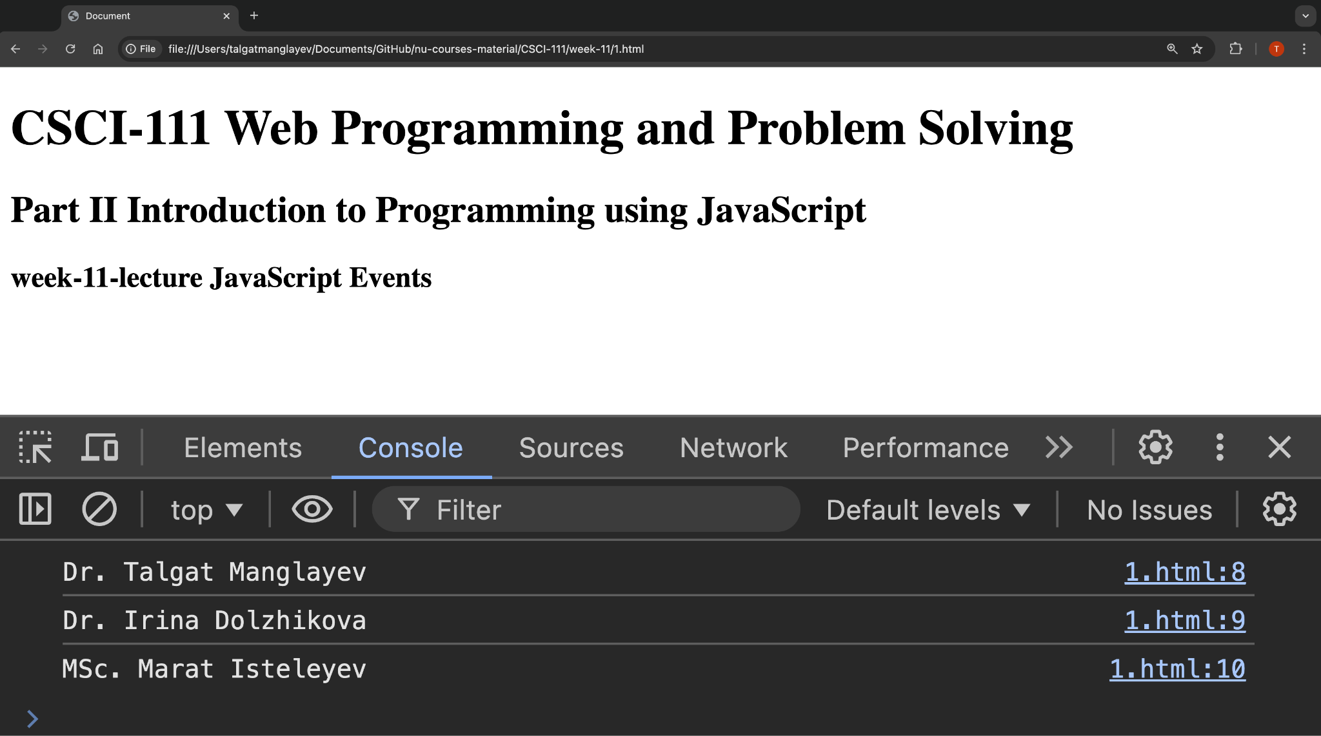
weeks [6-7] ∪ [9-11]

Slide 2
Content
•Introduction
•Inline Events
•Event Listeners
•Event Object

Slide 3
Introduction
When browsing a website, the user can interact with the website by:
Selecting, clicking, hovering over the elements on the page;
Filling the forms and pressing the keys;
Resizing or closing the browser window;
Playing or pausing the video or audio track, and so on …
All of these actions are called events and can be handled by the website

Slide 4
Inline events
Each time a user interacts with the web page, the browser triggers one of the predefined events such as:
Mouse events
Keyboard events
Form events
Window events
To handle the event, we can directly write event handler in the HTML element’s opening tag

Slide 5
Inline events
Each type of events has a predefined name to handle that event. For example for the mouse events:
mouseover
mouseenter
mouseout
etc.
<p id=" text1"
onmouseenter="style='background-color: yellow'"
onmouseout="style='background-color: white'">

Slide 6
this
this
keyword can be used to access the element where the event has been fired.
<h2 id="title" onclick="this.style.color='red'">Inline events</h2>
<p id="text2" onclick="changeFont(this)">

Slide 7
Event listeners
Inline event handling has some drawbacks:
Difficult to manage the code (debugging, flexibility)
Cannot have different handler of the same event
Mixes HTML and JavaScript in one document
To overcome these problems, we can use event listeners, which are more flexible and interactive.

Slide 8
Event listeners. Syntax.
element.addEventListener(event, function, useCapture);
let h = document.getElementById("title")
h.addEventListener(
"click",
function(event)
{
this.style.color="red";
});
The removeEventListener() method removes event handlers that have been attached with the addEventListener()
Event type
Event handler, Note the event argument of the function – event object

Slide 9
Event object
In some cases it is important not only know what type of event happened, but also know the context of the event such as:
what combination of the keys was pressed?
what are the coordinates of the mouse when clicked?
when the event happened?
These context information is called event object and the can be accessed in the event listeners.

Slide 10
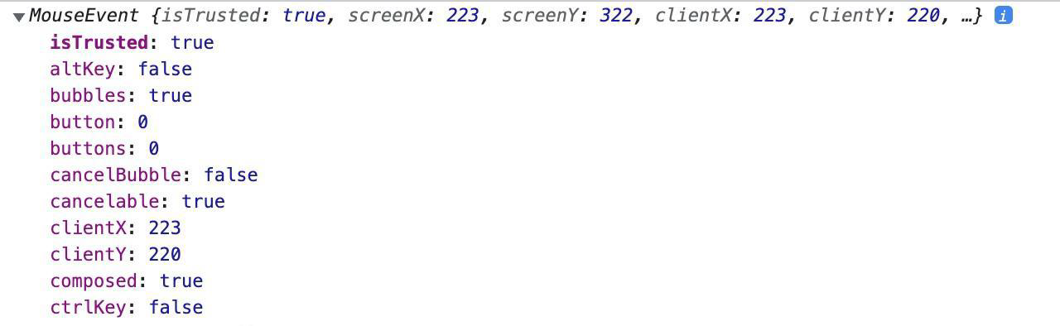
Style manipulation
The event object can be used to provide better user experience, add some features to the page, or something else.
h.addEventListener(
"click",
function (event)
{
console.log(event.clientX, event.clientY)
}
);

Slide 11
Useful links
https://www.w3schools.com/js/js_events.asp
https://www.w3schools.com/js/js_htmldom_events.asp
https://www.w3schools.com/js/js_htmldom_eventlistener.asp
https://www.w3schools.com/js/js_events_examples.asp
https://www.w3schools.com/js/js_this.asp

Slide 12
Summary
JavaScript can be used to handle events caused by user interaction with the web page: mouse, keyboard, browser, form, window events
There are two ways to handle the events on the webpage:
Inline events
Event listeners
this keyword can be used to access the element where event happened
To get more information about the event, we can use event object provided by the event listeners

