Slide 1
Multi-Faceted Music Retrieval
Combining Audio, Text, and Graph Embeddings for Smarter Song Recommendations
Wenny | Sid & Issac | Archive | Jiayi | Helena
Dataset: Free Music Archive (FMA) — 8,000 tracks, 8 genres
Deep Learning — Final Project Presentation

Slide 2
The Problem
Music retrieval systems typically rely on a single representation
“Chill lo-fi vibes” → requires understanding musical mood (acoustic features)
“Folk artists about travel” → requires understanding text & lyrics (semantic features)
“Songs like this one” → requires structural knowledge (graph relationships)
No single embedding captures all of these.
Our solution: build independent embedding views for each modality,
then fuse them into one retrieval system that outperforms any single view.

Slide 3
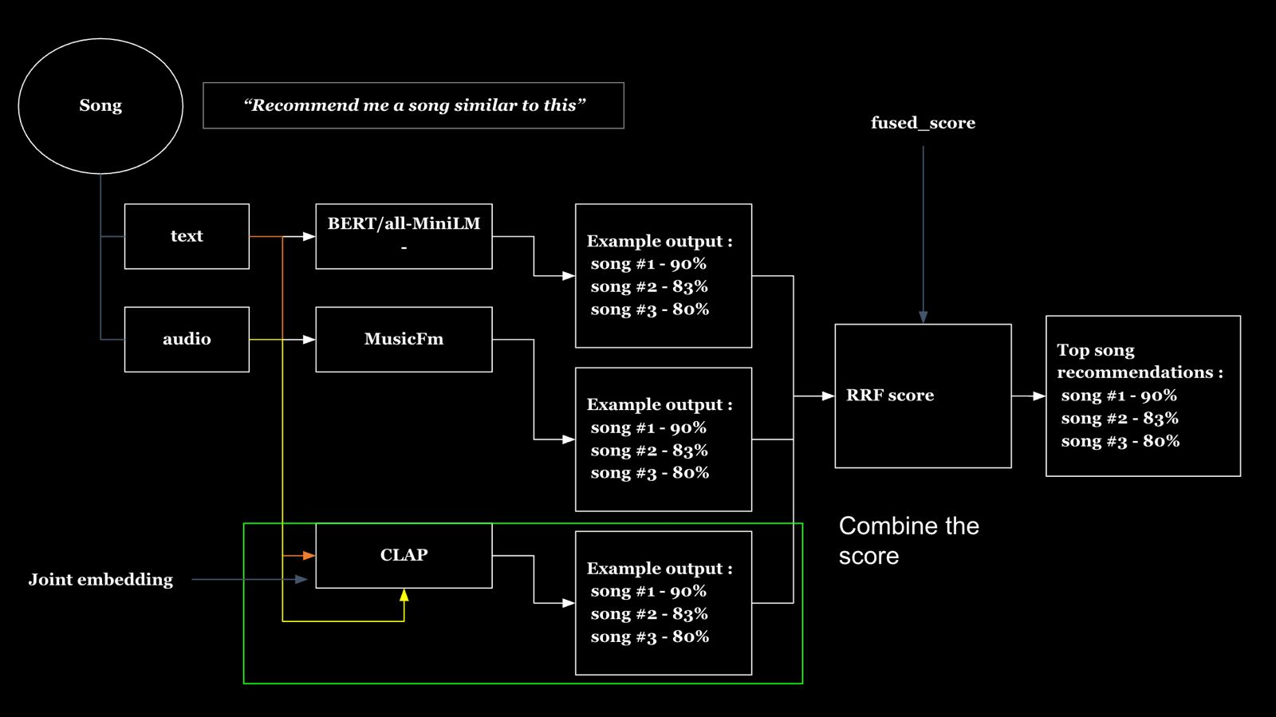
System Architecture
Reference diagram from our design phase

Slide 4
Four Retrieval Views
View 1: Vibe / Text Search
View 2: Lyrics / Semantic
View 3: Acoustic Similarity
View 4: Graph Recommendation
CLAP (HTSAT-tiny)
SBERT (all-MiniLM-L6-v2)
OpenL3
HeteroGNN (SAGEConv)
Dimensions: 512-d
Dimensions: 384-d
Dimensions: 512-d
Dimensions: 256-d
Input: Audio waveform
Input: Metadata + lyrics
Input: Audio waveform
Input: Track-artist-genre graph
High-level semantics: mood, genre feel, instruments
Textual semantics: artist identity, lyrical content
Low-level acoustics: timbre, rhythm, texture
Structural connectivity: co-genre, artist similarity

Slide 5
Dataset: Free Music Archive (FMA)
github.com/mdeff/fma
8,000 tracks across 8 top-level genres (FMA Small subset)
Genres: Electronic, Experimental, Folk, Hip-Hop, Instrumental, International, Pop, Rock
Open-licensed benchmark — freely available for research
Additional data sources:
• FMA metadata: tracks.csv, genres.csv (artist, title, tags, genre labels)
• Genius API: song lyrics (first 1,000 characters per track)
• Echo Nest: 8 continuous audio features (danceability, energy, valence, etc.)
• 294 tracks overlap with Echo Nest — used as independent evaluation ground truth

Slide 6
01
CLAP — Vibe / Text-to-Music Search
Maps both audio and text into a shared 512-d space via contrastive learning

Slide 7
CLAP: Text-to-Music Retrieval
Natural language queries against 7,997 audio embeddings (3 corrupt MP3s skipped)
Query
Top Result
Genre
Cosine Sim
“sad piano ballad”
DUITA — XPURM
Instrumental
0.65
“aggressive heavy metal”
Dead Elements — Angstbreaker
Rock
0.54
“upbeat happy pop song”
One Way Love — Ready for Men
Pop
0.52
“acoustic guitar folk”
Wainiha Valley — Mia Doi Todd
Folk
0.49
Genre Structure in CLAP Embedding Space
• Most similar: Hip-Hop & Pop (0.81 cosine), Folk & International (0.80)
• Most distinct: Rock & Electronic (0.64)
• PCA: 50 components capture ~85% of variance across 512 dimensions

Slide 8
02
SBERT — Lyrics & Semantic Search
Sentence-BERT encodes metadata + lyrics into 384-d embeddings

Slide 9
SBERT: Representation Analysis
Model: all-MiniLM-L6-v2 — 6-layer transformer, 384-d output
Trained on 1B+ sentence pairs (NLI + paraphrase datasets)
PCA Variance: highly distributed representation
• Top component captures only 4.1% of variance
• 181 components needed for 90% (vs. 50 for CLAP’s 512-d space)
• This means SBERT uses its dimensions more uniformly — desirable for retrieval
Representation tests:
• Semantic robustness: only 10% overlap between “lonely” vs “isolated” queries
• Lexical bias: “Blue music” retrieves titles with “Blue”, not Blues genre
• Truncation impact: minimal (FMA metadata strings are typically <50 words)

Slide 10
Data Leakage: Identified & Fixed
A critical methodological issue we caught and resolved
Problem
Fix
Original SBERT input included genre_top directly:
"{artist} - {title}. Tags: {genre}, {tags}"
48.8% of tags fields also contained genre-like
labels (e.g., 'folk', 'pop', 'melodic')
When evaluation uses genre as ground truth,
the model matches on the label itself —
artificially inflating retrieval scores.
1. Removed genre_top from input entirely
2. Filtered all 8 genre words from tags field
(electronic, folk, hip-hop, pop, rock, etc.)
3. Added Genius API lyrics (first 1,000 chars)
as a replacement semantic signal
New format:
"{title} by {artist}. Tags: {filtered}.
Lyrics: {lyrics}"
Genre retained for evaluation only —
never seen by the embedding model.

Slide 11
03
OpenL3 — Acoustic Similarity
Self-supervised audio embeddings capturing timbre, rhythm, and texture

Slide 12
OpenL3: Audio-to-Audio Retrieval
Role 1 — Wenny
Model: OpenL3 (content_type='music', 512-d embeddings)
Trained via self-supervised audio-visual correspondence on AudioSet
Captures low-level acoustic properties without any semantic label supervision
Key difference from CLAP:
• CLAP maps audio into a space shared with text (semantic)
• OpenL3 maps audio into a purely acoustic space
• Two songs that sound similar are close together, even if different genres
Use case: “Find me songs that sound like this one”
Processes all 8,000 tracks, indexed via FAISS for instant nearest-neighbor search

Slide 13
04
GNN — Graph-Based Recommendation
Learning structural relationships between tracks, artists, and genres

Slide 14
Heterogeneous GNN: Structural Embeddings
Role 3 — Archive
2-layer HeteroGNN using SAGEConv on a track-artist-genre graph
Node types: track (8,000), artist (unique IDs), genre (up to 163)
Edge types: track→artist, track→genre, artist→genre, co-genre
Node features:
• Track nodes: CLAP embeddings as initial features
• Artist nodes: mean-pooled track CLAP embeddings
• Genre nodes: one-hot / learnable embeddings
Training: link prediction on hidden track→genre edges
Output: 256-d track embeddings capturing connectivity structure
Includes Flask web demo at localhost:5050 for interactive search

Slide 15
Cross-Modal Comparison: Why Fusion Works
SBERT and OpenL3 retrieve almost entirely different tracks for the same query
5.6%
–0.77
Overlap @ Top-20 Neighbours
Spearman Rank Correlation
Only 1.1 of 20 neighbours shared between text and audio views
Tracks SBERT considers similar, OpenL3 considers dissimilar
Strong complementarity: each modality contributes information the other lacks. This is the core motivation for multi-view fusion — combining these independent signals produces better retrieval than any single view alone.

Slide 16
Fusion: Combining All Views
Role 4 — Jiayi: Evaluation & Multi-View Fusion
Method 1: Weighted Score Fusion
Method 2: Reciprocal Rank Fusion
Method 3: Learned Reranker
fused = w₁·clap + w₂·openl3 + w₃·sbert + w₄·gnn
RRF(d) = Σ 1/(k + rankᵢ(d)) for each view i
Concatenate per-view scores as features for each pair
Normalise all scores to [0,1] Tune weights on validation split
Robust, requires no tuning Uses k=60 (standard constant)
Logistic regression / MLP Train 70% / evaluate 30%

Slide 17
Evaluation: Echo Nest Ground Truth
Independent features no model saw during training (N=294 tracks)
Method
Avg Distance
vs Random
p-value
Random Baseline
3.80
—
—
SBERT (Text+Lyrics)
3.33
-12.4%
1.6e-06
Fused (SBERT+OpenL3)
3.22
-15.1%
1.4e-08
OpenL3 (Audio)
2.87
-24.3%
1.8e-21
Key Takeaways
• OpenL3 wins because both it and Echo Nest operate in the acoustic domain
• Fused embeddings beat either modality alone — confirms complementary signals
• Even SBERT (text only) significantly beats random (p < 10⁻⁶)
• All differences statistically significant (paired t-test)

Slide 18
Fine-tuning CLAP on FMA
Role 5 — Helena
Role 5 — Helena: improve pretrained CLAP with domain-specific contrastive learning
Approach:
• Construct (audio, text) pairs from FMA metadata
• Fine-tune with InfoNCE loss — pull matching pairs together, push others apart
• Batch size 32–64 (more negatives = better contrastive learning)
• 5–15 epochs with early stopping on validation loss
Goal: reduce conflation of similar genres
• Hip-Hop & Pop currently at 0.81 cosine similarity — nearly identical in CLAP space
• Fine-tuning should learn FMA-specific genre boundaries
• Before/after comparison: t-SNE, heatmaps, retrieval quality (P@10, NDCG@10)

Slide 19
Live Demo: Multi-View Recommendation App
localhost:5001 — app.py
Flask web application serving side-by-side recommendations
Features:
• Search any track by title, artist, or genre
• See recommendations from each view independently (SBERT, OpenL3, CLAP)
• Fused results via Reciprocal Rank Fusion across all views
• Per-view cosine similarity scores shown for each recommendation
• Audio playback of original MP3 files
Technical: all embeddings L2-normalised, cosine similarity via dot product
FAISS IndexFlatIP for exact search — <1ms per query at 8,000 vectors

Slide 20
Key Findings
1
Multi-view fusion outperforms any single embedding view
Fused retrieval: -15.1% distance vs random (vs -12.4% for text alone, -24.3% for audio alone)
2
Text and audio embeddings are highly complementary
Only 5.6% overlap in top-20 neighbours; Spearman rho = -0.77
3
Data leakage is a real risk in retrieval evaluation
48.8% of tags contained genre labels — caught and removed before evaluation
4
Domain-specific evaluation requires careful ground truth
Echo Nest features provide independent, audio-derived ground truth no model saw during training

Slide 21
Team Contributions
Wenny
OpenL3 embeddings, t-SNE comparison, genre centroid heatmaps
Role 1: Acoustic Similarity
Sid & Issac
SBERT pipeline, data leakage fix, Genius lyrics, representation analysis
Role 2: Lyrics & Semantic
Archive
Heterogeneous GNN, link prediction, Flask web demo
Role 3: Graph Recommendation
Jiayi
IR metrics (P@K, MAP, NDCG), weighted fusion, RRF, learned reranker
Role 4: Evaluation & Fusion
Helena
CLAP fine-tuning, before/after comparison, Echo Nest correlation, failure analysis
Role 5: Fine-tuning

Slide 22
Glossary
Embedding
OpenL3
A fixed-size numerical vector (e.g., 384 or 512 dimensions) representing a track in a continuous space where similar items are close together.
A self-supervised audio embedding model trained on AudioSet. Captures low-level acoustic features (timbre, rhythm, texture) without labels.
FAISS
GNN
Facebook AI Similarity Search — a library for efficient nearest-neighbor search over dense vectors. We use IndexFlatIP (exact inner product).
Graph Neural Network — learns node embeddings by aggregating information from graph neighbours. We use SAGEConv on a heterogeneous track-artist-genre graph.
Cosine Similarity
RRF
The cosine of the angle between two vectors, ranging from -1 to 1. Higher = more similar. Equals the dot product for L2-normalised vectors.
Reciprocal Rank Fusion — combines ranked lists by summing 1/(k + rank) across views. Robust and requires no weight tuning.
Contrastive Learning
Data Leakage
A training strategy where a model learns to map similar pairs close together and dissimilar pairs far apart, typically using InfoNCE loss.
When evaluation targets (e.g., genre labels) leak into model inputs, artificially inflating metrics. We removed genre from SBERT input strings.
CLAP
t-SNE
Contrastive Language-Audio Pretraining — maps audio and text into a shared embedding space. Captures high-level semantics (mood, genre, instruments).
t-distributed Stochastic Neighbor Embedding — a dimensionality reduction technique for visualising high-dimensional data in 2D.
SBERT
Sentence-BERT — a siamese transformer that produces fixed-size sentence embeddings optimised for semantic similarity. Model: all-MiniLM-L6-v2.

Slide 23
Datasets & References
Datasets
• Free Music Archive (FMA Small)
8,000 tracks, 8 genres, ~30s clips, open-licensed
Defferrard et al., 2017 — github.com/mdeff/fma
• Echo Nest / Spotify Audio Features
Danceability, energy, valence, tempo, acousticness, instrumentalness, liveness, speechiness
294-track overlap with FMA Small used as independent evaluation ground truth
• Genius API
Song lyrics (first 1,000 characters per track)
Used to enrich SBERT text embeddings after removing genre labels
• AudioSet
Training data for OpenL3 (self-supervised audio-visual correspondence)
Gemmeke et al., 2017 — research.google.com/audioset
Models & Libraries
• CLAP (LAION): HTSAT-tiny backbone, pretrained on AudioSet + music | laion/clap
• SBERT: all-MiniLM-L6-v2, 384-d | sentence-transformers
• OpenL3: self-supervised audio embeddings | marl/openl3
• PyTorch Geometric: heterogeneous GNN (SAGEConv) | pyg-team/pytorch_geometric
• FAISS: Facebook AI Similarity Search | facebookresearch/faiss

Slide 24
Thank You
Questions?
Demo available at localhost:5001 | Source code on GitHub

