Slide 1

XML
201935062 서용준
201935066 송윤수
201832630 심양관
201731456 염석천

Slide 2

CONTENTS
001
What is XML? What for?
XML syntax rules
002
What are Document Type Definition (DTD)? What for?
DTD syntax rules
003
What is XML Schema Definition (XSD)?
XSD syntax rules
004
Describe recent trend

Slide 3
Part 1.
XML Introduction
XML Introduction

Slide 4
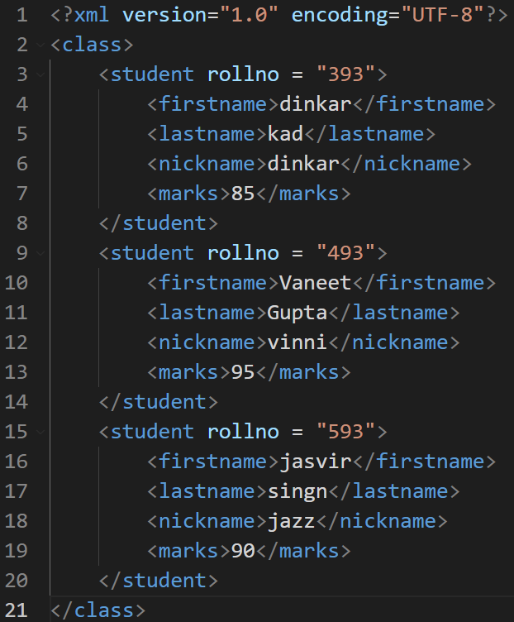
XML structure
XML (eXtensible Markup Language)
- Store and transmit data
- Markup Language
- similar to HTML
Charestic of XML
-
-
-
Notes:
1. What is XML(eXtensible Markup Language)?
- Markup language for storing and transmitting data
- Markup language : format of document using tags
- apparently similar to HTML
2. Characteristic
- Well-formed : predictable data format with text
=> can be read without relying on other things
- not for displaying data to user, for storing and transmitting data
- consists of text data format, Unicode characters only.

Slide 5
XML structure
class
student(393)
student(493)
firstname
lastname
nickname
marks
firstname
lastname
nickname
marks
dinkar
kad
dinkar
85
Vaneet
Gupta
vinni
95
Notes:
1. What is XML(eXtensible Markup Language)?
- Markup language for storing and transmitting data
- Markup language : format of document using tags
- apparently similar to HTML
2. Characteristic
- Well-formed : predictable data format with text
=> can be read without relying on other things
- not for displaying data to user, for storing and transmitting data
- consists of text data format, Unicode characters only.

Slide 6
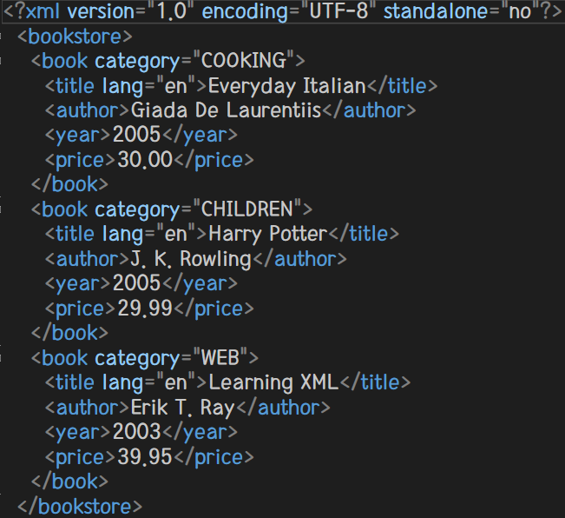
XML document structure
XML Prolog
Top-level tag
XML Prolog
-
-
-
Top-level tag
-
-
-
Notes:
A) XML Prolog
- uses the <xml> tag on the first line to indicate an XML document
- version : essential tag.
“1.0” means used XML version in this document
- encoding : Information about the language code to use.
- default : UTF-8
- standalone : tag about whether operating independently without external document
- default : yes
B) Top-level tag
- also called root element, document element
- There is only one top-level tag in a xml document.
- All other tags are in the top-level tag.

Slide 7
XML element vs attributes
XML element
-
-
-
-
XML attributes
-
-
-
-
Notes:
C) XML element
- element is a pair of start tag and end tag.
- case-sensitive
- If element has no datum, can be shown <tagname />
* naming rule of tag
- The first letter can be only be letter or _, not number.
- Space can not be the letter of name.
- Reserved word not available.
D) XML attribute
- Expressing information within a tag.
- Attribute can be an empty string, but must have value.
- Duplicate attribute in one element is not allowed.
- Attribute value is enclosed in quotes.
E) attribute vs elements
- Element can have child element.(attribute can’t)
- Attribute is not included in the xml tree.
=> Difficult to use for various purposes.
- Attribute is recommended only if the data is element-dependent.

Slide 8
Part 2.
XML parser
XML parser

Slide 9
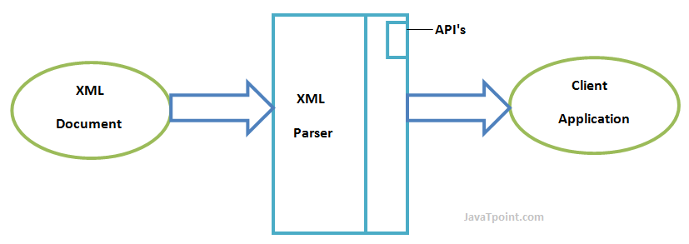
XML parser
Notes:
응용 프로그램이 xml 문서를 읽을 수 있도록 인터페이스를 제공해주는 라이브러리나 패키지

Slide 10
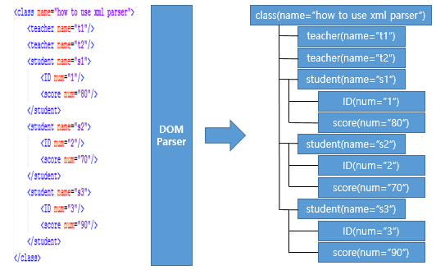
XML parser
DOM parser
(Document Object Model)
Load all contents of xml into memory
pros : Search, modification, and restructuring are quick and easy.
cons : Requires huge memory.

Slide 11
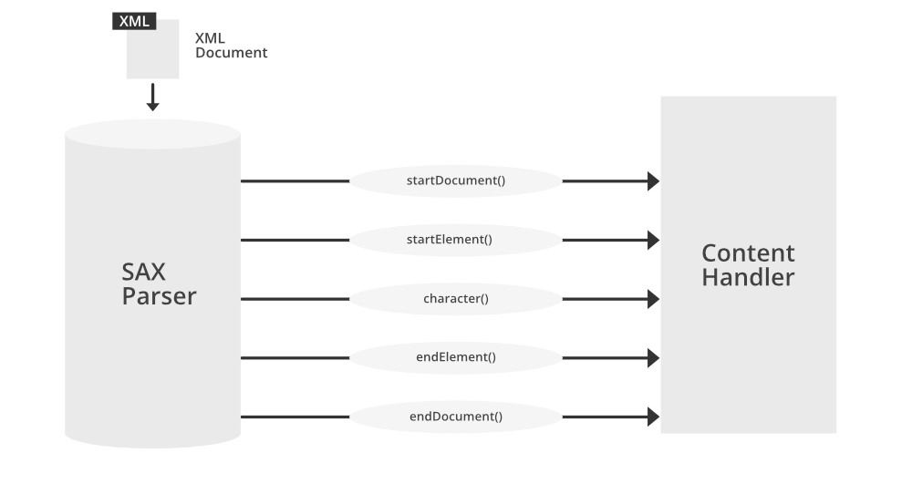
XML parser
SAX parser
(Simple Api for Xml)
Read the xml document sequentially.
Make event when opening and closing the tag.
Handle events and store and utilize them in variables.
pros : Low memory usage. Reading speed is fast.
cons : Complicated and difficult to modify the content. Structural changes are impossible.

Slide 12
Part 3.
DTD
DTD

Slide 13
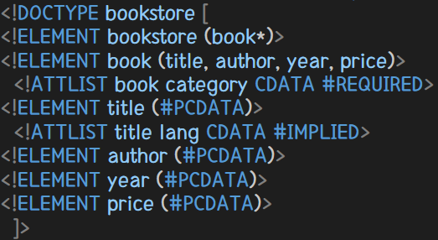
DTD (Document Type Definition)
Language to define the structure of an XML document.
Typed between the XML tag and the root element.
Initialize Internal DTD : <!DOCTYPE root [DTD content]>
Initialize External DTD : <!DOCTYPE root SYSTEM or PUBLIC “DTD_file”>
SYSTEM : URI
PUBLIC : DTD reference of name registered in ISO

Slide 14
Part 4.
XSD
XSD

Slide 15
DTD (Document Type Definition)
Language to define the structure of an XML document.
Typed between the XML tag and the root element.
Initialize Internal DTD : <!DOCTYPE root [DTD content]>
Initialize External DTD : <!DOCTYPE root SYSTEM or PUBLIC “DTD_file”>
SYSTEM : URI
PUBLIC : DTD reference of name registered in ISO

Slide 16
Part 5.
Recent Trend of XML
Recent Trend of XML

Slide 17
DTD (Document Type Definition)
Language to define the structure of an XML document.
Typed between the XML tag and the root element.
Initialize Internal DTD : <!DOCTYPE root [DTD content]>
Initialize External DTD : <!DOCTYPE root SYSTEM or PUBLIC “DTD_file”>
SYSTEM : URI
PUBLIC : DTD reference of name registered in ISO

Slide 18
Part 6.
Reference
& Reference

Slide 19
DTD (Document Type Definition)
Language to define the structure of an XML document.
Typed between the XML tag and the root element.
Initialize Internal DTD : <!DOCTYPE root [DTD content]>
Initialize External DTD : <!DOCTYPE root SYSTEM or PUBLIC “DTD_file”>
SYSTEM : URI
PUBLIC : DTD reference of name registered in ISO

