Slide 1


Python EDA Project

Slide 2











SMS Notification
◻ X
Advertising
Newsletter
Website
Customer
Sales Rise
Order Product
Ecosystem

Slide 3


Target Audience Persona
Needs
Current Market Trend by Product
Spotlight leading products and brands with majority market share
Identify Most active and valuable customers
Over 15+ years exp in Merchant Relationship Management
Julie
Managing Director,
Department of Merchant Management,
Amazon India

Slide 4




Agenda
Background
EDA
Summary
Future Work

Slide 5

Background
This Amazon Indian Sales data is sourced from Kaggle as
https://www.kaggle.com/datasets/karkavelrajaj/amazon-sales-dataset
Amazon.com.Inc was founded at Seattle, in July 1994 by Jeff Bezos. Claimed as the largest E-commerce platform in 2023, it started as an online bookstore initially and further expanded to many product lines including movies, music, apparel, baby products, consumer electronics, etc.

Slide 6
Background
Main sources of revenue:
Promotional fee paid by Merchants, Private-label products, and Third-party sellers to facilitate the priority of Search Engine results
Prime Membership Subscription
Commission fee through the Affiliate program

Slide 7







Background
Fiscal Year 2022 Market Share Contributors
$30B
(5.8%)
$356.11B
(69.3%)
UK
USA
Egypt
India
$8.6B
(1.67%)
$2.62B
(0.51%)
$2.63B
(0.51%)
Brazil
$33.5B
(6.26%)
Australia
Source: https://fourweekmba.com/amazon-revenue-by-country/

Slide 8



Background
2007
2013
Amazon India was established with 31.2% contribution to Indian Market Size in F2022
Flipkart was founded and headquartered in Bengaluru, which accounted for 31.9% Indian e-commerce market

Slide 9





Explanatory Data Analysis
Product Information
Product ID
About Product
Customer Information
Customer ID
Customer Name
Customer Review
Review Rating
Review Content

Slide 10
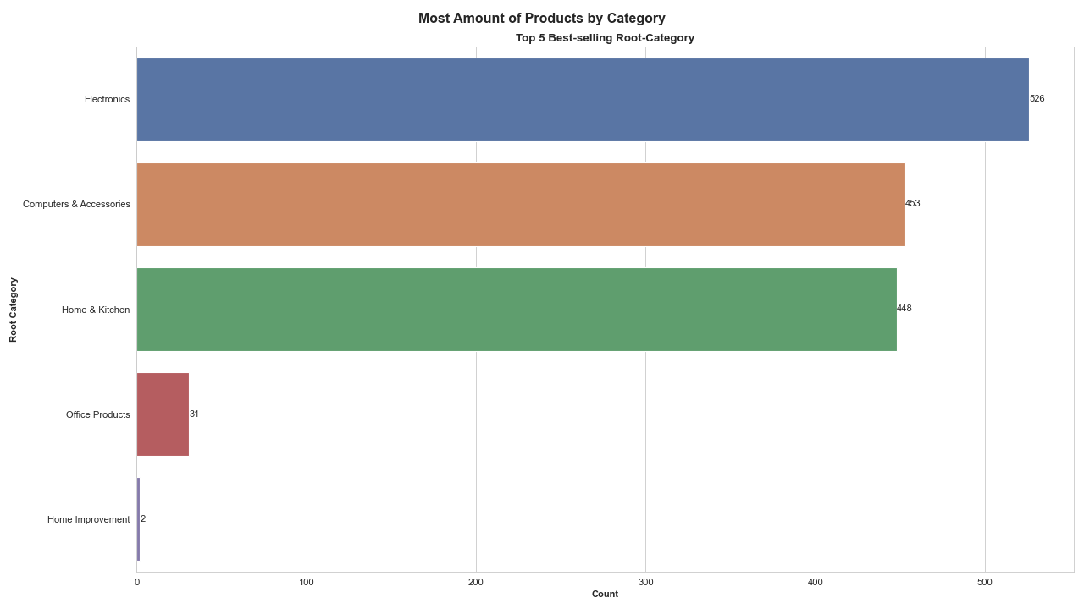

Explanatory Data Analysis
Electronics outperformed than its counterparts
with 526 sales, which accounts for 35.9% of totals sales;

Slide 11
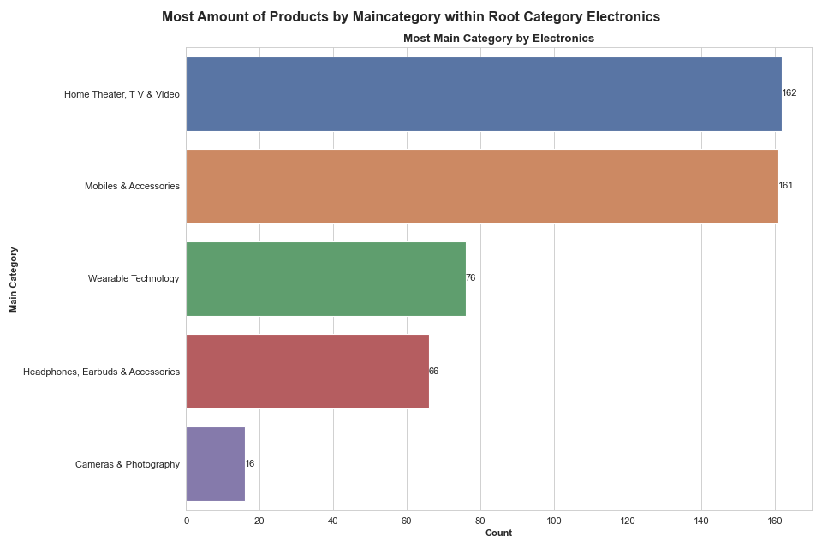
Explanatory Data Analysis
Both Home Theater, TV & Video and Mobiles & Accessories outnumbered remaining subcategories significantly, accounting for almost 1/3 sales respectively, within the group.

Slide 12
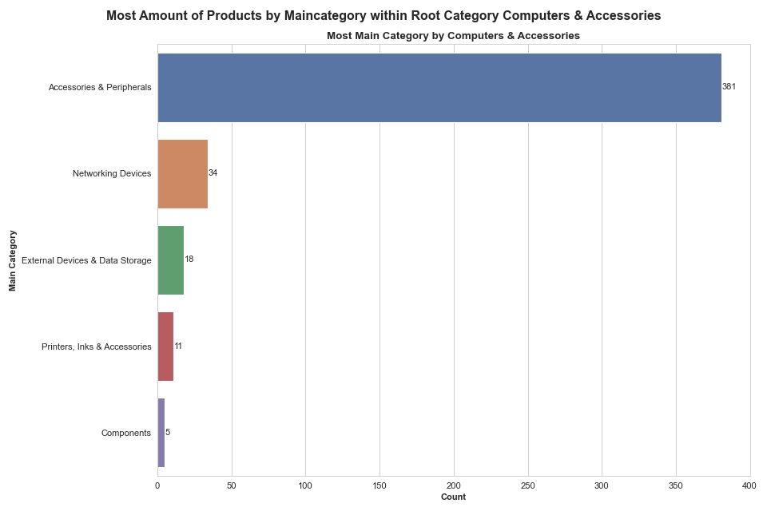
Explanatory Data Analysis
As shown aside, although Networking Devices being the second best-selling subcategory within Computer & Accessories Category, Accessories & Peripherals dominated with over 80% contribution within group.

Slide 13
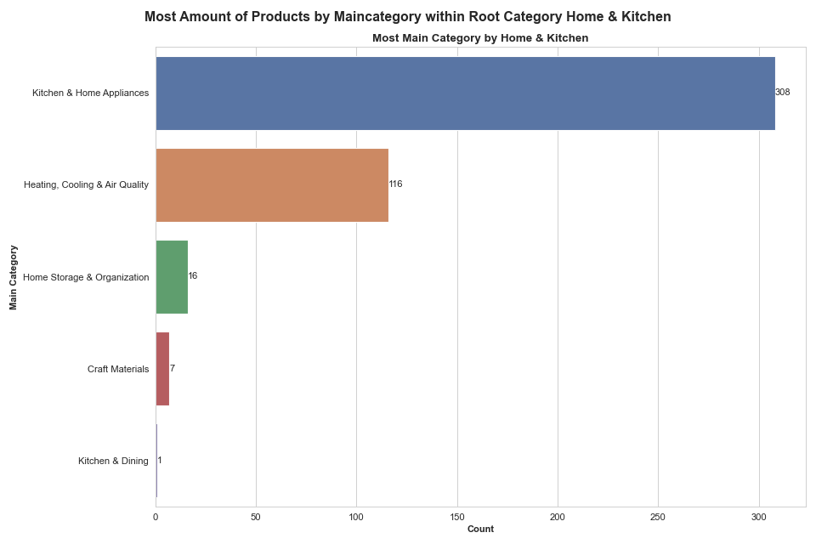
Explanatory Data Analysis
Kitchen & Home Appliances was the most -trendy subcategory within Home & Kitchen universe, which drove nearly 75% of the sales.

Slide 14
Explanatory Data Analysis
Bottom
Category
Sub-subcategory
Sub-category
Main Category
Top
Root Category

Slide 15
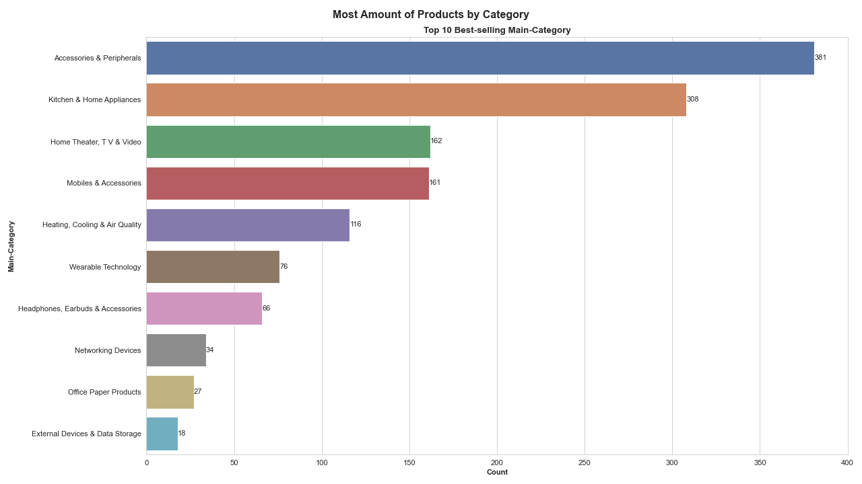
Explanatory Data Analysis
Accessories & Peripherals
Kitchen & Home Appliances
Home Theater, TV & Video
They each contributed 26%, 21%,
and 11%, respectively.
Not surprisingly, they inherited
Top-selling feature from the parent
Hierarchy, Root Category

Slide 16
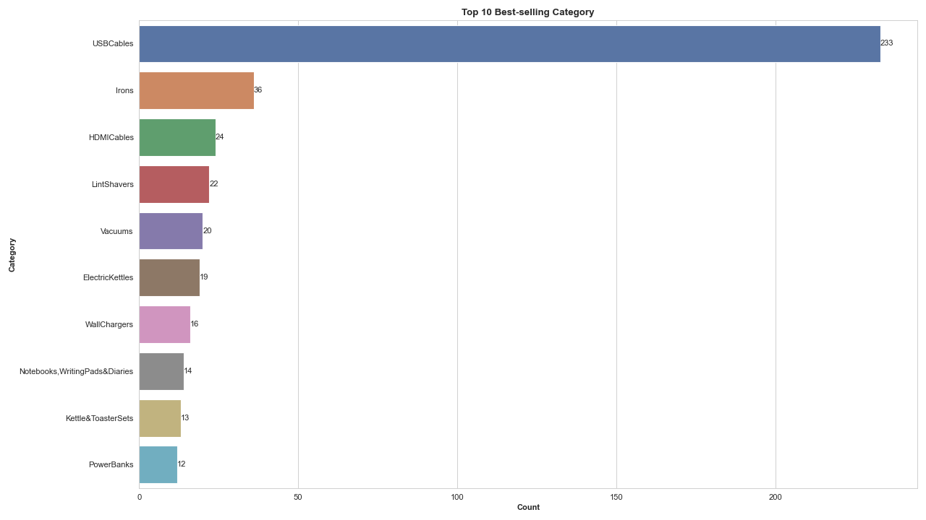
Explanatory Data Analysis
USB Cables >>> Computer & Accessories
Irons >>> Home & Kitchen Appliances
HDMI Cables >>> Electronics
They each contributed 16%, 2.5%,
and 1.6%, respectively.
Not surprisingly, they inherited
Top-selling feature from the parent
Hierarchy, Root Category

Slide 17
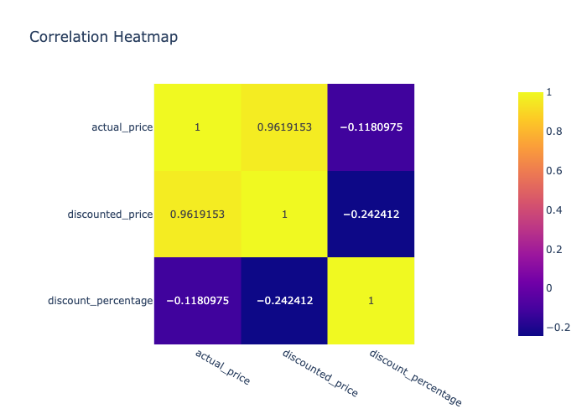


Explanatory Data Analysis

Slide 18
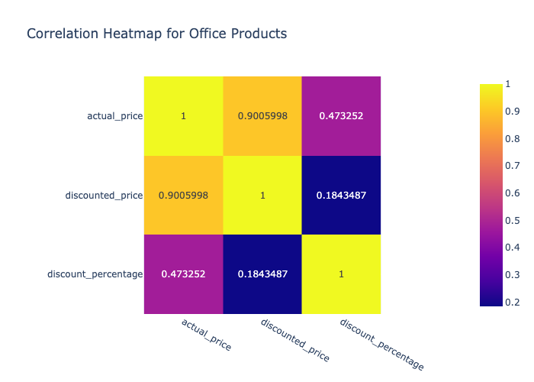

Explanatory Data Analysis
Top-selling Root Categories witnessed
a strong positive correlation above 0.9
between
Actual Price
&
% OFF
Discounted Price
Computer & Accessories Root Category stood out with the most magnitude of correlation being 0.97

Slide 19
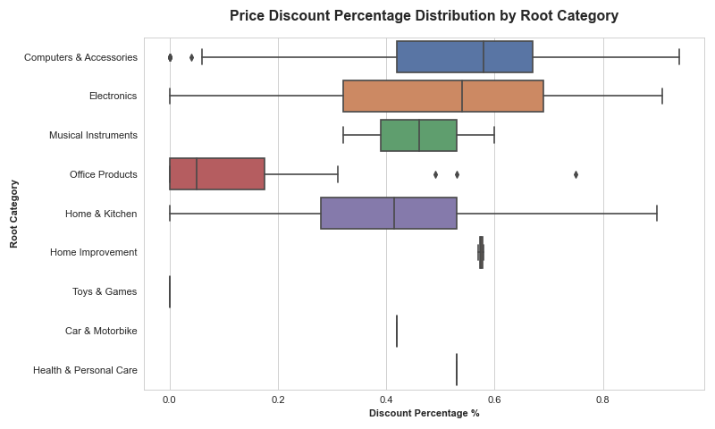
Explanatory Data Analysis
Computer & Accessories and Electronics show slight left-skewness with median discount price percentage around 60%
Home & Kitchen witnessed approximately normal distribution with median being around 40%

Slide 20
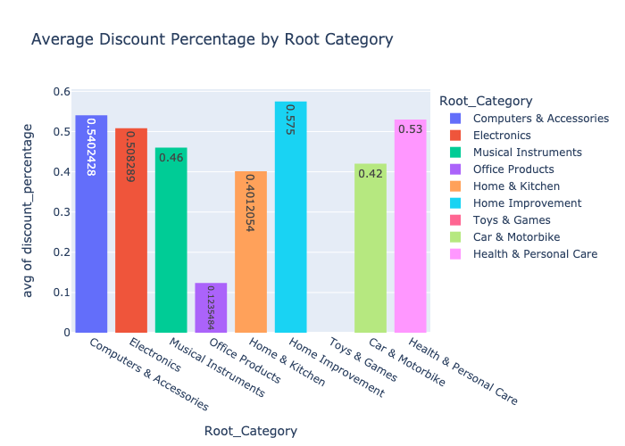
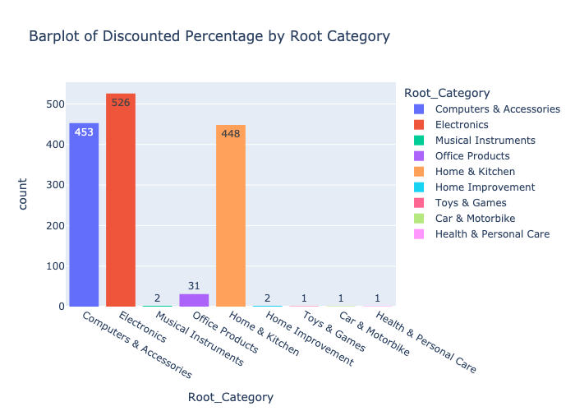
Explanatory Data Analysis
Home Improvement offered highest promotion on average at 57.5% yet with few product applicable
Electronics followed by Computer & Accessories outnumbered in discounted products at 50% off on average

Slide 21




Explanatory Data Analysis
PVC
Nylon (Braided)
TPE,aka Thermaplastic Elastomer
Type C
Non-Type C
Apple
Android
Available
NA
Port Type
Device
Material
Warranty

Slide 22
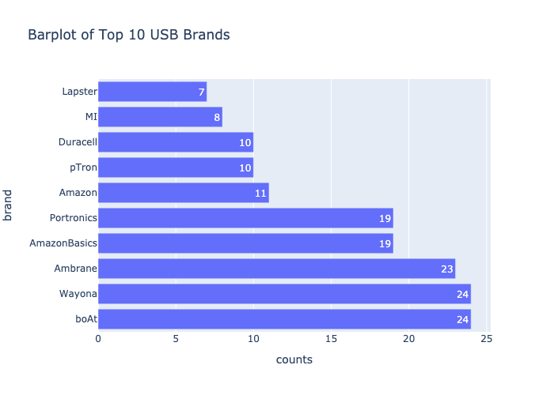
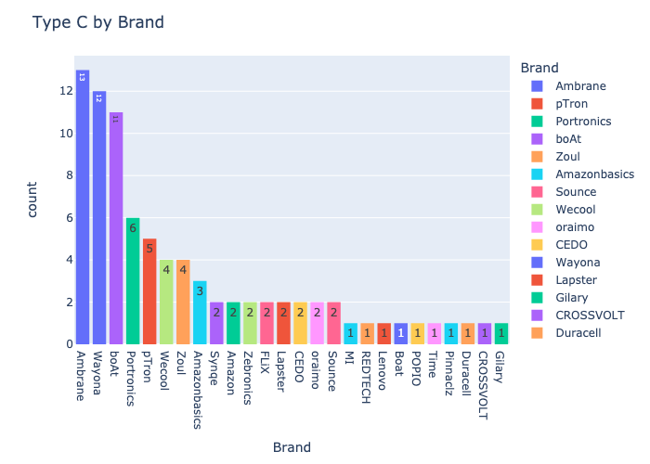
Explanatory Data Analysis
boat, Wayona, and Ambrane as leading brands accounted for almost 30% of the market share
Over 15% of Type C port USB Cables were from these Indian Native brands

Slide 23
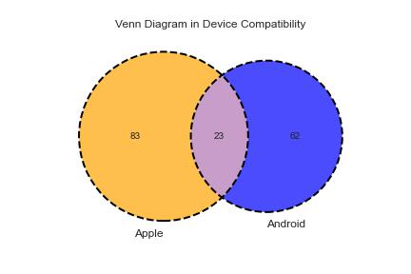
Explanatory Data Analysis
111 USB Cables are neither compatible with Apple nor Android products

Slide 24
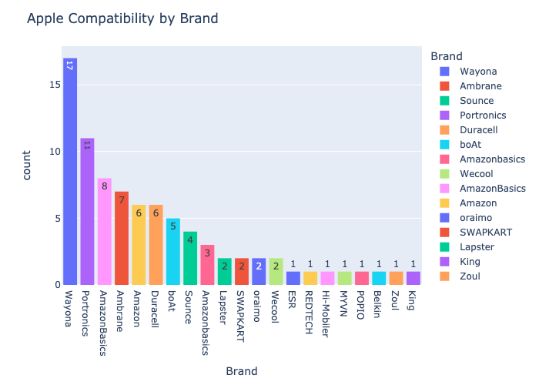
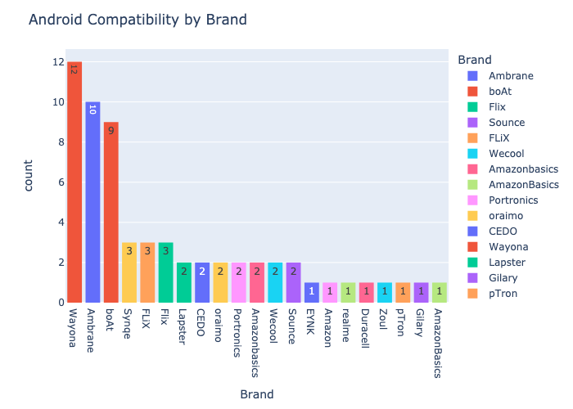
Explanatory Data Analysis
Wayona, Ambrane, boAt, and Portonics were more favorable by customers for more options compatible with Apple/Android devices

Slide 25
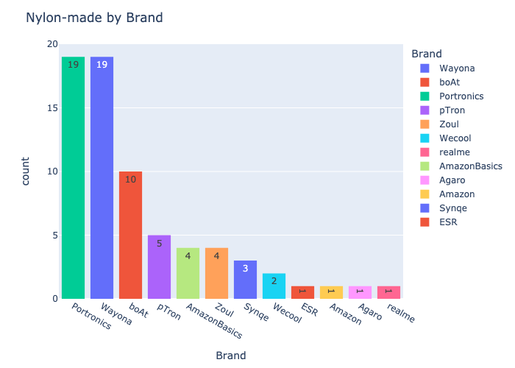
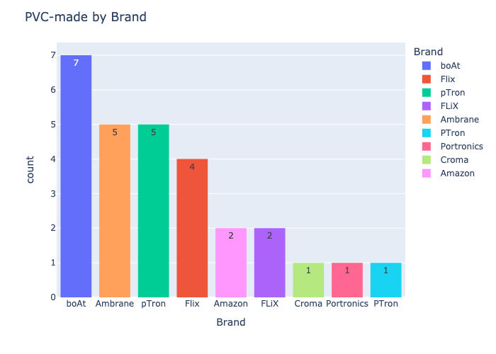
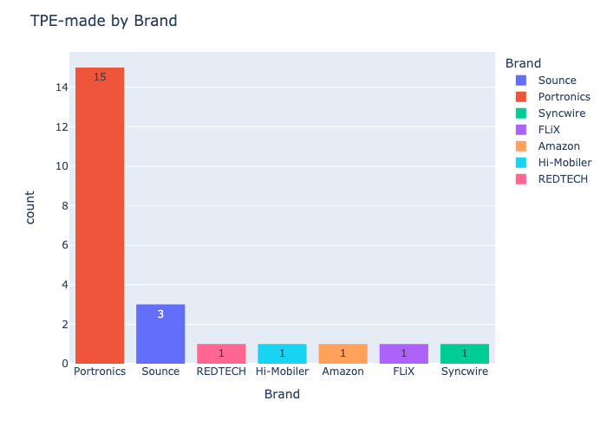
Explanatory Data Analysis
Portronic and Wayona dominated the Nylon genre while boAt was slightly advantageous in PVC segment

Slide 26
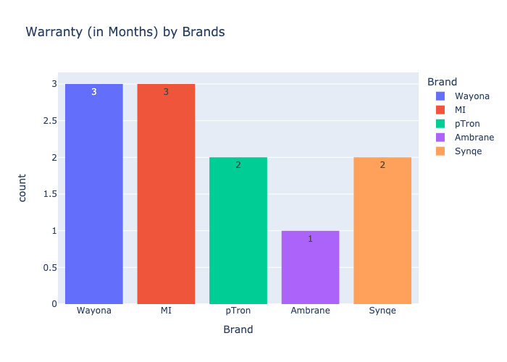
Explanatory Data Analysis
Only 11 out of 233 USB Cable transactions claimed warranty information

Slide 27
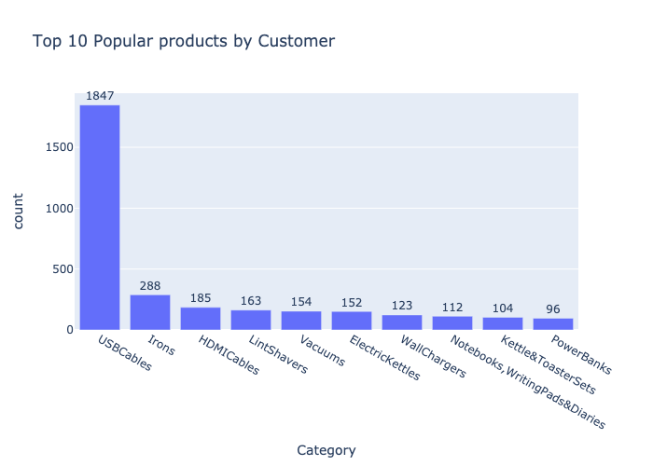
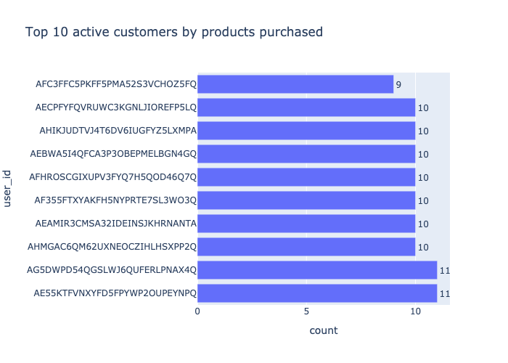
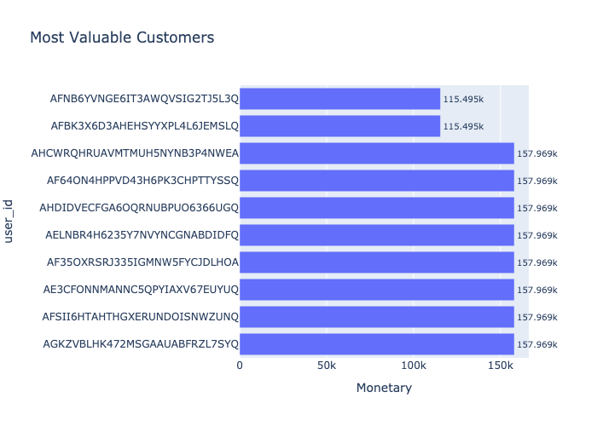
Explanatory Data Analysis
String manipulation and Dataframe explode were implemented to retrieve unique Customer ID
Popularity over USB Cables, Irons, and HDMI Cables was aligned with Product perspective
Most Valuable Customers placed orders on Electronics

Slide 28
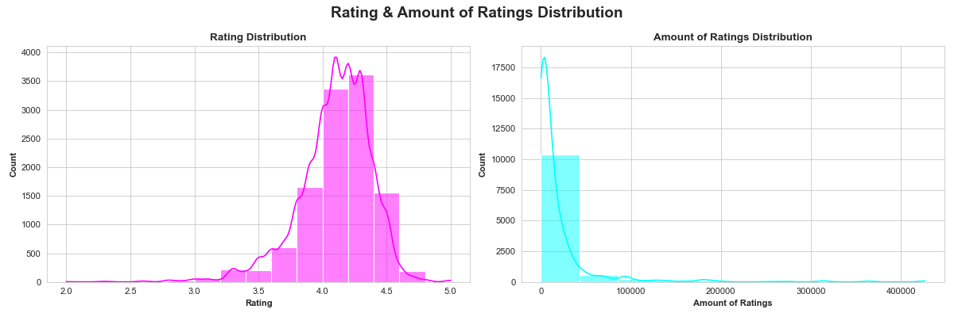
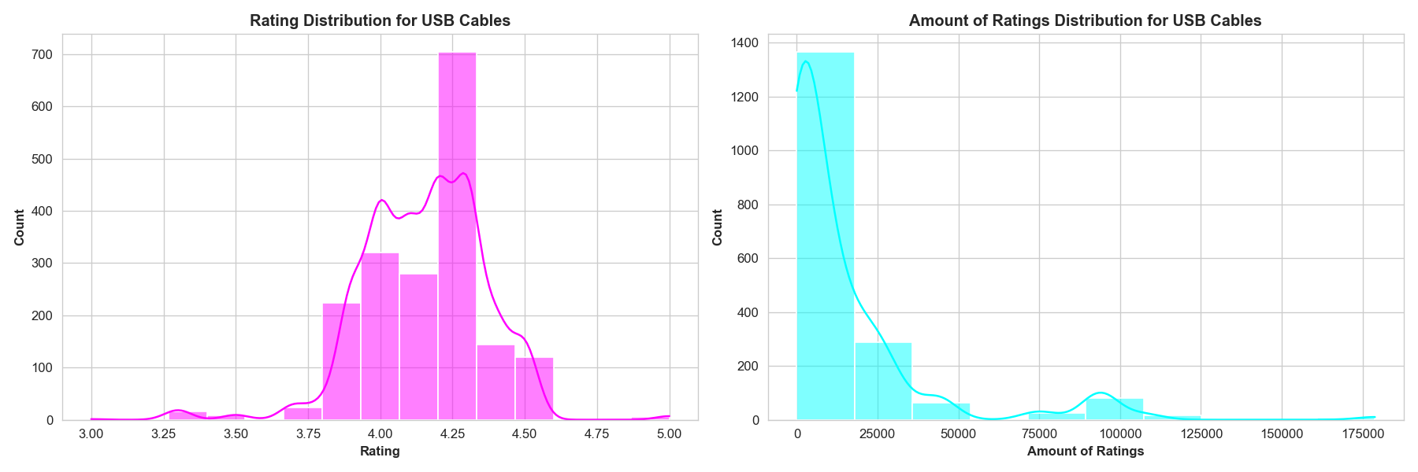
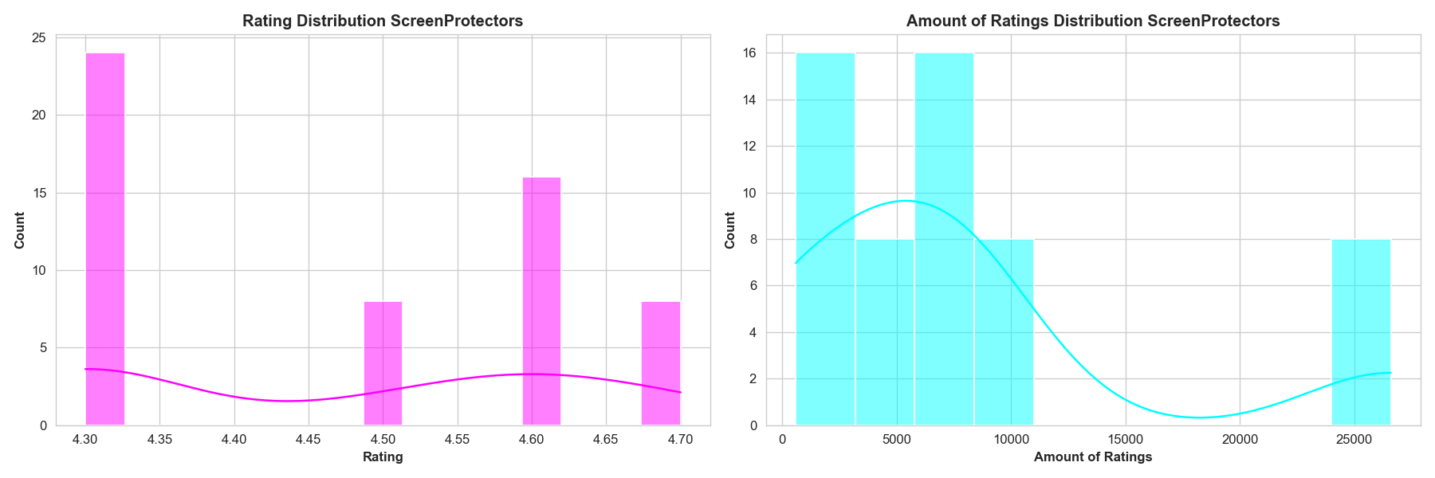
Explanatory Data Analysis
The rating distribution for USB Cables approximates that of Overall rating, which was slightly left-skewed.

Slide 29

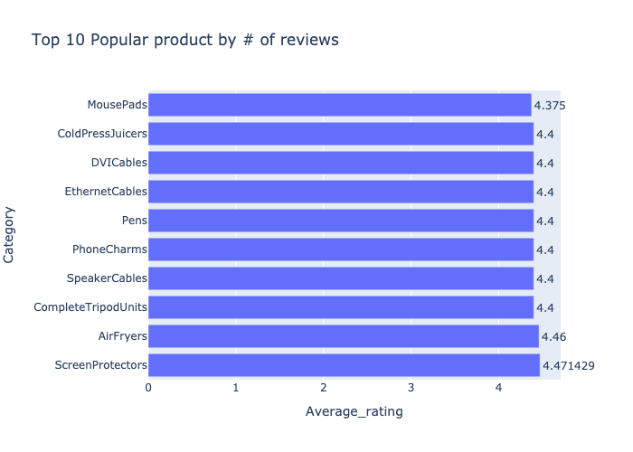
Explanatory Data Analysis
Surprisingly!! The product with the highest rating on average was Screen Protector rather than USB with mean rating being 4.47.

Slide 30




Summary
USB Cables of compatibility with Apple/Android devices, Type-C port were most popular
This dimension data entails 1465 records * 16 attributes
Most active customers placed orders on more than 9 items, majority of which were USB Cables
Most rated product was USB Cables while the product with highest rating on average was Screen Protector

Slide 31





Future WORK
ITEM 1
ITEM 3
ITEM 2
Adopt the conceptualization of Etsy to facilitate hand craftsmanship against operational risk from ONDC
Strengthen relationship with Electronics and Computer Accessories merchants
Proactively sourcing Bio-engineered materials such as Nylon to promote environmental-friendly ecosystem

Slide 32

NEW!
SPECIAL OFFER
70% OFF
OPEN

