Slide 1

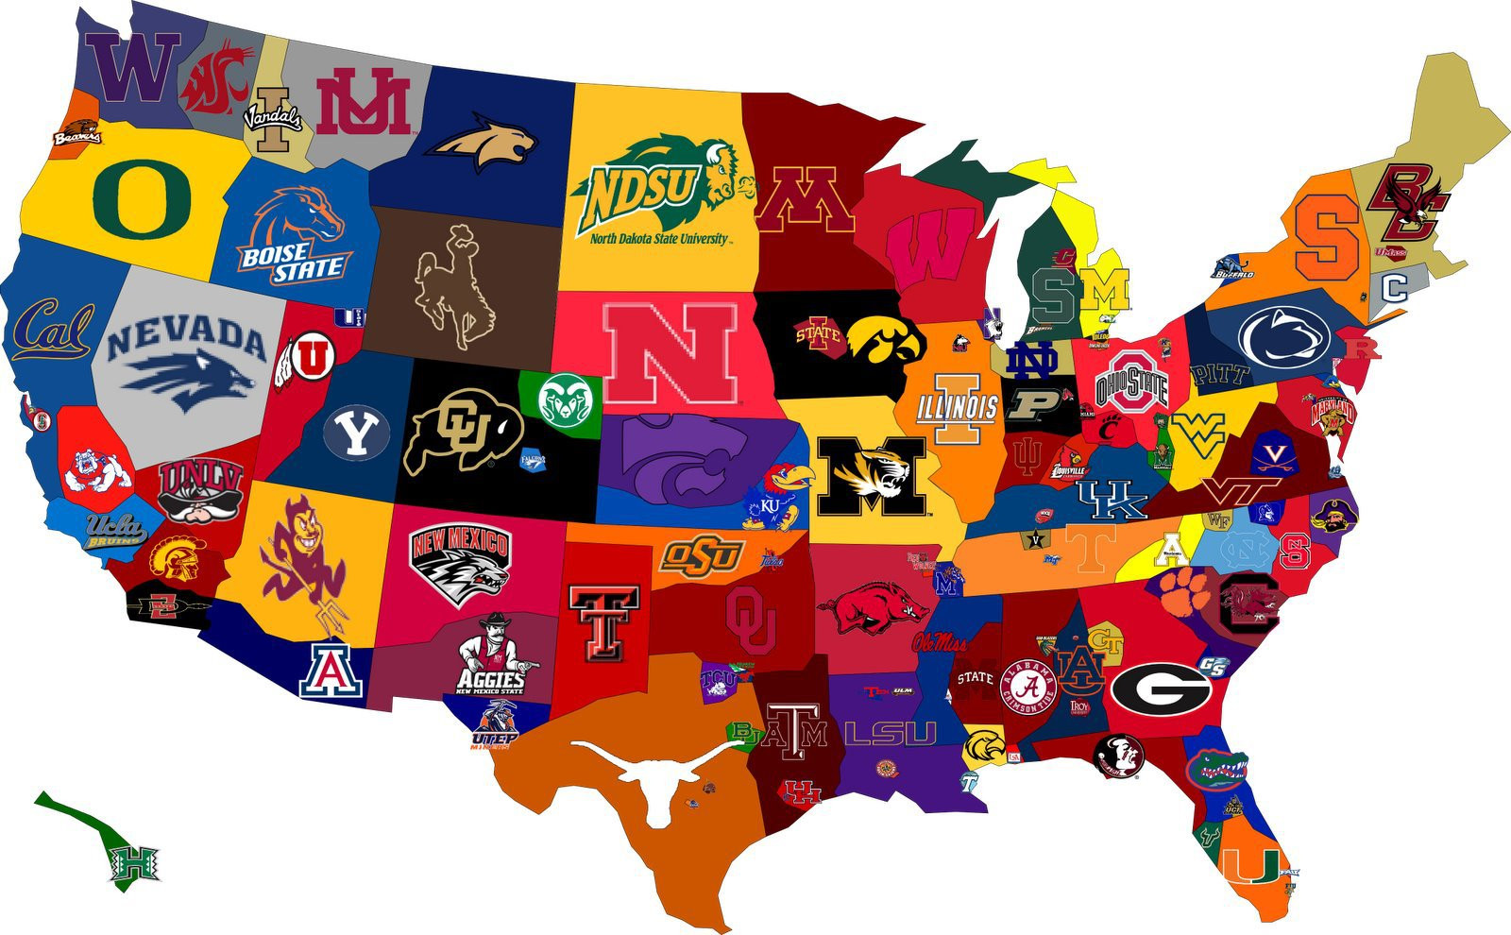

Completion Rate of US Colleges in 2013
Jacob Patenaude

Slide 2
Variables of Interest
SELECT
INSTNM Name,
CONTROL Type,
TUITIONFEE_OUT Tuition,
UGDS NumStudents,
(DISTANCEONLY == \"Distance-education only\") IsDistance,
PPTUG_EF PartTimeProportion,
PCTFLOAN FederalLoanProportion,
DEBT_MDN MedianDebt,
GRAD_DEBT_MDN MedianDebt_Graduated,
WDRAW_DEBT_MDN MedianDebt_Withdrew,
LO_INC_DEBT_MDN MedianDebt_LowIncome,
MD_INC_DEBT_MDN MedianDebt_MedIncome,
HI_INC_DEBT_MDN MedianDebt_HighIncome,
DEP_DEBT_MDN MedianDebt_Dependent,
IND_DEBT_MDN MedianDebt_Independent,
C200_4_POOLED_SUPP CompletionRate,
ACTCM25 CumulativeACT_25,
ACTCM75 CumulativeACT_75
FROM Scorecard
WHERE Tuition > 0
AND Year = 2013
AND MedianDebt > 0
AND NumStudents > 0
AND NumStudents < 100000
AND PartTimeProportion IS NOT NULL
AND FederalLoanProportion IS NOT NULL
AND CAST(CompletionRate AS decimal) > 0.01
AND CURROPER=\"Currently certified as operating\""
Completion Rate
Median Debt
College Type
Tuition
Number of Students
Distance Education Status
Part Time Proportion
Federal Loan Proportion
ACT Scores

Slide 3
Chosen Response Variable:
Completion Rate

Slide 4
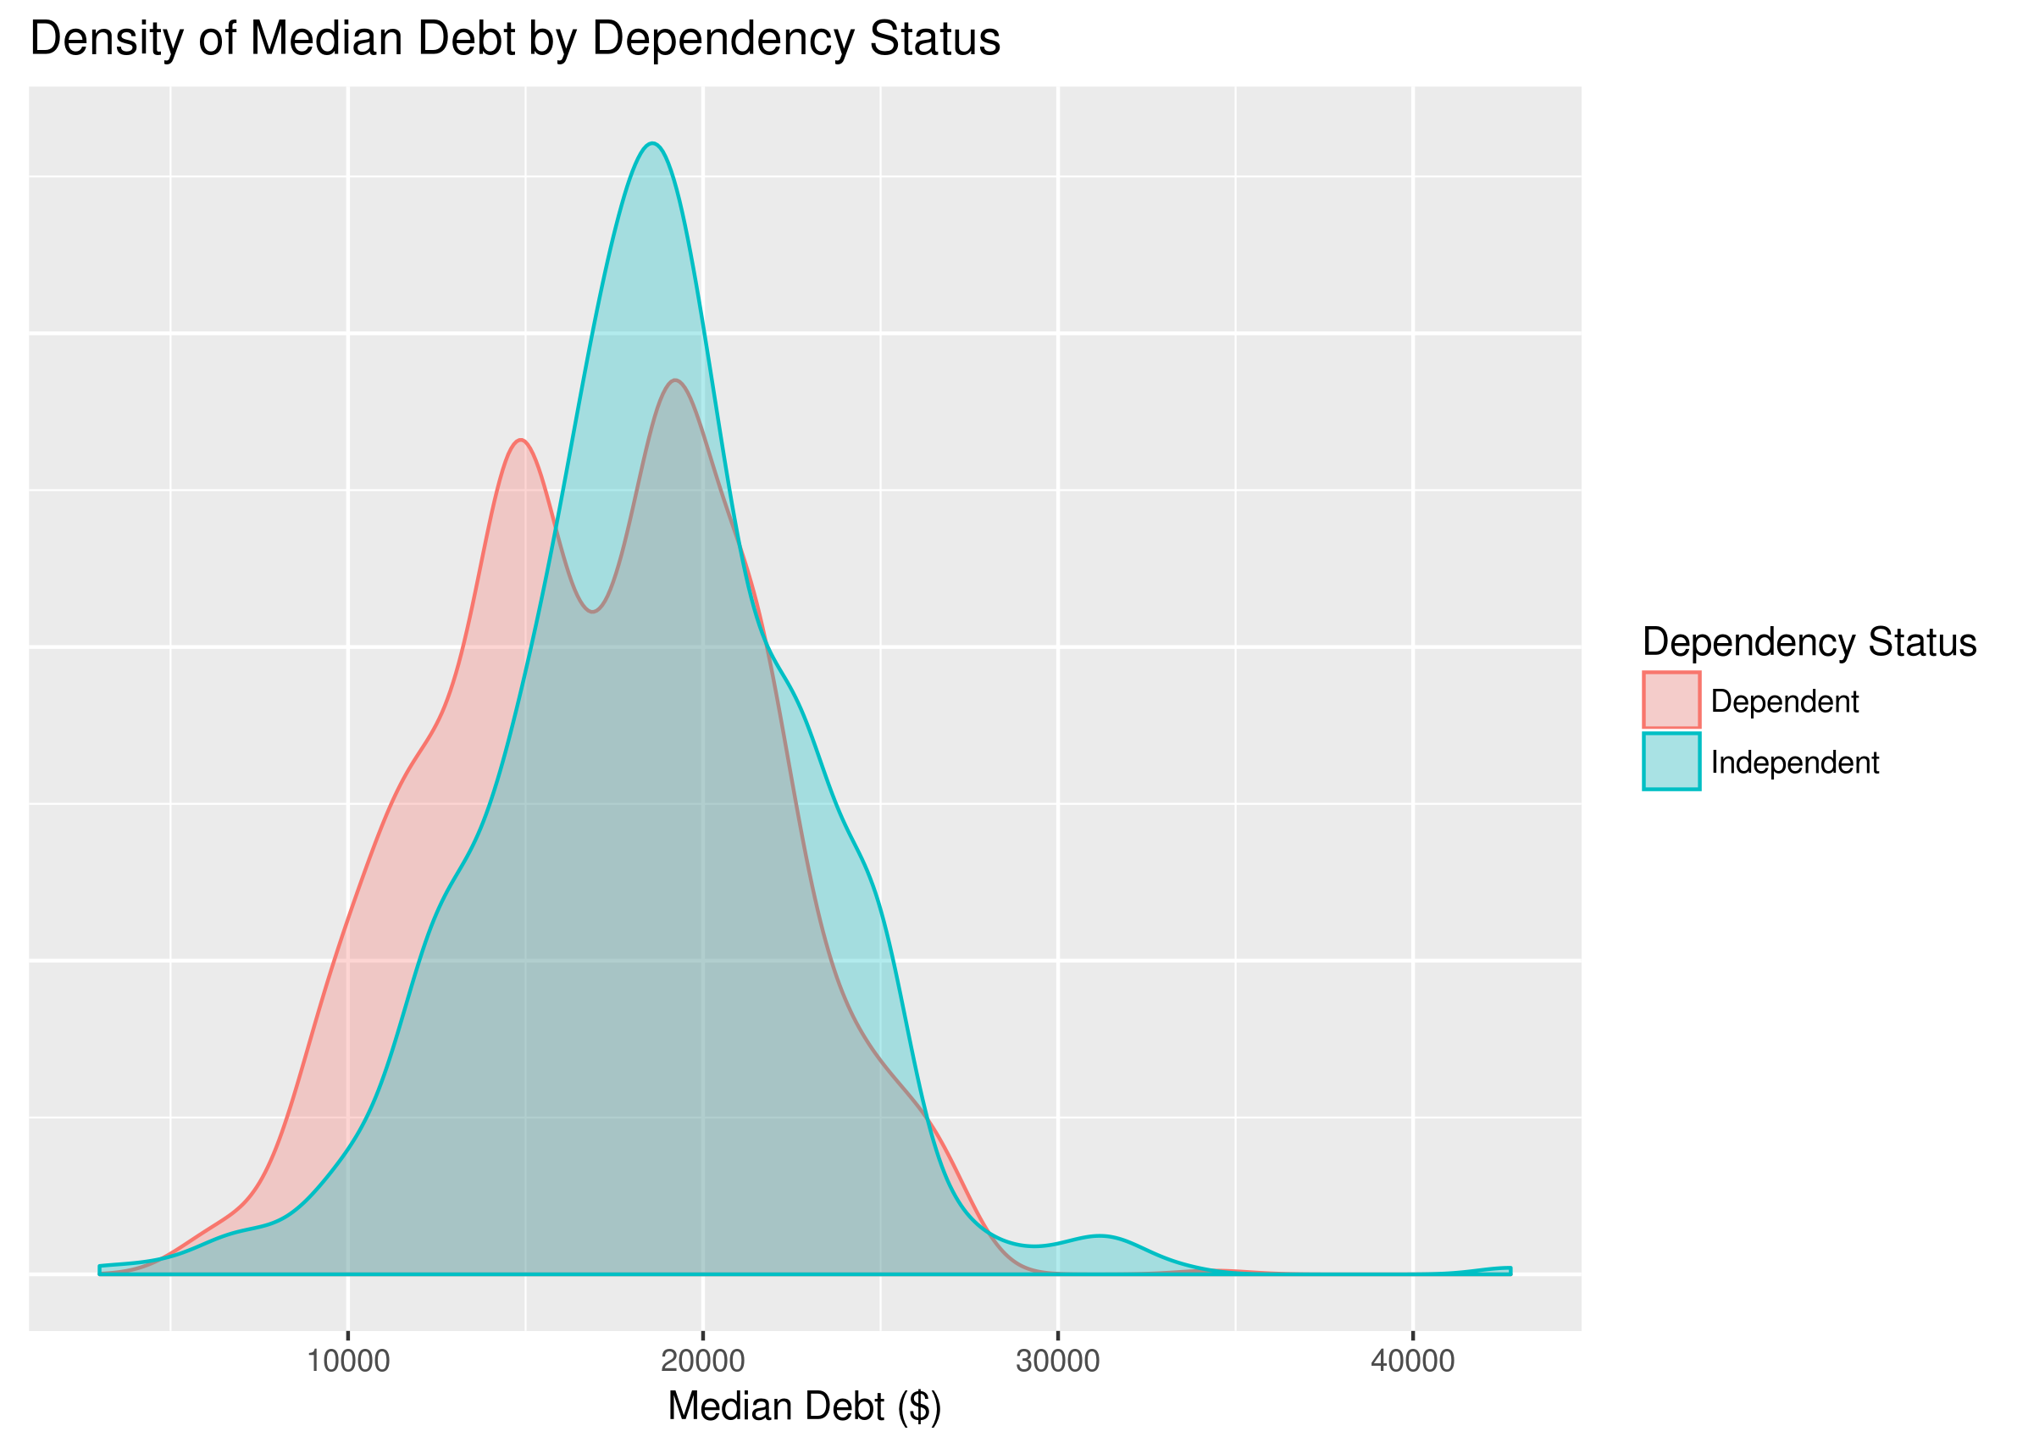
Data Exploration: Median Debt

Slide 5
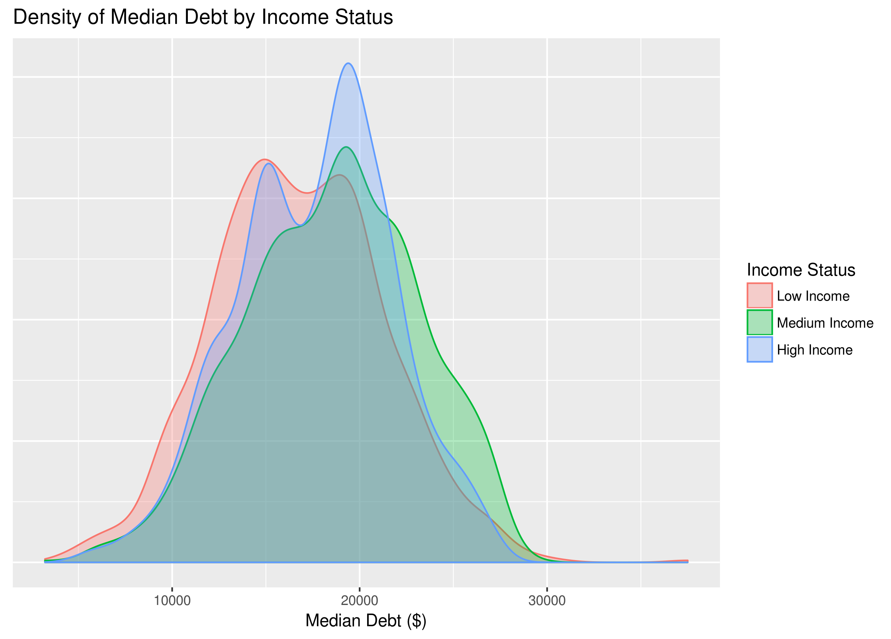
Data Exploration: Median Debt

Slide 6
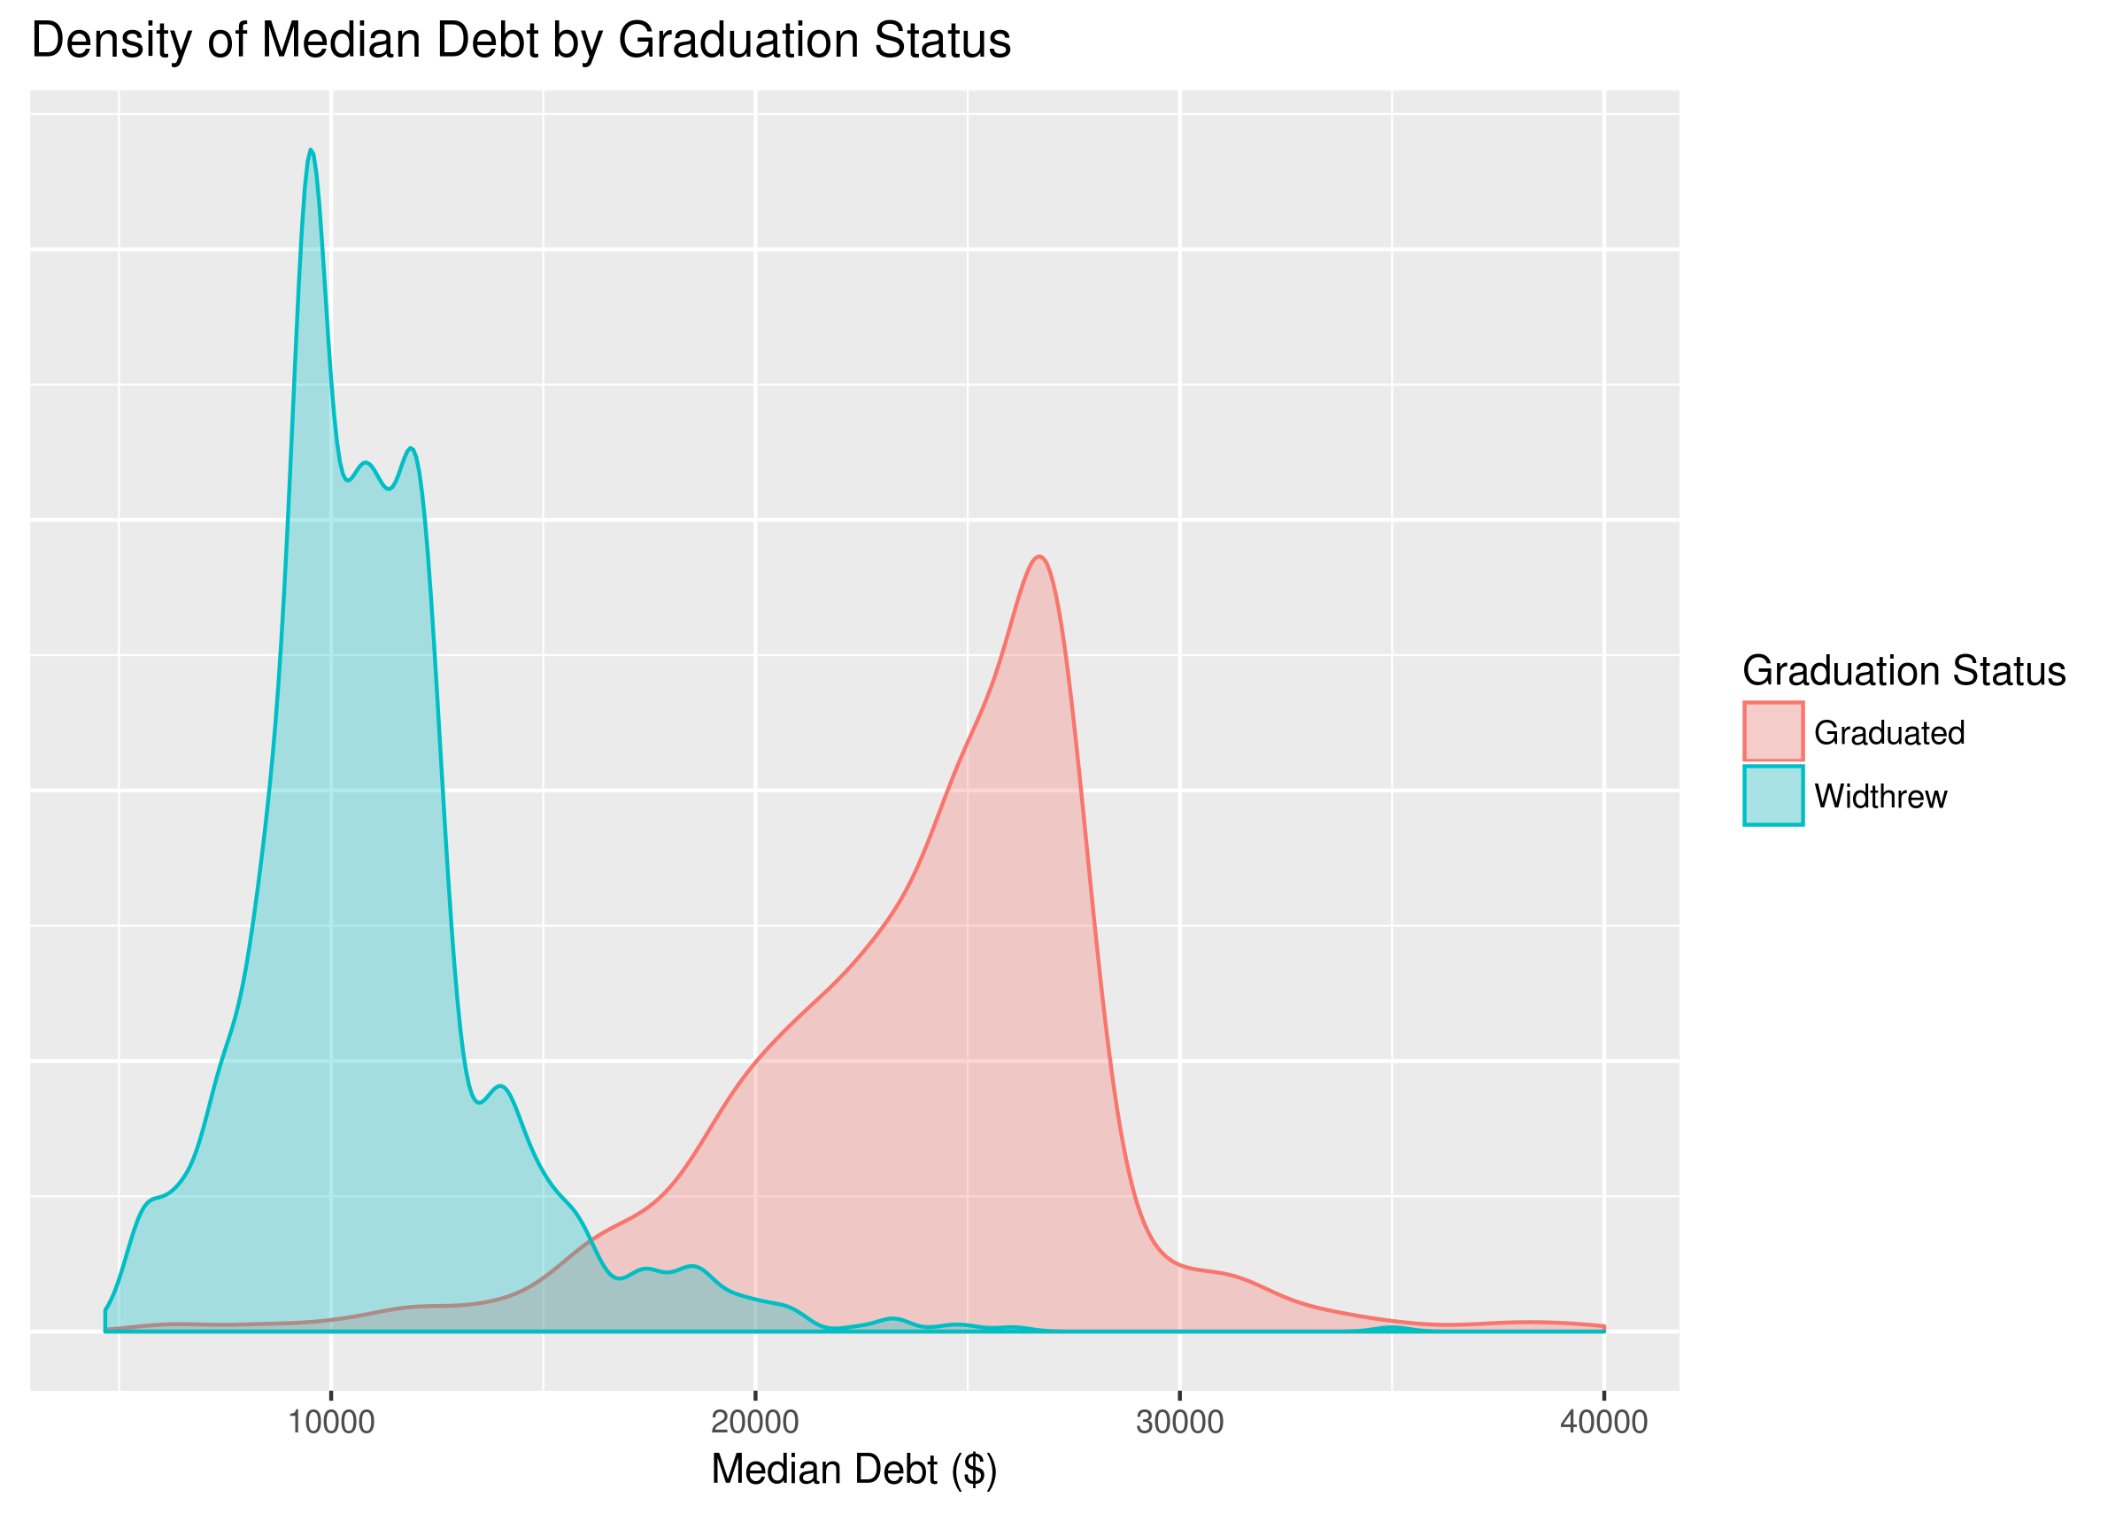
Data Exploration: Median Debt

Slide 7
Data Exploration: Distance-Only Schools
Name | Type | NumStudents | CompletionRate
Western Governors University | Private nonprofit | 35493 | 0.18893646
Colorado Technical University-Online | Private for-profit | 17902 | 0.09780886
The Art Institute of Pittsburgh-Online Division | Private for-profit | 10896 | 0.13193056
South University–Savannah Online | Private for-profit | 9592 | 0.08570000

Slide 8
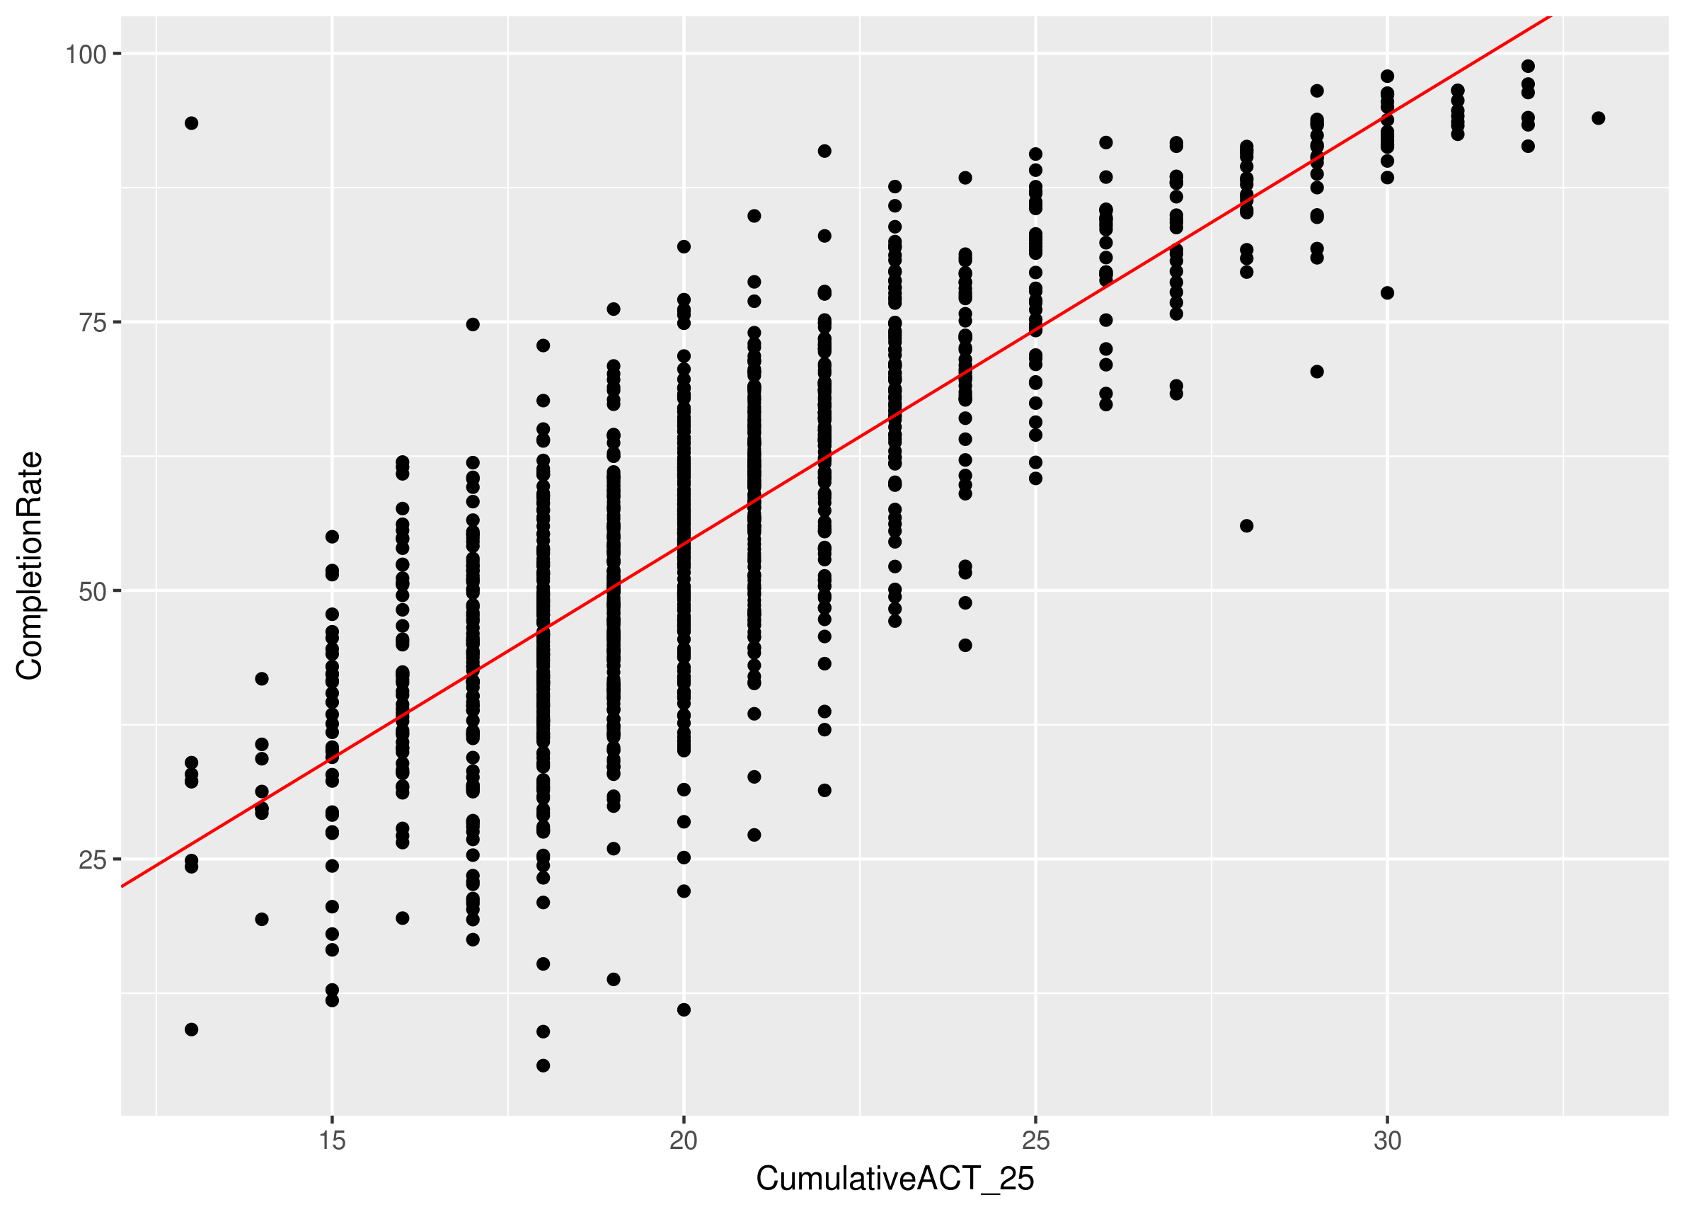
Completion Rate vs. ACT Scores (25th percentile)

Slide 9
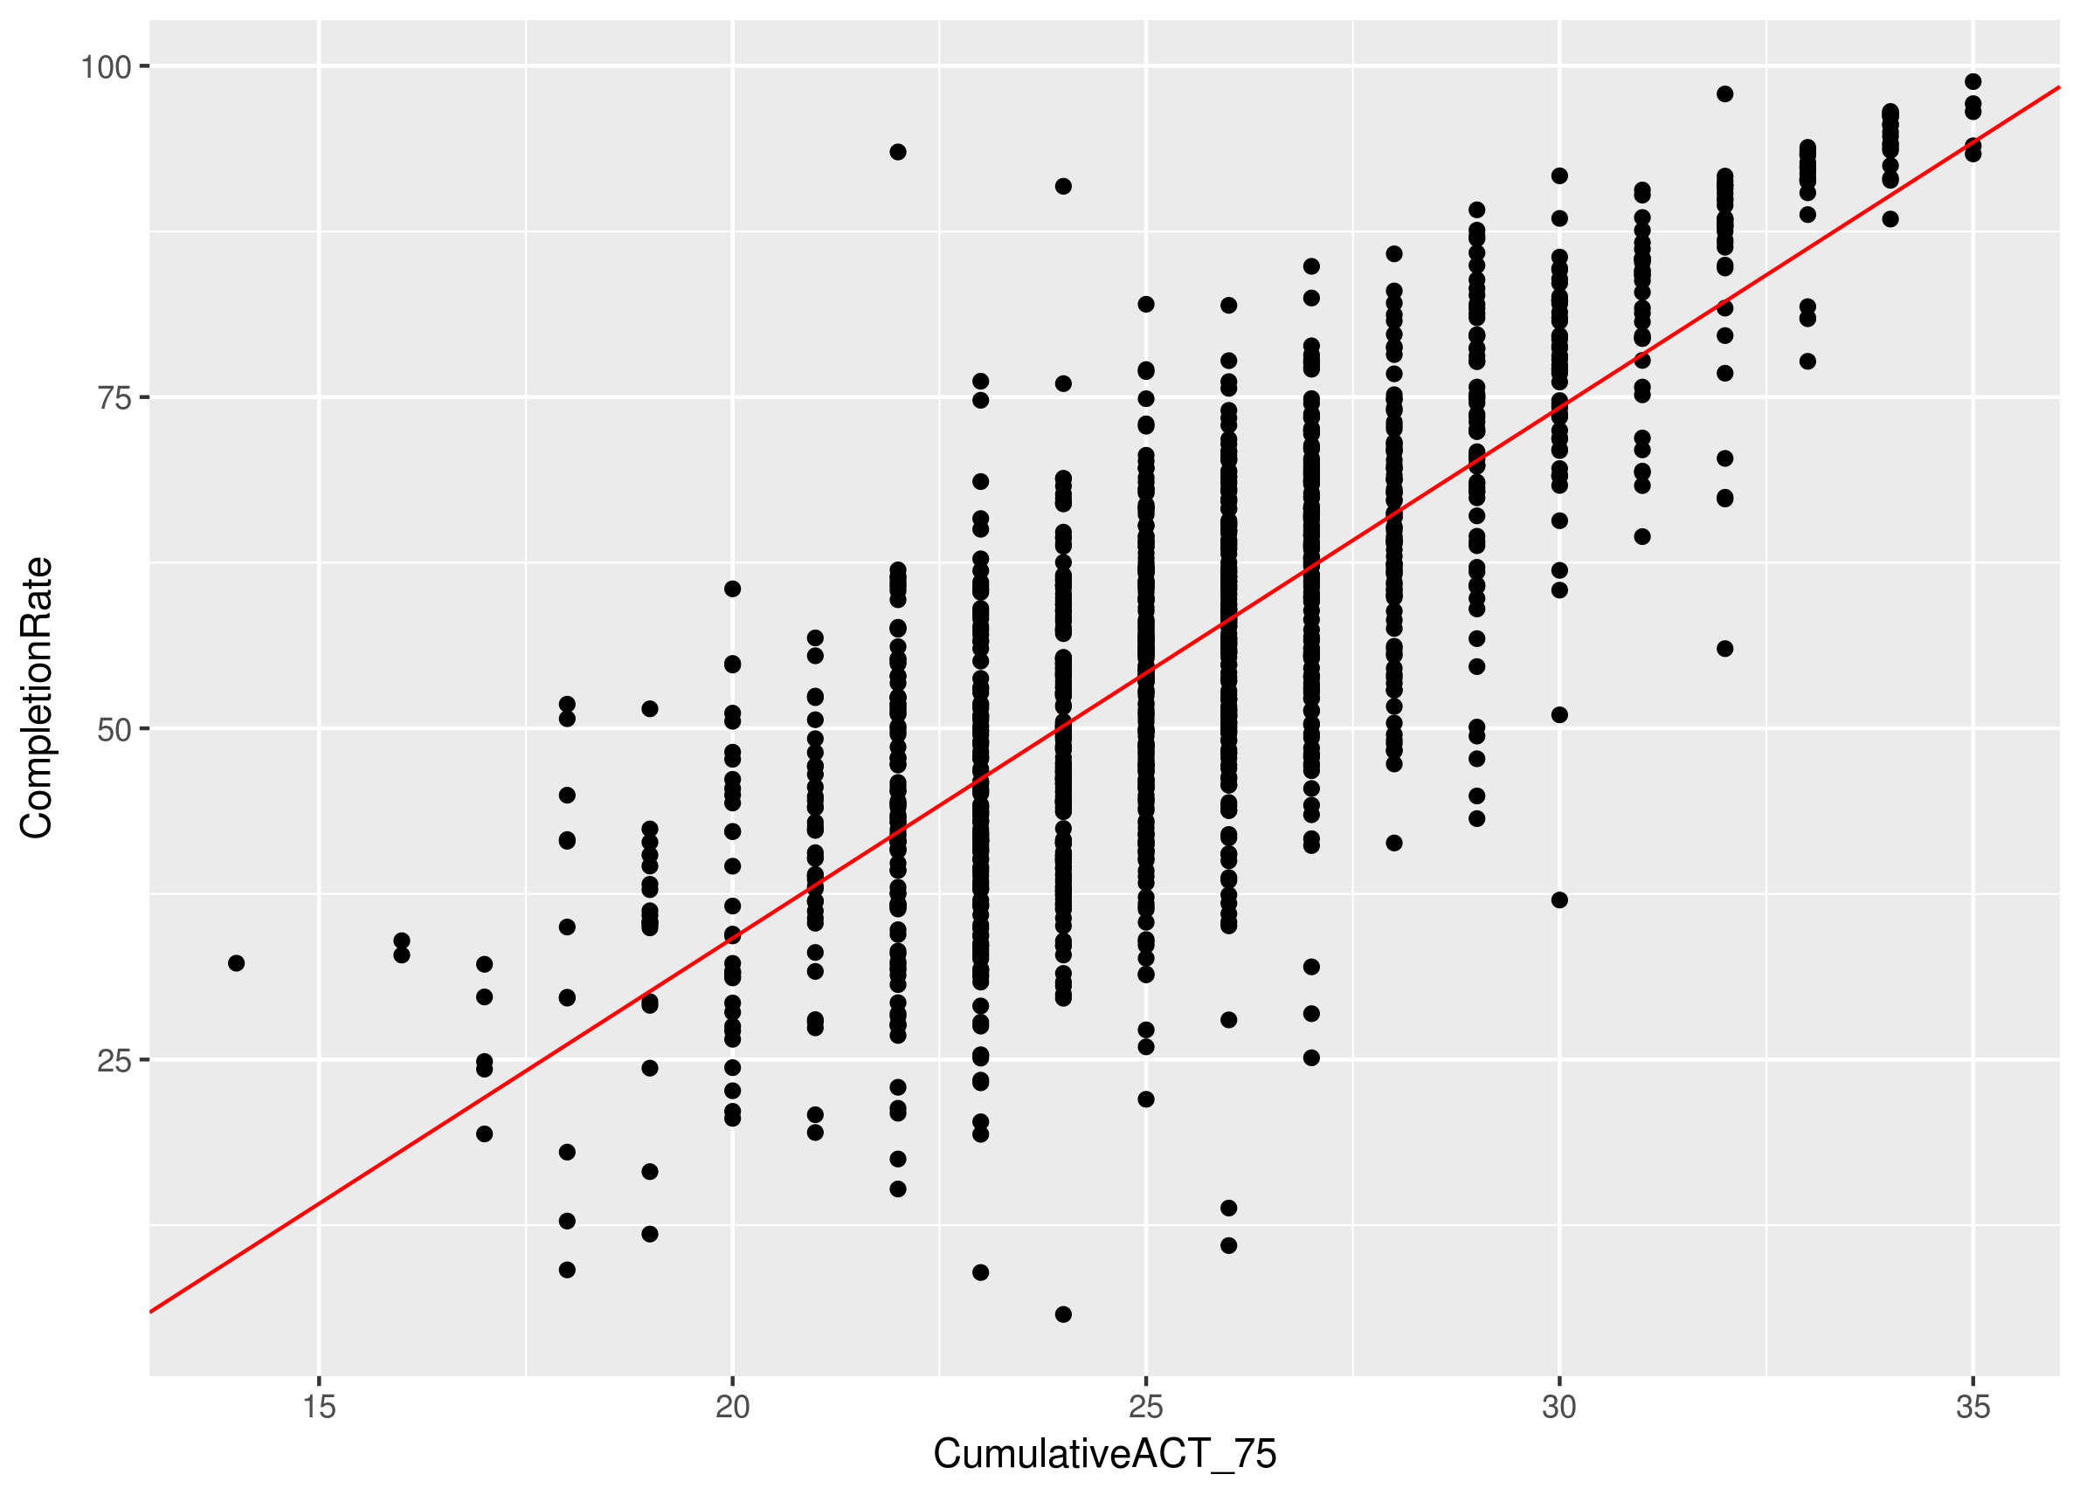
Completion Rate vs. ACT Scores (75th percentile)

Slide 10
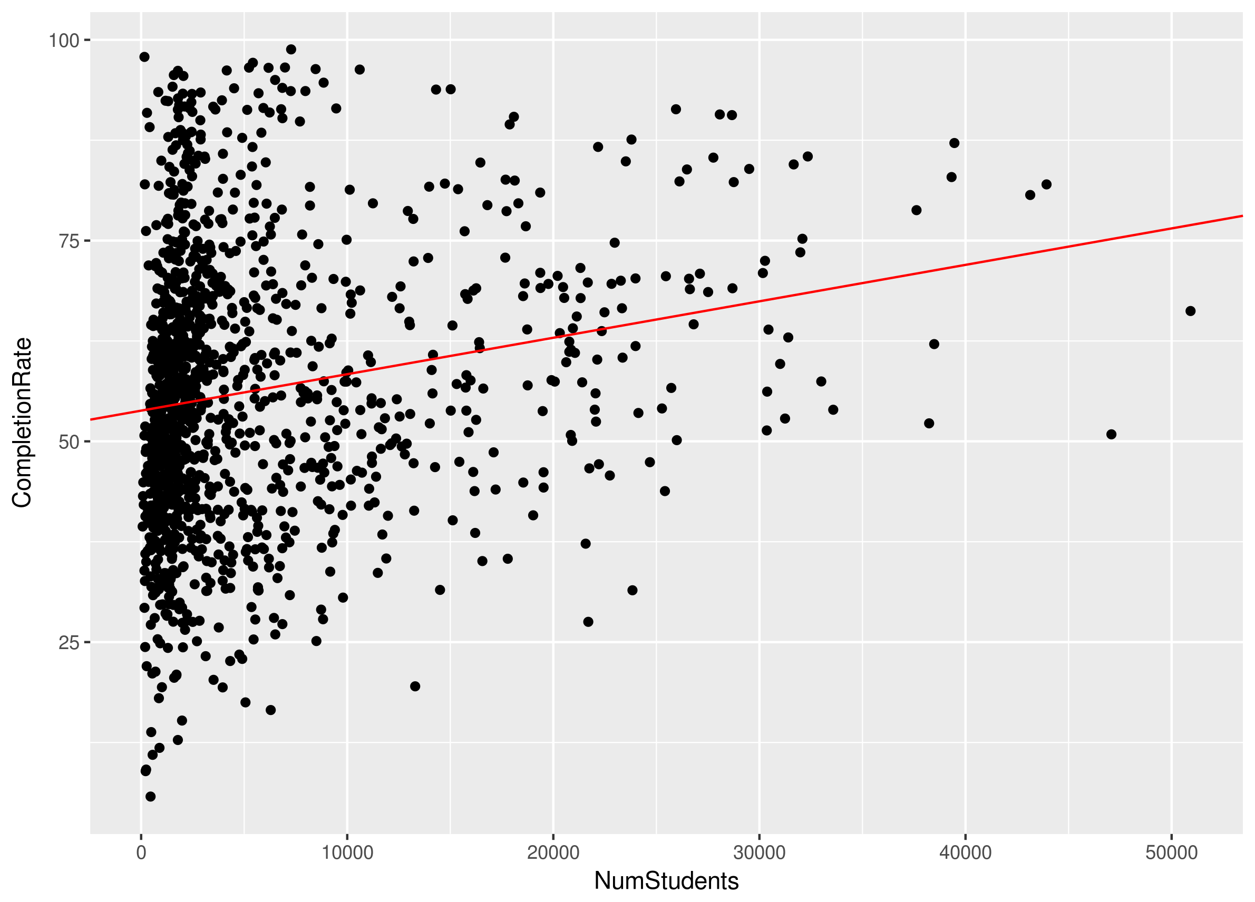
Completion Rate vs. Number of Students

Slide 11
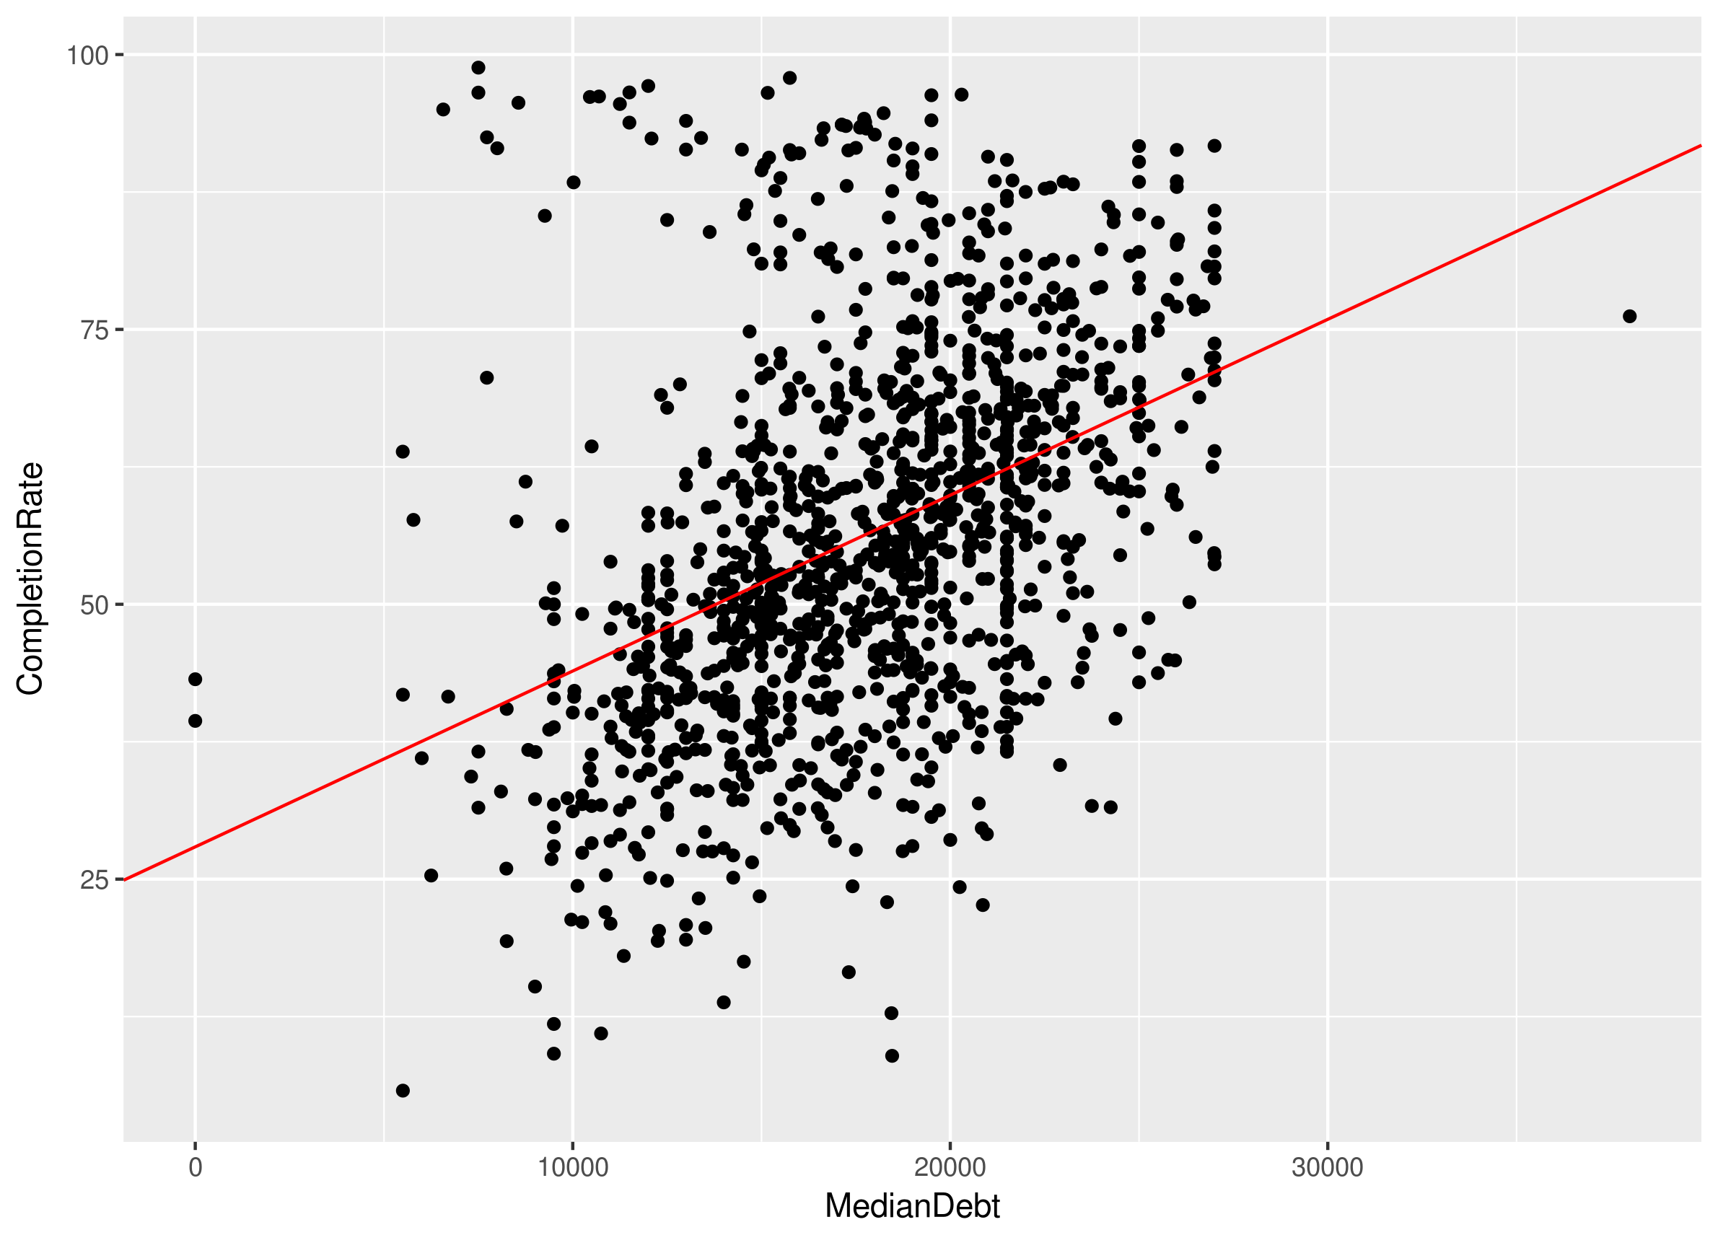
Completion Rate vs. Median Debt

Slide 12
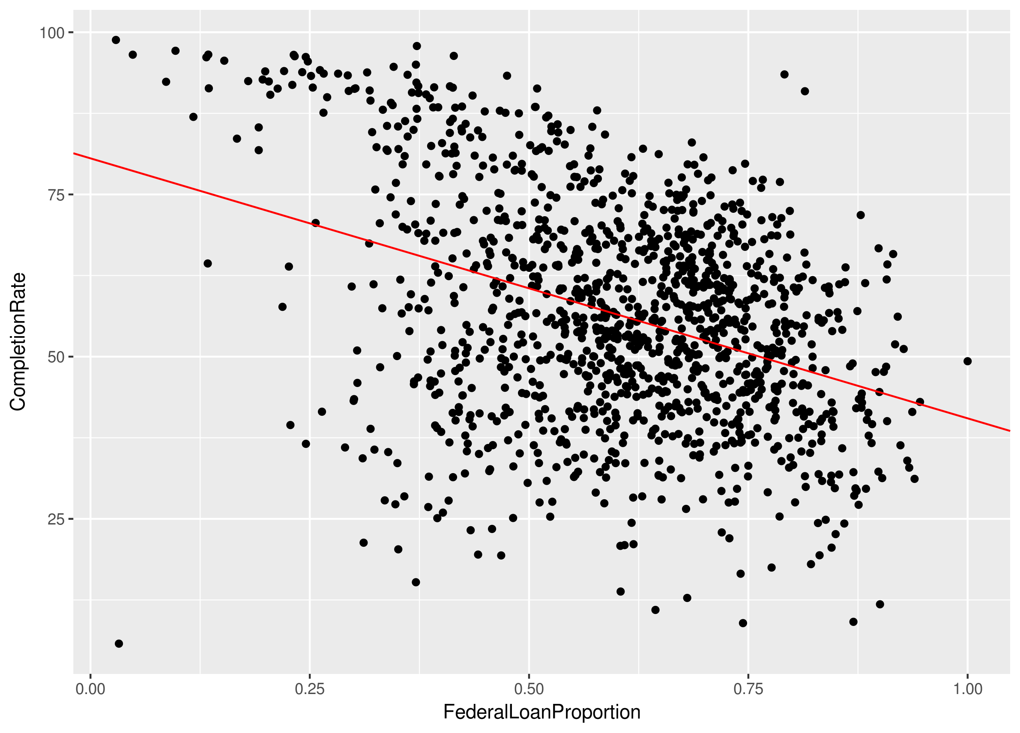
Completion Rate vs. Federal Loan Proportion

Slide 13
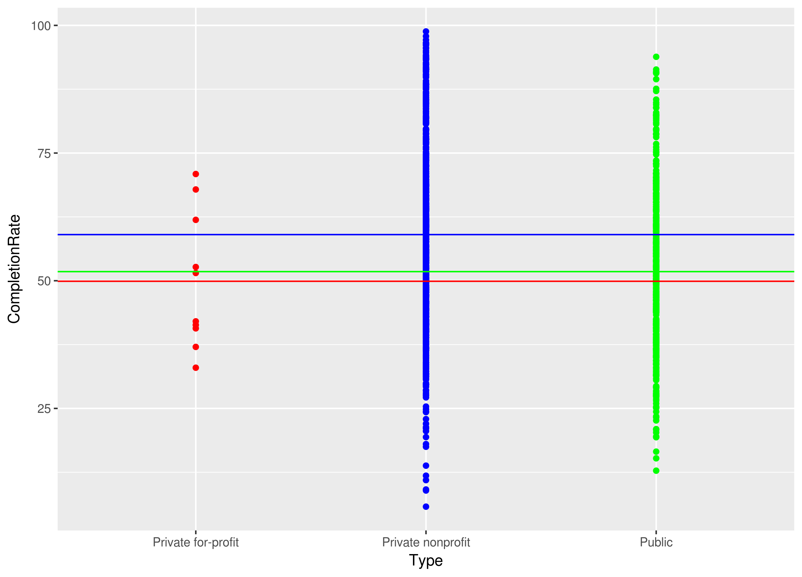
Completion Rate vs. College Type

Slide 14
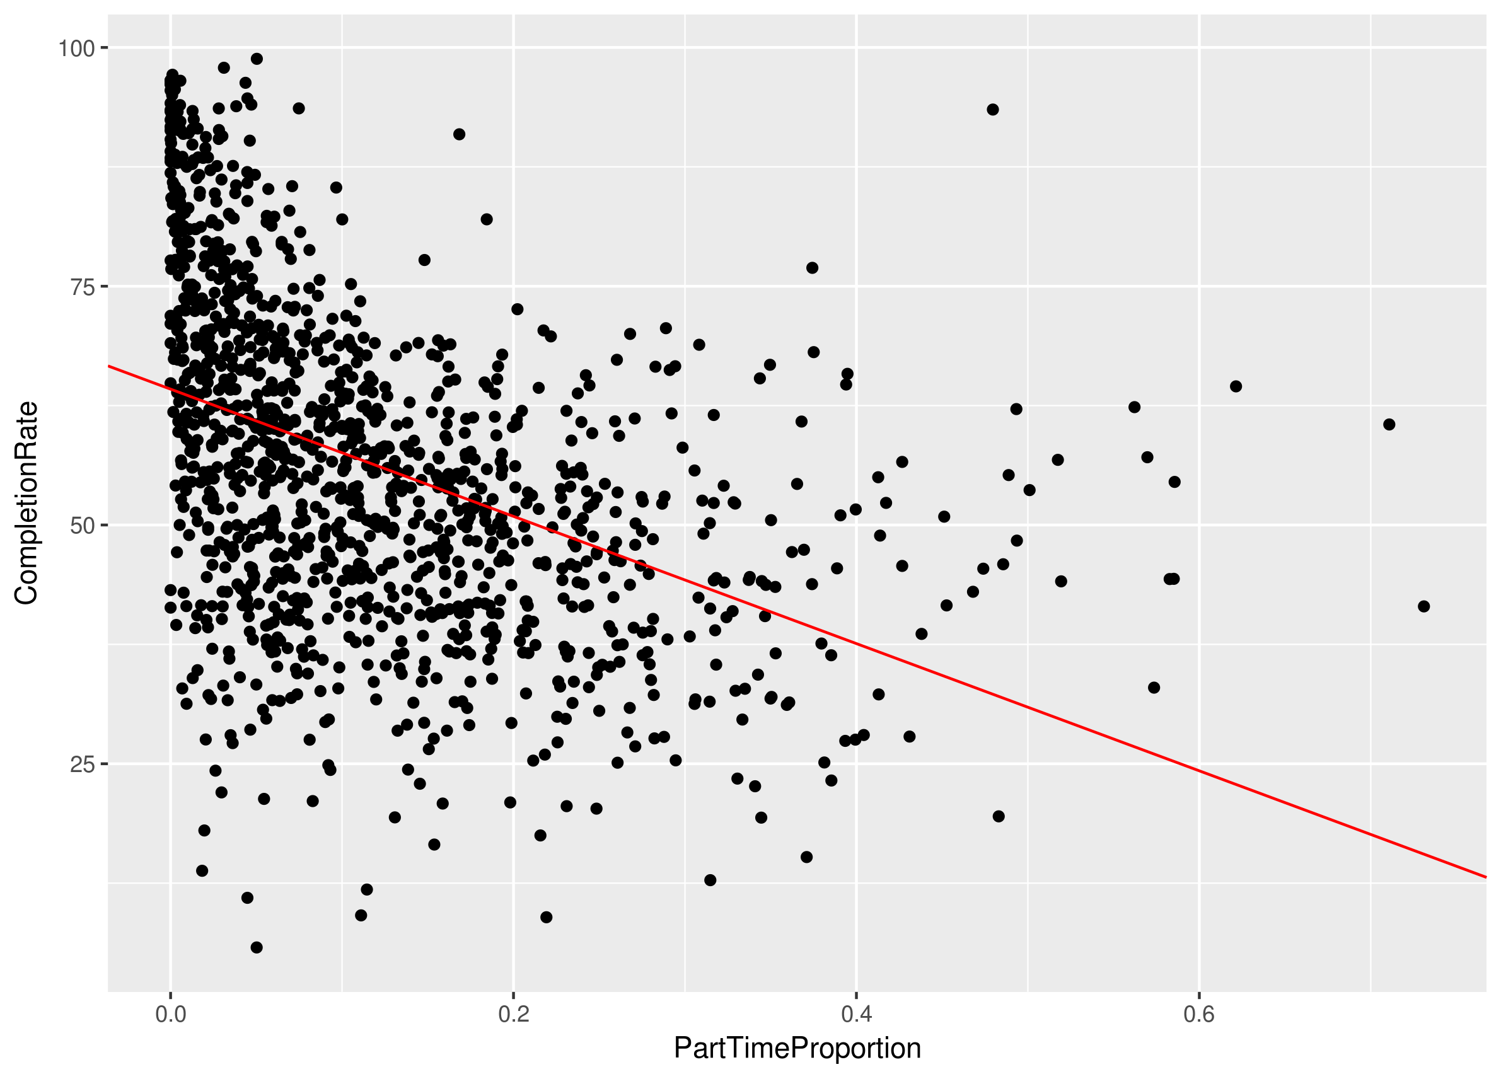
Completion Rate vs. Part Time Proportion

Slide 15
Model Selection: Reverse AIC
CompletionRate ~ .
+ Tuition:MedianDebt
+ Tuition:FederalLoanProportion
+ Tuition:PartTimeProportion
+ Tuition:CumulativeACT_25
+ MedianDebt:NumStudents
+ MedianDebt:Type
+ MedianDebt:CumulativeACT_75
+ FederalLoanProportion:Type
+ FederalLoanProportion:CumulativeACT_25
+ FederalLoanProportion:CumulativeACT_75
+ PartTimeProportion:NumStudents
+ PartTimeProportion:Type
+ PartTimeProportion:CumulativeACT_25
+ PartTimeProportion:CumulativeACT_75
+ NumStudents:CumulativeACT_75
+ Type:CumulativeACT_25
+ CumulativeACT_25:CumulativeACT_75
AIC: 5262.236
BIC: 5421.859

Slide 16
Model Selection: Both AIC
CompletionRate ~ .
+ Tuition:MedianDebt
+ Tuition:PartTimeProportion
+ Tuition:CumulativeACT_25
+ MedianDebt:FederalLoanProportion
+ MedianDebt:PartTimeProportion
+ MedianDebt:NumStudents
+ MedianDebt:Type
+ MedianDebt:CumulativeACT_25
+ MedianDebt:CumulativeACT_75
+ FederalLoanProportion:PartTimeProportion
+ FederalLoanProportion:CumulativeACT_25
+ FederalLoanProportion:CumulativeACT_75
+ PartTimeProportion:NumStudents
+ PartTimeProportion:Type
+ PartTimeProportion:CumulativeACT_25
+ NumStudents:Type
+ NumStudents:CumulativeACT_25
+ CumulativeACT_25:CumulativeACT_75
+ MedianDebt:CumulativeACT_25:CumulativeACT_75
+ MedianDebt:FederalLoanProportion:PartTimeProportion
+ PartTimeProportion:NumStudents:CumulativeACT_25
+ PartTimeProportion:NumStudents:Type
+ MedianDebt:FederalLoanProportion:CumulativeACT_25
AIC: 5220.184
BIC: 5410.701

Slide 17
Model Selection: Reverse BIC
CompletionRate ~ .
+ Tuition:PartTimeProportion
+ MedianDebt:CumulativeACT_75
+ PartTimeProportion:Type
+ PartTimeProportion:CumulativeACT_25
+ NumStudents:CumulativeACT_25
AIC: 5277.067
BIC: 5359.453

Slide 18
Model Selection: Reverse BIC
CompletionRate ~ .
+ Tuition:PartTimeProportion
+ MedianDebt:NumStudents
+ MedianDebt:CumulativeACT_25
+ MedianDebt:CumulativeACT_75
+ PartTimeProportion:Type
+ PartTimeProportion:CumulativeACT_25
+ CumulativeACT_25:CumulativeACT_75
+ MedianDebt:CumulativeACT_25:CumulativeACT_75
AIC: 5247.736
BIC: 5345.57

Slide 19
Selected Model
Coefficient | Estimate | Std. Error | Pr(>|t|)
(Intercept) | 110.9 | 31.85 | 0.000512 ***
Tuition | 0.0004121 | 0.00005882 | 3.99e-12 ***
MedianDebt | -0.008128 | 0.001831 | 9.79e-06 ***
FederalLoanProportion | -10.12 | 2.1 | 1.63e-06 ***
PartTimeProportion | 85.74 | 21.55 | 7.30e-05 ***
NumStudents | 0.0008569 | 0.0001683 | 4.11e-07 ***
TypePrivate nonprofit | -2.634 | 3.033 | 0.385244
TypePublic | 3.516 | 3.115 | 0.25915
CumulativeACT_25 | -6.997 | 1.992 | 0.000461 ***
CumulativeACT_75 | -3.351 | 1.182 | 0.004671 **
Tuition:PartTimeProportion | -0.001227 | 0.0003333 | 0.000241 ***
MedianDebt:NumStudents | -3.133E-08 | 9.923E-09 | 0.001632 **
MedianDebt:CumulativeACT_25 | 0.0005891 | 0.0001112 | 1.40e-07 ***
MedianDebt:CumulativeACT_75 | 0.000282 | 0.00006913 | 4.79e-05 ***
PartTimeProportion:TypePrivate nonprofit | 23.85 | 15.72 | 0.129333
PartTimeProportion:TypePublic | -34.22 | 16.05 | 0.033162 *
PartTimeProportion:CumulativeACT_25 | -4.428 | 0.9996 | 1.03e-05 ***
CumulativeACT_25:CumulativeACT_75 | 0.2887 | 0.05681 | 4.29e-07 ***
MedianDebt:CumulativeACT_25:CumulativeACT_75 | -0.00001901 | 0.000003273 | 8.08e-09 ***

Slide 20
Some Issues
Some Issues
Insignificant categorical variable Type
Doesn’t include some interaction terms of interest
(e.g. Tuition vs. Median Debt on next slide)
Other explanatory variables from the dataset not yet included

Slide 21
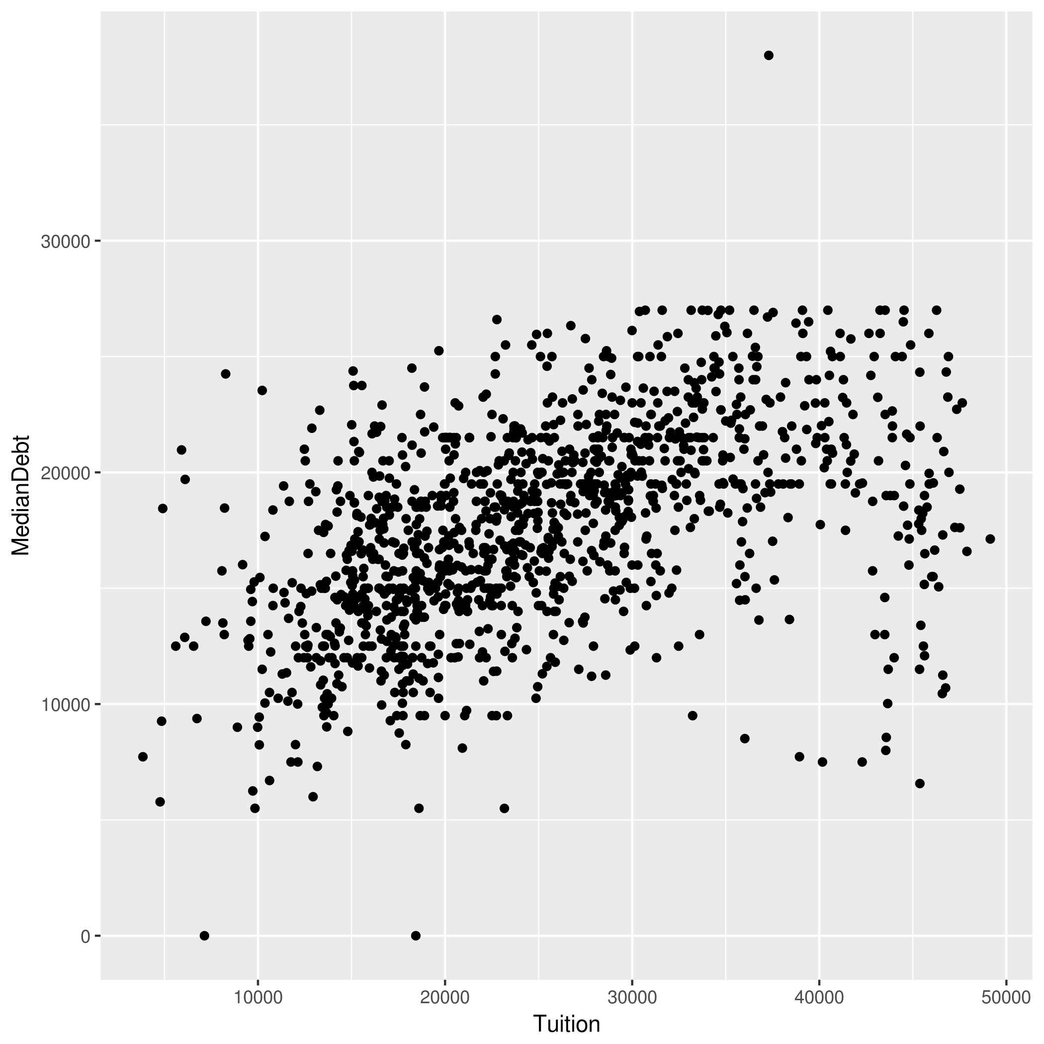
An Example of a Missing Interaction Term:
Median Debt vs. Tuition

Slide 22
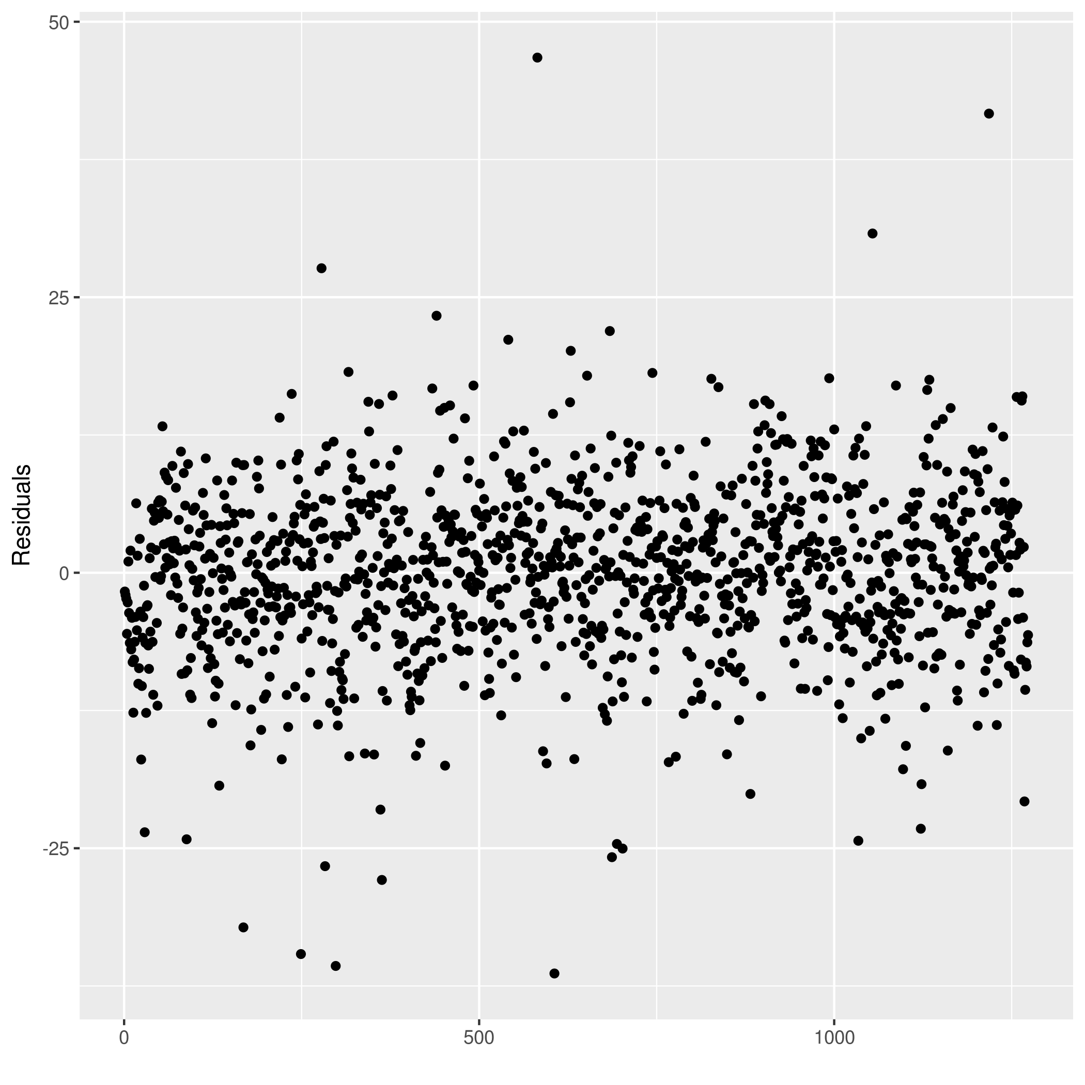
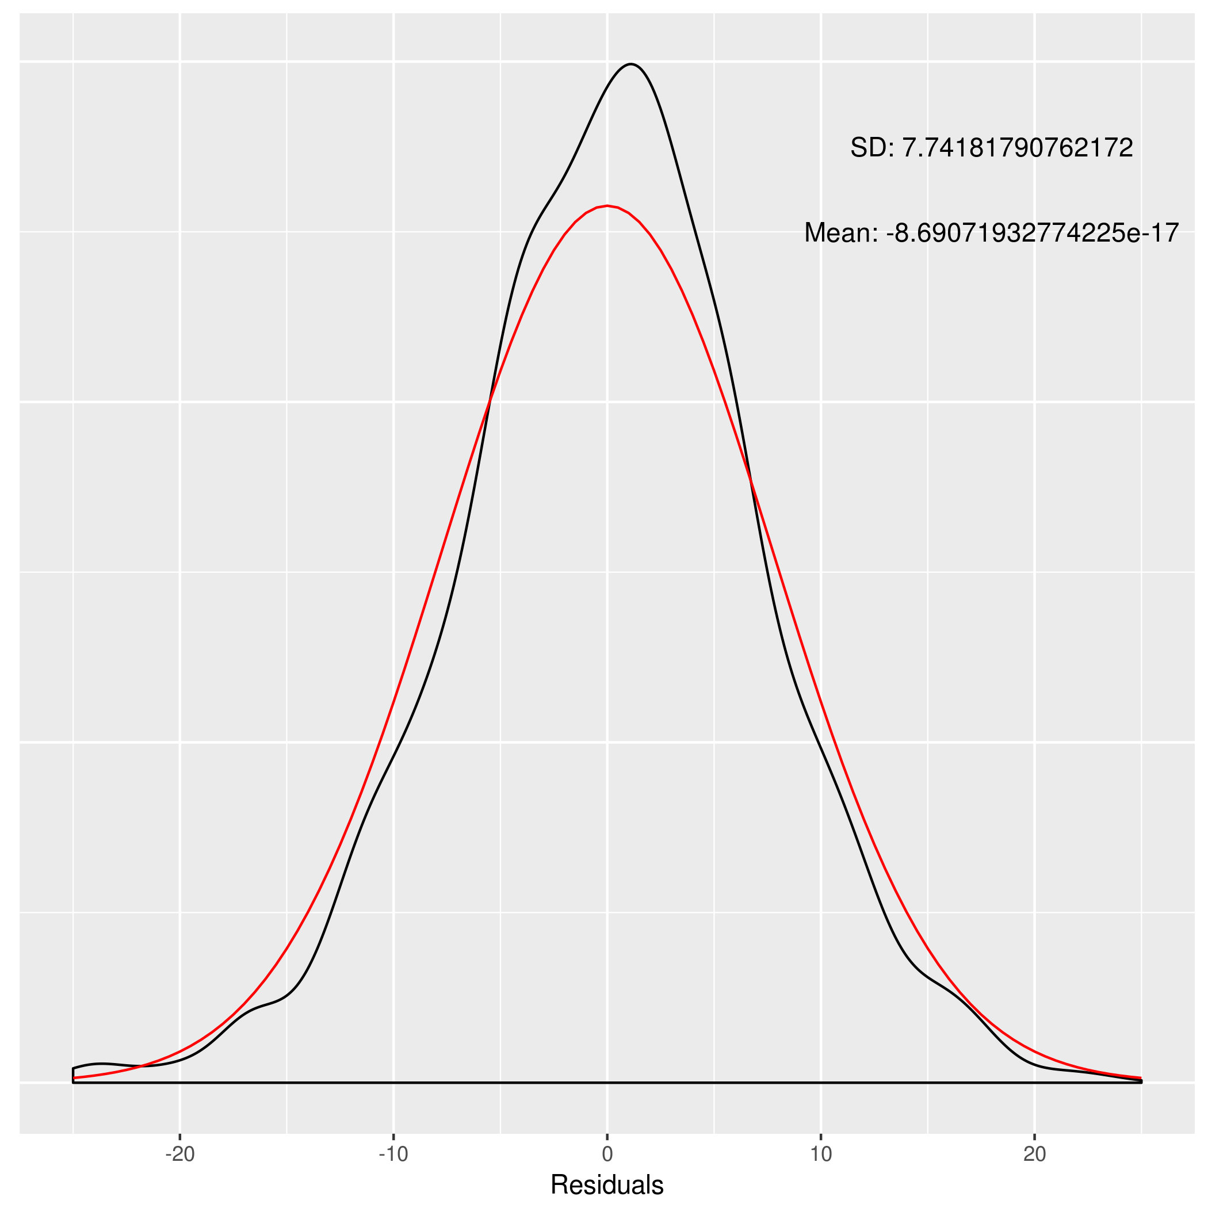
Residual Plots

Slide 23
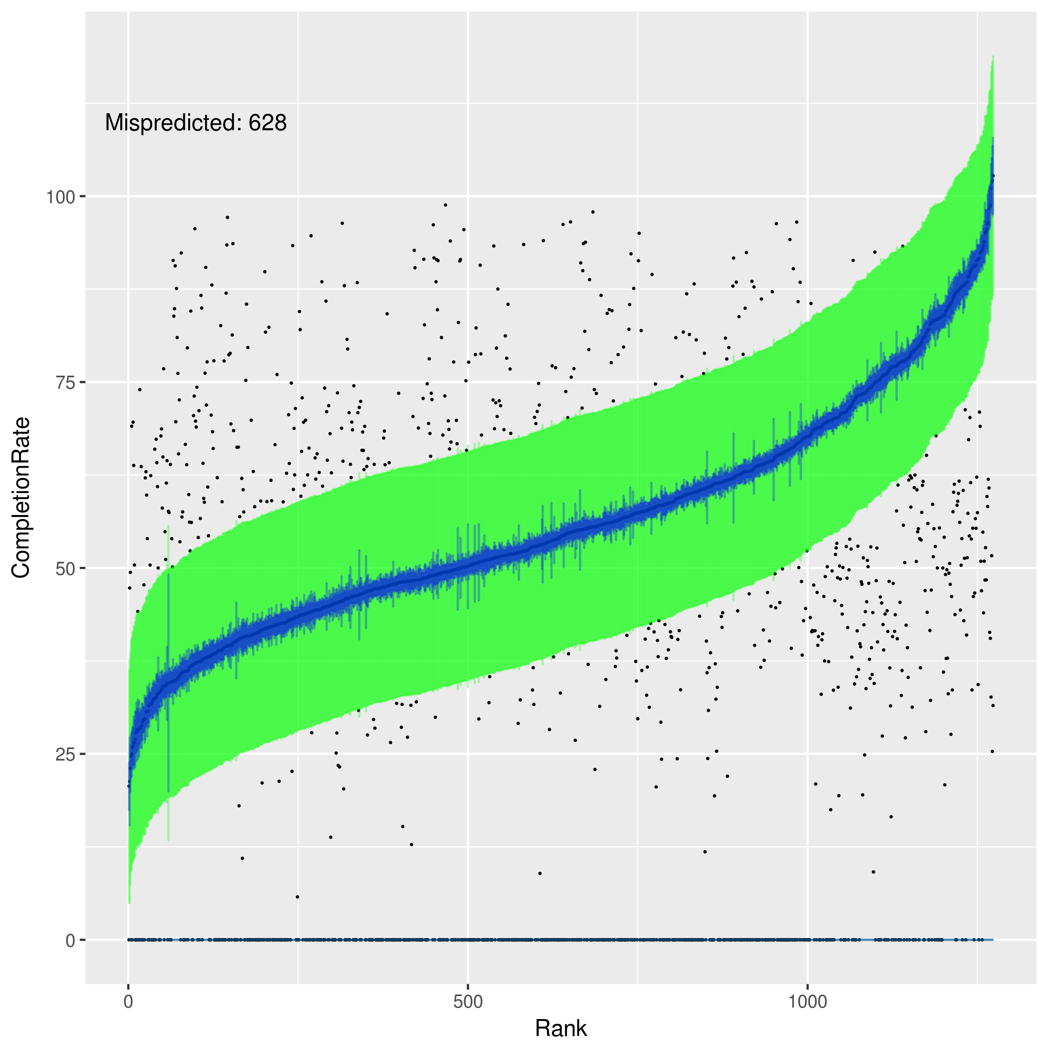
Predicted vs. Actual Completion Rates

Slide 24
Next Steps
Potentially investigate a new response variable
Investigate alternative models and model selection processes
(attempting some automation here)
Investigate other explanatory variables (e.g. location or program type)

Slide 25
Questions/Comments?

