Slide 1
Internship Summary
Xinyu Ren | 2024.8.26
Notes:
各位大家好.今天主要是跟大家介紹RAS.

Slide 2
Introduction
01
Internship Content
02
Content
Personal Growth
03
Future Prospect
04

Slide 3

Part
One
A brief introduction
Introduction

Slide 4


Introduction
Internship Purpose
Accumulate experience in the internship and improve personal practical skills such as coding and business logic ability.
Personal Motivation
Adapt to the transition from campus to the workplace as soon as possible, and grow to meet the needs of the position in advance, in order to output more efficiently in the formal work
Internship Period
Mid-June to late October

Slide 5
Part
Two
Internship content and result
Internship
Content

Slide 6
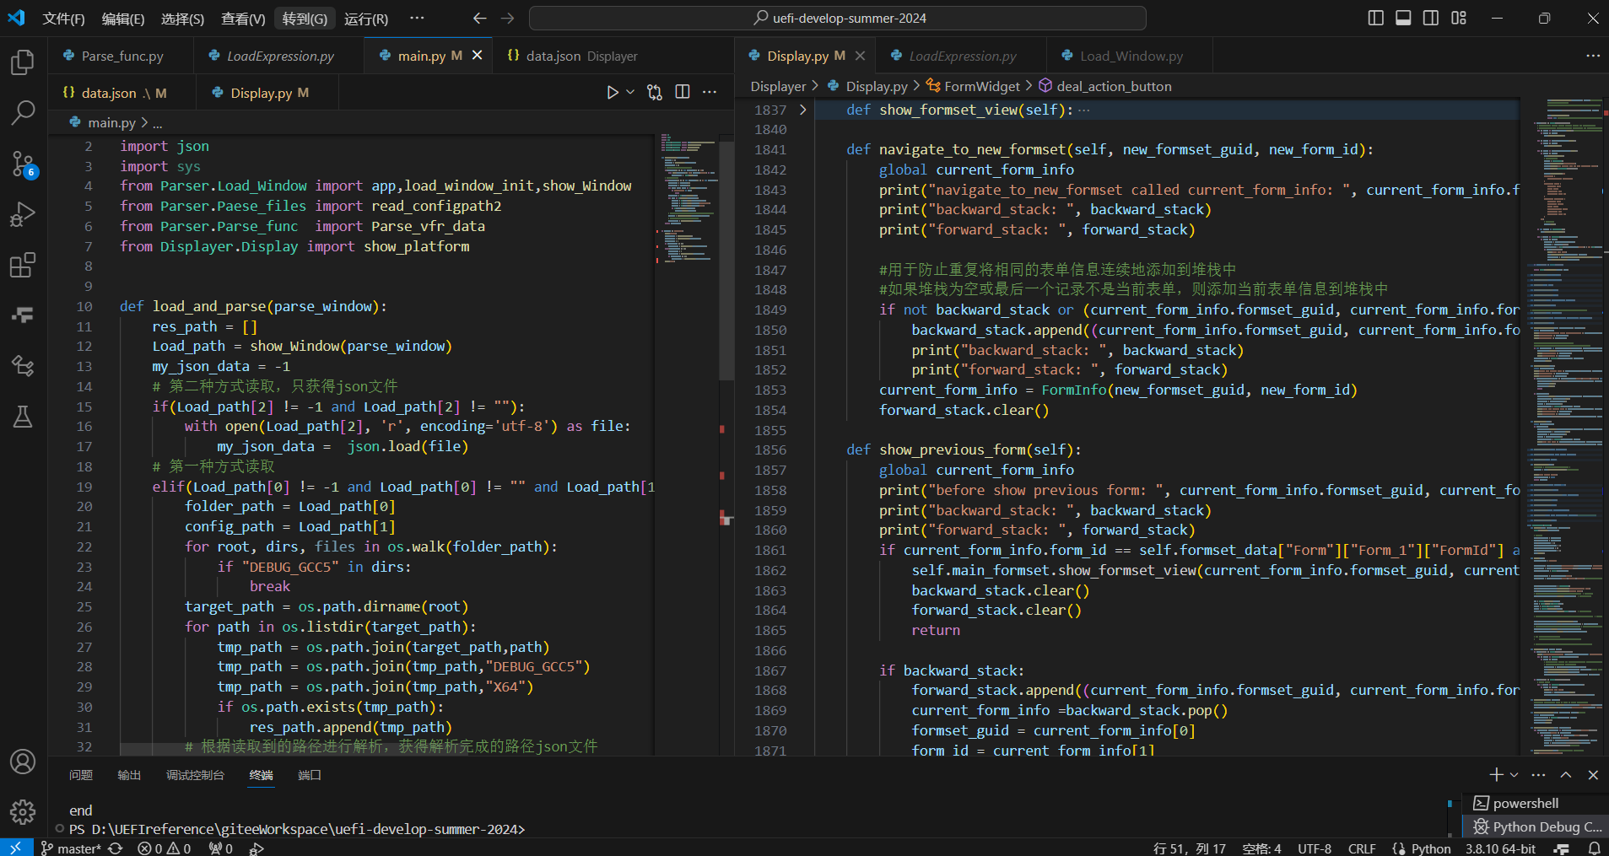
Internship Content
In this whole process, a number of tasks were completed, which mainly including:
Build the EDK2 Environment
Run the First MyHelloWorld App
PEI Modules Communication via Ppi
DXE Drivers Communication via Protocol
Hobs Between PEI and DXE
Event Callback and Notify
Enumerate PCI Devices
Dump Memory Map Space and Variables
Static and Dynamic Setup Creation
Cross Platform Setup Browser Implementation

Slide 7
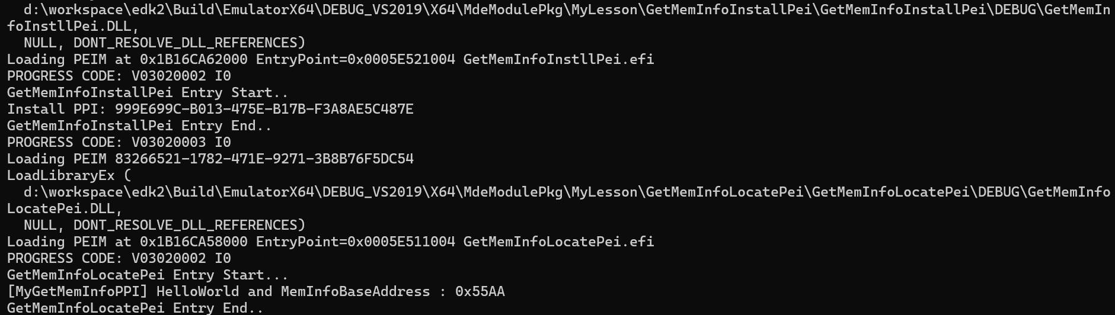
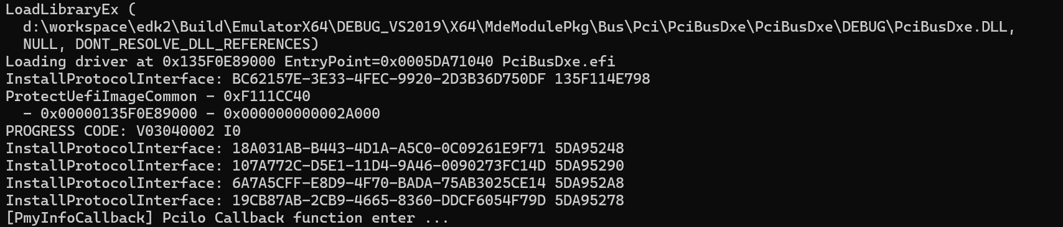
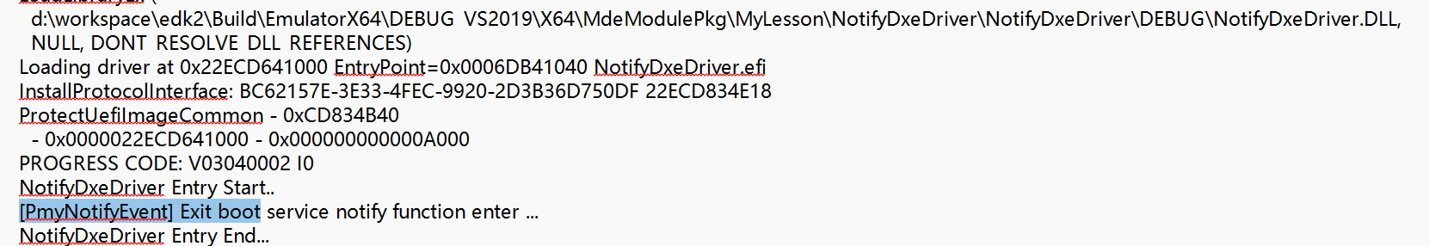
Partial Task Results
1. PPI exercise
Install PPI Successfully!
Locate PPI Successfully!
2. Event exercise: callback, notify

Slide 8
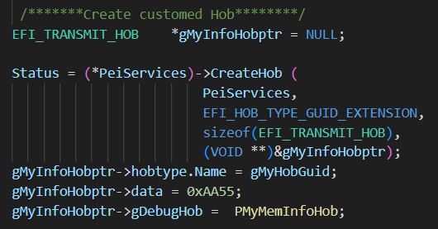
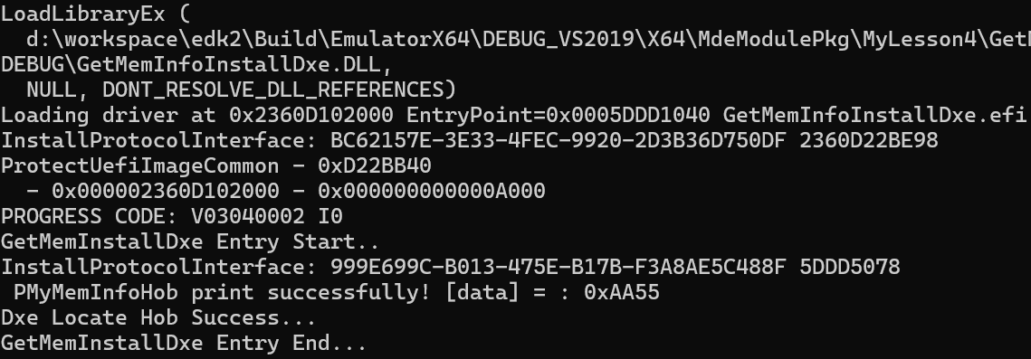
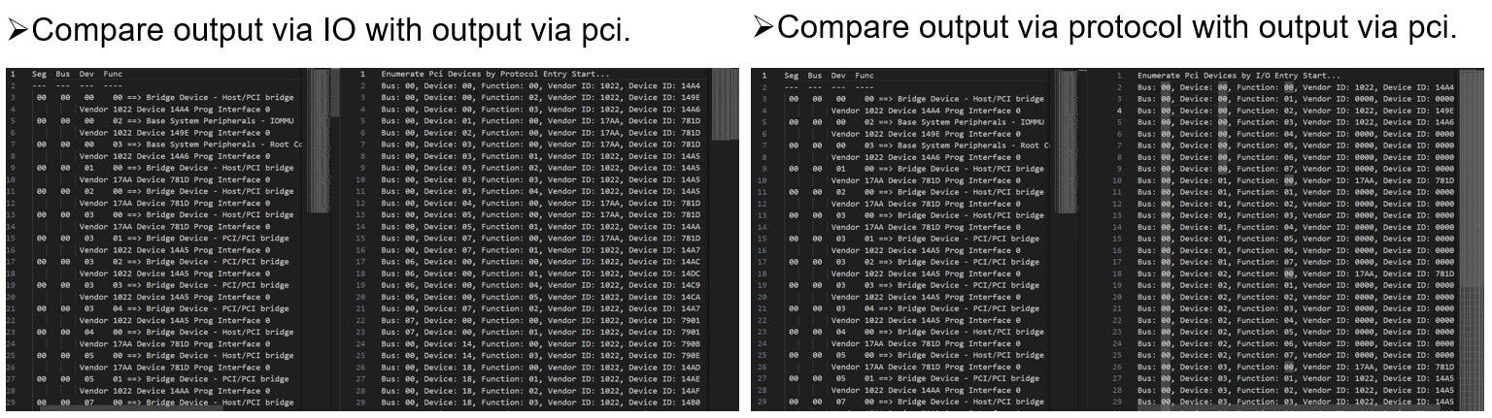
Partial Task Results
3. Protocol and Hob exercise
Fetch HOB Successfully!
4. Enumerate Pci devices exercise

Slide 9
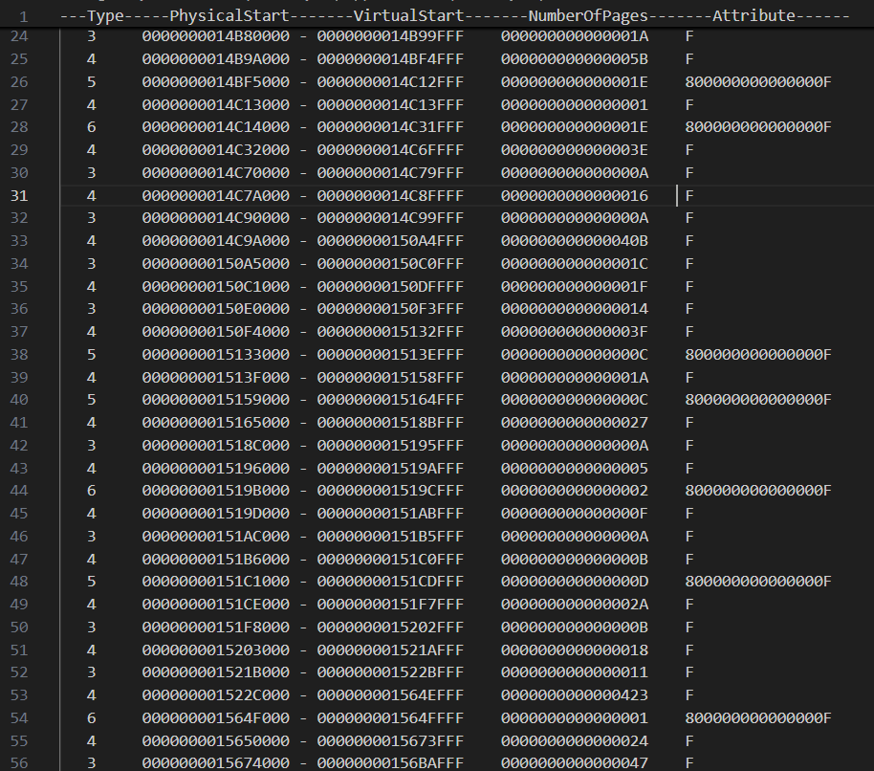
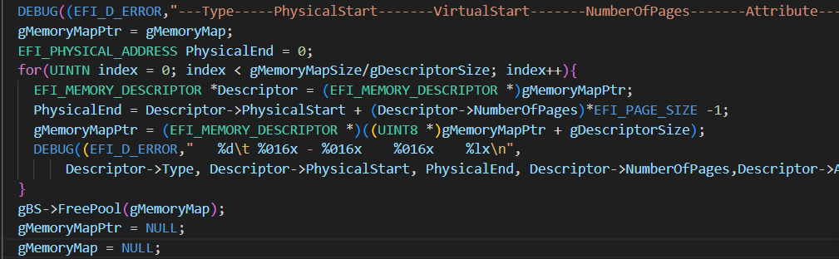
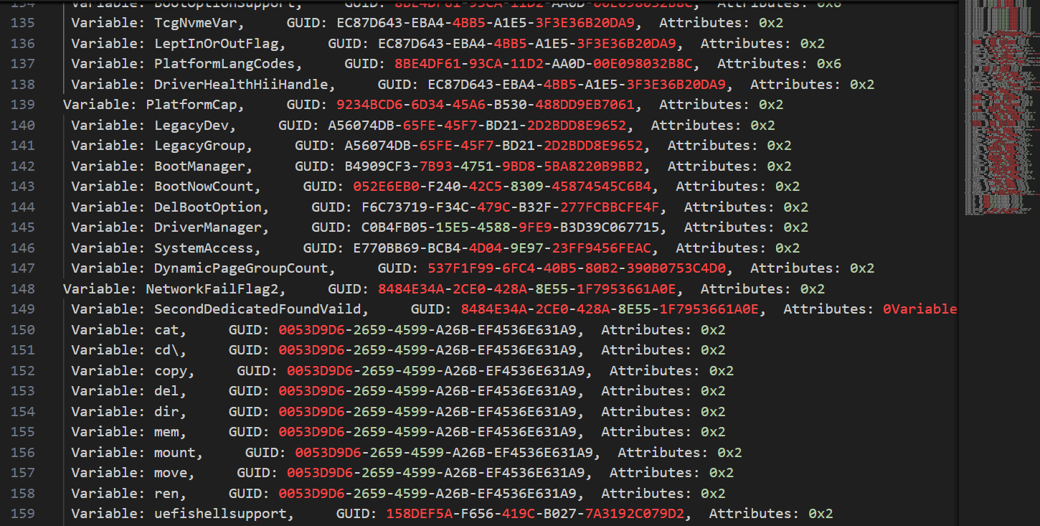
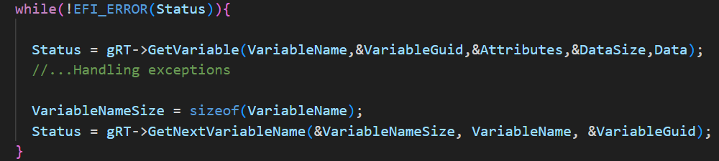
Partial Task Results
5. Dump MM space exercise
6. Dump variables exercise

Slide 10
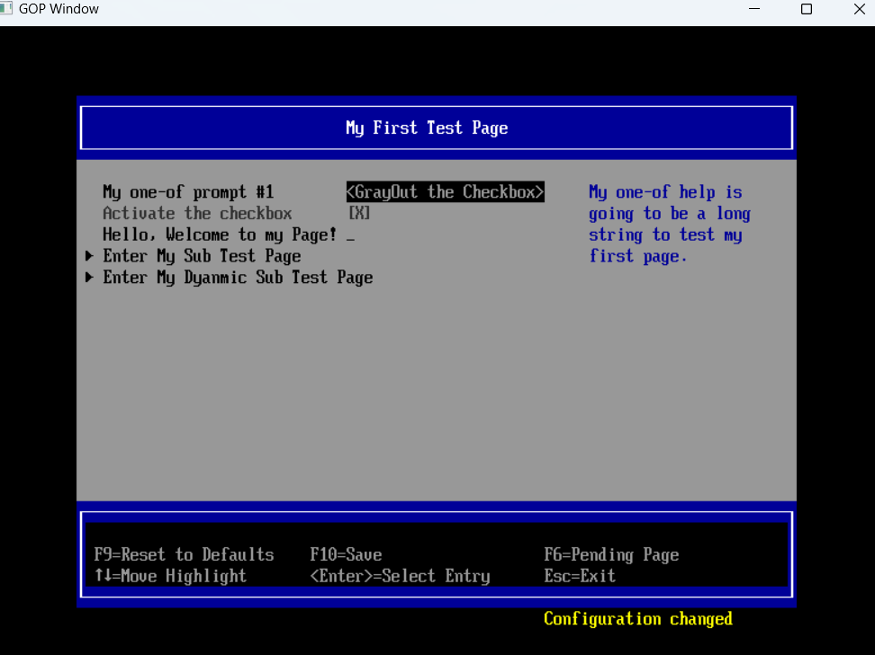
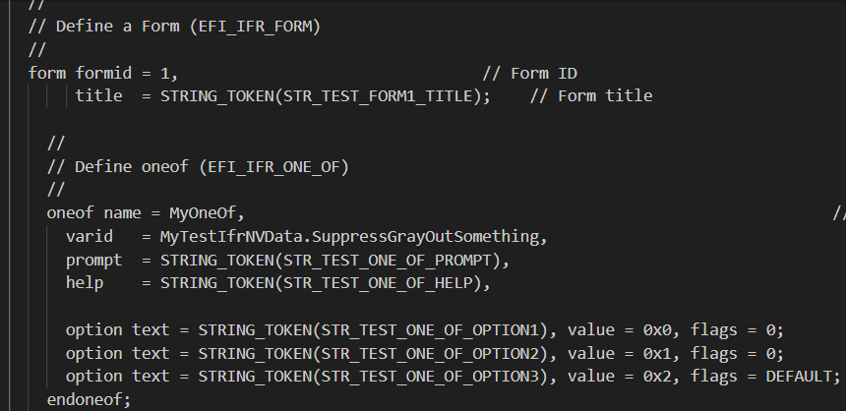
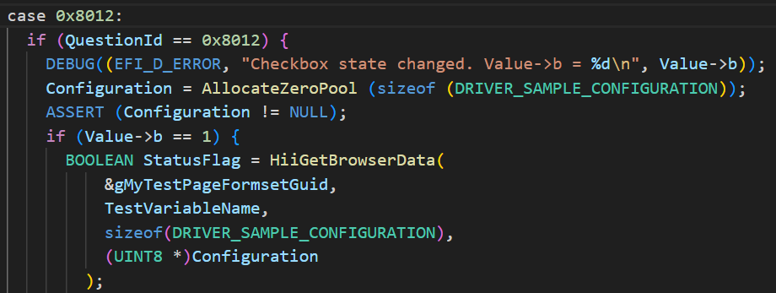
Partial Task Results
7. Setup exercise

Slide 11
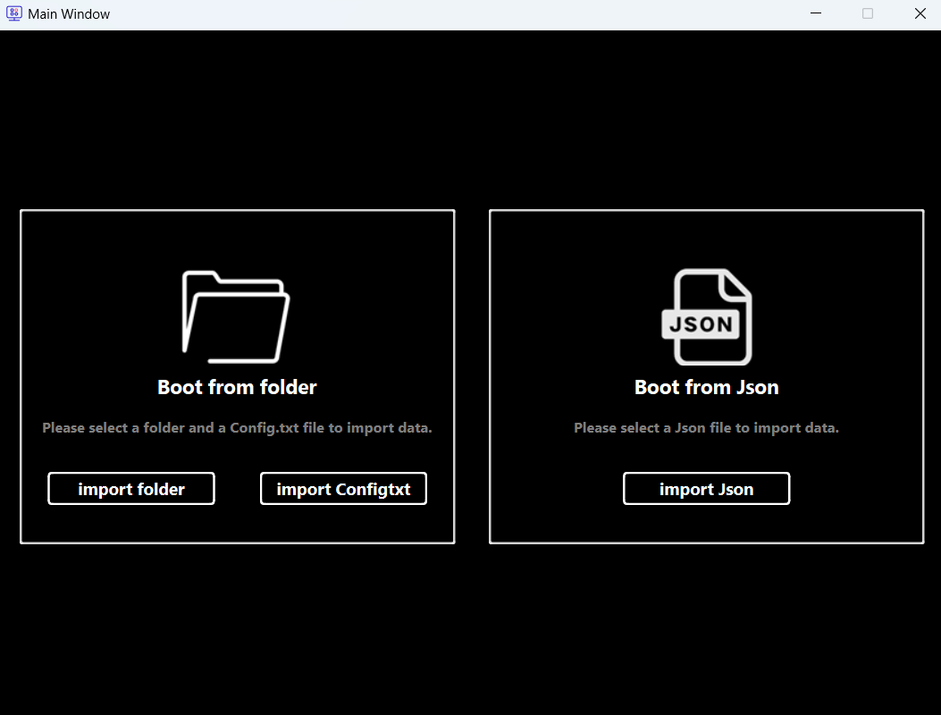
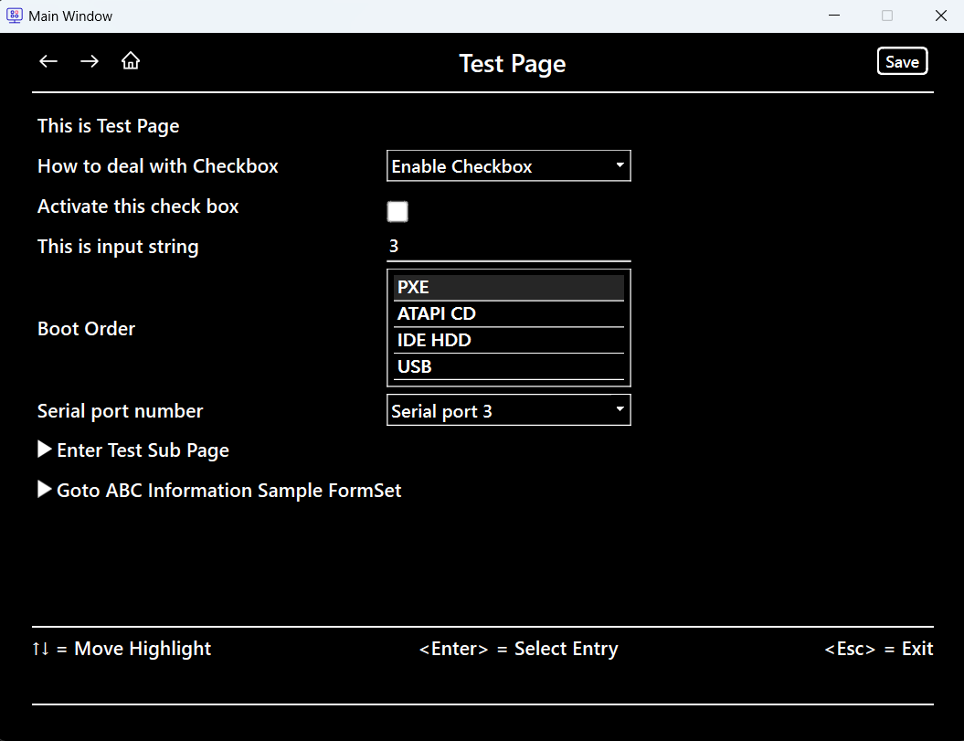
Requirement Content and Results
8. Cross platform setup browser
The content of UI page control mainly includes:
Binary Files
Setup Browser
Construct base data structure
Multi-page management and update language
Handle Page jump and navigation
Implement storage feature
Boot Option
Main Formset

Slide 12
Requirement Content and Results
Code basic architecture is as follows.
FormSetWidget
MainWindow
BootOption
json data
MainFormSet
app
window
flag
FormWidget
Data structure:
form_stacked_widget,
self.index_mapping,
…
Function call:
create_formset_Widget
create_form_Widget
Data structure:
self.form_buttons,
self.statements ,
…
form_stacked_widget
…
form1
form2
form3
Method:
init_ui
updatelanguage,
goto_form_by_
guid_id,
add_form,
…
Method:
init_UI
updatelanguage,
updatetime,
eventFilter
…
index
index_mapping
[formset_guid, form_id]

Slide 13
Part
Three
Personal growth
Personal
Growth

Slide 14

Personal Growth
Accumulate some basic knowledge of UEFI
Improved practical skills
Gain
Get exposure to the real, proven way the industry works
Have a further understanding of the direction of career development
Made a great group of friends and colleagues
14

Slide 15
Part
Four
Future prospect and thanks
Future
Prospect

Slide 16
Future Prospect
Career goal
Learning plan
Development direction
Deeply ploughing UEFI and constantly digging and learn-ing.
Improve code and debug capabilit-ies in requirements, and align with the direction of more rigorous, standardized and modular.
Be demand-oriented, gradually clarify a specific, valuable direction area and dig deeper.
16

