Slide 1
The Law of Cosines
Applying the Law of Cosines to Determine Sentence Similarity
with Natural Language Processing
Nathan Lloyd

Slide 2
The Law of Cosines
Relates the lengths of the sides of a triangle to the cosine of one of its angles
Generalizes the Pythagorean Theorem, which only holds true for right triangles, to all triangles
Reduces to the Pythagorean Theorem when angle A = 90 degrees since then the cos 90 degrees = 0
Wikipedia

Slide 3
Natural Language Processing
Computer Science field which strives to understand text the way humans do
Context and Sentiment analysis
(I like pizza, I like peperoni, I hate pizza) => first two are more similar
Named Entity Recognition (NER)
Can distinguish between “Apple” the company and “apple” the tasty fruit
Part of Speech Tagging (nouns, verbs, etc.)

Slide 4
Comparing Sentences
An NLP “model” is data that can be used to process text. The models are generated by artificial neural networks (ANNs) using a machine learning technique known as “deep learning”.
The process is computationally intensive and cannot be performed in a significant way on a home computer. Thankfully, there are hundreds of “pre-trained” models optimized for a variety of tasks available on the internet provided by Universities, researchers and major tech companies.
1. Obtain a trained “model”
2. Use “model” to convert sentences text to vectors
“I like pizza” -> [ 0.1301118 , 0.17063677, 0.06719759, -0.34385097…]
3. Use a method such as “cosine similarity” to compare the vectors

Slide 5
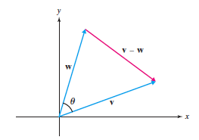
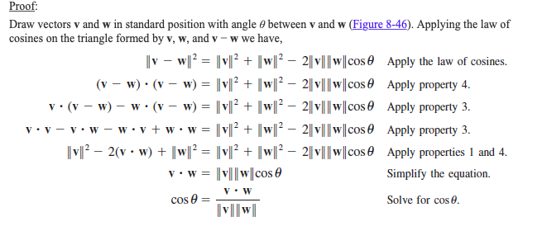
Cosine Similarity
From section 8.5 of the Textbook
**Can be generalized to vectors of any length!

