Slide 1

Capstone Project
Taxi Caller Application on Windows Phone

Slide 2
Presentation outlines
Project Overview
Project Management
Requirement Specification
Software Design
Web service
Testing
Lesson Learned
Demo
Q&A

Slide 3
1. Project overview
Current situation
Nowadays number of people are using smart phone with Windows Phone OS increase, especially in Vietnam.
There is no application which directly connect between taxi driver from original taxi company and customer.
Taxi driver drive spin around, wrong way and wrong calculation charges.
Demand for using taxi is increase too.

Slide 4
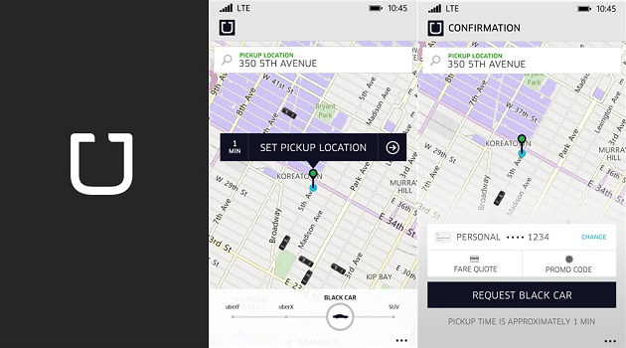
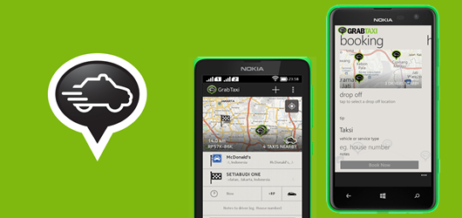
Current Application
Uber
GrabTaxi

Slide 5
Idea
Support Vietnamese for Vietnamese people.
Help people using windows phone and taxi driver can communicate better

Slide 6
Objectives and Goals
Fulfill requirements from FPT University.
Develop a product that expressed the above ideas.
Study how to develop application on Windows Phone OS.
Apply software development process for this project.
Have skills in communication, time management, risks management etc.

Slide 7
2. Project Management
Software Process Model
Software Project Plan
Project Organization
Equipment and Tools
Communication Management
Risk Management

Slide 8
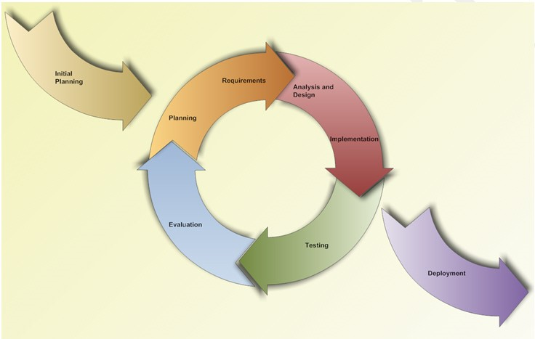
Software process model
Iterative and Incremental Software Process Model

Slide 9
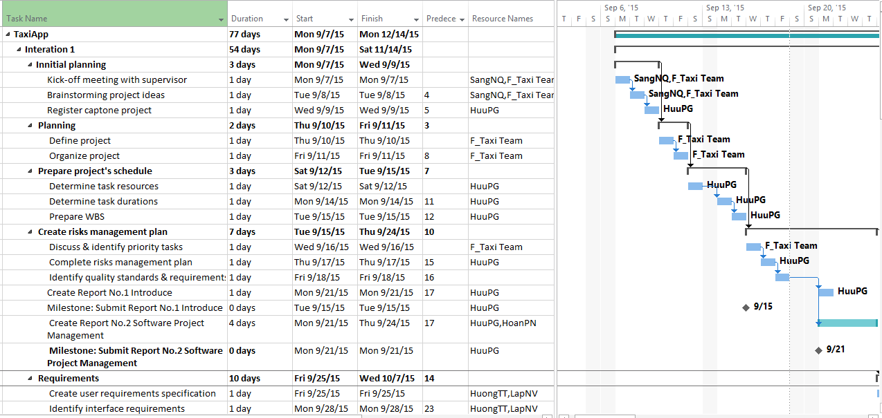
Project Plan

Slide 10
Project Organization
Project Manger
Pham Gia Huu
Member
Nguyen Van Lap
Member
Ta Thien Huong
Member
Pham Ngoc Hoan
Supervisor
Nguyen Van Sang

Slide 11









Equipment's and tools
Microsoft Office
Photoshop
TortoiseGIT
Visual Studio
Postman

Slide 12




Communication Management

Slide 13
Risk Management
ID | Risk Content | Probability | Effect | Solution
# | People Risks
1 | Team member may not follow deadlines. | HIGH | SERIOUS | Find out reasons Depending on circumstances, may set penalty rule.
2 | Team members are sick, cannot complete task under deadline. | HIGH | SERIOUS | Increase project team’s working effort in “peace period”. Allow all team members clear about what others do, so that they can cover the tasks when necessary.
3 | Conflict between team members. | HIGH | SERIOUS | Setup an open-talk environment in project team. “Do not criticize” is set as a rule. Organize team-building more often. In some cases, manager must use his power to make decisions.
4 | New technology is hard to apply for project | HIGH | SERIOUS | List tasks and check continuously. Evaluate quality and progress weekly. Send email to other member or supervisor to ask for help.
5 | Problems in communication breakdown makes changing time, work and delay plan | HIGH | SERIOUS | We need using words more clearly, improve our communication skills Using note and email to confirm information.

Slide 14
3. Requirement specification
System Overview
Non-functional Requirement
Functional Requirement

Slide 15
System overview

Slide 16
Functional requirement

Slide 17
Functional requirement

Slide 18
Functional requirement

Slide 19
Functional requirement

Slide 20
Functional requirement

Slide 21
Functional requirement

Slide 22
Functional requirement

Slide 23
Functional requirement

Slide 24
Functional requirement

Slide 25
Non-Functional requirement
Performance
Time for loading content is 3-5 seconds depend on speed of internet.
Time to process function will not exceed 7 seconds.
Usability
User can easily take a trip in few tap on screen.
Support Vietnamese for user can easy understand.
Availability
Application must be available 95% of time.
Users can access to application everywhere from windows mobile device with internet connection.

Slide 26
4. Software design
Application Architecture Design
Screen Design
Sequence Diagram

Slide 27
Application Architecture design
Three Layered Architecture

Slide 28
Sequence diagram

Slide 29
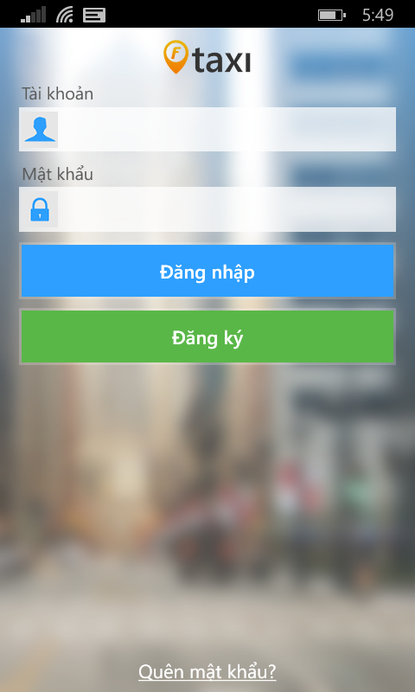
Screen design
Element | Type | Description
Tài khoản text field | Edit text | Enter Email
Mật khẩu text field | Edit text | Enter Password
Đăng nhập | Button | Tap button for logging in application
Đăng ký | Button | Tap button for register new rider
Quên mật khẩu | Label | Tap label for showing forget password screen

Slide 30
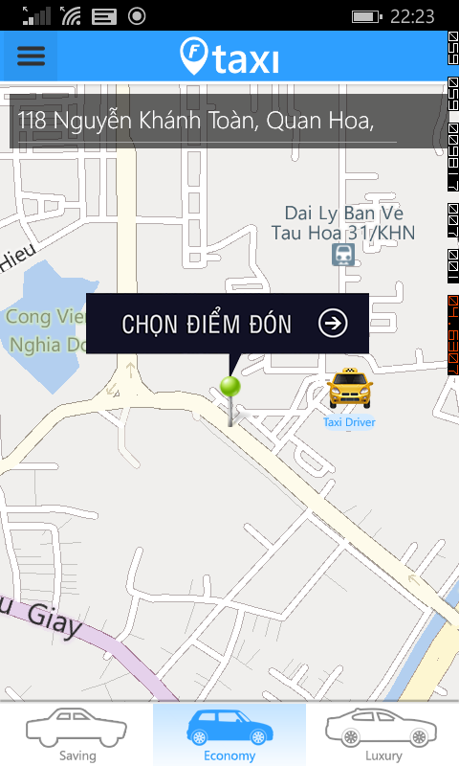
Screen design
Element | Type | Description
Map | Map | Show map
Taxi Image | Button | Clickable button for show Trip bar
Chọn điểm đón | Button | Clickable button for choose pick up position
Menu | Menu | Show left menu
Địa chỉ đón text field | Edit Text | Text field to enter keyword to search
My position | Image | Show current user position
Marker | Image | Always on middle of screen for user choose pick up position
Taxi icon | Button | Clickable button for show kind of taxi

Slide 31
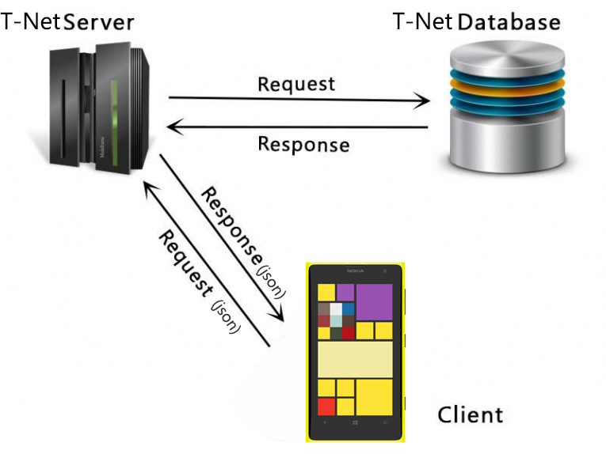
Web service

Slide 32
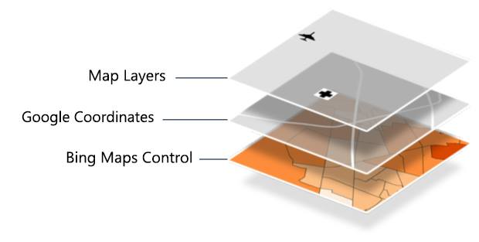
Maps

Slide 33
6. Testing
Test Model
Test Report
Test Case
Bug List

Slide 34
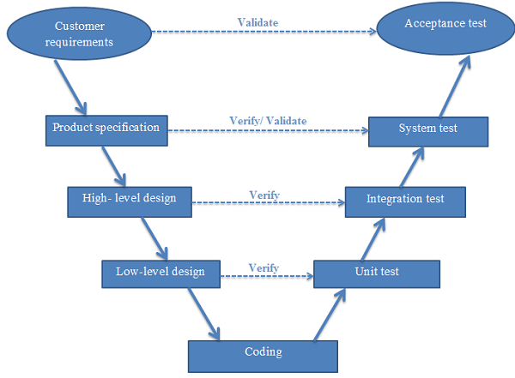
Test model
V-Model

Slide 35
Test Case
Module Code | Login
Test requirement
Tester | HuuPG
ID | Test Case Description | Test Case Procedure | Expected Output | Inter-test case Dependence | Result1 | Result2 | Test date | Note
 | Login as Rider
[Login-1] | Login successfully | 1. Input valid email and password 2. Tap on button "Đăng nhập" | 2. Move to Rider Homepage screen |  | Fail | Pass | 28/11
[Login-2] | Check format of email | 1. Input invalid format of email 2. Tap on button "Đăng Nhập" | 2. Show error message "Email không hợp lệ" |  | Fail | Pass | 28/11
[Login-3] | Check email is blank | 1. Let email is blank 2. Input password 3. Tap on button "Đăng Nhập" | 3. Show error message "Mời bạn nhập email" |  | Fail | Pass | 28/11
[Login-4] | Check password is blank | 1. Input valid email 2. Let password is blank 3. Tap on button "Đăng Nhập" | 3. Show error message "Mời bạn nhập password" |  | Pass | Pass | 28/11
[Login-5] | Check email is invalid | 1. Input invalid email 2. Input valid password 3. Tap on button "Đăng Nhập" | 3. Show error message "Tài khoản không đúng" |  | Fail | Pass | 28/11
[Login-6] | Check password is invalid | 1. Input valid email 2. Input invalid password 3. Tap on button "Đăng Nhập" | 3. Show error message "Mật khẩu không đúng" |  | Pass | Pass | 28/11

Slide 36
Test Report
No | Module code | Pass | Fail | Untested | N/A | Number of test cases
1 | GUI | 78 | 8 | 0 | 0 | 41
2 | Log in | 24 | 0 | 0 | 0 | 12
3 | Log out | 2 | 0 | 0 | 0 | 1
4 | Account management | 47 | 3 | 0 | 0 | 25
5 | Rider actions | 53 | 7 | 0 | 0 | 30
6 | Driver actions | 20 | 4 | 0 | 0 | 30
7 | Conflict | 20 | 0 | 0 | 0 | 22
 | Sub total | 244 | 22 | 0 | 0 | 161
 | Test coverage |  | 82.61 | %
 | Test successful coverage |  | 75.78 | %

Slide 37
Lesson Learned
Understand and able to create a Windows Phone application.
Had more experience about teamwork and solve member problem.
Earn knowledge about FSOFT process and able to use some FSOFT document.
Improve organization and planning skill.

Slide 38


Slide 39


Slide 40


