Slide 1

Capstone Project
Taxi Caller Application on Windows Phone
Pham Gia Huu – SE02705
Nguyen Van Lap – SE02314
Ta Thien Huong – SE02900
Pham Ngoc Hoan – SE2268
Supervisor : Nguyen Van Sang

Slide 2
Presentation outlines
Project Overview
Project Management
Requirement Specification
Software Design
Web service
Testing
Lesson Learned
Demo
Q&A

Slide 3
1. Project overview
Current situation
Nowadays number of people are using smart phone with Windows Phone OS increase, especially in Vietnam.
There is no application which directly connect between taxi driver from original taxi company and customer.
Taxi driver drive spin around, wrong way and wrong calculation charges.
Demand for using taxi is increase too.

Slide 4
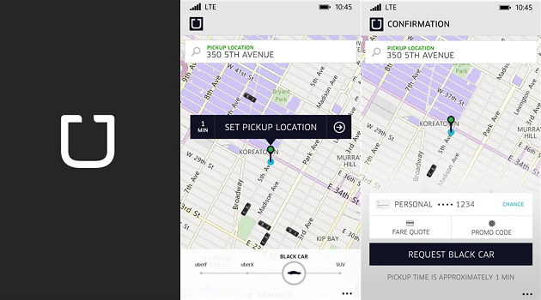
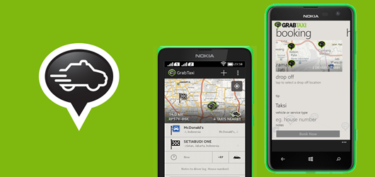
Current Application
Uber
GrabTaxi

Slide 5
Idea
Support Vietnamese for Vietnamese people.
Help people using windows phone and taxi driver can communicate better

Slide 6
Objectives and Goals
Fulfill requirements from FPT University.
Develop a product that expressed the above ideas.
Study how to develop application on Windows Phone OS.
Apply software development process for this project.
Have skills in communication, time management, risks management etc.
Notes:
Thực hiện đầy đủ các yêu cầu của Trường Đại học FPT.
Phát triển một sản phẩm mà thể hiện các ý tưởng trên.
Nghiên cứu làm thế nào để phát triển các ứng dụng trên hệ điều hành Windows Phone.
Áp dụng quy trình phát triển phần mềm cho dự án này.
Có kỹ năng giao tiếp, quản lý thời gian, quản lý rủi ro, vv

Slide 7
2. Project Management
Software Process Model
Software Project Plan
Equipment and Tools
Communication Management
Risk Management
Notes:
Mô hình phát triển phần mềm
Kế hoạch quản lý dự án
Công cụ, thiết bị để làm dự án
Quản lý sự liên lạc giữa các thành viên trong nhóm
Quản lý rủi ro

Slide 8
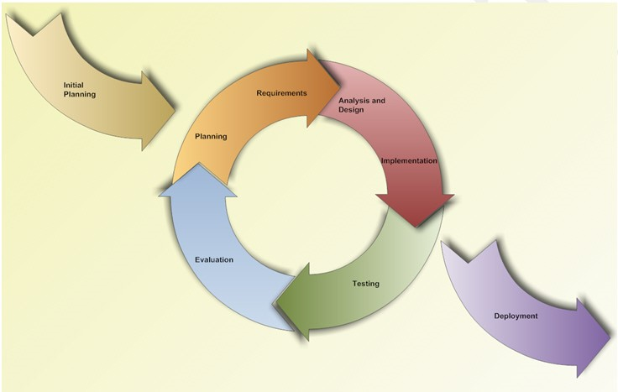
Software process model
Iterative and Incremental Software Process Model
Notes:
Chưa có kinh nghiệm phần mềm, lần đầu tiên làm một phần mềm, mô hình giúp giảm thiểu công sức, có các thay đổi của requirement. Khi có vấn đề khó khan xảy ra thì se nhận ra được sau mỗi interation
Học hỏi và phát triển phần mềm theo từng interation, vẫn dụng những điều đã học để cải thiện ứng dung tốt hơn
Dễ dàng để quản lý rủi ro và kiểm thử phần mêm trong từng 1 interation

Slide 9
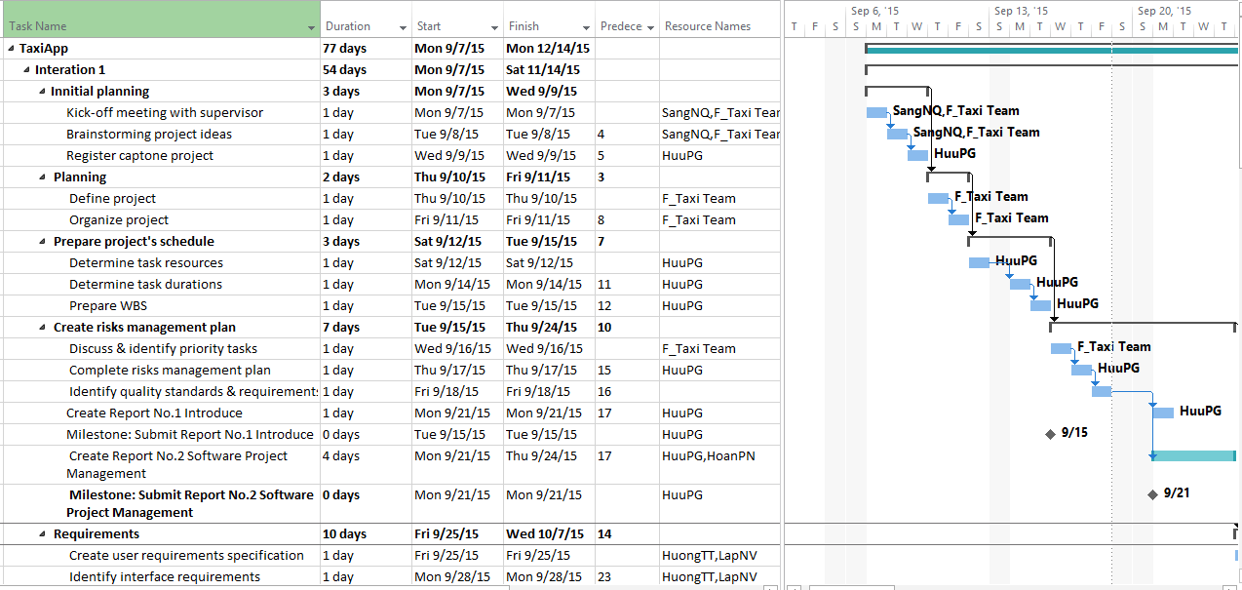
Project Plan

Slide 10









Equipment's and tools
Microsoft Office
Photoshop
TortoiseGIT
Visual Studio
Postman
Notes:
Postman là một ứng dụng Chrome. giúp kiểm tra input , output API.

Slide 11




Communication Management

Slide 12
Risk Management
ID | Risk Content | Probability | Effect | Solution
# | People Risks
1 | Team member may not follow deadlines. | HIGH | SERIOUS | Find out reasons Depending on circumstances, may set penalty rule.
2 | Team members are sick, cannot complete task under deadline. | HIGH | SERIOUS | Increase project team’s working effort in “peace period”. Allow all team members clear about what others do, so that they can cover the tasks when necessary.
3 | Conflict between team members. | HIGH | SERIOUS | Setup an open-talk environment in project team. “Do not criticize” is set as a rule. Organize team-building more often. In some cases, manager must use his power to make decisions.
4 | New technology is hard to apply for project | HIGH | SERIOUS | List tasks and check continuously. Evaluate quality and progress weekly. Send email to other member or supervisor to ask for help.
5 | Problems in communication breakdown makes changing time, work and delay plan | HIGH | SERIOUS | We need using words more clearly, improve our communication skills Using note and email to confirm information.
Notes:
Quản lý rủi ro : people risk, process risk, technical risk, requirement risk, management risk

Slide 13
3. Requirement specification
System Overview
Non-functional Requirement
Functional Requirement

Slide 14
System overview

Slide 15
Functional requirement

Slide 16
Functional requirement

Slide 17
Functional requirement

Slide 18
Functional requirement

Slide 19
Functional requirement

Slide 20
Functional requirement

Slide 21
Functional requirement

Slide 22
Functional requirement

Slide 23
Functional requirement

Slide 24
Non-Functional requirement
Performance
Time for loading content is 3-5 seconds depend on speed of internet.
Time to process function will not exceed 7 seconds.
Usability
User can easily take a trip in few tap on screen.
Support Vietnamese for user can easy understand.
Availability
Application must be available 95% of time.
Users can access to application everywhere from windows mobile device with internet connection.

Slide 25
4. Software design
Application Architecture Design
Screen Design
Sequence Diagram

Slide 26
Application Architecture design
Three Layered Architecture

Slide 27
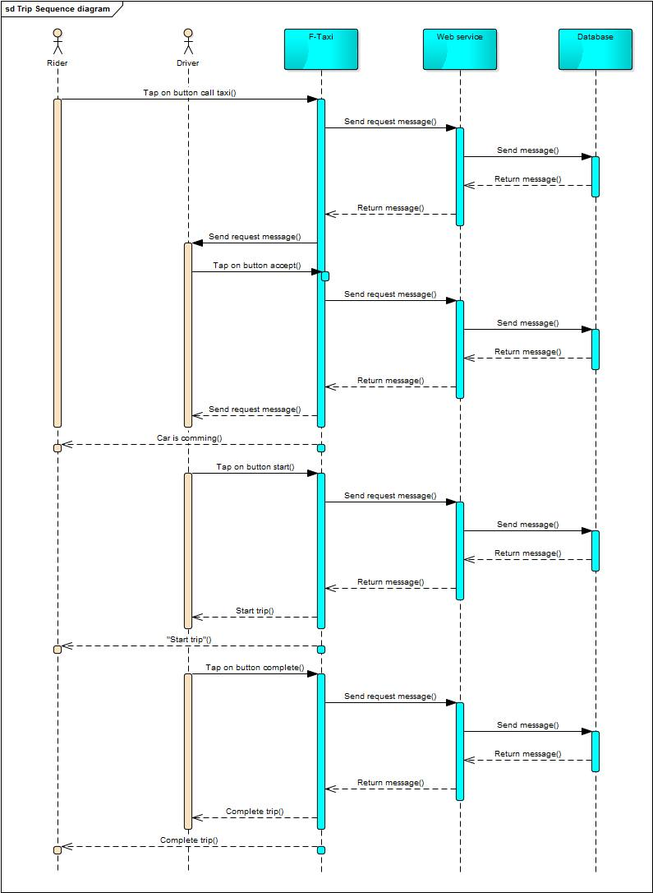
Sequence diagram

Slide 28
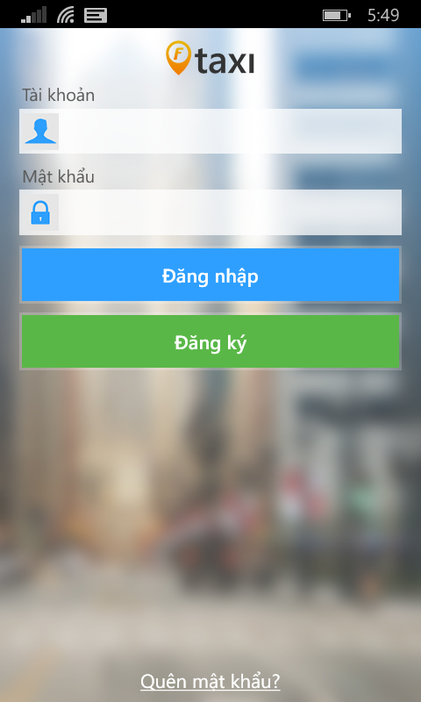
Screen design
Element | Type | Description
Tài khoản text field | Edit text | Enter Email
Mật khẩu text field | Edit text | Enter Password
Đăng nhập | Button | Tap button for logging in application
Đăng ký | Button | Tap button for register new rider
Quên mật khẩu | Label | Tap label for showing forget password screen

Slide 29
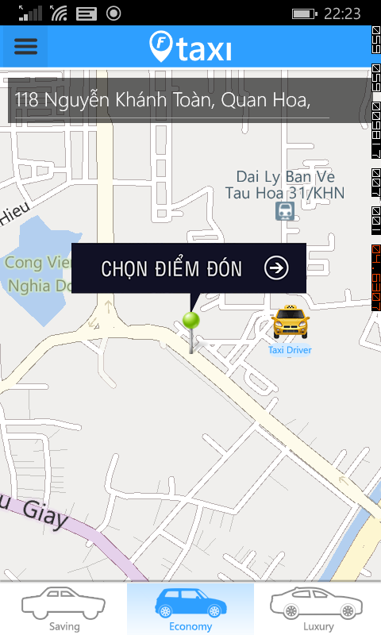
Screen design
Element | Type | Description
Map | Map | Show map
Taxi Image | Button | Clickable button for show Trip bar
Chọn điểm đón | Button | Clickable button for choose pick up position
Menu | Menu | Show left menu
Địa chỉ đón text field | Edit Text | Text field to enter keyword to search
My position | Image | Show current user position
Marker | Image | Always on middle of screen for user choose pick up position
Taxi icon | Button | Clickable button for show kind of taxi

Slide 30
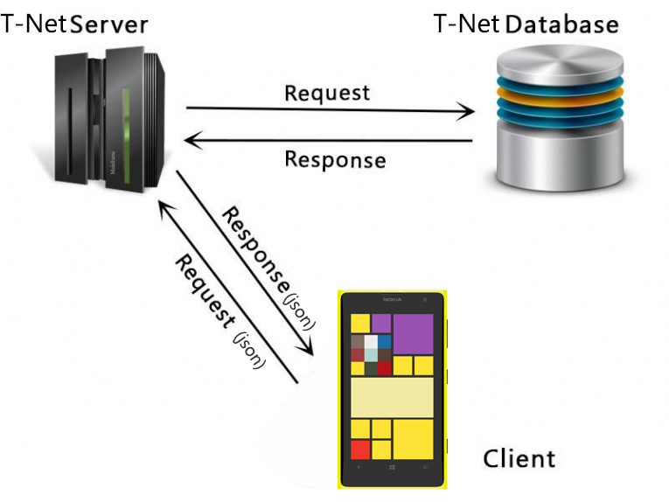
Web service

Slide 31
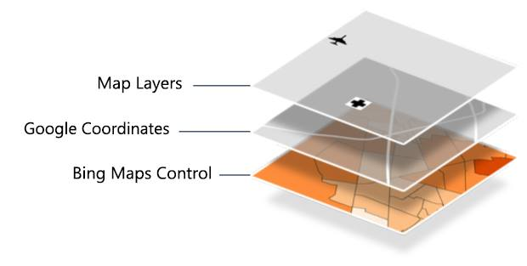
Maps

Slide 32
6. Testing
Test Model
Test Report
Test Case
Bug List

Slide 33
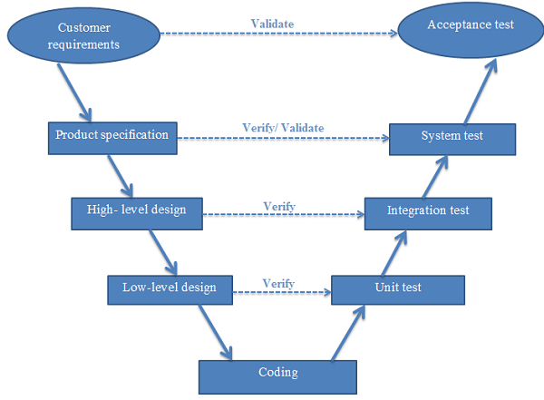
Test model
V-Model

Slide 34
Test Case
Module Code | Login
Test requirement
Tester | HuuPG
ID | Test Case Description | Test Case Procedure | Expected Output | Inter-test case Dependence | Result1 | Result2 | Test date | Note
 | Login as Rider
[Login-1] | Login successfully | 1. Input valid email and password 2. Tap on button "Đăng nhập" | 2. Move to Rider Homepage screen |  | Fail | Pass | 28/11
[Login-2] | Check format of email | 1. Input invalid format of email 2. Tap on button "Đăng Nhập" | 2. Show error message "Email không hợp lệ" |  | Fail | Pass | 28/11
[Login-3] | Check email is blank | 1. Let email is blank 2. Input password 3. Tap on button "Đăng Nhập" | 3. Show error message "Mời bạn nhập email" |  | Fail | Pass | 28/11
[Login-4] | Check password is blank | 1. Input valid email 2. Let password is blank 3. Tap on button "Đăng Nhập" | 3. Show error message "Mời bạn nhập password" |  | Pass | Pass | 28/11
[Login-5] | Check email is invalid | 1. Input invalid email 2. Input valid password 3. Tap on button "Đăng Nhập" | 3. Show error message "Tài khoản không đúng" |  | Fail | Pass | 28/11
[Login-6] | Check password is invalid | 1. Input valid email 2. Input invalid password 3. Tap on button "Đăng Nhập" | 3. Show error message "Mật khẩu không đúng" |  | Pass | Pass | 28/11

Slide 35
Test Report
No | Module code | Pass | Fail | Untested | N/A | Number of test cases
1 | GUI | 78 | 8 | 0 | 0 | 41
2 | Log in | 24 | 0 | 0 | 0 | 12
3 | Log out | 2 | 0 | 0 | 0 | 1
4 | Account management | 47 | 3 | 0 | 0 | 25
5 | Rider actions | 53 | 7 | 0 | 0 | 30
6 | Driver actions | 20 | 4 | 0 | 0 | 30
7 | Conflict | 20 | 0 | 0 | 0 | 22
 | Sub total | 244 | 22 | 0 | 0 | 161
 | Test coverage |  | 82.61 | %
 | Test successful coverage |  | 75.78 | %

Slide 36
Lesson Learned
Understand and able to create a Windows Phone application.
Had more experience about teamwork and solve member problem.
Earn knowledge about FSOFT process and able to use some FSOFT document.
Improve organization and planning skill.

Slide 37


Slide 38


Slide 39


