Slide 1

Capstone Project
Taxi Caller Application on Windows Phone

Slide 2
Presentation outlines
Project Overview
Project Management
Requirement Specification
Software Design
Coding
Testing
Lesson Learned
Demo
Q&A

Slide 3
1. Project overview
Current situation
Nowadays number of people are using smart phone with Windows Phone OS increase, especially in Vietnam.
There is no application which directly connect between taxi driver from original taxi company and customer.
Taxi driver drive spin around, wrong way and wrong calculation charges.
Demand for using taxi is increase too.

Slide 4
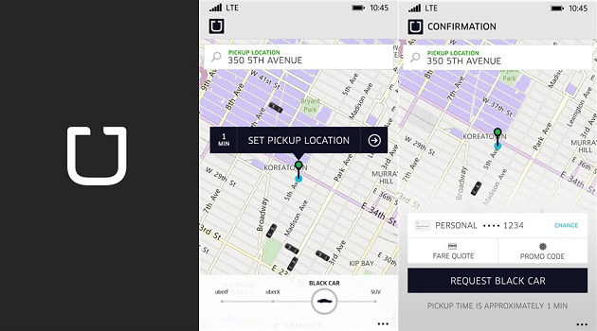
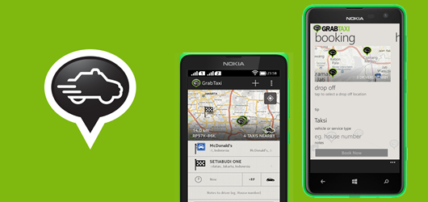
Current Application Limitation
Uber
GrabTaxi
Easy to use but only English supported.
No supported for a long time, user comment.

Slide 5
Idea
Support Vietnamese for Vietnamese people.
Have good features from current application.
High performance with device and easy to use
Help people using windows phone and taxi driver can communicate better

Slide 6
Objectives and Goals
Fulfill requirements from FPT University.
Develop a product that expressed the above ideas.
Study how to develop application on Windows Phone OS.
Apply software development process for this project.
Have skills in communication, time management, risks management etc.

Slide 7
2. Project Management
Software Process Model
Software Project Plan
Project Organization
Equipment and Tools
Communication Management
Risk Management

Slide 8
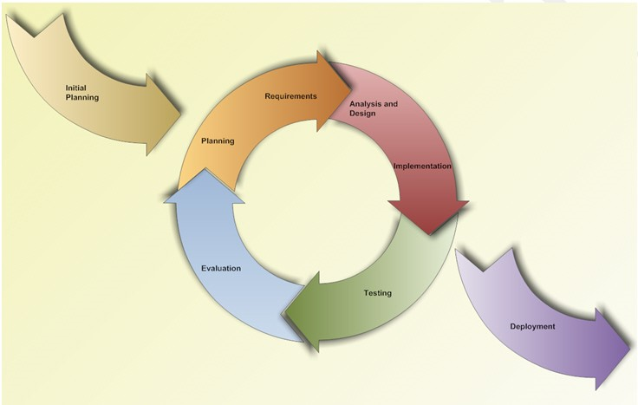
Software process model
Iterative and Incremental Software Process Model

Slide 9
Why this model was chosen
We can learn from time to time during our process, and use anything we learned to improve the product.
Through every iteration, we are able to control scope and requirements, flexibly update or even change anything if we think it will help us to have a better product.
Customers can respond after each build of the product.
It is easy to manage risks by dividing into many pieces and solve it as quick as possible in each iteration.
It is also easy to test and debug during a smaller iteration.

Slide 10
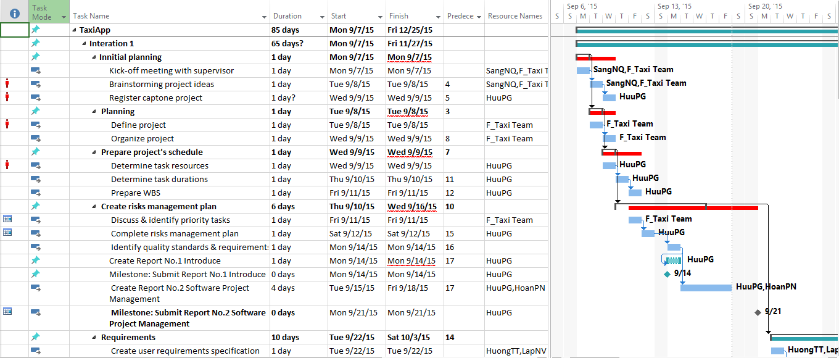
Project Plan

Slide 11
Project Organization
Project Manger
Pham Gia Huu
Member
Nguyen Van Lap
Member
Ta Thien Huong
Member
Pham Ngoc Hoan
Supervisor
Nguyen Van Sang

Slide 12









Equipment's and tools
Microsoft Office
Photoshop
TortoiseGIT
Visual Studio
Postman

Slide 13




Communication Management

Slide 14
Risk Management
ID | Risk Content | Probability | Effect | Solution
# | People Risks
1 | Team member may not follow deadlines. | HIGH | SERIOUS | Find out reasons Depending on circumstances, may set penalty rule.
2 | Team members are sick, cannot complete task under deadline. | HIGH | SERIOUS | Increase project team’s working effort in “peace period”. Allow all team members clear about what others do, so that they can cover the tasks when necessary.
3 | Conflict between team members. | HIGH | SERIOUS | Setup an open-talk environment in project team. “Do not criticize” is set as a rule. Organize team-building more often. In some cases, manager must use his power to make decisions.
4 | New technology is hard to apply for project | HIGH | SERIOUS | List tasks and check continuously. Evaluate quality and progress weekly. Send email to other member or supervisor to ask for help.
5 | Problems in communication breakdown makes changing time, work and delay plan | HIGH | SERIOUS | We need using words more clearly, improve our communication skills Using note and email to confirm information.

Slide 15
3. Requirement specification
System Overview
Non-functional Requirement
Functional Requirement

Slide 16
System overview

Slide 17
Functional requirement

Slide 18
Functional requirement

Slide 19
Functional requirement

Slide 20
Functional requirement

Slide 21
Functional requirement

Slide 22
Functional requirement

Slide 23
Functional requirement

Slide 24
Functional requirement

Slide 25
Functional requirement

Slide 26
Functional requirement

Slide 27
Functional requirement

Slide 28
Non-Functional requirement
Performance
Time for loading content is 3-5 seconds depend on speed of internet.
Time to process function will not exceed 7 seconds.
Usability
User can easily take a trip in few tap on screen.
Support Vietnamese for user can easy understand.
Availability
Application must be available 95% of time.
Users can access to application everywhere from windows mobile device with internet connection.

Slide 29
4. Software design
Application Architecture Design
Screen Design
Sequence Diagram

Slide 30
Application Architecture design
Three Layered Architecture

Slide 31
Sequence diagram

Slide 32
Screen design
Element | Type | Description
F-Taxi | Image | Logo F-Taxi
Tài khoản text field | Edit text | Enter Email
Mật khẩu text field | Edit text | Enter Password
Đăng nhập | Button | Tap button for logging in application
Đăng ký | Button | Tap button for register screen
Quên mật khẩu | Label | Tap label for showing forget password screen

Slide 33
Screen design
Element | Type | Description
Email text field | Edit text | Enter Email
Mật khẩu text field | Edit text | Enter Password
Nhập lại mật khẩu text field | Edit text | Enter Confirm Password
Tên text field | Edit text | Enter Last Name
Họ text field | Edit text | Enter First and Middle Name
Số điện thoại text file | Edit text | Enter Phone Number
Đăng ký | Button | Register new user as Rider

Slide 34
Screen design
Element | Type | Description
Map | Map | Show map
Taxi Image | Button | Clickable button for show Trip bar
Chọn điểm đón | Button | Clickable button for choose pick up position
Menu | Menu | Show left menu
Địa chỉ đón text field | Edit Text | Text field to enter keyword to search
Marker | Image | Always on middle of screen for user choose pick up position
My position | Image | Show current user position
Taxi icon | Button | Clickable button for show kind of taxi

Slide 35
Screen design
Element | Type | Description
Menu | Menu | Show left menu
My position | Image | Show current user position
Map | Map | Show Map
Chuyển qua chế độ nghỉ | Button | Tap on for change driver status

Slide 36
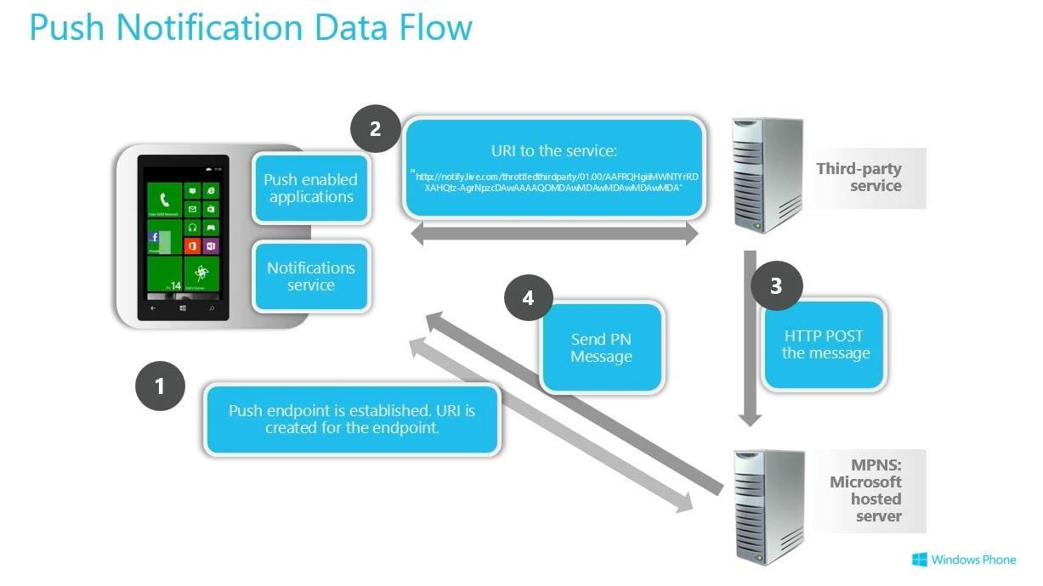
5. Coding

Slide 37
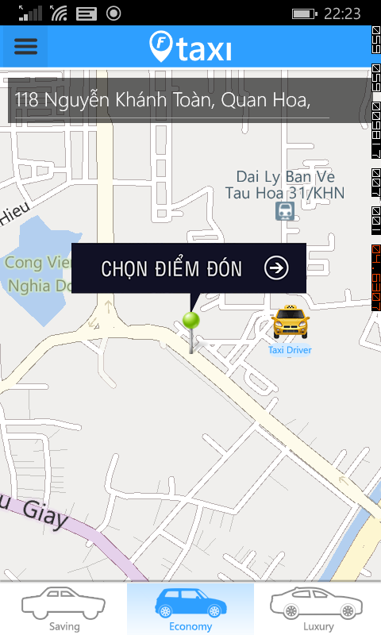
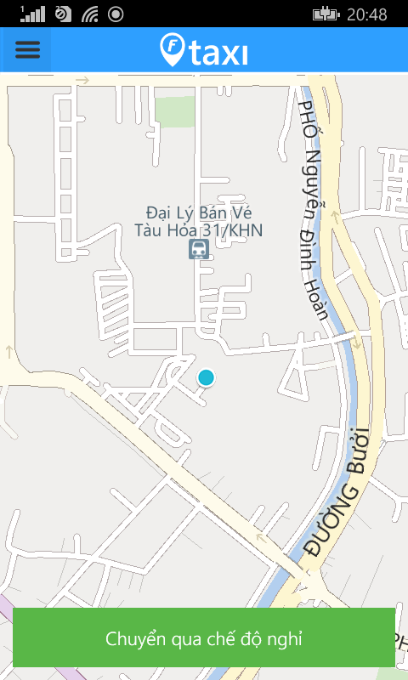
Maps controller

Slide 38
6. Testing
Test Model
Test Report
Test Case
Bug List

Slide 39
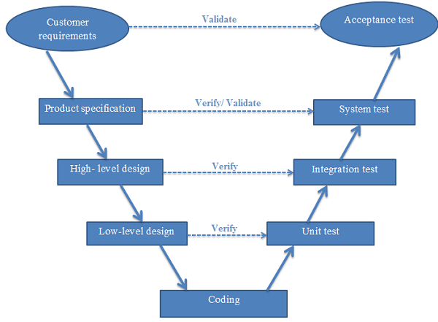
Test model
V-Model

Slide 40
Test Case
Module Code | Login
Test requirement
Tester | HuuPG
ID | Test Case Description | Test Case Procedure | Expected Output | Inter-test case Dependence | Result1 | Result2 | Test date | Note
 | Login as Rider
[Login-1] | Login successfully | 1. Input valid email and password 2. Tap on button "Đăng nhập" | 2. Move to Rider Homepage screen |  | Fail | Pass
[Login-2] | Check format of email | 1. Input invalid format of email 2. Tap on button "Đăng Nhập" | 2. Show error message "Email không hợp lệ" |  | Fail | Pass
[Login-3] | Check email is blank | 1. Let email is blank 2. Input password 3. Tap on button "Đăng Nhập" | 3. Show error message "Mời bạn nhập email" |  | Fail | Pass
[Login-4] | Check password is blank | 1. Input valid email 2. Let password is blank 3. Tap on button "Đăng Nhập" | 3. Show error message "Mời bạn nhập password" |  | Pass | Pass
[Login-5] | Check email is invalid | 1. Input invalid email 2. Input valid password 3. Tap on button "Đăng Nhập" | 3. Show error message "Tài khoản không đúng" |  | Fail | Pass
[Login-6] | Check password is invalid | 1. Input valid email 2. Input invalid password 3. Tap on button "Đăng Nhập" | 3. Show error message "Mật khẩu không đúng" |  | Pass | Pass

Slide 41
Test Case
Module Code | Register
Test requirement
Tester | HuuPG
ID | Test Case Description | Test Case Procedure | Expected Output | Inter-test case Dependence | Result1 | Result2 | Test date | Note
 | Register
[Account-1] | Register successfully | 1. Input valid data in all field. 2. Tap on "Đăng ký" button | 2. Move to Log in screen |  | Pass | Pass
[Account-2] | Check email is blank | 1. Let email is blank | 1. Show error message "Vui lòng nhập email" Name, Profile picture, Address f, Report breach area Reason textbox, “Report breach” button |  | Fail | Pass
[Account-3] | Check password is blank | 1. Let password is blank | 1. Show error message "Vui lòng nhập mật khẩu" |  | Fail | Pass
[Account-4] | Check confirm password is blank | 1. Let confirm password is blank | 1. Show error message "Vui lòng nhập mật khẩu" |  | Fail | Pass
[Account-5] | Check first name is blank | 1. Let first name is blank | 1. Show error message "Vui lòng nhập tên của bạn" |  | Pass | Pass
[Account-6] | Check last name is blank | 1. Let last name is blank | 1. Show error message "Vui lòng nhập ho của bạn" |  | Pass | Pass
[Account-7] | Check phone number is blank | 1. Let phone is blank | 1. Show error message "Vui lòng nhập số điện thoại" |  | Pass | Pass

Slide 42
Test Case
Module Code | Conflict
Test requirement
Tester | HuuPG
ID | Test Case Description | Test Case Procedure | Expected Output | Inter-test case Dependence | Result1 | Result2 | Test date | Note
 | Conflict
[Conflict-1] | While using application, calling came | Accept call then finish call | Revert to latest status of application before calling |  | Fail | Pass
[Conflict -2] |  | Reject call | Revert to latest status of application before calling |  | Fail | Pass
[Conflict -3] | While using application, message came | View message and close | Revert to latest status of application before calling |  | Fail | Pass
[Conflict -4] |  | Close message | Revert to latest status of application before calling |  | Pass | Pass
[Conflict -5] | While using application, alarm came Check password is invalid | Close alarm | Revert to latest status of application before calling |  | Fail | Pass
[Conflict -6] |  | Let alarm run until finish | Revert to latest status of application before calling |  | Pass | Pass
Module Code | Login
Test requirement
Tester | HuuPG
ID | Test Case Description | Test Case Procedure | Expected Output | Inter-test case Dependence | Result1 | Result2 | Test date | Note
 | Conflict
[Conflict-1] | While using application, calling came | Accept call then finish call | Revert to latest status of application before calling |  | Fail | Pass
[Conflict -2] |  | Reject call | Revert to latest status of application before calling |  | Fail | Pass
[Conflict -3] | While using application, message came | View message and close | Revert to latest status of application before calling |  | Fail | Pass
[Conflict -4] |  | Close message | Revert to latest status of application before calling |  | Pass | Pass
[Conflict -5] | While using application, alarm came Check password is invalid | Close alarm | Revert to latest status of application before calling |  | Fail | Pass
[Conflict -6] |  | Let alarm run until finish | Revert to latest status of application before calling |  | Pass | Pass

Slide 43
Test Report

Slide 44
Lesson Learned
Understand and able to create a Windows Phone application.
Had more experience about teamwork and solve member problem.
Earn knowledge about FSOFT process and able to use some FSOFT document.
Improve organization and planning skill.

Slide 45


Slide 46


Slide 47


