Slide 1

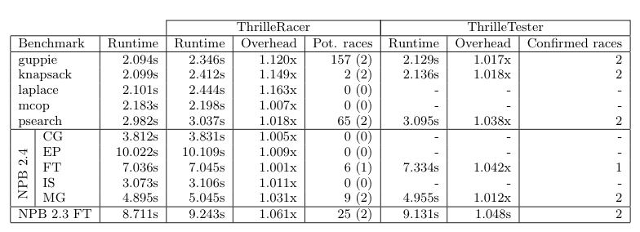
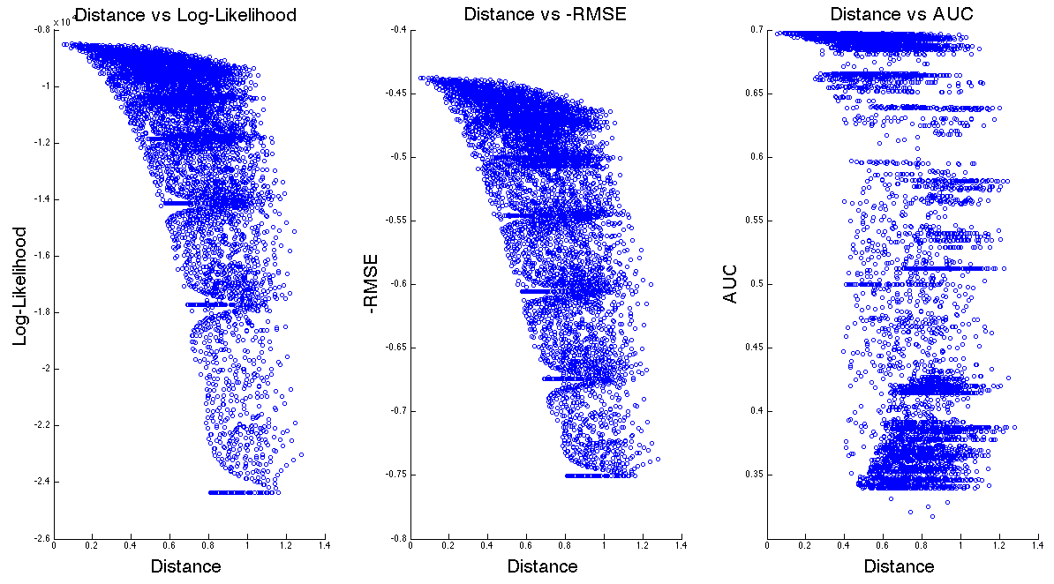
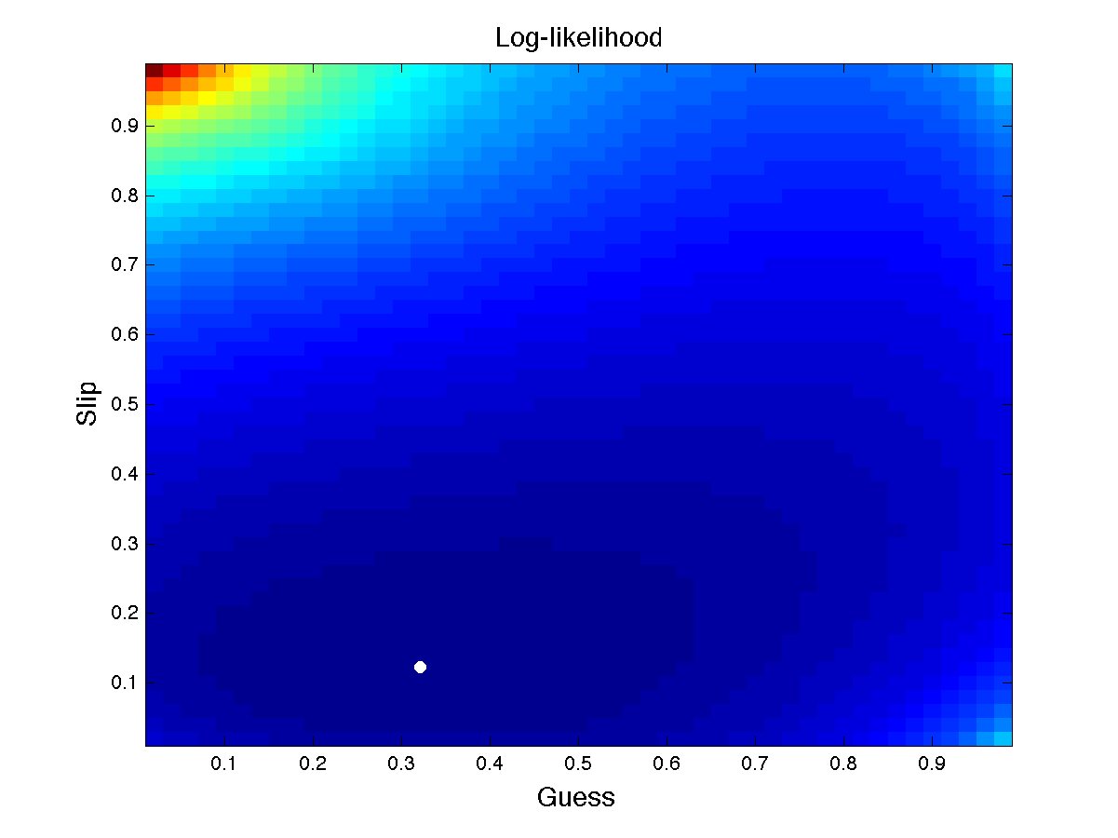
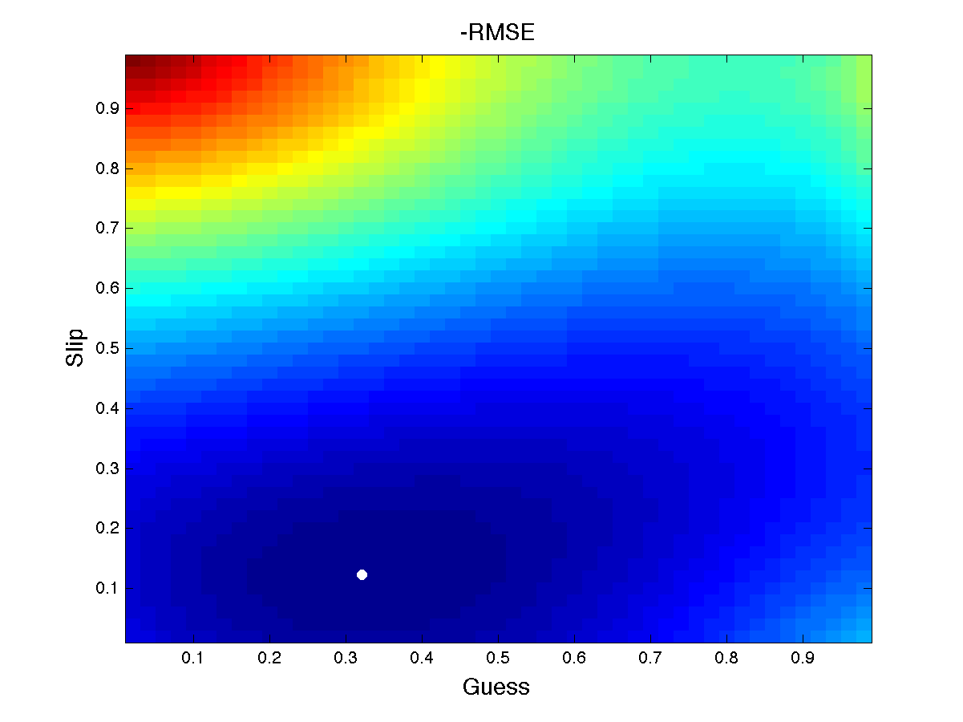
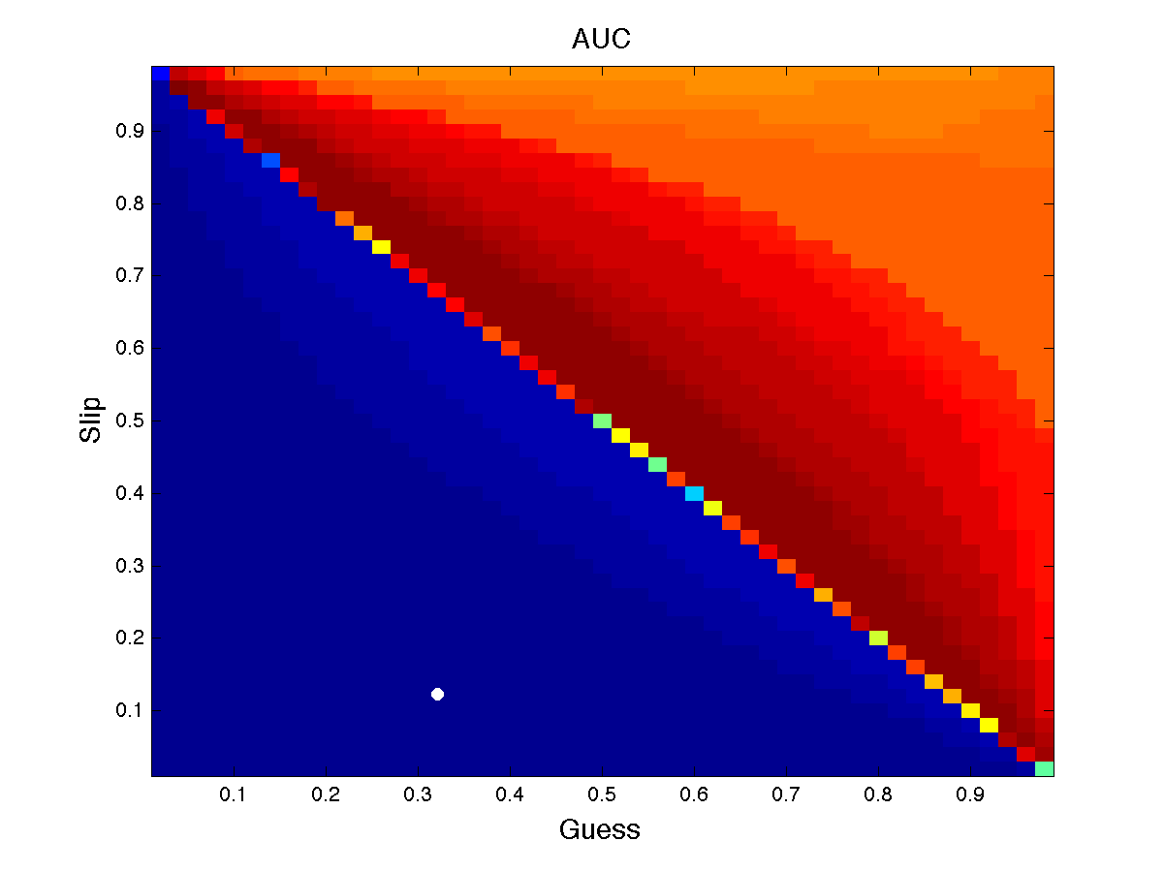
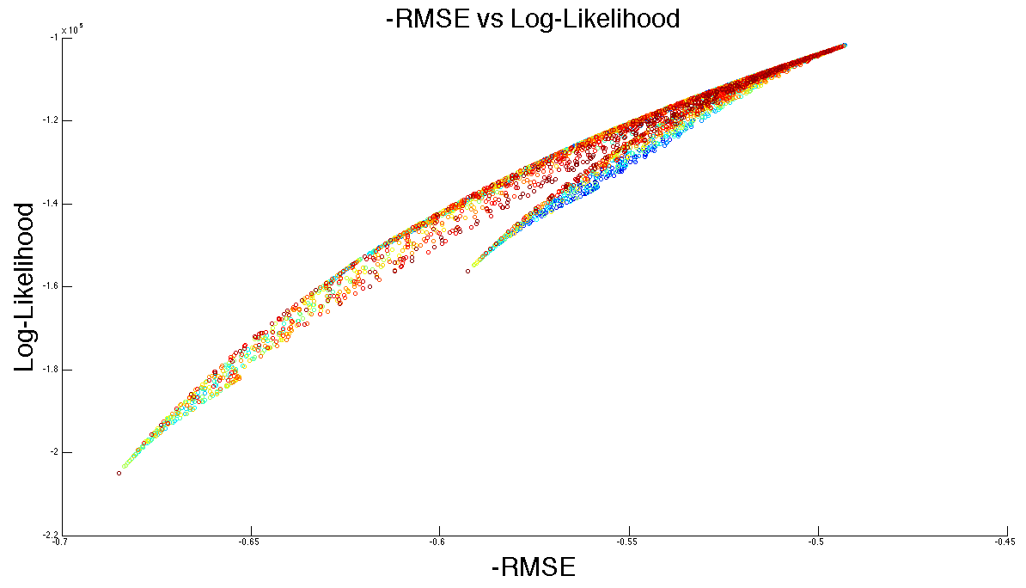
A Comparison of Error Metrics for Learning Model Parameters in Bayesian Knowledge Tracing
Berkeley Parlab
Asif Dhanani*, Seung Yeon Lee*, Phitchaya Mangpo Phothilimthana*, and Zachary Pardos
University of California, Berkeley
1. INTRODUCTION
2. CORRELATIONS TO THE GROUND TRUTH
Error metric is essential for learning model parameters: prior, learn, guess, and slip in BKT.
Common metrics are:
log-likelihood (LL)
root-mean-squared error (RMSE)
area under the ROC curve (AUC).
Pardos and Yudelson [1] compares different error metrics to investigate which one has the most accuracy of estimating the moment of learning.
Our work extends this comparison by looking closer into the relationship between three popular error metrics: LL, RMSE, and AUC, and particularly elucidating the relationship to one another closer to the ground truth point.
To assess whether LL, RMSE, or AUC is the best error metric to use in parameter searching for the BKT model, we synthesize 26 datasets to use in various experiments by simulating student responses based on diverse known ground truth parameter values.
Methodology
Values calculated by different error metrics vs distances to the ground truth
Correlation comparisons of error metrics
Evaluated LL, RMSE, and AUC values on all points over the entire prior/learn/guess/slip parameter space with a 0.05 interval.
Looked at the correlations between values calculated from error metrics (i.e. LL, RMSE, and AUC) and the euclidean distances from the points to the ground truth.
Tested whether the correlation between the values calculated by any particular error metric and the distances is significantly stronger than the others’.
Correlation Comparisons |  | Number of Datasets
RMSE vs LL | RMSE > LL | 26
 | RMSE < LL | 0
RMSE vs AUC | RMSE > AUC | 18
 | RMSE < AUC | 8
LL vs AUC | LL > AUC | 15
 | LL < AUC | 11
One-tailed paired T-test statistics
Comparison | ∆ of correlations | t | p-value
RMSE > LL | 0.0408 | 8.9900 | << 0.0001
RMSE > AUC | 0.0844 | 2.7583 | 0.0054
LL > AUC | 0.0436 | 1.4511 | 0.0796
Results
The average LL, RMSE, and AUC correlations were 0.4419, 0.4827, and 0.3983 respectively. One-tailed paired t-test revealed RMSE as statistically significantly better than both LL and AUC.
[1] Z. A. Pardos and M. V. Yudelson. Towards moment of learning accuracy. In Proceedings of the 1st AIED Workshop on Simulated Learners, 2013.
3. DISTRIBUTION OF VALUES
4. DIRECT COMPARISON: LL AND RMSE
5. CONCLUSION
Methodology
Methodology
Results
LL values and RMSE values correlate logarithmically.
A secondary curve, the “hook”, is observed in varying sizes among datasets.
When we look at a fixed LL value with varied RMSE values:
Most points in the hook have higher -RMSE values and are closer to the ground truth than do the points in the main curve.
However, this same pattern is not seen for a fixed RMSE value with varied LL values.
After the curve and hook converge, both RMSE and LL give similar estimates of the ground truth. However, for a portion of the graph before this point, RMSE is a better predictor of ground truth values.
We discovered that RMSE serves as the strongest indicator metrics for evaluating the closeness of estimated parameters to the true parameters in the BKT model.
RMSE has a significantly higher correlation to the distance from the ground truth on average than both LL and AUC, and RMSE is notably better when the estimated parameter value is not very close to the ground truth.
The effectiveness of teaching systems without human supervision relies on the ability of the systems to predict the implicit knowledge states of students. We hope that our work can help advance the parameter learning algorithms used in the knowledge tracing model, which in turn can make these teaching systems more effective.
Visualized the values of LL and -RMSE of all points over the 2 dimensional guess/slip space with a 0.02 interval while fixing prior and learn parameter values to the actual ground truth values.
Methodology
Plotted LL values vs RMSE values.
Labeled each data point by its distance to the ground truth with a color.
The range of colors is the same as used in the previous method.
Heat Maps
Red represents low values, while blue represents high values. The white dots represent the ground truth.
LL
-RMSE
AUC
LL heat map’s gredient: very high at the beginning (far from the ground truth) and very low at the end (close to the ground truth).
-RMSE heat map: the change in the gradient is low.
Additionally, the darkest blue region in -RMSE heat map is smaller than that in LL heat map. This suggests that we may be able to refine the proximity of the ground truth better with RMSE.
prior = 0.564, learn = 0.8, guess = 0.35 , and slip = 0.4
* Asif Dhanani, Seung Yeon Lee, and Phitchaya Mangpo Phothilimthana contributed equally to this work and are listed alphabetically.

