Slide 1


Portable Performance on Heterogeneous Architectures
Phitchaya Mangpo Phothilimthana
Jason Ansel
Jonathan Ragan-Kelley
Saman Amarasinghe
Computer Science and Artificial Intelligence Laboratory
Massachusetts Institute of Technology
Notes:
Heterogeneity is here. If you care about performance and energy efficiency, you will need to work with system with different specialized accelerators such as gpu. Programing on heterogeneous system is hard, but making the program portable across different systmes is even harder.

Slide 2
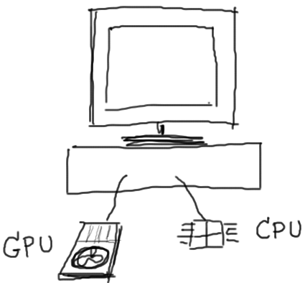


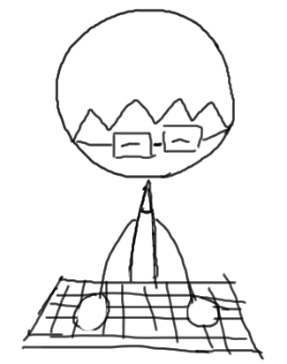

Programming on Heterogeneous Architectures …
2D Convolution
2D Convolution
Notes:
Efficient program on your machine: best mapping of program to devices, algorithms to use, type of memory
Now you get a new machine
You port all your programs there, all excited expecting that you get so much speed up.

Slide 3
Programming on Heterogeneous Architectures …
Sep Convolution
Notes:
Efficient program on your machine: best mapping of program to devices, algorithms to use, type of memory
Now you get a new machine
You port all your programs there, all excited expecting that you get so much speed up.

Slide 4
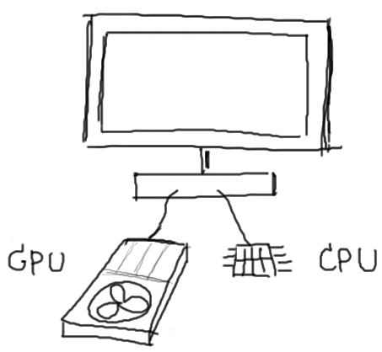

Porting to Another System …
Sep Convolution
Sep Convolution

Slide 5



Porting to Another System …
Sep Convolution
2D w/ local
scratchpad
Sep Convolution
Notes:
Transition sentence: Let make it concrete.

Slide 6
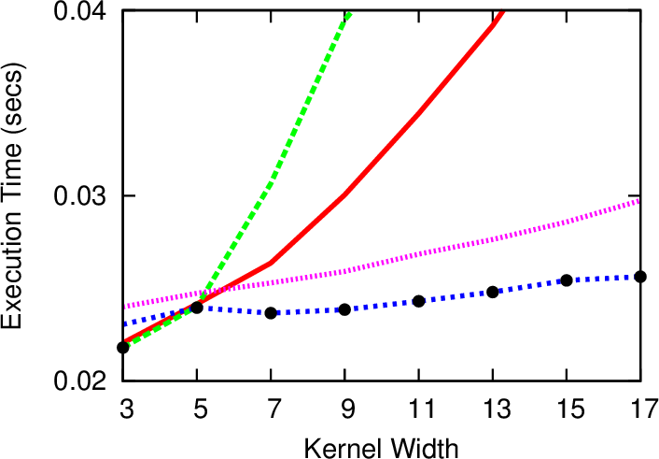
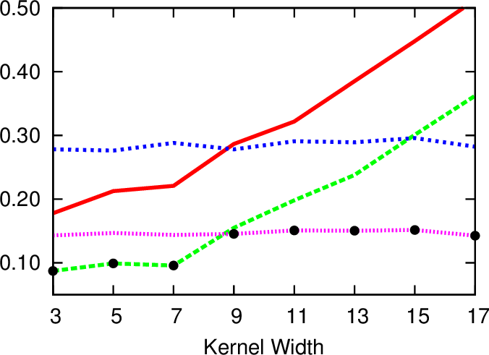
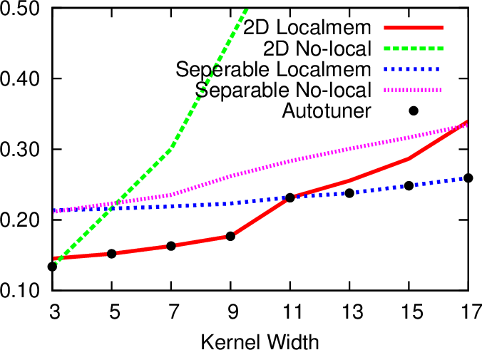
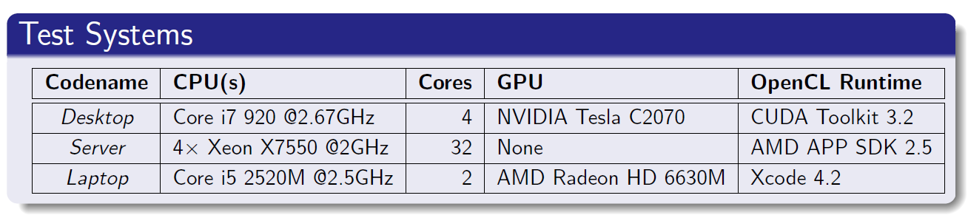
Concrete Example: Convolution
All choices are in OpenCL
Desktop
Server
Laptop
At kernel width =15
At kernel width = 7
Notes:
Intro: here is a real program on real machines.
Points:
4 lines on each figure represent 4 different implementation of convolution in opencl.
There are 2 different algorithmic choices: 1-pass 2D convolution and 2-pass separable convolution.
Each algorithm has 2 version: using global and local memory.
These graphs show the runtime vs kernel with (or think of it as a blur size of the image you do convolution on).
Transition: in practice, there are a lot more choices than what we show here.

Slide 7

Search Space is Huge and Complex …
Which devices?
Which algorithms?
Which memory?
How many threads per block?
How to divide workload?
Transfer data to a faster device or keep the computation local?
…
Notes:
When you deal with heterogeneous architectures, we deal with a huge and complex search space
Transition: you can keep on asking more and more questions.

Slide 8

Search Space is Huge and Complex …
Infeasible to find the best choice manually.
Unified model-driven analysis across tool chains is hard.
Need to build programs to automatically adapt!
Notes:
Conclusion: therefore, we need a programming model that allows users to write programs to automatically adapt across machines.

Slide 9
Portable Programming Model for Heterogeneous Architectures
Compiler that automatically converts input program into optimized code for different devices
Runtime system that schedules tasks efficiently and manages memory cleverly
Hybrid CPU work-stealing GPU work pushing model
Empirical autotuner that automatically finds the best program configuration:
Mapping of computations to devices
Types of memory to use
Workload balance among devices
Algorithms

Slide 10
PetaBricks
PetaBricks
Program
- algorithmic choices
- parellelization techniques
- data distributions - transformations - CPU/GPU choices - global/local memory - CPU-GPU workload ratio
- GPU local work size - etc.
- dependency analysis - data movement analysis
- CPU/GPU task creations - task scheduler - C++ code gen - OpenCL code gen
- etc.
- dependency analysis
- task creations
- task scheduler - C++ code gen
- etc.
Compiler
Training Information
- algorithmic choices
- parellelization techniques
- data distributions - transformations - etc.
Autotuner
C++ output
Program
Choice
Configuration
Runtime System
- CPU work-stealing model
- CPU work-stealing model
- GPU work-pushing model
- memory management
Notes:
Compiler for algorithmic choices. It can autotune for both algorithmic choices and more fine-grained parameters.

Slide 11
Compiler
Notes:
It is best to explain the language using an example.

Slide 12
Algorithmic Choices of Convolution
2D Convolution
k₁k₁ | k₁k₂ | k₁k₃
k₂k₁ | k₂k₂ | k₂k₃
k₃k₁ | k₃k₁ | k₃k₁
k₁ | k₂ | k₃
1D kernel
2D kernel
k₁k₁ | k₁k₂ | k₁k₃
k₂k₁ | k₂k₂ | k₂k₃
k₃k₁ | k₃k₁ | k₃k₁
k₁k₁ | k₁k₂ | k₁k₃
k₂k₁ | k₂k₂ | k₂k₃
k₃k₁ | k₃k₁ | k₃k₁
k₁k₁ | k₁k₂ | k₁k₃
k₂k₁ | k₂k₂ | k₂k₃
k₃k₁ | k₃k₁ | k₃k₁
k₁k₁ | k₁k₂ | k₁k₃
k₂k₁ | k₂k₂ | k₂k₃
k₃k₁ | k₃k₁ | k₃k₁
output
input
Notes:
We have seen that there 2 common ways to do convolution.

Slide 13
Algorithmic Choices of Convolution
2D Convolution
Separable Convolution
Convolve Row
k₁ | k₂ | k₃
k₁ | k₂ | k₃
k₁k₁ | k₁k₂ | k₁k₃
k₂k₁ | k₂k₂ | k₂k₃
k₃k₁ | k₃k₁ | k₃k₁
k₁ | k₂ | k₃
k₁ | k₂ | k₃
1D kernel
2D kernel
input
intermediate
Convolve Column
k1
k₂
k₃
k1
k₂
k₃
k1
k₂
k₃
output
input
output
intermediate
Notes:
Transition: we can represent this algorithmic choices in the existing petabricks language like this.

Slide 14
Language [PLDI’09]
transform SeparableConvolution
from In[w, h], Kernel[KWIDTH]
to Out[w - KWIDTH+1, h - KWIDTH+1]
{
// Choice 1: single pass 2D convolution
to(Out out) from(In in, Kernel kernel) {
Convolve2D(out, in, kernel);
}
// Choice 2: two pass separable convolution
to(Out out) from(In in, Kernel kernel)
using(buffer[w - KWIDTH+1, h]) {
ConvolveRows(buffer, in, kernel);
ConvolveColumns(out, buffer, kernel);
}
}
Notes:
Convolution transform can convolves by using one of these 2 choices.
first rule maps from In to Out in a single pass, by directly applying the another transform Convolve2D.
Choice 2 maps in two passes, by first calling ConvolveRows, and then ConvolveColumns transform.
transition: In order to generate opencl code automatically.

Slide 15
Automatic OpenCL Code Generation
STEP 1: dependency analysis
Allow sequential dependency and data parallel dependency patterns, and reject complex data dependency
STEP 2: syntactic conversion
Rewrite data accesses to GPU global memory
STEP 3: GPU local memory utilization
When there is stencil computation pattern, GPU local memory version kernel is generated.
Phase 1: work-items cooperate to load data into local memory that will be accessed by the work-group they belong to
Phase 2: actual computation derived from the basic version by replacing global memory accesses with local memory accesses
Notes:
We perform data dependency analysis and syntactic conversion to OpenCL using just GPU global mem
Step 3: we generate another version OpenCL code with GPU local memory if it has stencil computation pattern.

Slide 16
Scheduling Choices: Convolution
Schedule 1:
Convolve2D();
Schedule 2:
Convolve2D_opencl();
Schedule 3:
ConvolveRows();
ConvolveColumns();
Schedule 4:
ConvolveRows ();
ConvolveColumns_opencl();
Schedule 5:
ConvolveRows_opencl();
ConvolveColumns();
Schedule 6:
ConvolveRows_opencl();
ConvolveColumns_opencl();
Schedule 1:
Convolve2D();
Schedule 2:
ConvolveRows();
ConvolveColumns();
Before adding OpenCL
After adding OpenCL

Slide 17
Scheduling Choices: Convolution
Schedule 1:
Convolve2D();
Schedule 2:
Convolve2D_opencl();
Schedule 3:
Convolve2D_opencl_local();
Schedule 4:
ConvolveRows();
ConvolveColumns();
Schedule 5:
ConvolveRows ();
ConvolveColumns_opencl();
Schedule 6:
ConvolveRows ();
ConvolveColumns_opencl_local();
Schedule 7:
ConvolveRows_opencl();
ConvolveColumns();
Schedule 8:
ConvolveRows_opencl_local();
ConvolveColumns();
Schedule 9:
ConvolveRows_opencl();
ConvolveColumns_opencl();
Schedule 10:
ConvolveRows_opencl();
ConvolveColumns_opencl_local();
Schedule 11:
ConvolveRows_opencl_local();
ConvolveColumns_opencl();
Schedule 12:
ConvolveRows_opencl_local();
ConvolveColumns_opencl_local();
Local memory = scratchpad memory shared by all work-items (gpu threads)
in the block
Schedule 1:
Convolve2D();
Schedule 2:
Convolve2D_opencl();
Schedule 3:
ConvolveRows();
ConvolveColumns();
Schedule 4:
ConvolveRows ();
ConvolveColumns_opencl();
Schedule 5:
ConvolveRows_opencl();
ConvolveColumns();
Schedule 6:
ConvolveRows_opencl();
ConvolveColumns_opencl();
Schedule 1:
Convolve2D();
Schedule 2:
ConvolveRows();
ConvolveColumns();
Original Choices
After adding OpenCL
After adding local mem version

Slide 18
Data Movement Analysis
Goal: minimize data transfer between CPU and GPU
TRANSFORM
Input: A
Output: D, E
Task 1 (GPU)
Input: A
Output: B, C
must copy-out region B
reused region C
may copy-out region E
Task 2 (CPU)
Input: B
Output: D
Task 3 (GPU)
Input: C
Output: E
Notes:
In order to achieve good performance, minimizing data transfer is vital.
Recall schedule
Transition: we will use this information in our runtime system.

Slide 19
Runtime System

Slide 20
Runtime System
Non Runnable
Tasks
CPU Worker
CPU Worker
CPU Worker
GPU Manager
Local Task Creation
Runnable Task
Deques
Randomized Work-stealing
GPU Task Pushing
Notes:
The existing runtime system is based on work-stealing model. …
Unfortunately, this model doesn’t work with gpu because gpu requires different tasks and it has segregated mem.
Therefore, we introduce a dedicated thread for GPU management that has FIFO queue where CPU workers can push GPU tasks to the end of the queue.
Non-runnable tasks can also depend on GPU tasks.

Slide 21
GPU Tasks
Prepare tasks allocate buffers on the GPU, and update metadata for GPU execution.
Copy-in tasks copy the required input data to the GPU.
Execute tasks initiate the asynchronous execution of the kernel, perform non-blocking reads from GPU buffers.
Copy-out completion tasks check the status of the non-blocking reads called by the execute task.
Depending on the result of data movement analysis, tasks to prepare, copy-in, execute, and copy-out completion are inserted into the schedule by the compiler.
Notes:
To execute an OpenCL kernel, we need one prepare and one execute tasks. Copy-in tasks and copy-out completion tasks are inserted into the schedule according to the data movement analysis. Whether or not to copy-in something. Whether to copy-out lazily or eagerly. GPU tasks are then executed by the gpu manager that takes care of mem management.
--------------------------
Recall that one program can have multiple schedules. Different schedules consist of different tasks and the orders of execution are different. We perform data movement analysis as described earlier for each individual schedule, and GPU taks are inserted into the schdules depending on the analysis.

Slide 22
Memory Management
GPU memory is allocated and managed by the GPU management thread.
keeps a table of data stored in the GPU
releasing stale buffers
copy data back to main memory when the data is needed or flagged for eager copy-out
handle CPU-GPU data division
Optimization
Copy-in Management
If data in a copy-in task is already on GPU, change the status of the task to complete without actually executing the task.
Otherwise, it will perform the required copy.
Copy-out Management
One buffer for one output matrix.
Multiple rules may write to the same buffer.
Notes:
That handles book keeping task such as …
and dynamic optimization
Transition: to get an even better performance we need …

Slide 23
CPU-GPU Workload Balancing
CPU/GPU ratio parameter statically defines how much of the data should be computed on each device.
Program
Program

Slide 24
Autotuner
Notes:
When we put everything together, we end up with many choices, and here is when the autotuner comes in. First, let’s look at all the choices we have.

Slide 25
GPU Choice Representation
Schedule 1:
Convolve2D();
Schedule 2:
Convolve2D_opencl();
Schedule 3:
Convolve2D_opencl_local();
Schedule 4:
ConvolveRows();
ConvolveColumns();
Schedule 5:
ConvolveRows ();
ConvolveColumns_opencl();
Schedule 6:
ConvolveRows ();
ConvolveColumns_opencl_local();
Schedule 7:
ConvolveRows_opencl();
ConvolveColumns();
Schedule 8:
ConvolveRows_opencl_local();
ConvolveColumns();
Schedule 9:
ConvolveRows_opencl();
ConvolveColumns_opencl();
Schedule 10:
ConvolveRows_opencl();
ConvolveColumns_opencl_local();
Schedule 11:
ConvolveRows_opencl_local();
ConvolveColumns_opencl();
Schedule 12:
ConvolveRows_opencl_local();
ConvolveColumns_opencl_local();
TYPE 1: decision of if and when to use GPU
possible to use GPU for some input sizes and not others
possible to have poly-algorithms that run some parts of computation on GPU and others on CPU
TYPE 2: global or local memory
TYPE 3: number of work-items in work-groups (local work size)
different for different OpenCL kernels
TYPE 4: GPU-CPU workload ratio
Different for each transforms
range from 1/8 to 8/8

Slide 26
GPU Choice Representation
Schedule 1:
Convolve2D();
Schedule 2:
Convolve2D_opencl();
Schedule 3:
Convolve2D_opencl_local();
Schedule 4:
ConvolveRows();
ConvolveColumns();
Schedule 5:
ConvolveRows ();
ConvolveColumns_opencl();
Schedule 6:
ConvolveRows ();
ConvolveColumns_opencl_local();
Schedule 7:
ConvolveRows_opencl();
ConvolveColumns();
Schedule 8:
ConvolveRows_opencl_local();
ConvolveColumns();
Schedule 9:
ConvolveRows_opencl();
ConvolveColumns_opencl();
Schedule 10:
ConvolveRows_opencl();
ConvolveColumns_opencl_local();
Schedule 11:
ConvolveRows_opencl_local();
ConvolveColumns_opencl();
Schedule 12:
ConvolveRows_opencl_local();
ConvolveColumns_opencl_local();
Local Work Size
GPU-CPU Ratio
1/8
2/8
4
3/8
9
…
16
8/8
25

Slide 27
GPU Choice Representation
Schedule 1:
Convolve2D();
Schedule 2:
Convolve2D_opencl();
Schedule 3:
Convolve2D_opencl_local();
Schedule 4:
ConvolveRows();
ConvolveColumns();
Schedule 5:
ConvolveRows ();
ConvolveColumns_opencl();
Schedule 6:
ConvolveRows ();
ConvolveColumns_opencl_local();
Schedule 7:
ConvolveRows_opencl();
ConvolveColumns();
Schedule 8:
ConvolveRows_opencl_local();
ConvolveColumns();
Schedule 9:
ConvolveRows_opencl();
ConvolveColumns_opencl();
Schedule 10:
ConvolveRows_opencl();
ConvolveColumns_opencl_local();
Schedule 11:
ConvolveRows_opencl_local();
ConvolveColumns_opencl();
Schedule 12:
ConvolveRows_opencl_local();
ConvolveColumns_opencl_local();
Local Work Size
GPU-CPU Ratio
Other Parameters …
…
1/8
2/8
4
3/8
…
9
…
…
16
8/8
25
…
Big Search Space!
up to 10¹⁰⁴⁰ choices
…
Bottem-up evolutionary algorithm [GECCO’11]
Notes:
Emphasize that autotuner

Slide 28
Experimental Results

Slide 29
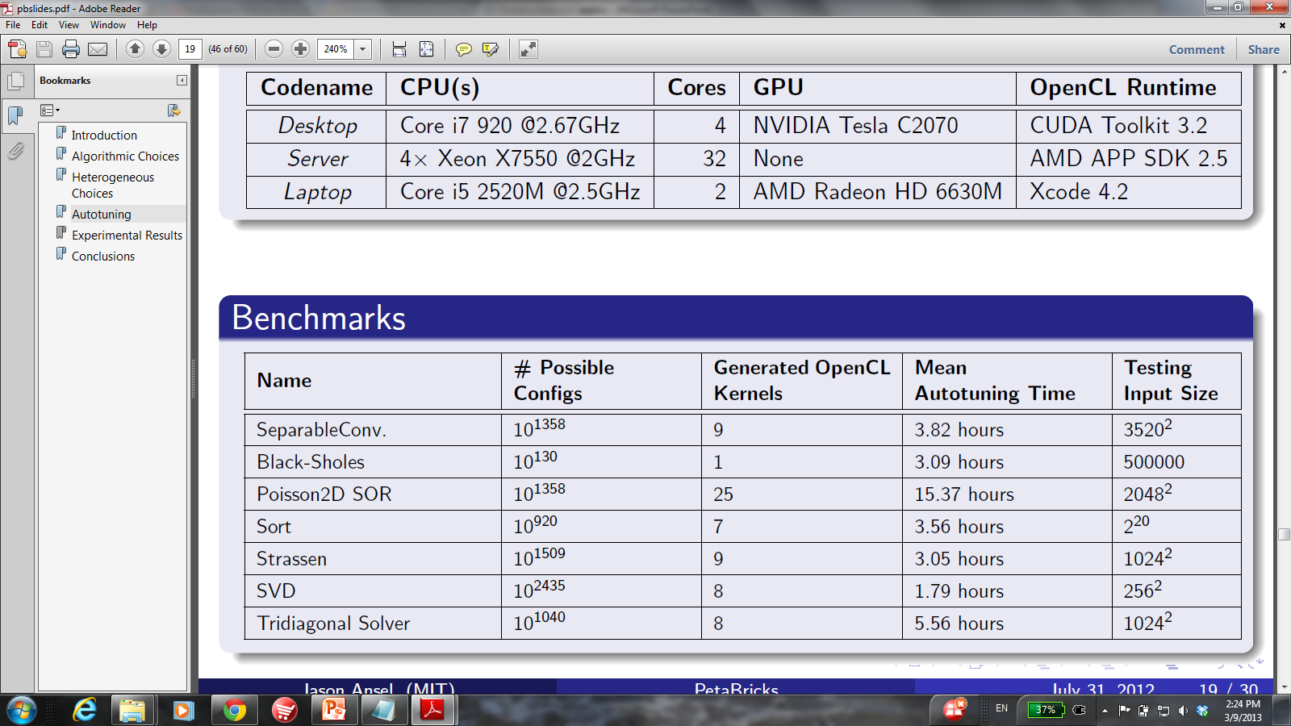
Experimental Results
Convolution Black-Sholes
Poisson2D SOR Sort
Strassen Tridiagonal Solver
Single Value Decomposition
Notes:
Use OpenCL and GPU interchangably

Slide 30
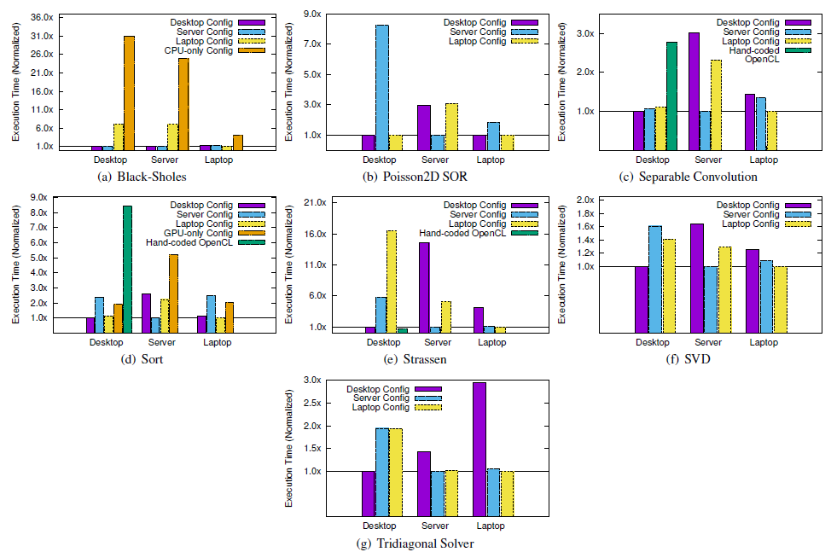
All Benchmarks

Slide 31
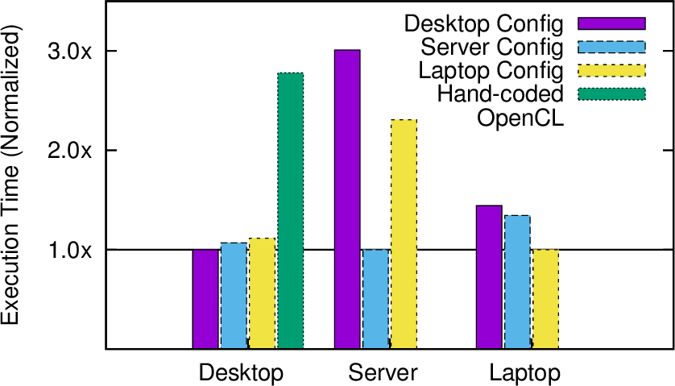
Experiment: Convolution
Autotune on each machine
Test cross-run
Normalize execution time by the best config
Desktop config
Separable convolution w/
local memory on GPU
Lower is better.
Server config
Separable convolution
on OpenCL
Laptop config
2D convolution w/
local memory on GPU
Hand-coded OpenCL

Slide 32
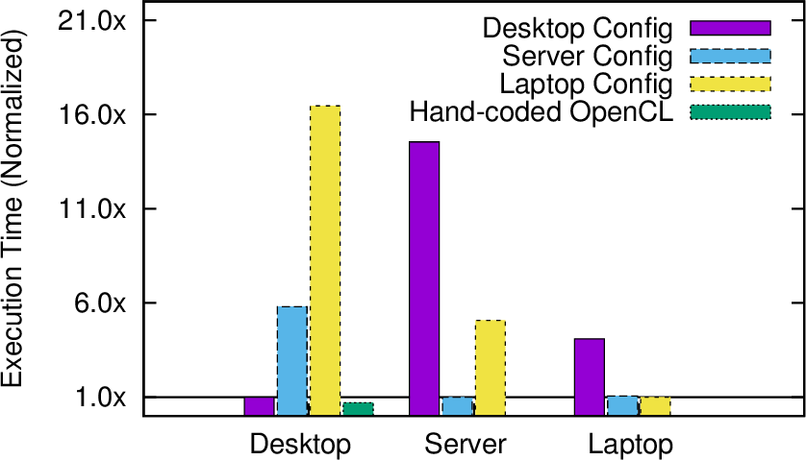
Experiment: Stressen (Matrix Multiply)
Right configuration can provide huge performance improvement.
Desktop config
16.5x
Data parallel on GPU
Server config
Recursive decomposition
-> LAPACK on CPU
Laptop config
LAPACK on CPU
Hand-coded OpenCL
Notes:
Right configuration can provide huge performance improvement.

Slide 33
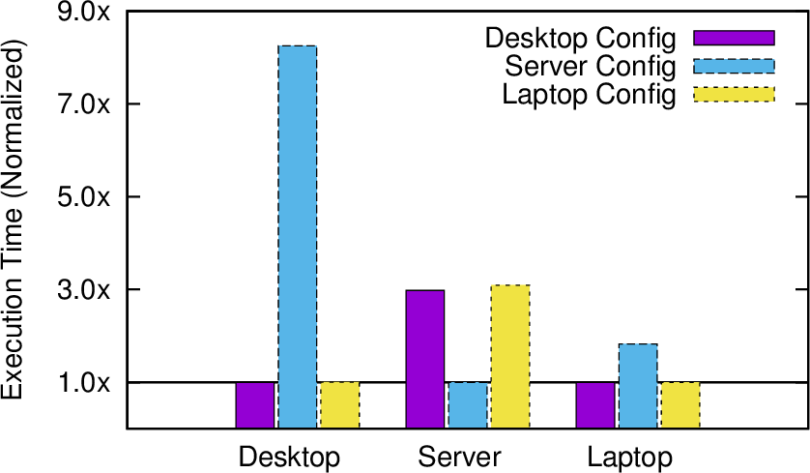
Experiment: Poisson 2D SOR
Optimal placement is almost the opposite of another across machines.
Desktop config
Split on CPU
Compute on GPU
Server config
Split on OpenCL
Compute on CPU
Laptop config
Split on CPU
Compute on GPU
Notes:
Right configuration can provide huge performance improvement.

Slide 34
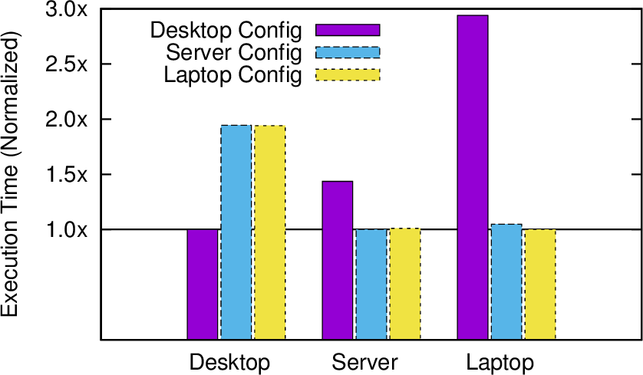
Experiment: Tridiagonal Solver
Algorithmic choice dramatically affects performance.
Desktop config
Cyclic reduction on GPU
Server config
Direct solve on CPU
Laptop config
Direct solve on CPU
Notes:
Right configuration can provide huge performance improvement.

Slide 35
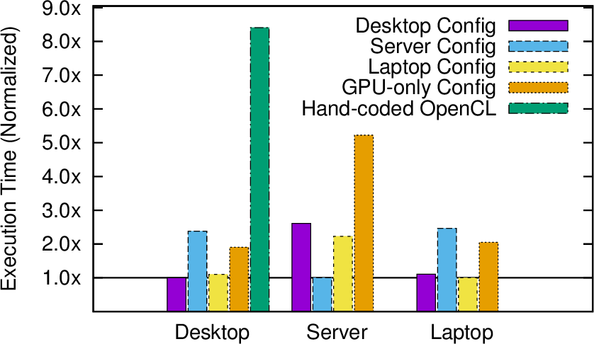
Experiment: Sort
It is not always best to use accelerators.
Desktop config
2MS -> QS -> 4MS -> IS
on CPU
Server config
4MS -> 2MS -> IS
on CPU
Laptop config
4MS -> 2MS -> 4MS -> IS
on CPU
GPU-only config
Bitonic sort
Hand-coded OpenCL
Radix sort
Notes:
Right configuration can provide huge performance improvement.

Slide 36
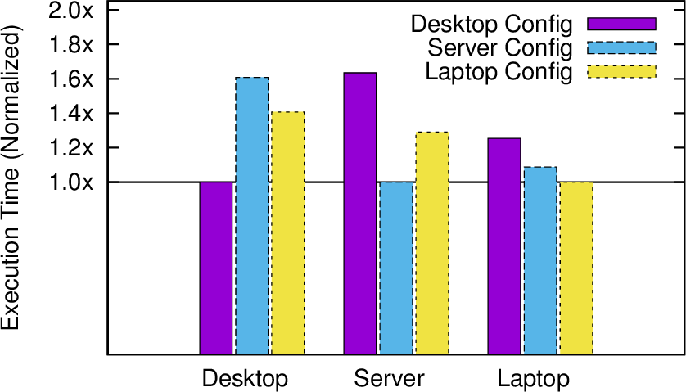
Experiment: SVD
GPU-CPU task parallel division on some machines
Desktop config
Task parallelism between
CPU/GPU
Server config
All on CPU
Laptop config
All on CPU
Notes:
Right configuration can provide huge performance improvement.

Slide 37
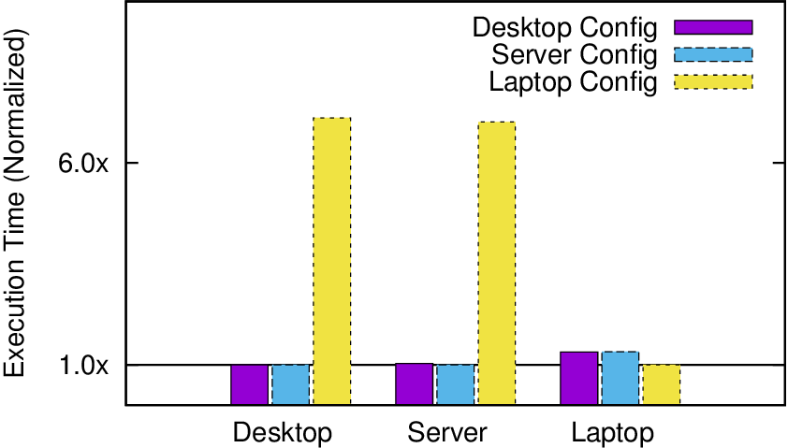
Experiment: Black-sholes
GPU-CPU task workload division on some machines
Desktop config
All on GPU
Server config
All on OpenCL
Laptop config
25% on CPU, 75% on GPU
Notes:
Right configuration can provide huge performance improvement.

Slide 38
Choice Differences Across Machines
GPU/CPU task parallelism
Global/local memory
Devices (C++/OpenCL)
Algorithms
GPU-CPU ratio
Convolution
Stressen
SOR
Tridiagonal Solver
Sort
SVD
Black-sholes
Notes:
In this slides, I’ll show the override theme of the benchmarks. I look at the 3 configurations obtained from tuning on the 3 machines and compare them.
In these 5 benchmarks, the best configurations show different mapping of program portions to different devices.
The blue ones show that best algorithmic choices are changed across the machines.
Different GPU-Cpu ratio affects performance in Black-sholes, while GPU/CPU task parallelism affects SVD benchmark.
And global/local mem decision affects convolution.

Slide 39
Best algorithms and mapping strategies on one system are often not the same on another.
Model-driven analysis alone is not enough.
Empirical exploration is essential when facing with programs and machines of ever-increasing complexity.
Notes:
The best choices are often complex, and map different algorithms in multiple ways across all processors and memories.
The interdependent space of best mapping is very difficult to predict from model-driven analysis, alone, but empirical exploration effectively and automatically accounts for many interacting effects on actual machine performance.

Slide 40
Benchmarks

Slide 41
When Task Becomes Runnable: Case 1
3
CPU Worker
GPU Manager
GPU non-runnable task
1
2
4
5
CPU non-runnable task
6
7
3
CPU Worker
GPU Manager
4
2
6
5
7
CPU Worker
GPU Manager
4
5
6
7
3
GPU task is always pushed to the bottom of GPU management thread’s queue

Slide 42
When Task Becomes Runnable: Case 1
3
CPU Worker
GPU Manager
GPU non-runnable task
1
2
4
5
CPU non-runnable task
6
7
3
CPU Worker
GPU Manager
4
5
6
7
CPU Worker
GPU Manager
4
7
6
3
GPU management thread pushes a CPU task to the bottom of a random CPU worker’s deque

Slide 43
When Task Becomes Runnable: Case 3
3
CPU Worker
GPU Manager
GPU non-runnable task
1
2
4
5
CPU non-runnable task
6
7
3
CPU Worker
GPU Manager
4
5
6
7
CPU Worker
GPU Manager
3
5
6
7
CPU worker pushes a CPU task to the top
of its own deque

