Slide 1
Gradle
Manuel Vega Ulloa
Para VUMI

Slide 2

Gradle
open source
build automation system
builds upon the concepts of Apache Ant and Apache Maven
introduces a Groovy-based domain-specific language (DSL)

Slide 3
Why gradle?
Designed for multi-project builds which can grow to be quite large
Supports incremental builds
Tracks version upgrades

Slide 4
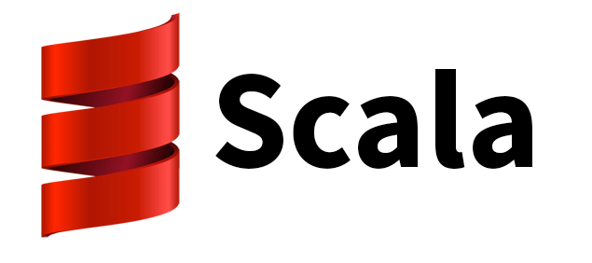
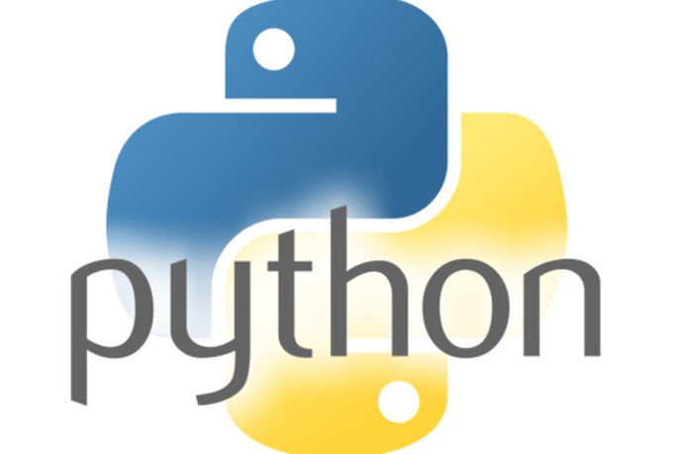
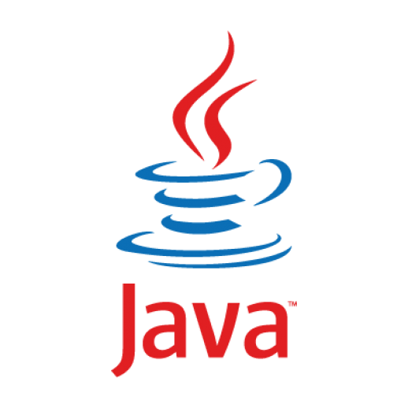


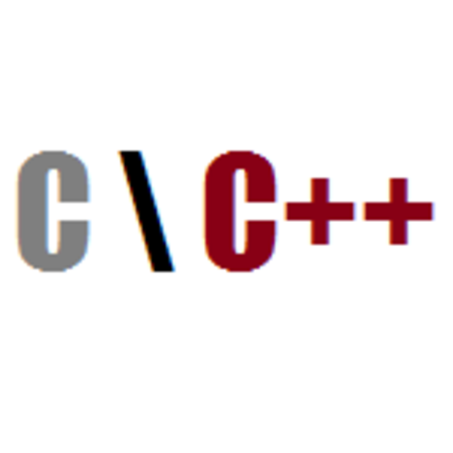
Polyglot builds
Linkedin uses Gradle to build 60 different programming languages

Slide 5


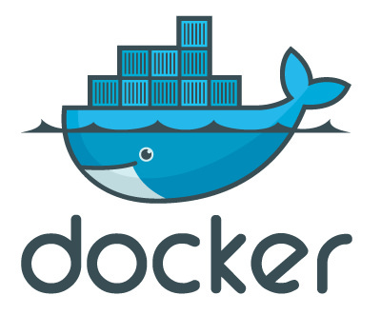


Tool integrations

Slide 6


Robust Dependency Management
Retrieve artifacts from any known binary repository, from public to private to local.
Flat

Slide 7
High Performance Builds
Gradle avoids unnecessary workload by caching:
remote metadata and artifacts
transitive dependency resolution
build execution plan
plugin inputs and outputs
test results

Slide 8
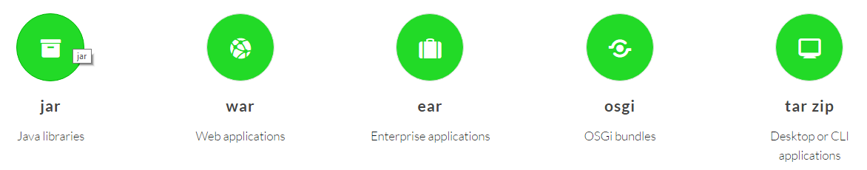
Packs all the gear to build enterprise software for the JVM
Test frameworks: JUnit, TestNG, Spock
Application frameworks: Java EE, Grails, Play!,
Code analysis cops: Checkstyle, CodeNarc, FindBugs,
JDepend, PMD, JaCoCo, Sonar

Slide 9
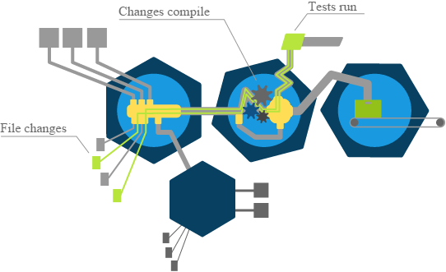
Reliable incremental builds

Slide 10
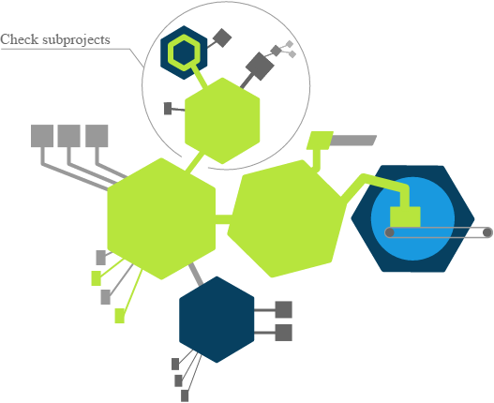
Partial builds
Gradle helps quickly accomplish the task by only building parts of the project

Slide 11
Efficient test execution
Filter tests by type, group or pattern
Run a single test
Rerun failed tests
Fail fast (stop on first failure)
Run tests in parallel
Distribute tests across multiple runtimes or machines
Skip tests when not needed

Slide 12
Gradle’s Daemon
cuts startup time to near zero
enhances incremental builds
reuses the execution plan between subsequent builds
monitors changes to make builds reactive
lets you move seamlessly between the IDE and command line
performs preemptive work and maintenance tasks

Slide 13
From continuous integration to delivery
Get feedback sooner thanks to CI job caching and Gradle’s incremental build capabilities.
Activate Gradle’s numerous reports to inspect build results, troubleshoot problems and monitor build performance.
Use Gradle’s publishing tasks to turn the CI server into a publishing tool and release manager.
Push artifacts to a binary repository, documentation to a web server or your app to a staging or production environment.

Slide 14
Android studio
Automatic configuration of build variants and multiple APK file generation
ProGuard obfuscation
App-signing capabilities
Vector drawables
Project wizard for creating a Gradle-based project
Command line and IDE compatibility

Slide 15
Repositories
repositories {
jcenter()
mavenCentral()
maven { url 'https://twittersdk.artifactoryonline.com/twittersdk/public/' }
maven { url 'https://maven.fabric.io/public' }
}

Slide 16
Global parameters
maven {
credentials {
username projectNexusUsername
password projectNexusPassword
}
url 'http://nexus.app.lan/nexus/content/repositories/releases'
}

Slide 17
How to verify installtion
gradle
gradle -v

Slide 18
Running Gradle for the first time
Gradle has a build file
Typically build.gradle
This contains….
Tasks
And Plugins
And Dependencies
And Properties

Slide 19
Vi build.gradle
task hello {
doLast {
println “Hello, Gradle”
}
}
> gradle hello

Slide 20
Basic Gradle Tasks
Objectives
Task Domain Specific Language
Each Task has a lifecycle
Gradle Properties
Defined by Gradle
Custom Properties
Please google & Learn About DSL….
What is DSL
What is DSL Language
What is use of DSL Language

Slide 21
What is Task
Code that Gradle executes
Has a lifecycle
Initialization phase
Configuration phase
Execution phase
Has Properties
Has ‘actions’
First action
Last action
Can have dependencies

Slide 22
Define Task
vi build.gradle
Way 1
project.task(“Task1”)
Way 2
task(“Task2”)
Way 3
task “Task3”
Way 4
task Task4
> gradle tasks

Slide 23
Define a Description
Task4.description = “Tasks 4 Description”

Slide 24
Execute/Running Task
Task4.doLast {println “This is Task 4”}
Task3 << {println “This is Task 3”}
task Task5 << {println “This is Task 5”}
Task5 << {println “Another Clousure”}
Now
task Task6 {
description “This is task 6”
doLast {
println “This is a Task6”
}
}
> gradle Task3 | 5

Slide 25
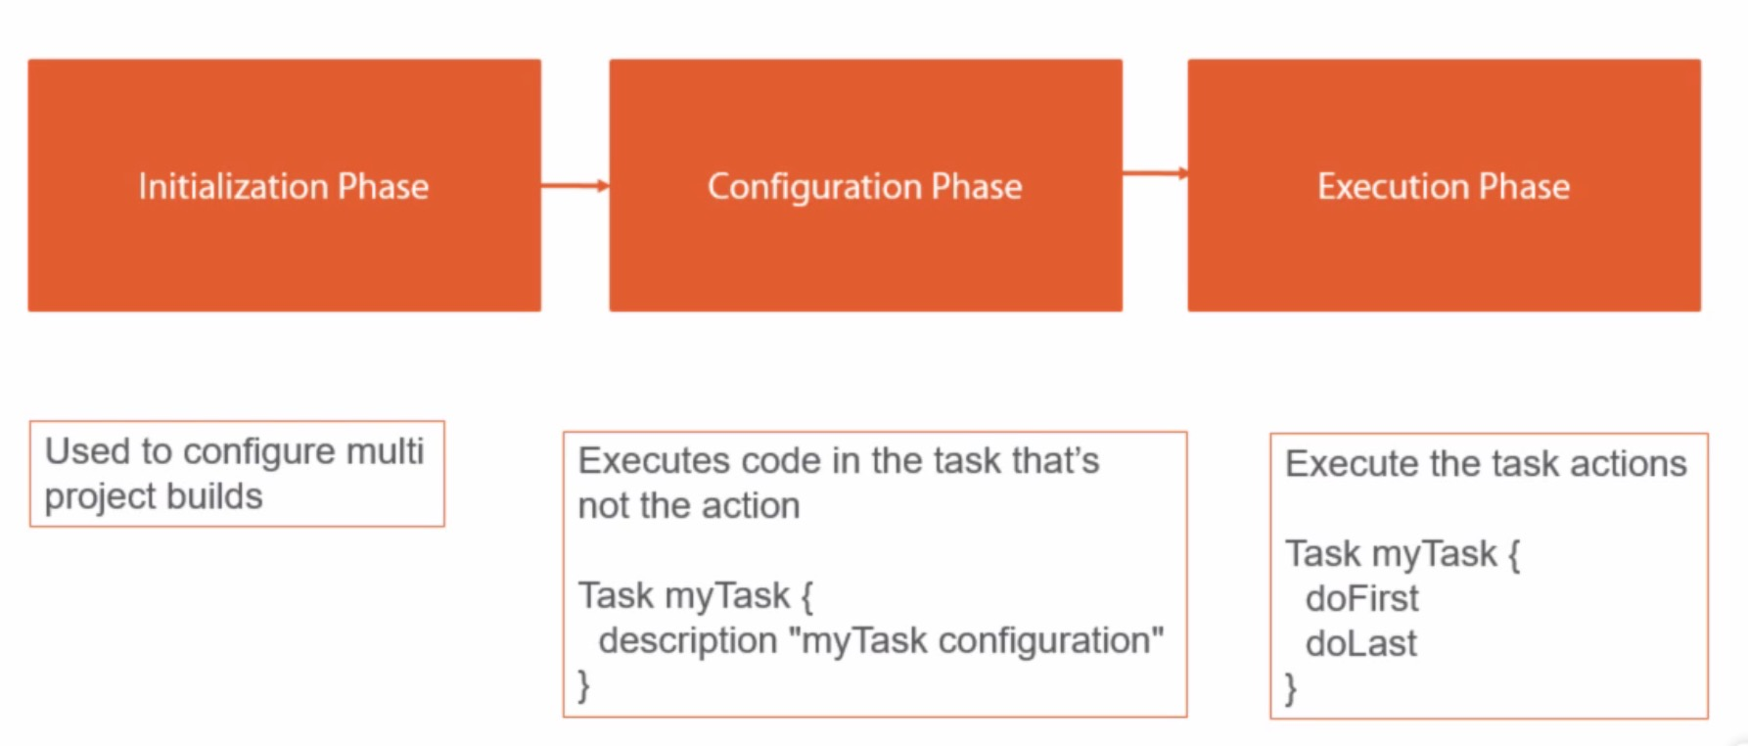
Each Task Build Phases

Slide 26
Example
task Task6 {
description “This is task 6”
doFirst {
println “This is a First Task6”
}
doLast {
println “This is a Task6”
}
}

Slide 27
Define a Property
Define?
def projectVersion = “2.0”
projectVersion = “2.0”
How to use?
$projectVersion

Slide 28
Question?

