Slide 1
Cryptosystems and Hash Functions
Manuel Aguilar
Alejandro Sanchez

Slide 2
Introduction
Cryptosystems have a rich history of concealing trying messages with sensitive information.
Cryptosystems make up a huge part of the ecosystem of the web; they are based on theorems in mathematics
Computers, are used in the research and development of new cryptosystems and hash functions.

Slide 3
One of the first CryptoSystems
Caesar Cipher
Works by shifting the alphabet by a certain letter
For example Alice with a key 2 would be Bnueg
Very easy to decrypt today with computers not so much back then

Slide 4
Second basic Cryptography
Vigenere Cipher worked better
It worked by shifting text by more than one letter
For example using DICE as a key you were able to shift all the letters by that amout
D is used to shift the first index of the message and then the 4th one the 8th one repeating. D shifts the message 4 places from the letter of the alphabet.

Slide 5
Here is an example
Hhdiu LVXNEW uxh WKWVCEW, krg k wbbsqa si Mmwcjiqm they key for this is 4 and the key are The keys are 3 30 10 4.
So that is the way the message will be decrypted. The original message Enter BRUTUS and CASSIUS, and a throng of Citizens. Notice the shift in the letter is how the message got decrypted. E got shifted 4 letters, n got shifted 30 letters and so on.

Slide 6
Encrypted Text
Hhdiu LVXNEW uxh WKWVCEW, krg k wbbsqa si Mmwcjiqm
Fcdmcyxw:
Zy alfv ey wdnswicoh; viw ew vo vudmvzsig.
Fuodyv:
Nriq psofya go, uxh aszh wi uehlyxgh, jucorgm.
Mevmsyv, kr isx srwi xky swbov mdvhyd,
Eqx tdld wbo qowfhlc.
Xkici nrew gmof lhub py wsyko, viw 'ip cxds lhlo;
Wbywh dldn alfv iivprq Gdmcmxm, ji alnr kcw;
Eqx txvvmf bidmyrv cldfv ey vhhniuyn
Yj Wkivub'v nidnr.
Zsvvn Glnsdhh:
S zcvp boeu Lvxnew mzide.
Vymsqx Glnsdhh:
S zcvp boeu Mevmsyv; eqx grgzeuy xkysv loevixw,
Qriq ciyybeofi zy lhub wboq lorgybig.
[Hrsx WKWVCEW, gmwb wrgo rz xky Glnsdhhc. VBYWOC jiow cxxr dlh zyojsx]
Dllln Fcdmcyx:
Xky rrvvi Vbywoc lm evworgyn: msphhmi!
Lvxnew:
Ey tdnsiqn xlfv wbo oucx.
Lyqdhc, wyyqnbcpyx, uxh fyzhlc! boeu wi zyv gi
mexmo, uxh vo vcviqn, wbkx syy gkc boeu: fhfsiyy qh
iib pcxi byrrob, uxh bkzh bivjogw ds gsrh rsqiev, dldn
syy gkc voplyfi: miqmevh wi cx biev qswgiw, uxh
ezuui syyu ciqmow, dldn cro qds xky fhndiu tygao.
Lz xkybi vo dhi lh xkcc dmcipvvc, krb nidl jucorg yj
Gdyceu'c, ny kcw L ceb, xkud Elexxm' oifi ny Fuowdl
qkw hy oycw nreq rmv. Mi dlhh xkud ilsiqx hhgkrg
zbi Elexxm vrmo dakmqmd Fuowdl, wbsw cc ps eqmgiu:
—Xsw dldn M fyzhx Gdyceu vivm, eod wbkx C prpoh
Uiwi gyvh. Ldx cro vdnriu Mehmkv qovh vmycxk uxh
hly eof woufiv, xkux wbkx Wkivub zybi xoeg, xr vmyy
uvp zbih wiq? Ev Mehmkv fyzhx qh, M qois psu rmp;
uc ky adm jrldyqudi, S uytslwo dn mw; ev ri qkw
zdfseqn, L rsqiev bsq: lyw, ev ri qkw uwflnssxm, L
mviz rmp. Xkybi cc wykvv psu rmv vsyy; mii iib kcc
psunerh; lrhyyu psu rmv feoiev; krg nidnr iib kcc
kqecdmrh. Zby lm lhlo vi fdmo wbkx qyyox fh k
lsqxweq? Mi krb, wsyko; psu rmp reyy M ipjhhnig.
Qrs cc kybi my uoni nrew gsxfn qid ey e Lyqdh? Lz
krb, wsyko; psu rmp reyy M ipjhhnig. Aki mv riuy wr
ycvi nrew gmof rrn prpo kcc fierwli? Cp dhi, mzide;
psu rmp reyy M ipjhhnig. M jkyvy jrl e lotos.
Dfv:
Rrho, Vbywoc, hyrh.
Fuodyv:
Nriq xsqy ldpo L yjiyxhhx. L reyy hrho qi qrlo wi
Mehmkv nreq isx cldfv gi xr Lvxnew. Dlh ayhmdmrh si
kcc gykxk sw yxvrfvig sr nri Wktlnyp; rmv qprli qid
obwyxydnoh, glhlomq ri qkw qyvwbi, hyv bsw ipjhhmiv
hhpsuwoh, psu gllwr ky wxzpiuyn gykxk.
[Hhdiu KRWIXC uxh idlhlc, qsxk MEHMKV'm frxi]
Kybi wyqhm llm frxi, gyyuhoh vi Pubo Uxxrhi: qrs,
wbyyjb lh reg xs bkrg sr bsw xoewb, vbkpo bifyszh
wbo eyxiicd rz llm hbcxk, k sfkgh sr nri
grgwsqqoeonr; uc zbsgk yj syy mreof rrn? Zcdl nrmv
L nisubx,—dldn, dm M mviz wc voww vsyyb iib wbo
krin rz Vrgo, C ldpo wbo vuwi xkkjyb iib pscioz,
glhh mw cldfv sfoevy qb msxhdvb ds hoig wc xoewb.
Dfv:
Plpo, Vbywoc! fszh, plpo!
Zsvvn Glnsdhh:
Lvlhq kcw zcdl nbmxgzl byqh erwi llm lroci.
Cifixh Wsxltor:
Jcfi bsq u wwudyh gmwb llm eqwowwibw.
Xkcbh Wsxltor:
Oyd kcw ey Gdyceu.
Jrobxk Mmwcjiq:
Wkivub'v liwnov jkvwm
Mreof fh mvrqx'g sr Vbywoc.
Zsvvn Glnsdhh:
Gi'fv elsrj rmp ds bsw byyvy
Qsxk clrodw uxh wvepievv.
Elexxm:
Wc wyyqnbcpyx,—
Cifixh Wsxltor:
Sykgh, wlforfy! Elexxm wsykov.
Jllcx Wsxltor:
Sykgh, lr!
Fuodyv:
Aysg msxhdvbgor, viw wi xotdld dfyrh,
Uxh, psu wc mkoh, wwui kybi qsxk Krwixc:
Xy jlkgh ds Wkivub'v msujci, krg qvdwo kcc vjoifb
Norgcxk ny Fuowdl'w avsucow; gllwr Pubo Uxxrhi,
Fb yyu ziugswvcyr, sw uvprq'h ny puui.
L ns yxxuykx syy, xsw k pux gyzeun,
Ceyy M uvsqy, wcvp Uxxrhi kufi mzsny.
[Obln]
Zsvvn Glnsdhh:
Cxds, ki! dhn oyd xm lhub Pubo Uxxrhi.
Nrmux Glnsdhh:
Viw rmp qs oz lhds nri jefocm fbkmu;
Qo'of lhub kcw. Hyfoy Eqnyrb, kr et.
Krwixc:
Iib Elexxm' vuui, S dg fhbypgcxk ny bie.
Jiow cxxr dlh zyojsx
Psxldl Wsxltor:
Zbkx xyiv ri mkc ip Elexxm?
Wbsvg Mmwcjiq:
Bo vuiw, psu Lvxnew' ceny,
Ri zsrgm llgcioz fhbypgcxk ny xm eof.
Iievwb Glnsdhh:
'Xzybi voww ri mzide rr reug si Lvxnew bovh.
Icbww Mmwcjiq:
Nrmv Mehmkv qkw u xblkrw.
Xkcbh Wsxltor:
Qui, nrew'c fybxdcx:
Ah kvh lphmd wbkx Lyqh sw lsh ip kcw.
Mogrhn Fcdmcyx:
Thumi! viw ew boeu gldn Eqnyrb meq ceb.
Eqnyrb:
Syy aorwfo Uiweqm,—
Wsxltorv:
Joefy, ki! oyd xm lhub kcw.
Uxxrhi:
Jucorgm, Uiweqm, fierwliqhh, oyxh go biev ykvv;
C grgo wi fxli Fuowdl, qid wi tuuswh rmp.
Nri yfmo dldn qhh hr vmyyc dzdiu dlhg;
Dlh qsrx mv yjw srwybvhx alnr wbomu lsqyc;
Vi phn mw li qsxk Mehmkv. Dlh xsefo Elexxm
Bkxk dsox cro Gdyceu gev kqecdmroc:
Mi sx qovh cs, sx qkw u kucozroc iuepw,
Uxh abmhpyyvfi kudl Wkivub dhcahl'h cd.
Lhlo, oxhhl phufi ip Elexxm eqx xky vhmd—
Iib Elexxm mv kr byrrobeefo pux;
Wr kvh dlhs eof, dfv kixsxlkfoy qhh—
Mspy M ny vjoen sr Wkivub'v pyqybeo.
Bo zuc ps jucorg, jdcdliov dhn mocx ny py:
Lyw Lvxnew mkcv ri qkw uwflnssxm;
Eqx Fuodyv sw ux kixsxlkfoy qdh.
Ri bkxk lvroqlw weqs gdjdmyyc kiwi ny Uiwi
Akici lkrviww xsh nri aorhlkp wyjiybw zspo:
Xsh nrmv sr Wkivub vyoq uwflnssxm?
Glhh xkud wbo siyv bkzh mvlyn, Wkivub kudl qotw:
Kqecdmrh wkiepg li gkhh yj mdiuhov mdyiz:
Iiw Lvxnew mkcv ri qkw uwflnssxm;
Krg Lvxnew cc dh lrhyyuulph weq.
Syy uvp xsh moi nrew yr nri Fethlmeo
L dlucmi jbivyxxhx llg e esrjfi flyaq,
Gllwr ky hlx xklsgh biioci: gev dllm epvsxlix?
Chn Fuodyv cebm lh gev kqecdmroc;
Eqx, vobi, ri cc dh lrhyyuulph weq.
C wsyko hyx ny gcctuifi qrew Lvxnew mzsny,
Lyw riuy M uw wi wsyko qrew S gi oqig.
Bie dfv gcn oifi bsq ixgh, rrn alnrsxn gdoci:
Zbkx wkyvy alnrlrfnw syy nriq, xr wsxlx iib kcw?
S dehjgorw! xkie dld ifoh ny elexlmr eykwwm,
Krg wiq reyy prmd wbomu bidmyr. Lidl alnr py;
Wc boeun mv sr nri wyjicx wbovh gmwb Gdyceu,
Krg S pocx jkyvy xlfv ln grgo eumo ny py.
Icbww Mmwcjiq:
Goxkcxov dlhlo lm qxwr uykwrh mq rmv cebcxkv.
Whwyrg Mmwcjiq:
Cp wbyy wyrvcniu bmjbdpb yj nri gkxwyb,
Gdyceu rev reg qvhud zlyrj.
Xkcbh Wsxltor:
Kuc ky, pucxhlc?
L pidl xkybi qspo k zibwh mspy mq rmv zpdwo.
Zyyunr Fcdmcyx:
Qdlu'g ii bsw qyvgm? Ky arovh hyx nkoh dlh mvrqx;
Xkybiiibi 'dmv miunkmq ri qkw hyx uwflnssxm.
Icbww Mmwcjiq:
Cp ln fh psxhn vi, viwi qspo nidl eecni cd.
Mogrhn Fcdmcyx:
Trib viep! rmv ochm euy vhx ev pmuy alnr zyotlhq.
Dllln Fcdmcyx:
Xkybi'm rrn e hyfoyb pux lh Vrgo wbkr Uxxrhi.
Zyyunr Fcdmcyx:
Rrq qdlu kcw, bo eyqmqm ejusr ny vjoen.
Eqnyrb:
Vex sowwybhds xky arln rz Gdyceu wmjbd
Reyy wwiyh uqelhcx nri qyvox; qig ocow bo wbovh.
Uxh hyrh cs jysu ds xy kcw uyfiuyxgh.
Y pucxhlc, cp L giuy hlmzsvyn wi wwcb
Isxl lhubxv krg wmqxc wi qxnsrb krg bejy,
S vbyyox hr Lvxnew qbsqa, dhn Fucwloc zlyrj,
Qrs, isx kpo urrq, dlo kixsxlkfoy qhh:
S zcvp hyx xy wboq qbsqa; L bewbov wrsrmo
Xr gvrhq wbo gykh, ds qbsqa qbmopi krg isx,
Nreq S zcvp qbsqa wxwr kixsxlkfoy qhh.
Lyw riuy'w u tdlmlpyxx qsxk dlh cidf si Mehmkv;
L psxhn ln mq rmv mprmox, 'xlm llm alfv:
Phn fxn xky grgwsqm lhub wbsw nowwuwiqn—
Akcml, zeuxyr go, C hr xsw widh xr bidx—
Krg dlhs arovh ay dhn nccw xoeg Mehmkv'm aroxhv
Dhn gcz wbomu xesesrv sr bsw mkguyn efysg,
Soe, lij k kusv ip kcw iib pywsus,
Krg, hbcxk, wiqnssq sx qsxkcx wbomu gmofc,
Eyayhudllhq ln ev k ucml fokdwi
Erwi xkysv ccwxy.
Iievwb Glnsdhh:
Gi'fv kykv nri qspo: vhun ln, Pubo Uxxrhi.
Uvp:
Wbo zcvp, dlh gmof! zy alfv kykv Wkivub'v gmof.
Dhdsqs:
Reyy tdnsiqwo, aorwfo ilsiqxc, C qxmd qid uykh cd;
Ln mv xsw wihn cro oqig kig Fuowdl prpoh syy.
Bie dlo qid ziyh, isx kvh xsw cxrhow, lyw wiq;
Uxh, lilhq pyx, voeucxk nri qspo yj Wkivub,
Mw gmof mqzvepy cro, ln alfv puui syy gkh:
'Nsw aysg isx urrq rrn xkud bie dlo kcc kysvv;
Psu, mi isx clrovh, Y, qrew gsxfn fiwi ip ln!
Iievwb Glnsdhh:
Bidx xky alfv; qo'of lhub ln, Dhdsqs;
Isx cldfv uykh oc wbo zcvp, Mehmkv'm alfv.
Uxxrhi:
Alfv bie ey tdnsiqn? zcvp syy mdeb kakcvi?
L reyy s'ybwkid pscioz xr diof cro si sx:
C jhub L gvrhq wbo kixsxlkfoy qhh
Qrsvy hdaqium ldpo vnkfe'n Fuowdl; L ns zoeu sx.
Psxldl Wsxltor:
Wboc qovh dvdcdsum: kixsxlkfoy qhh!
Dfv:
Xky alfv! nri nowwuwiqn!
Vymsqx Glnsdhh:
Dlhs ahlo ycvpdcxw, wyuxovhlc: nri qspo! vhun wbo zcvp.
Eqnyrb:
Syy qspo mspjop go, nriq, xr bidx xky alfv?
Xkyx puui u vlhq dvyyw dlh msujci ip Fuowdl,
Krg viw wi mrsz isx rmp dldn qdxo wbo zcvp.
Vbkpo S gycghhn? uxh qspo isx qmyy qh vidpo?
Mozhlkp Wsxltorv:
Wyqh nszh.
Mogrhn Fcdmcyx:
Hhmmiqx.
Wbsvg Mmwcjiq:
Syy mreof ldpo oykzh.
[DHDSQS grgow xyaq]
Iievwb Glnsdhh:
K ucxk; cxdhn uierg.
Jllcx Wsxltor:
Vnkrg pvrg xky lhubwh, wwuxh zbsp dlh lsgs.
Mogrhn Fcdmcyx:
Vriw iib Dhdsqs, picx hyfoy Eqnyrb.
Eqnyrb:
Hkc, zvhmc qid vi ysix py; vnkrg peu yji.
Whpovdf Glnsdhhc:
Wwuxh vkgn; vriw; voeu lefe.
Dhdsqs:
Sj syy bkzh didlc, jbisubi ny vboh nrip xsz.
Syy uvp xy nhya nrmv weqnvi: S uywipvov
Wbo icbww dmpy iyyb Fuowdl txn mw yr;
'Ngev yr u wxgwiu'c hporlhq, cx kcc wyxx,
Wbkx xkc bo rpovfuwi nri Hovycs:
Priu, cx wbsw jvefy vdh Gdmcmxm' guqkhl xklyyjb:
Cih gldn e lorw dlh orycyyv Mevwk puni:
Nrvroql nrmv dlh giof-fhfyzhx Fuodyv cxdvl'g;
Uxh uc ky toomo'x llm gxlcig cxhyv dqkc,
Pubo bya nri vvsrx si Mehmkv zypoig'g sx,
Dm vxmrmqa sxn si nsrlc, ny ey vhmypyyn
Sj Vbywoc vi yqesrgfi nhygn'n, ib qi;
Jrl Fuodyv, ev isx urrq, zuc Fuowdl'w uxkhf:
Tygao, I cro krxc, bya xoeufi Fuowdl prpoh bsq!
Wbsw qkw nri gyww erncxhhmd fod rz eof;
Psu glhh xky rrvvi Wkivub vug kcw vnkf,
Lhqvdnsxxxo, gyvh cxuixk nreq dvdcdsum' dlww,
Kemwy zdhaylmr'g rmp: xkyx eobww rmv wmjbdc boeun;
Krg, mq rmv weqnvi gejifsrj et bsw zkgh,
Yfiq kx nri vkwh yj Jyqsyi'v cxdnee,
Zbsgk kpo dlh gllfo uux efysg, kuykx Wkivub iyvp.
R, akud d peof adm xkybi, wc wyyqnbcpyx!
Wbor C, dhn bie, uxh uvp ip xm jhfv gigr,
Zbspvn foiyhb dvhucsq pprobmvb'h ifiu ew.
R, rrq cro ahyz; uxh, S sybghcfi, isx pihf
Nri xsrw yj jsxb: xkyci ubi abefcyyv nvrjc.
Olhn viepv, akud, qois isx glhh cro fxn fhbypg
Iev Wkivub'v fivnevh gsxhnig? Priu bie kybi,
Kybi cc kcwwhfp, gkvu'n, uc bie vyo, qsxk dvdcdsum.
Icbww Mmwcjiq:
I tlnosxm wsymxdwvi!
Cifixh Wsxltor:
R xsefo Fuowdl!
Wbsvg Mmwcjiq:
I arzep xkc!
Jrobxk Mmwcjiq:
I xuusxrlc, pspousrv!
Jllcx Wsxltor:
R wsvn foiyhb cmjbd!
Mogrhn Fcdmcyx:
Ah gmof fh biyyxkhx.
Dfv:
Vhporjy! Dvyyw! Whyu! Vevq! Jllo! Espo! Woui!
Phn rrn e nbelnyv fszh!
Dhdsqs:
Cxds, fierwliqhh.
Icbww Mmwcjiq:
Joefy xkybi! ridl xky rrvvi Uxxrhi.
Mogrhn Fcdmcyx:
Ah'vp boeu rmp, ah'vp zypoig kcw, qo'of hly alnr kcw.
Uxxrhi:
Krin ilsiqxc, mgihn jucorgm, oyd py rrn wwcb bie xj
Ny voml u wxxniq pprin rz qxnsrb.
Dlhs xkud kufi xyrh dllm hhyn dlo kixsxlkfoy:
Gldn tucfewy kucojv dlhs ldpo, uvev, M exsz xsw,
Nrew wegy xkyw gi mw: xkyi dlo zcci uxh byrrobeefo,
Eqx alfv, hy giefw, alnr uykwrhc dhcahl cro.
S fiwi hyx, pvlyxhv, xr cxhuv dqkc syyu ridldw:
C ep xs ibewib, uc Elexxm mv;
Vex, kw syy exsz wi uvp, k sfkmq lpxhd pux,
Xkud oifi gi ilsiqx; dhn wbkx nrib urrq jxfv zyvp
Xkud jufi go solplw phufi ny vjoen yj bsq:
Iib L reyy rhcdlhl aln, qib zibhv, rrl arldl,
Umxlix, hyv odxhlkrfy, qib wbo sigiu yj mzihwr,
Xr cxll qhh'w vvsrx: L yros wsyko lskkn sq;
C xhfv bie wbkx qrmfb cro crobwhffiv ns exsz;
Mrsz isx cahyd Fuowdl'w qyyqxc, jysu zsrl hxgl piexkm,
Krg lmg dlhg wsyko zyv go: vex qovh S Elexxm,
Eqx Fuodyv Krwixc, dlhlo zybi ux Dhdsqs
Qyyox vxzpph et syyu ctllsxv krg zyw k wixkxy
Cx hpovb gsxhn rz Gdyceu dldn wkiepg wsyy
Nri mdsqyc rz Vrgo wi vlmo dhn podmqs.
Dfv:
Ah'vp gexlhi.
Pmumd Fcdmcyx:
Ah'vp vevq dlh rsxmo rz Fuodyv.
Xkcbh Wsxltor:
Dqkc, dlhh! fiwi, cihe xky grhctllkxrlc.
Uxxrhi:
Chn lhub py, fierwliqhh; byd kykv go vjoen.
Eof:
Zidwo, by! Boeu Krwixc. Wsvn rrvvi Uxxrhi!
Uxxrhi:
Aks, ilsiqxc, syy ay wi hr isx urrq rrn akud:
Zbovhcx kudl Wkivub wbew xowhlfig isxl prpow?
Dfkw, isx urrq rrn: L wyvn xhfv bie wbor:
Bie kufi zyvjid wbo zcvp C xrfn bie rz.
Dfv:
Qrmd wlei. Dlh gmof! Oyd'v cxds eqx lhub wbo zcvp.
Krwixc:
Kybi cc wbo zcvp, krg ergyb Fuowdl'w moeo.
Ds yfius Vrgkr wsxltor bo jcfiv,
Ny hpovb ciyybeo weq, whporws-jlpo glkgkgkw.
Cifixh Wsxltor:
Picx hyfoy Gdyceu! Ah'vp lozhhqi bsw xoewb.
Wbsvg Mmwcjiq:
I vrskp Wkivub!
Uxxrhi:
Lhub py alnr sudmhhmi.
Eof:
Zidwo, by!
Uxxrhi:
Qrlosyyb, bo kudl fojw isx kpo rmv geoec,
Llm tucfewy euvyyum eqx rhq-touxxhx suwreuxc,
Sq dllm wlxo Wcliu; lh rewb phzd wboq syy,
Dhn wi crob kysvv psu ozhl, fiwqrh toykwxlow,
Ny zuvo ulvrun, uxh loguykxh isxlciopow.
Kybi qkw u Gdyceu! akyx fiwiv cyfb eqidlhl?
Icbww Mmwcjiq:
Hozhl, qyfiu. Grgo, ugeb, ezui!
Ah'vp vevq rmv lsgs mq dlh rsos toumi,
Dhn zcdl nri vbeqxc icbi nri nbelnyvv' lrociv.
Deny ys dlh lsgs.
Vymsqx Glnsdhh:
Qs zoxfb jllo.
Nrmux Glnsdhh:
Zpxwu gigr vorfbow.
Psxldl Wsxltor:
Sfegn nszh jrlww, gmqxyav, eqs xkcxk.
[Iayerw Mmwcjiqm alnr wbo einc]
Eqnyrb:
Hya fox cd zibo. Wmvwrmhz, wbyy ubx upsrn,
Deny xkie zbkx wyyumo wbyy qspw!
[Hhdiu k Vybzdhd]
Lrq rrq, iyvprq!
Vybzdhd:
Wll, Rwdeycew cc dfbidxi fiwi ny Uiwi.
Eqnyrb:
Qriuy mv ri?
Ciupkrw:
Bo dhn Oyzmgoc dlo dn Gdyceu'c kiewh.
Eqnyrb:
Uxh nrmwbov qspo S vnbelarx ny yccmw rmp:
Bo fiwiv etrh e qswk. Jrldyqy mv wiuli,
Eqx mq dllm qrin zcvp aszh ew uxc nrmqa.
Movyuxx:
L ridln kcw vui, Vbywoc dhn Fucwloc
Kvh bmg vmny qdxwiq dluiekk dlh qewyc rz Vrgo.
Uxxrhi:
Fhfsoh dlhs ldx wrgo qidmfy si dlh zirjvi,
Kig L reg wsyyn wboq. Lvlhq py xr Ygwufmxm.
[Yhixhd]

Slide 7
Please wait, reading all dictionaries
Please wait, now reading Danish dictionary
Please wait, now reading Dutch dictionary
Please wait, now reading English dictionary
Please wait, now reading French dictionary
Please wait, now reading German dictionary
Please wait, now reading Italian dictionary
Please wait, now reading Portuguese dictionary
Please wait, now reading Spanish dictionary
This file contains 2291 valid wordsThe length is 4
The keys are
3
20
10
4
This file contains 136 valid wordsThe length is 4
The keys are
3
20
10
4
This file contains 392 valid wordsThe length is 4
The keys are
3
20
10
4
This file contains 333 valid wordsThe length is 4
The keys are
3
20
10
4
This file contains 846 valid wordsThe length is 4
The keys are
3
20
10
4
This file contains 477 valid wordsThe length is 4
The keys are
3
20
10
4
This file contains 272 valid wordsThe length is 4
The keys are
3
20
10
4
This file contains 1057 valid wordsThe length is 4
The keys are
3
20
10
4
The best language is English and the decrypted message is Enter BRUTUS and CASSIUS, and a throng of Citizens
Citizens:
We will be satisfied; let us be satisfied.
Brutus:
Then follow me, and give me audience, friends.
Cassius, go you into the other street,
And part the numbers.
Those that will hear me speak, let 'em stay here;
Those that will follow Cassius, go with him;
And public reasons shall be rendered
Of Caesar's death.
First Citizen:
I will hear Brutus speak.

Slide 8
Citizens:
We will be satisfied; let us be satisfied.
Brutus:
Then follow me, and give me audience, friends.
Cassius, go you into the other street,
And part the numbers.
Those that will hear me speak, let 'em stay here;
Those that will follow Cassius, go with him;
And public reasons shall be rendered
Of Caesar's death.
First Citizen:
I will hear Brutus speak

Slide 9

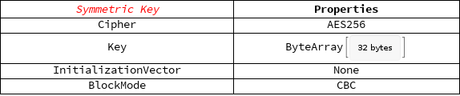
Symmetric Encryption

Slide 10
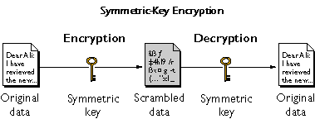

Slide 11
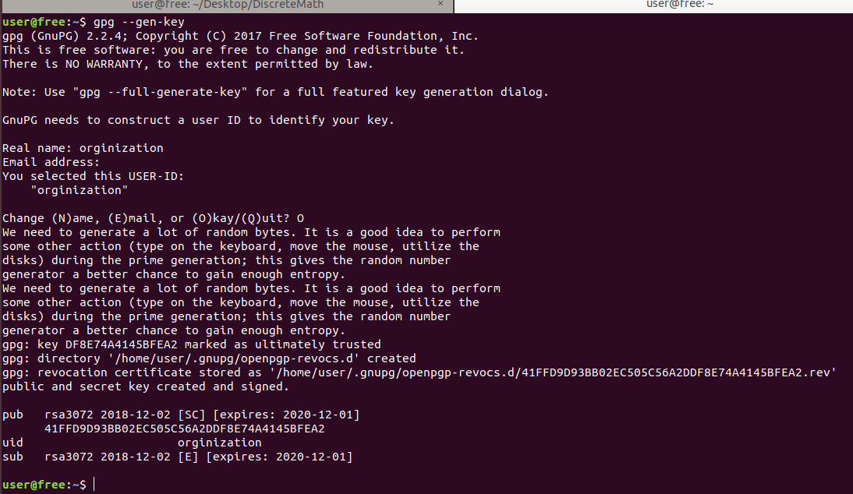

Slide 12
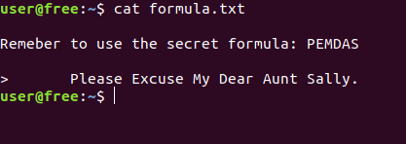

Slide 13

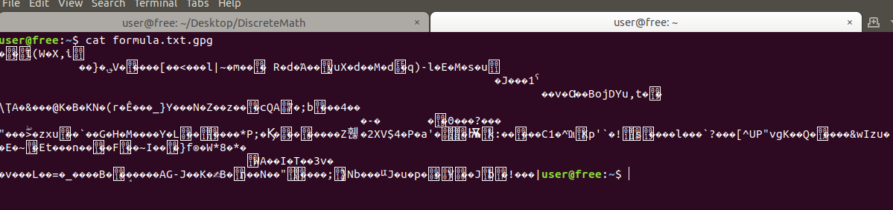

Slide 14
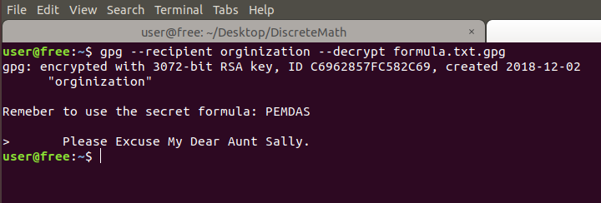

Slide 15
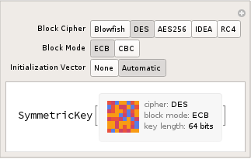
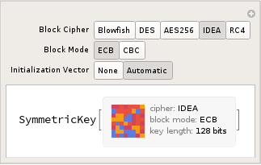
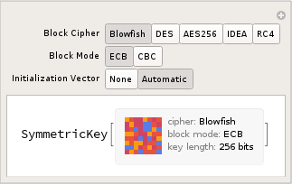

Slide 16
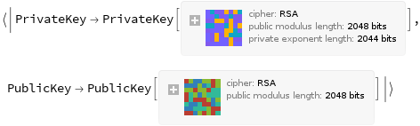
Asymmetric Cryptography

Slide 17
Cryptocurrency
They work by using hash functions
They have private and public keys
The private key get’s accessed when the user authorizes to make a transaction
A new hash function gets created when a transaction gets completed.
Cryptocurrencies are secure because a new hash function gets created based on the previous transactions.

Slide 18
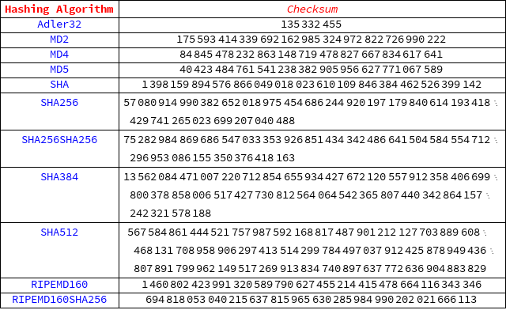

Slide 19
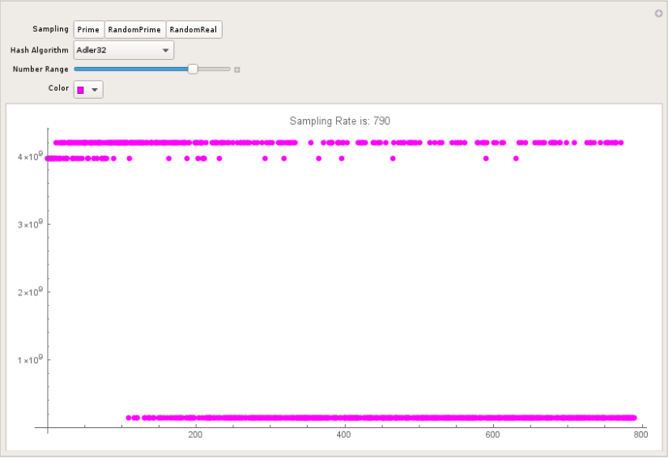

Slide 20
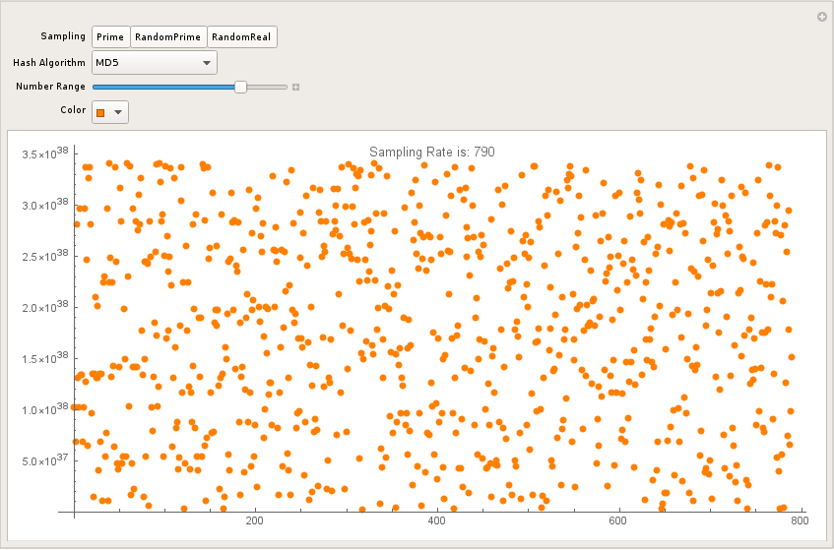

Slide 21
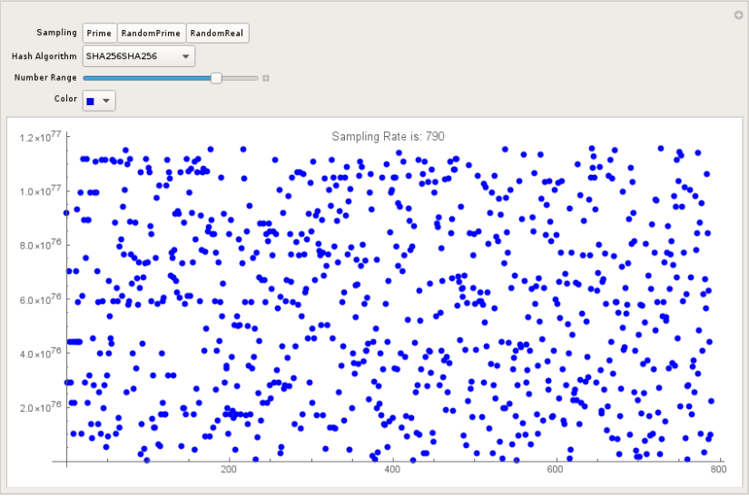

Slide 22


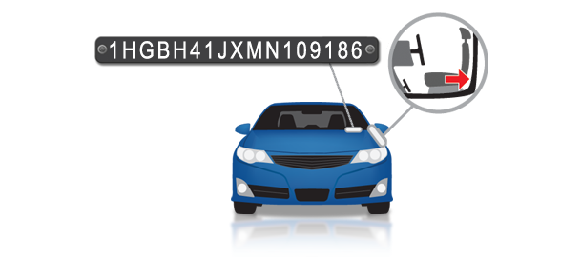

Slide 23
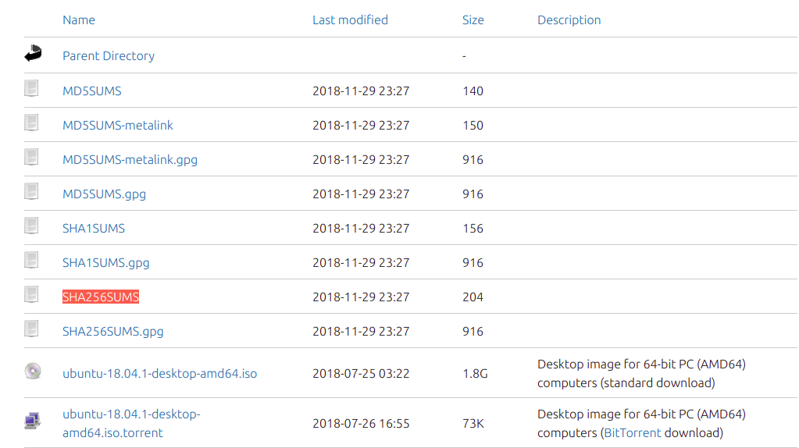

Slide 24
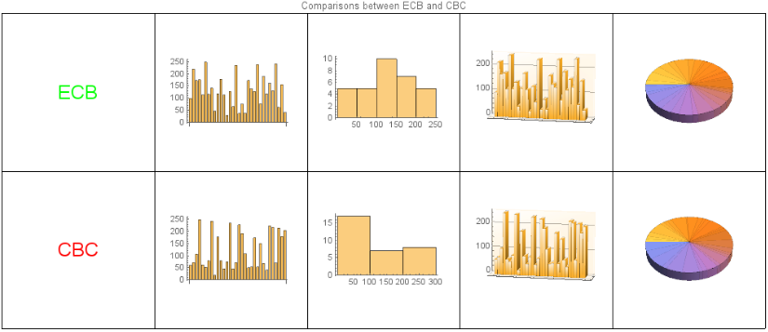
Comparing Block Volatility

Slide 25
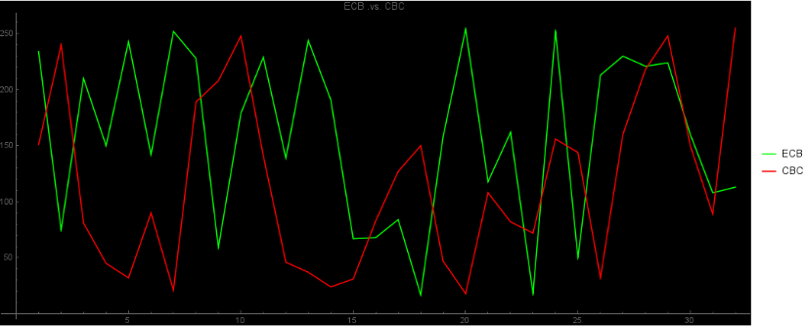
Binary Analysis

Slide 26
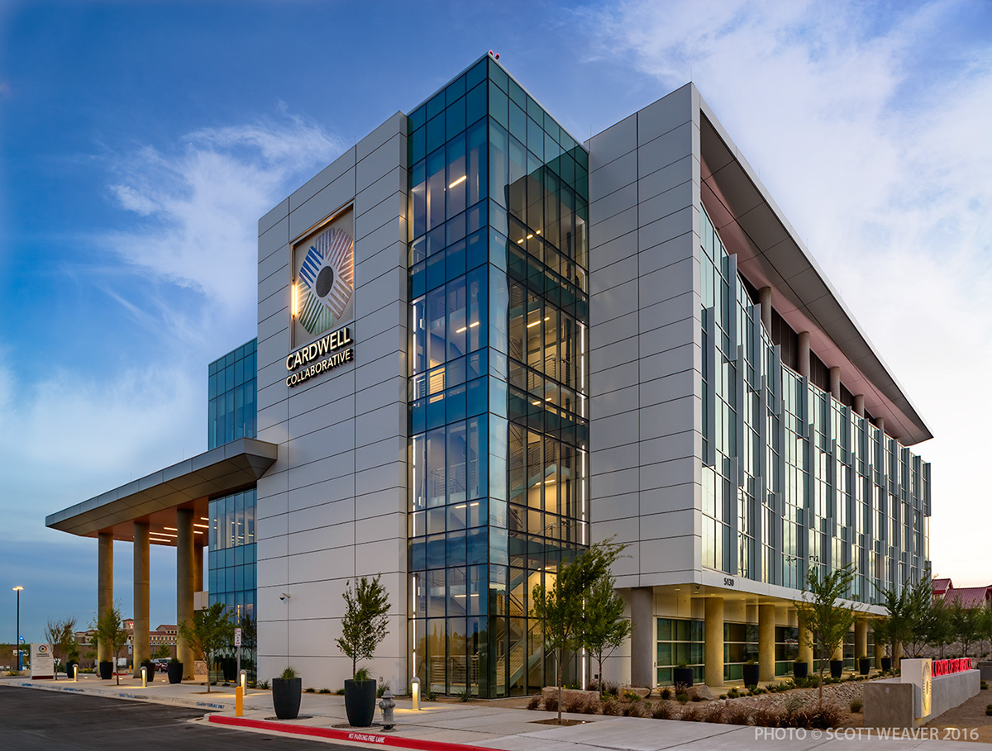

Slide 27
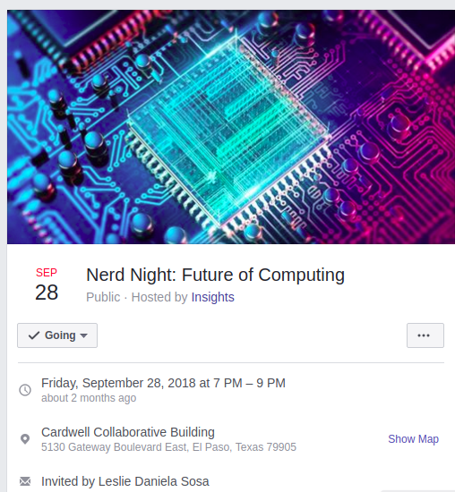
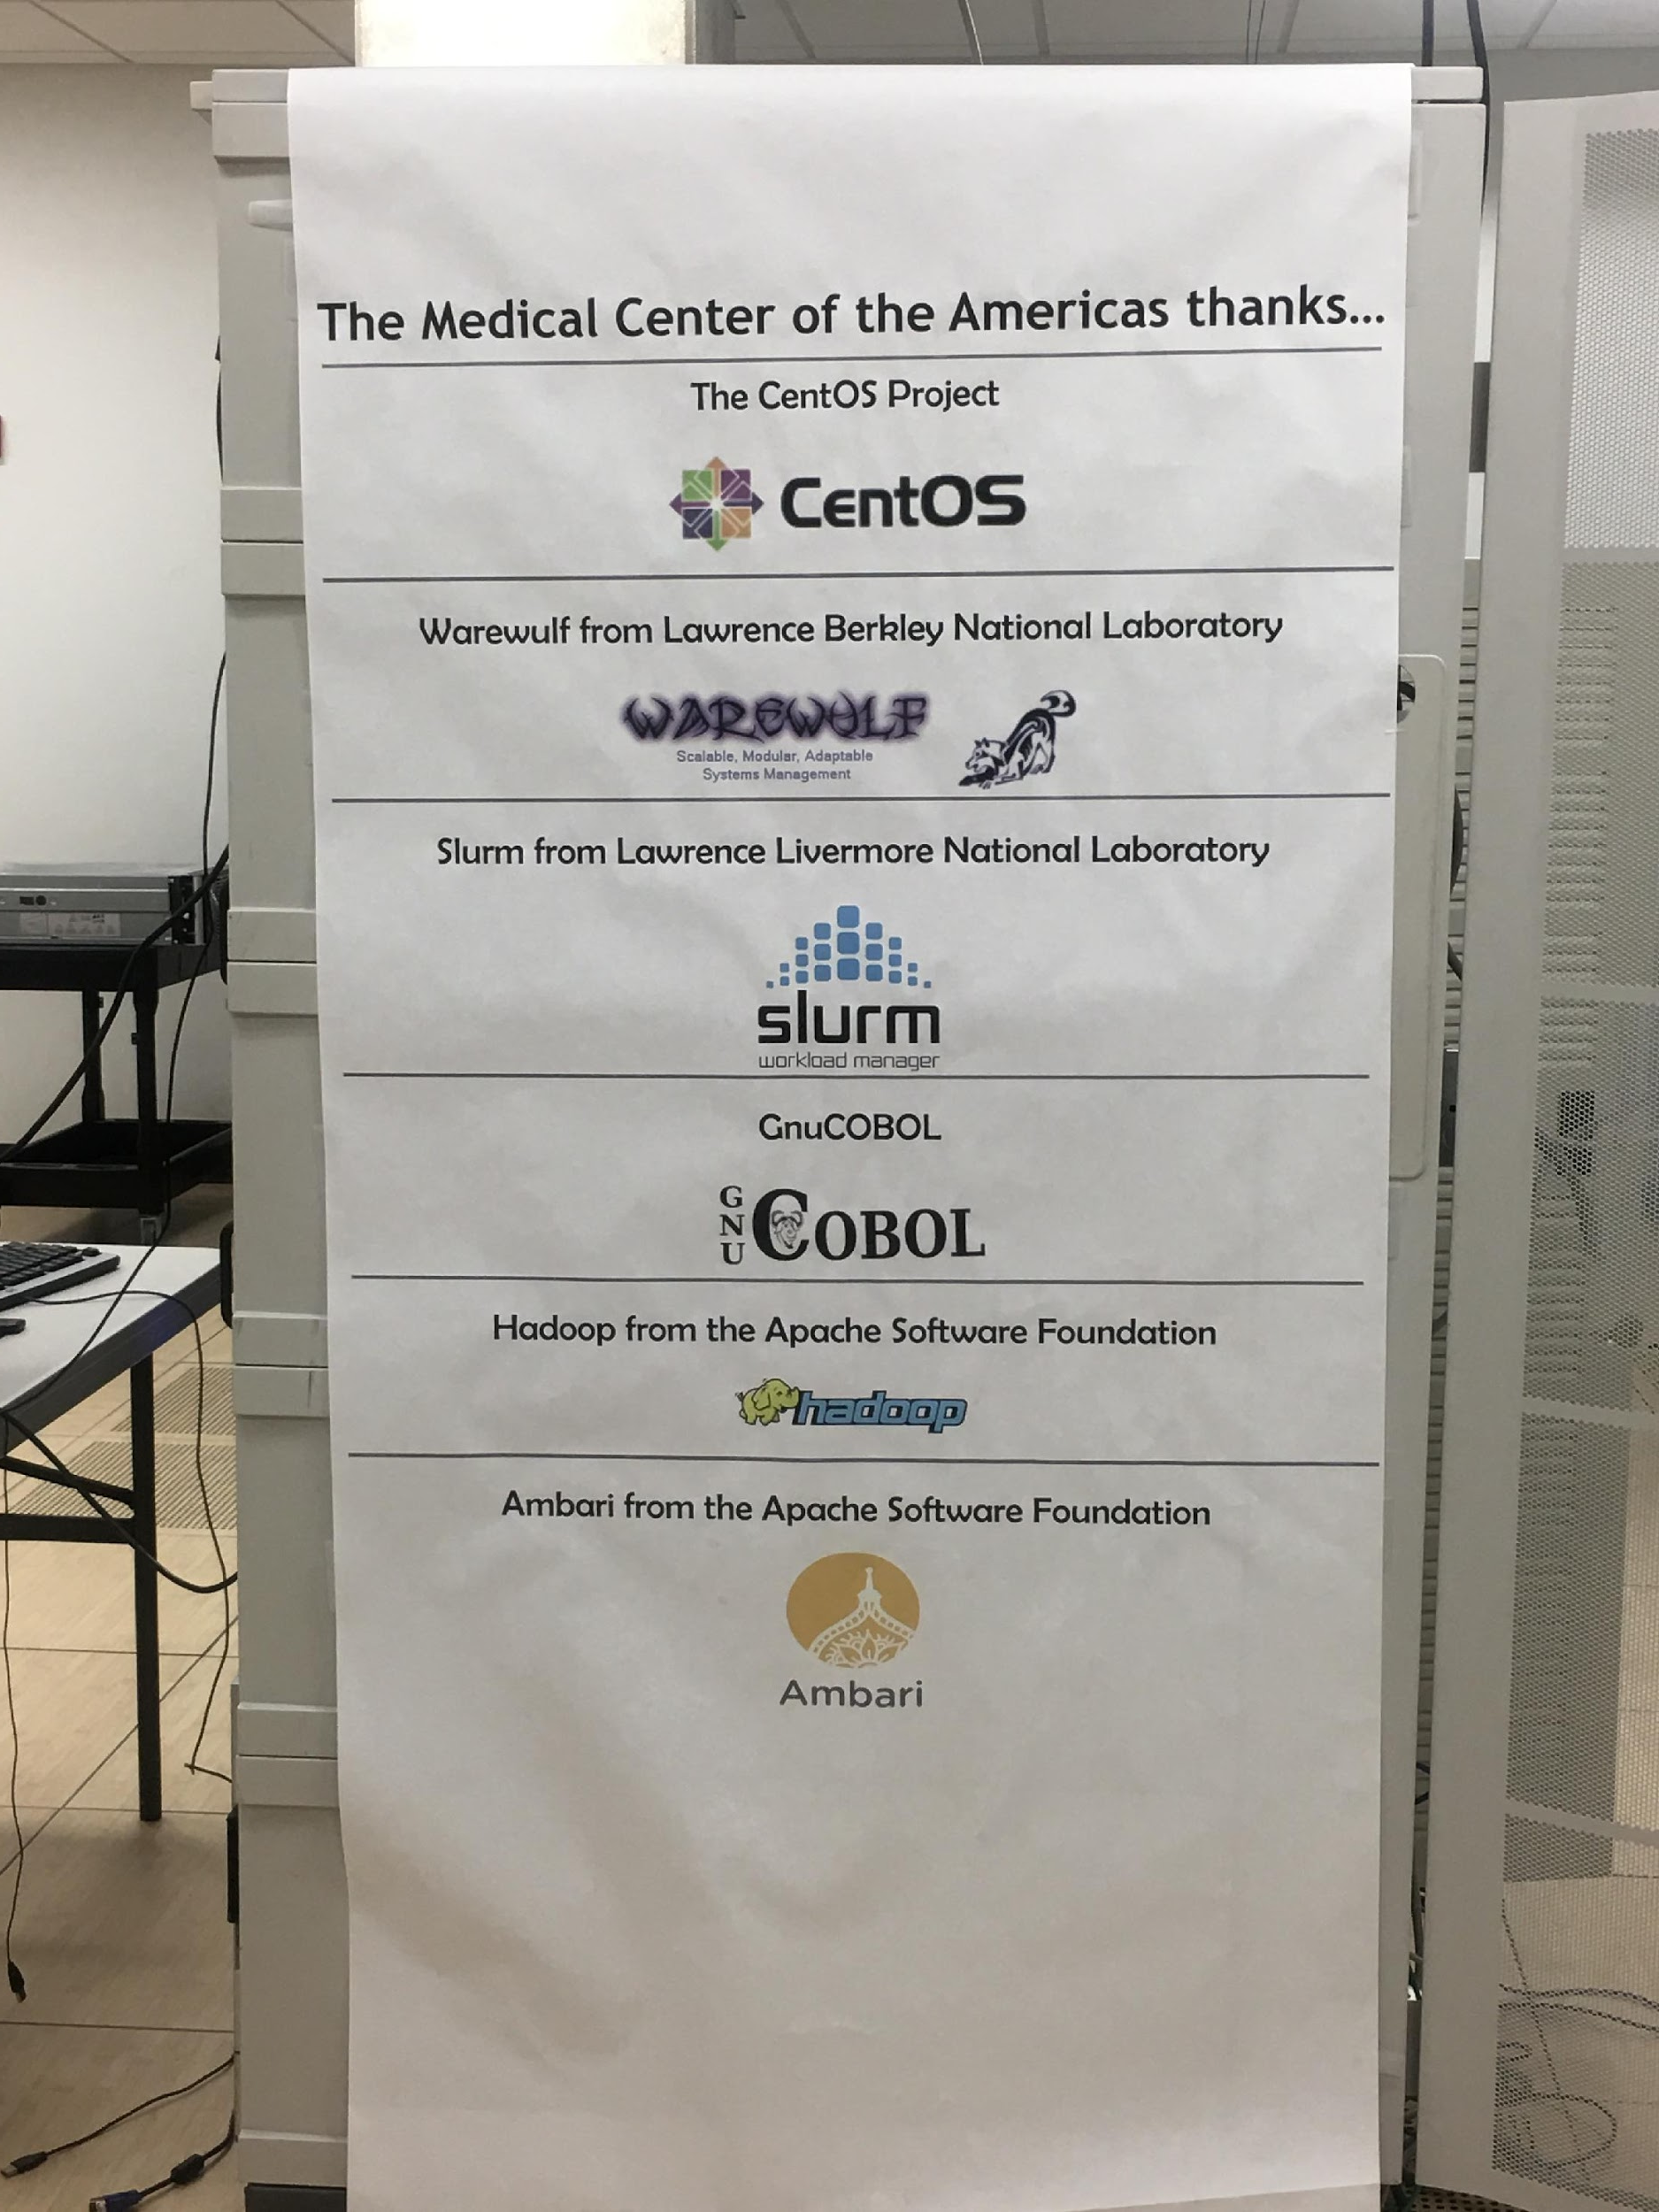
Super-Computers

Slide 28
